Slide 1

Sticky-Notes
Team :
Ibrahim AbuSamrah Abed Al-Fattah Hroub

Slide 2
Content :
What is Sticky-Notes ?
How to market Sticky-Notes ?
How to reach Sticky-Notes ?
How to use Sticky-Notes ?
What is Future Plans ?

Slide 3


Slide 4
What is Sticky-Notes ?
Is a simple interface that contains several options that help the user store his or her notes in a file that is specific to his / her name .
Contains several options including adding a new user And add new notes in addition to displaying all the notes stored with a specific user name
Offline
What is operating system run Sticky-Notes ?

Slide 5
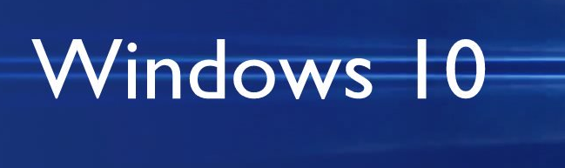


What is operating system run the Sticky-Notes ?

Slide 6


How to market my service ?
social media
online marketing

Slide 7
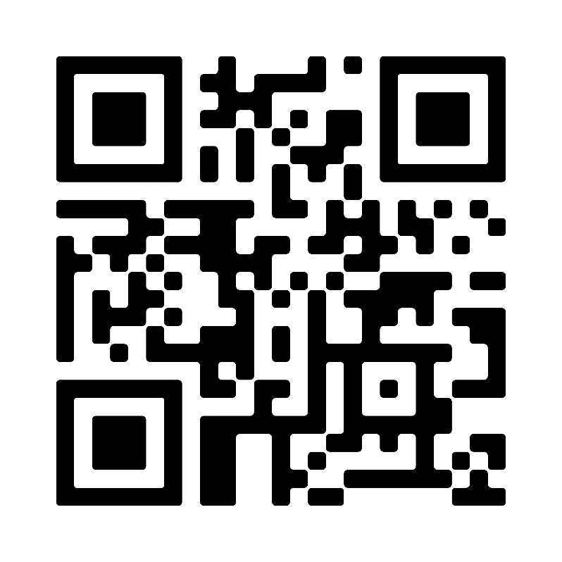

How to reach Sticky-Notes ?
Scan QR code
https://www.facebook.com/Sticky-Notes

Slide 8
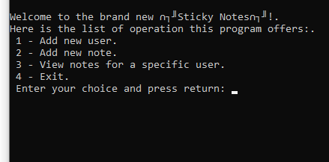
How to use Sticky-Notes ?

Slide 9
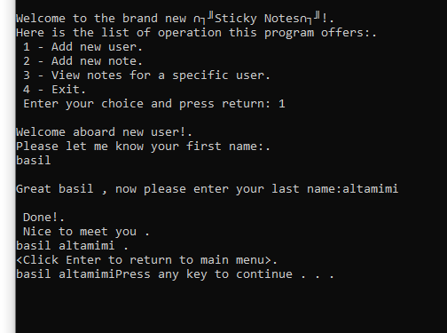
Add user name

Slide 10
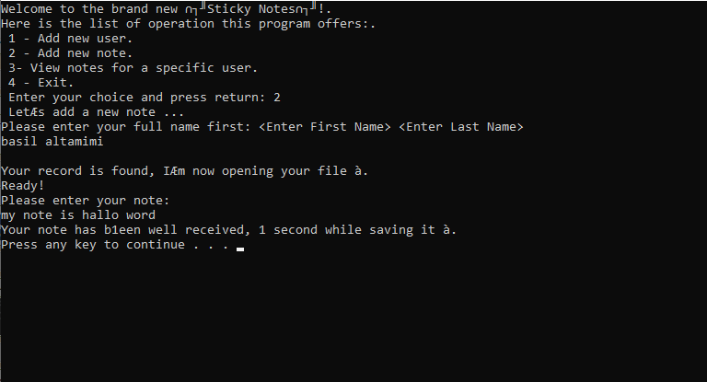
Add user note

Slide 11
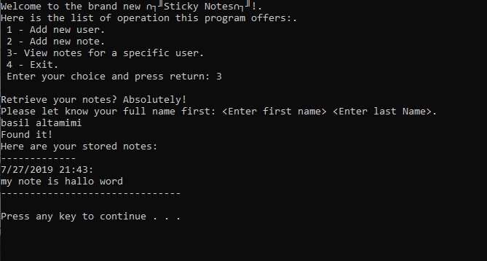
View notes for a specific user

Slide 12
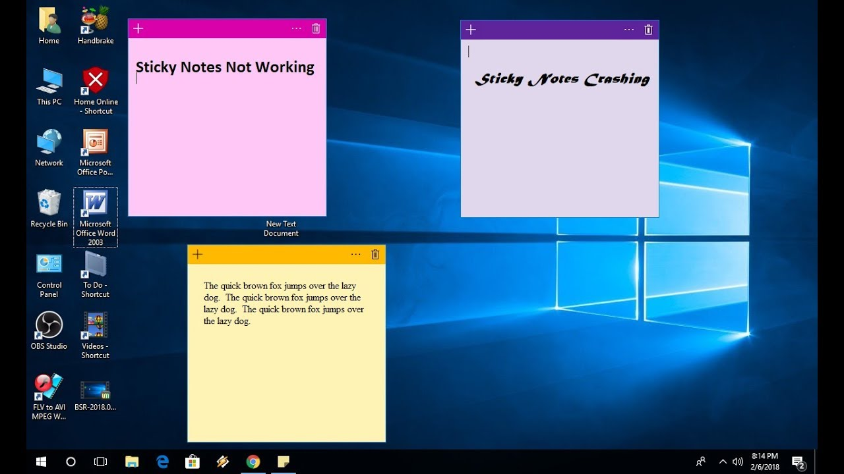

Slide 13


 | Save and view | Multiple users | Save the date and time of notes | Interface | On\Offline
 |  |  |  |  | Offline
Windows Sticky-Notes |  |  |  |  | Offline

Slide 14
What is Future Plans ?
Compatible with all systems
Online
Edit the note and user
Notification
GUI interface
Licance

