Slide 1
DATA CLEANING TOOLKIT
  Prudhvinath Dokuparthi - 20020562
  Thrinath Reddy Adaboina - 20015966

Slide 2
Introduction
  Data cleaning is often the most time-consuming stage of data analysis, yet it's pivotal for achieving valid insights. Our toolkit offers comprehensive solutions for missing data imputation, outlier detection, data normalization, and much more, all implemented in Python and easy to integrate into your existing workflows.
Notes:
1.7.2013
‹#›

Slide 3
Challenges in Data Cleaning
Data cleaning is a fundamental yet challenging step in the data analysis process. Every dataset, no matter the source, often comes with its set of issues that can significantly skew analysis and lead to inaccurate conclusions if not addressed properly. Here are some common challenges that our toolkit aims to tackle:
  Missing Values
  Outliers
  Inconsistencies
  Scalability
Notes:
1.7.2013
‹#›

Slide 4
Toolkit Features Overview
Overview of the Data Cleaning Toolkit's features:
  Automated tools for missing data,
  Outlier detection,
  Normalization and more,
all designed to simplify your data preprocessing tasks.
Notes:
1.7.2013
‹#›

Slide 5
Handling Missing Data
Missing data is a prevalent challenge that can significantly impact the outcomes of data analysis. Our toolkit offers robust solutions to manage missing values effectively:
  Imputation Techniques: Utilize methods such as mean, median, mode, and more sophisticated algorithms to fill in missing values, depending on the nature of your data.
  Flexible Application: Easily apply these methods across different data types and structures to maintain the integrity of datasets.
  Enhanced Data Quality: Ensure that your cleaned data provides a reliable foundation for further analysis, reducing biases introduced by incomplete or missing data.
Notes:
1.7.2013
‹#›

Slide 6
Handling Outliers
Outliers can distort statistical analyses and impair the performance of predictive models. This toolkit is equipped with effective methods to identify and remove outliers, ensuring more reliable data analysis:
  Statistical Methods: Leverage robust statistical techniques such as the Interquartile Range (IQR) and Z-score methods to detect outliers.
  Visual Aid Tools: Utilize visualization tools included in the toolkit to help identify outliers visually, making outlier detection not only analytical but also intuitive.
  Maintain Data Integrity: By carefully managing outliers, maintain the integrity and accuracy of your datasets, ensuring that the results of your analysis are based on clean and precise data.
Notes:
1.7.2013
‹#›

Slide 7
Normalizing Data
Normalization is essential for preparing data for analysis and machine learning, helping to ensure that numerical features contribute equally to the process:
  Standard Techniques: The toolkit provides popular normalization methods, such as Min-Max Scaling and Z-score (Standard Score) normalization, to standardize the range of data features.
  Uniformity in Data: Apply these techniques to bring different variables into alignment and reduce the skewness caused by variables operating on different scales.
  Enhance Model Performance: Proper normalization can significantly improve the performance of machine learning algorithms by ensuring that each feature contributes optimally without biasing the model with scale differences.
Notes:
1.7.2013
‹#›

Slide 8
Additional Utilities
Beyond handling missing data, outliers, and normalization, this toolkit is equipped with a suite of additional utilities designed to refine your data preparation processes:
  Categorical Data Handling: Tools for encoding categorical data through methods like one-hot encoding and label encoding, crucial for machine learning model compatibility.
  String Cleaning Operations: Functions to clean and preprocess text data, removing unwanted characters, correcting typos, and standardizing text formats.
  Flexibility and Ease of Use: These tools are designed to be intuitive and flexible, allowing users to apply complex data transformations with simple and direct function calls.
Notes:
1.7.2013
‹#›

Slide 9
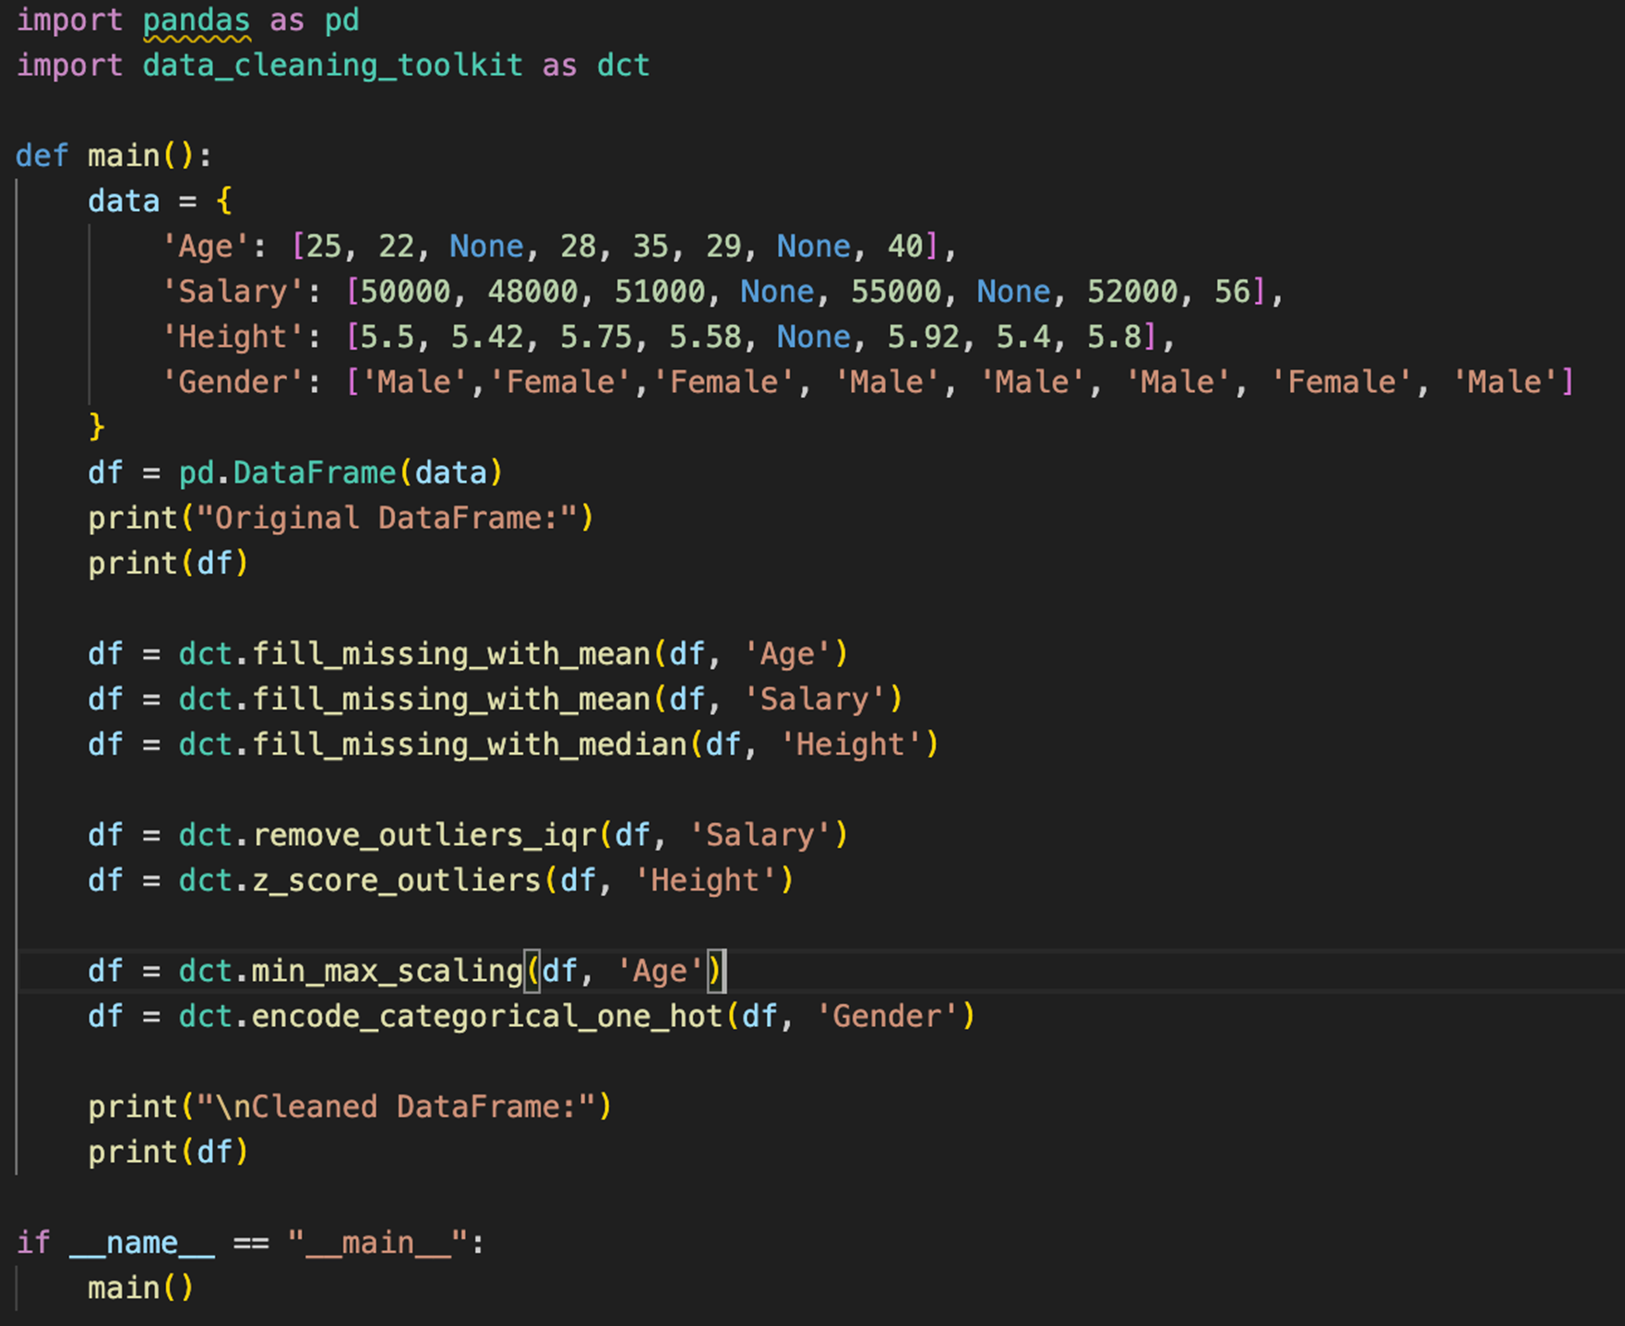
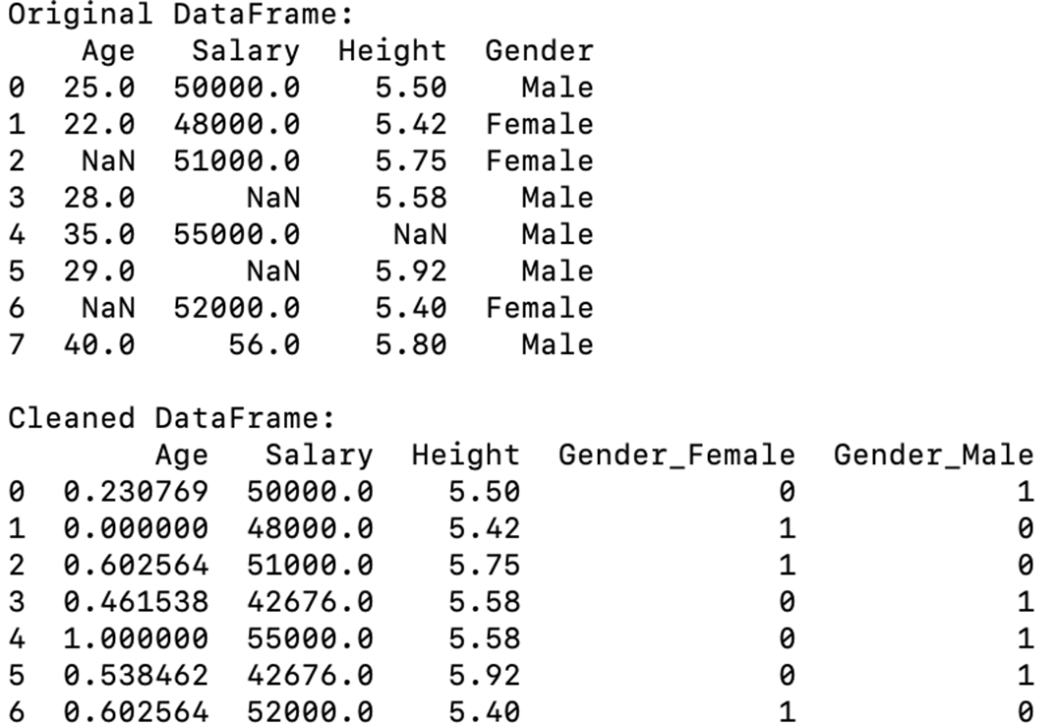
Results

Slide 10
Benefits of our Toolkit
This Data Cleaning Toolkit is designed not just with functionality but also to deliver tangible benefits to its users across various domains:
  Efficiency and Productivity: Automate repetitive and time-consuming data cleaning tasks, allowing data professionals to focus more on analysis and less on data preparation.
  Improved Data Quality: Enhance the reliability and accuracy of your datasets, which directly contributes to better analytics outcomes and more accurate predictions.
  Versatility Across Industries: Whether you're in healthcare, finance, marketing, or any other sector that relies on data, our toolkit provides the necessary tools to ensure data cleanliness.
Notes:
1.7.2013
‹#›

Slide 11
Applications of our Toolkit
Key Application Include:
  Machine Learning: Clean and preprocess data to create better training datasets that lead to more effective machine learning models.
  Business Intelligence: Facilitate better decision-making processes by providing cleaner data for BI tools and applications.
  Research: Enable researchers to handle diverse datasets more effectively, ensuring that their findings and insights are based on quality data.
Notes:
1.7.2013
‹#›

Slide 12
Future Developments and Collaboration
As we continue to enhance the Data Cleaning Toolkit, our focus remains on innovation and community engagement:
  Upcoming Features: We are planning to integrate advanced machine learning algorithms for predictive data cleaning, increase the range of automated error detection tools, and expand our library of normalization and encoding methods.
  Open Collaboration: We encourage developers, data scientists, and users from various industries to contribute their ideas and improvements. Collaboration is key to evolving our toolkit and ensuring it meets the diverse needs of the community.
  Engagement Opportunities: Participate in our open-source project on GitHub, join discussions, submit bug reports, or propose new features. Your input is invaluable in shaping the future of this toolkit.
Notes:
1.7.2013
‹#›

Slide 13
Thank you!
Any question?

