Slide 1
Forex Prediction using Deep Learning Neural Networks
By Abhishek Jain, Pradyumna Kaushik, Sreedhar Kumar

Slide 2
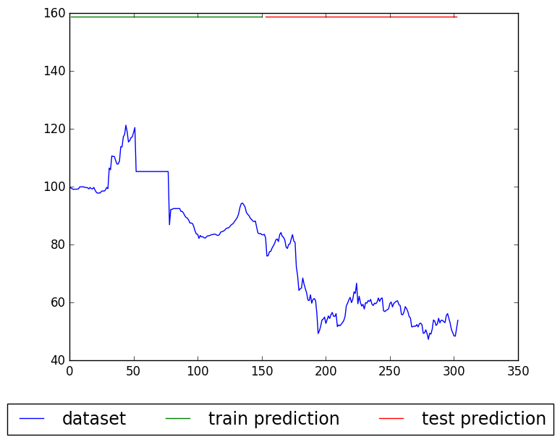
Dataset description
The Trade Weighted Index (TWI) is a weighted average of a basket of currencies that reflects the importance of the sum of USA’s exports and imports of goods by country.
This dataset consists of 304 time points, each being the month ending value of the index, from May 1970 to August 1995.
The interpretation of the effective exchange rate is that if the index rises, other things being equal, the purchasing power of that currency also rises.
TWI index value
X-axis = time in months
https://datamarket.com/data/set/22tb/exchange-rate-twi-may-1970-aug-1995#!ds=22tb&display=line

Slide 3
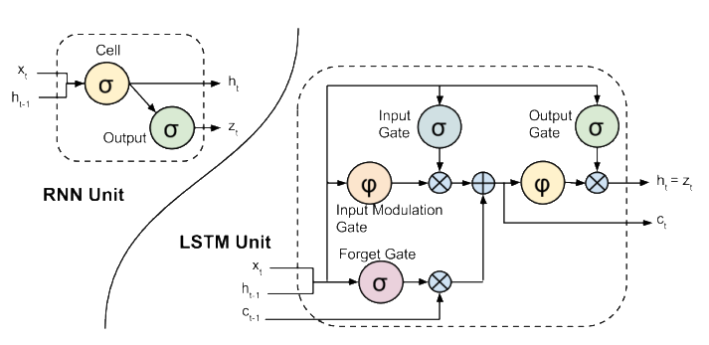
LSTM Neural Network Architecture
Motivation:
Long Short-Term Memory is a recurrent neural network that is efficient in sequence learning tasks involving long term dependencies.
Forget Gate: conditionally decides what information to discard from the unit.
Input Gate: conditionally decides which values from the input to update the memory state.
Output Gate: conditionally decides what to output based on input and the memory of the unit

Slide 4
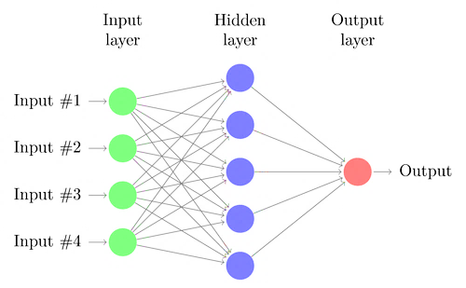
Technical terms
No: of layers
No: of computational units within a layer
Optimiser – algorithm used to update and learn the correct weights. Variants include stochastic gradient descent, RMSprop, Adam etc.
Learning rate - This number controls the step size of the weight update and is critical to the convergence of the algorithm to the global minima of the objective function.
Momentum - Momentum simply adds a fraction m of the previous weight updates to the current one. When the gradient keeps pointing in the same direction, this will increase the size of the steps taken towards the minimum.
Epochs – An epoch is one complete presentation of the data set to be learned by a learning machine. Learning machines like feedforward neural nets, that use iterative algorithms, often need many epochs during their learning phase.

Slide 5
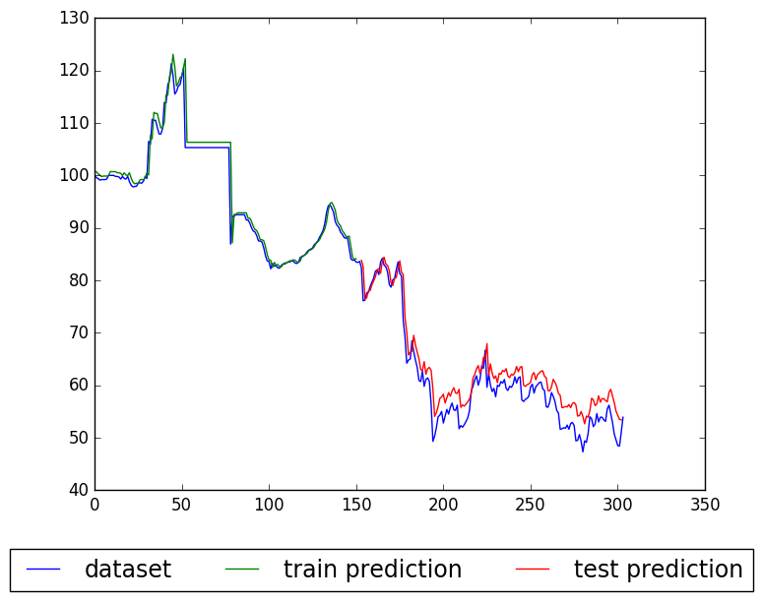
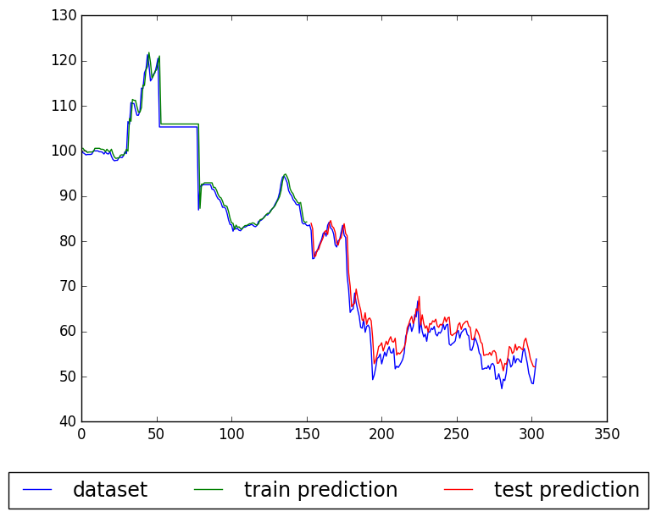
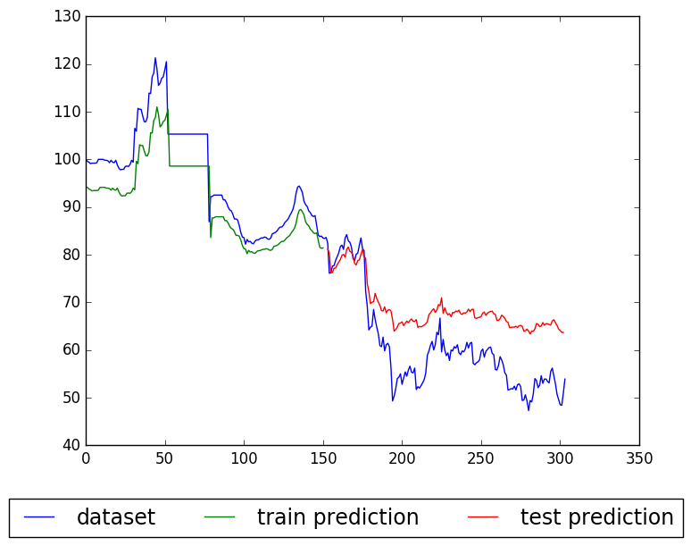
Network architecture
LSTM with RMSprop - variation with number of layers
learning_rate=0.001, training_percent=0.5, epochs = 100
train-time = 39.463s
test-RMSE = 3.313
n_layers=3,
layer_dimensions
=[1, 60, 1]
train-time = 57.046s
test-RMSE = 2.961
n_layers=4, layer_dimensions=[1, 60, 60, 1]
train-time = 90.995s
test-RMSE = 9.600
n_layers=6,
layer_dimensions=
[1, 60, 60, 60, 60, 1]

Slide 6
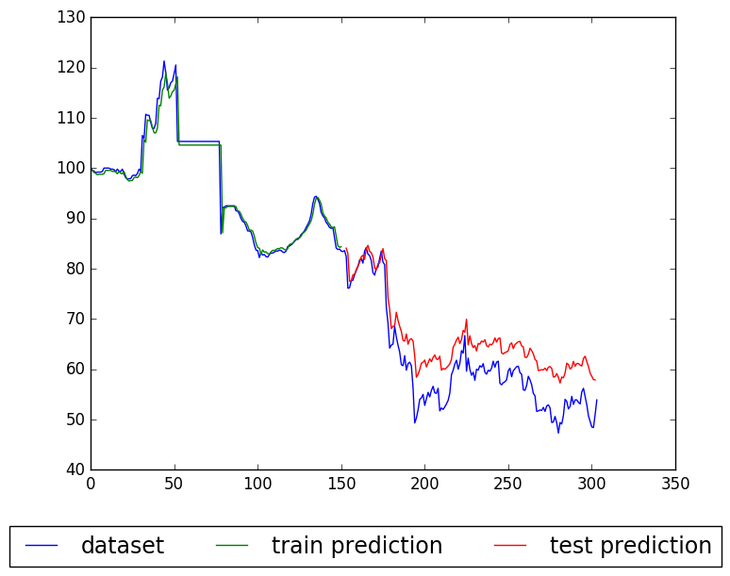
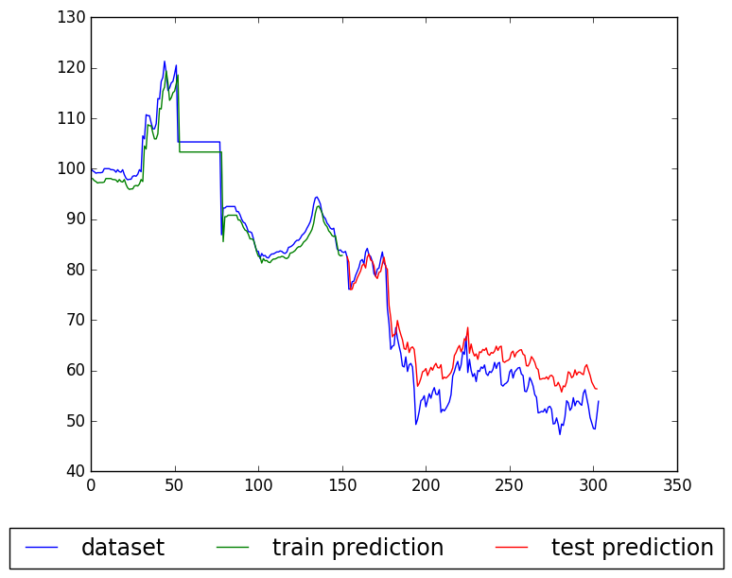
No: of units within a layer
LSTM with RMSprop - variation with number of units
learning_rate=0.001, training_percent=0.5, epochs = 100
train-time = 53.092s
test-RMSE = 5.044
n_layers=4, layer_dimension=
[1, 20, 20, 1]
train-time = 53.131s
test-RMSE = 6.103
n_layers=4,
layer_dimensions=[1, 10, 10, 1]
train-time = 57.047s
test-RMSE = 2.961
n_layers=4,
layer_dimension=
[1, 60, 60, 1]

Slide 7
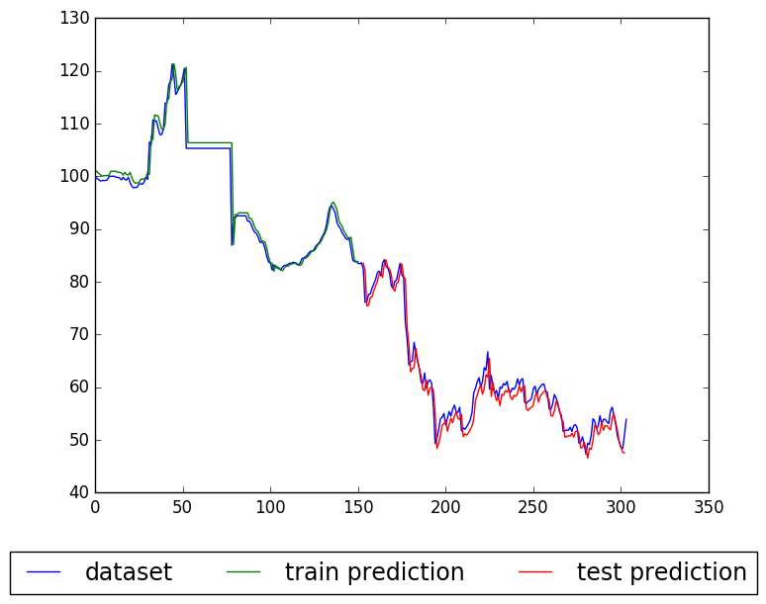
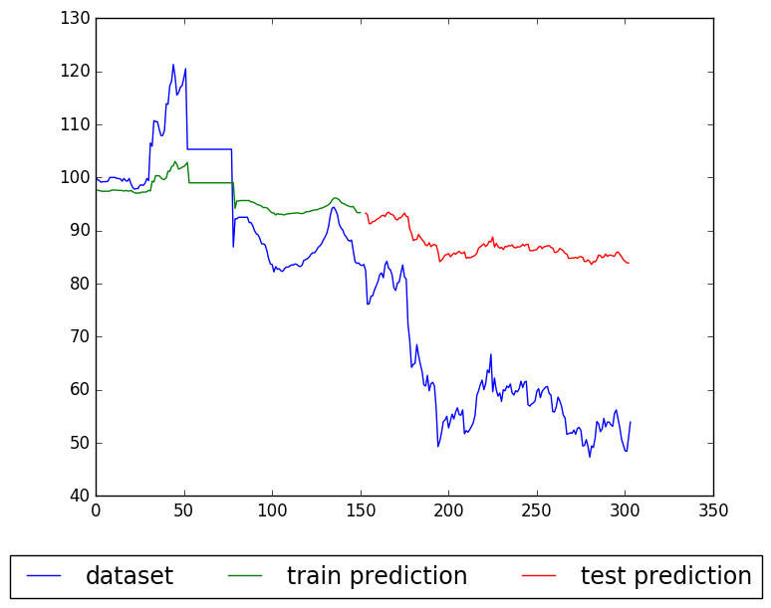
Optimsers
Stochastic Gradient Descent - training-time = 37.251s, test-RMSE =27.53
RMSprop - training-time = 57.047s, test-RMSE = 2.962
Adam - training-time = 60.804s, test-RMSE = 2.419
Adam
n_layers=4, layer_dimension=[1, 60, 60, 1]
RMSprop
SGD

Slide 8
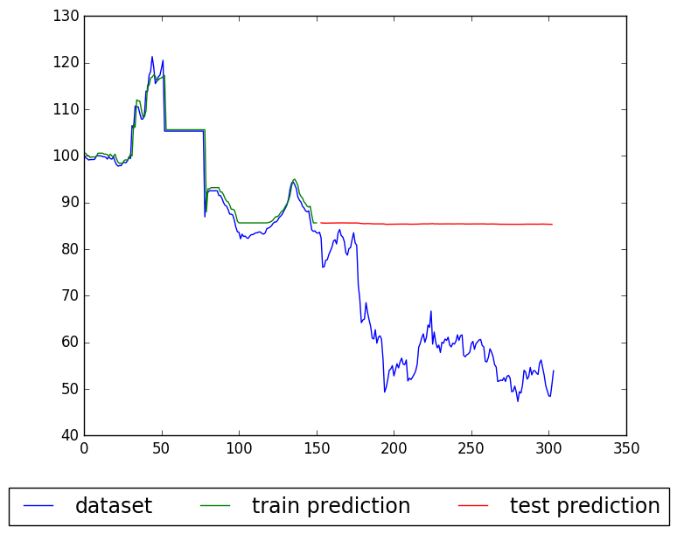

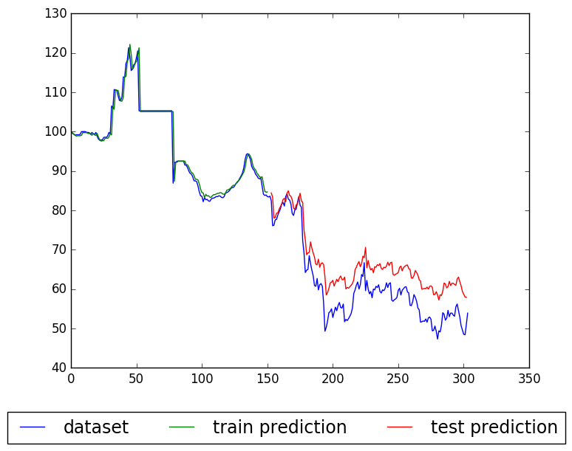
Learning rate
train-time = 64.890s
test-RMSE = 26.596
learning_rate=0.01
LSTM with Adam Optimiser
n_layers = 4, layer_dimension = [1, 60, 60, 1]
Note: No: of epochs is kept
constant at 100
train-time = 63.186s
test-RMSE = 6.652
learning_rate=0.0001
train-time = 62.031s
test-RMSE = 2.201
learning_rate=0.001

Slide 9
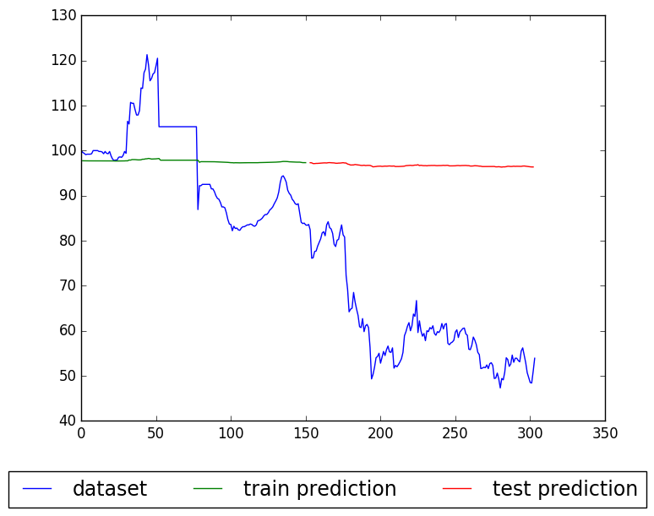


Momentum
train-time = 52.988s
test-RMSE = 36.627
learning_rate=0.01,
momentum=0.6
Momentum with SGD optimiser with
n_epochs = 100, training_percent=0.5
n_layers=4, layer_dimension=[1, 60, 60, 1]
train-time = 52.557s,
test-RMSE = 1.932
learning_rate=0.01, momentum=0.9
train-time = 52.038s
test-RMSE = 37.291
learning_rate=0.01, momentum=0.1

Slide 10
Dropout – a strategy for countering overfitting
Reduces overfitting in deep neural networks.
Randomly drop computation units or nodes along with their connections from the network during training.
This is equivalent to training a number of different “thinned” networks and then averaging their prediction to get the final output.
In effect, this strategy gets the benefit of both bagging and boosting used in machine learning.

Slide 11
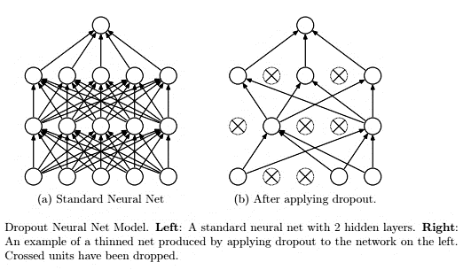
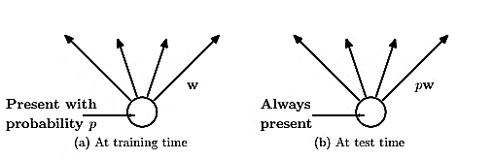

In the case of LSTM, dropout can be applied at two levels
Dropping inputs
Dropping recurrent connections

Slide 12

With dropout Without dropout
Size = [1,60,60,1], train-time = 63.596s
test-RMSE = 2.071, Learning rate = 0.001
CV_error = 2.8 e-4
Dropout percent = 0.4, Optimiser = Adam
Size = [1,60,60,1], train-time = 60.804s
test-RMSE = 2.203, Learning rate=0.001
CV_error = 5.15 e-4
Optimiser = Adam

Slide 13

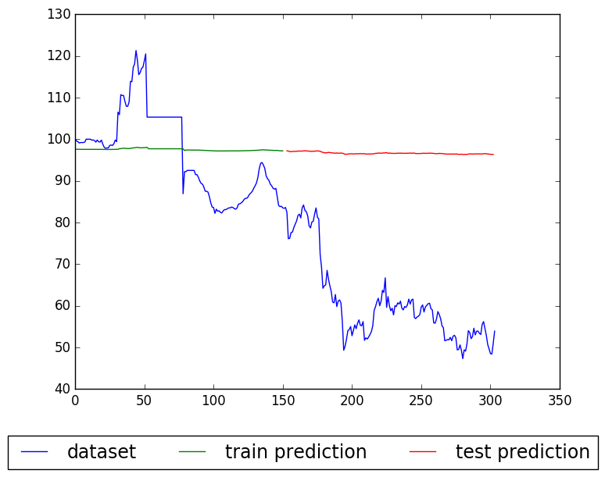
Is regularization always necessary ?
train-time = 51.674s, Optimiser = SGD
test-RMSE = 1.980
Learning Rate = 0.1, n_epochs = 100
Momentum = 0
train-time = 52.511s, Optimiser = SGD
test-RMSE = 37.243
Learning = 0.01, n_epochs = 100
Momentum = 0

Slide 14
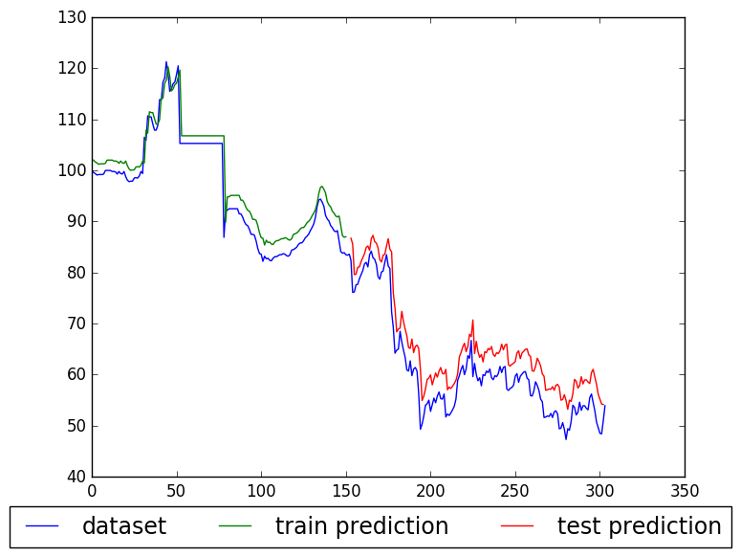
Increasing number of epochs
train-time = 232.706s
train-RMSE = 7.382
test-RMSE = 26.015
optimizer=SGD
Learning = 0.01,
n_epochs = 700
Momentum = 0

Slide 15
Result and recommendations
For the given dataset, assuming that future data points will be from the same data distribution, the optimal hyperparameters for the LSTM Deep Learning Neural Network are
No: of layers = 4, Layer dimensions = [1,60,60,1], Optimser = Adam, Drop_out_recurrent = 0.4, Learning rate = 0.001, Momentum = 0. Test-RMSE = 2.071
No: of layers = 4, Layer dimensions = [1,60,60,1], Optimser = SGD, Drop_out_recurrent = 0, Learning rate = 0.1, Momentum = 0. Test-RMSE = 1.980
No: of layers = 4, Layer dimensions = [1,60,60,1], Optimser = SGD, Drop_out_recurrent = 0, Learning rate = 0.01, Momentum = 0.9. Test-RMSE = 1.983
Increasing the number of epochs, while computationally costly, will provide the algorithm more iterations over the data, enabling it to converge to the right weights even for a plain vanilla optimizer.

Slide 16
Deliverables
A GUI is proved to enable experimentation with the hyperparameters.
A report and readme describing the materials, methodology and results.
References
G. Hinton, N. Srivastava, A. Krizhevsky, I. Sutskever, and R. Salakhutdinov, “Improving neural networks by preventing co-adaptation of feature detectors,” CoRR, vol. abs/1207.0580, 2012
https://datamarket.com/data/set/22tb/exchange-rate-twi-may-1970-aug-1995#!ds=22tb&display=line
Greff, Klaus, Srivastava, Rupesh Kumar, Koutn´ık, Jan, Steunebrink, Bas R, and Schmidhuber, Jurgen. Lstm: A search space odyssey. arXiv preprint arXiv:1503.04069, 2015.
http://cs229.stanford.edu/proj2015/054_report.pdf
Srivastava, Nitish, et al. "Dropout: a simple way to prevent neural networks from overfitting." Journal of Machine Learning Research 15.1 (2014): 1929-1958.
Schaul, Tom, Sixin Zhang, and Yann LeCun. "No more pesky learning rates." ICML (3) 28 (2013): 343-351.

