Slide 1
Power Load Forecasting
Park Jee Hyun
-
SungKyunGwan University
Nanyang Technological University

Slide 2
Contents
Purpose
Hypothesis
Experiments
Results
Think Backward
Conclusion

Slide 3
Purpose
Accurate load forecasting is pivotal for the economic and secure operation of the power system
Goal: Achieving high load forecasting accuracy
Two main way to do this:
improvement of the performance of the learning algorithm
how well the data features are extracted through the pre-processing process.

Slide 4
Hypothesis
H-ELM can outperform other Algorithms
Various algorithms are being developed as research on artificial intelligence proceeds.
Machine Learning(ML)
Deep Learning(DL)
Extreme Learning Machine(ELM)
Hierarchical ELM(H-ELM)
ML vs. ELM :
Better efficiency(fast learning speed )
Better generalization(random initialization)
Multi-Layer
Better accuracy
Allows us to train Machine with more abstract & complicated information
Importance and Contribution of Preprocessing
Feature extraction algorithm
Well-refined dataset

Slide 5
H-ELM can outperform other Algorithms
Moore-Penrose inverse matrix
Randomly initialized input weight
ML
ELM
Single layer
Back-propagation based
Single layer
Feed-forward - fast learning speed
Better generalization
Multi-layer
DL
H-ELM
Multi layer - able to represent more abstract information
Feed forward
Better generalization
Multi layer - able to represent more abstract information
Back-propagation based

Slide 6
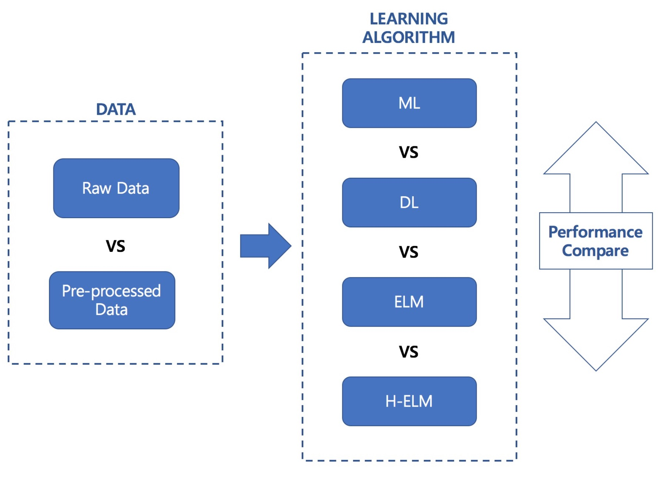
Experiments

Slide 7
Data Container
Dataset
Raw
Preprocessed
Train (0.8)
Test (0.2)
Train (0.8)
Test (0.2)
…
…
…
Feature data
(input)
Label data
(output)

Slide 8
Raw vs. Preprocessed
Given data:
Daily Max and Mean Temperature data [2 points/day]
Daily power load data with 30 mins interval [48 points/day]
Raw data:
Normalization(power_load_data) + (Max.Temp) + (Mean.Temp) [50 points/day]
Preprocessed data:
Normalization(power load data) + Normalization[(power_load_data) powered by (Max.Temp)] + Normalization[(power_load_data) powered by (Mean.Temp)] [48x3 points/day]

Slide 9
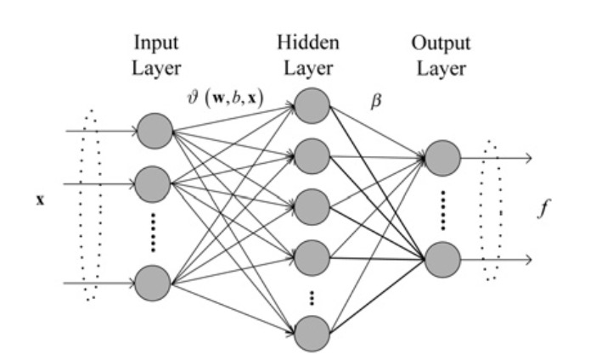
No. of Hidden Neurons & Hidden Layers
Number of Hidden Neurons : ability to learn the feature ➔ need to be tuned properly

Slide 10
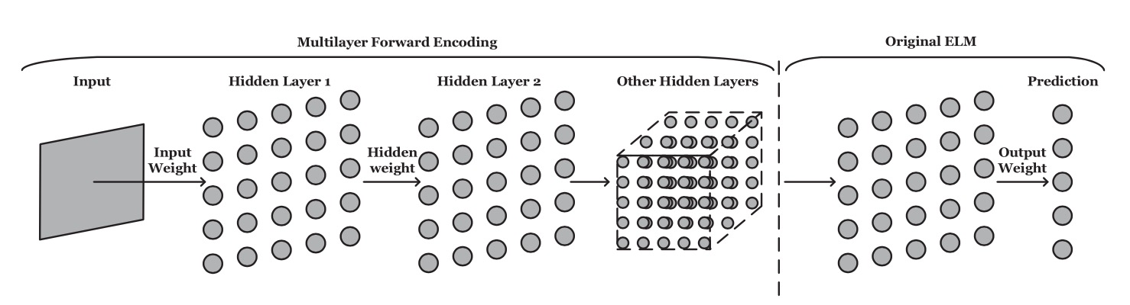
No. of Hidden Neurons & Hidden Layers
Number of Hidden Layers(& number of neuron in each layers) : ability to extract features from input data ➔ need to be tuned properly

Slide 11
Results
ELM
Single hidden layer(=ELM)[number of Hidden Neurons]
rand('state',78309924);
Number of Hidden Neurons | Raw data Acc [RMSE] / Training time [sec] | Preprocessed data Acc [RMSE] / Training time [sec]
10 | 0.1132 / 0 | 0.0768 / 0.0100
50 | 0.4152 / 0 | 0.0591 / 0.0200
100 | 0.5442 / 0.0100 | 0.0680 / 0.0300
500 | 129.1498 / 0.2000 | 0.2249 / 0.1700
1000 | 2.2648 / 0.2600 | 0.1135 / 0.1700
10000 | 0.1452 / 1.6900 | 0.0829 / 1.7100
100000 | 0.1240 / 16.8200 | 0.0822 / 17.5200

Slide 12
Results
HELM :
2 hidden layers[N1, N2] + ELM[N0]
rand('state',78309924);
[N1, N2, N0] | Raw data Acc [RMSE] / Training time [sec] | Preprocessed data Acc [RMSE] / Training time [sec]
[1000, 1000, 1000] | 1377.8722 / 3.5884 | 22.1721 / 2.9963
[1000, 1000, 10000] | 71.3779 / 4.1811 | 1.9531 / 3.9826
[1000, 1000, 100000] | 19.609 / 14.2782 | 0.5342 / 16.2698
[1000, 2000, 100000] | 5.9443 / 24.9313 | 0.27096 / 28.5468
[2000, 2000, 100000] | 2.9783 / 36.4784 | 0.24563 / 39.5701
[2000, 3000, 100000] | 0.77526 / 59.166 | 0.21216 / 61.9761
[3000, 3000, 100000] | 1.405 / 86.9903 | 0.16366 / 92.9009

Slide 13
Think Backward
Why Multi-layer Machine failed to outperform Single-layer Machine in this experiment?
Improper fine tuning
Number of neurons
Number of layers
Type of activation function
etc.
Too simple input data
there is a chance that excessive layer distract to extract useful feature from input data

Slide 14
Conclusions

Slide 18
Main

Slide 19
Sub

