Slide 1
Power Load Forecasting
Park Jee Hyun
19 APR 2017
-
SungKyunGwan University
Nanyang Technological University

Slide 2
Contents
Purpose
Hypothesis
Experiments
Results
Think Backward
Conclusion

Slide 3
Purpose
Accurate load forecasting is pivotal for the economic and secure operation of the power system
Goal: Achieving high load forecasting accuracy
Two main way to do this:
improvement of the performance of the learning algorithm
how well the data features are extracted through the pre-processing process.

Slide 4
Hypothesis
H-ELM can outperform other Algorithms
Various algorithms are being developed as research on artificial intelligence proceeds.
Machine Learning(ML)
Deep Learning(DL)
Extreme Learning Machine(ELM)
Hierarchical ELM(H-ELM)
ML vs. ELM :
Better efficiency(fast learning speed )
Better generalization(random initialization)
Multi-Layer
Better accuracy
Allows us to train Machine with more abstract & complicated information
Importance and Contribution of Preprocessing
Feature extraction algorithm
Well-refined dataset

Slide 5
H-ELM can outperform other Algorithms
Moore-Penrose inverse matrix
Randomly initialized input weight
ML
ELM
Single layer
Back-propagation based
Single layer
Feed-forward - fast learning speed
Better generalization
Multi-layer
DL
H-ELM
Multi layer - able to represent more abstract information
Feed forward
Better generalization
Multi layer - able to represent more abstract information
Back-propagation based

Slide 6
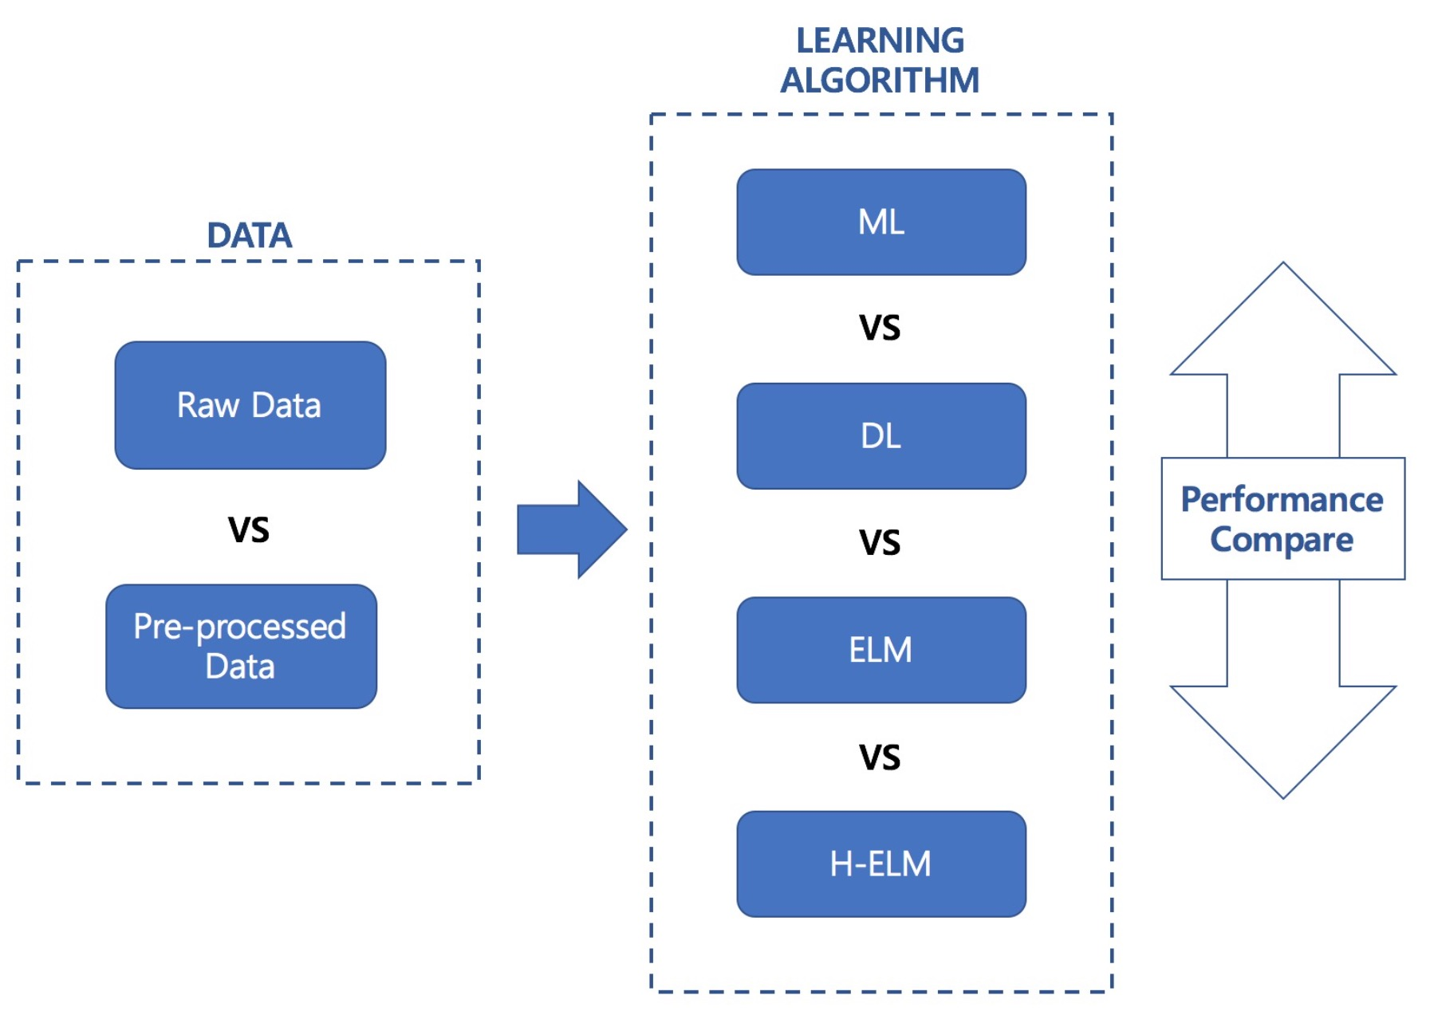
Experiments

Slide 7
Data Container
Dataset
Raw
Preprocessed
Train (0.8)
Test (0.2)
Train (0.8)
Test (0.2)
…
…
…
Feature data
(input)
Label data
(output)

Slide 8
Raw vs. Preprocessed
Given data:
Daily Max and Mean Temperature data [2 points/day]
Daily power load data with 30 mins interval [48 points/day]
Raw data:
Normalization(power_load_data) + (Max.Temp) + (Mean.Temp) [50 points/day]
Preprocessed data:
Normalization(power load data) + Normalization[(power_load_data) powered by (Max.Temp)] + Normalization[(power_load_data) powered by (Mean.Temp)] [48x3 points/day]

Slide 9
Results
RMSE score
Better and stable RMSE score with Preprocessed data
RLM, HELM, RNN show sufficient performance
 | Raw [RMSE / std] | Preprocessed [RMSE / std]
ELM | 0.18977 / ____ | 0.061715 / ____
HELM | 0.21287 / ____ | 0.063221 / ____
Single Layer Perceptrons | 6.30388 / 1.0803 | 1.86425 / 0.314612
Multiple Layer Perceptrons | 27.0591 / 23.0247 | 2.2562 / 3.21933
Convolutional Neural Network | 4.66314 / 3.42078 | 2.59278 / 1.15136
Recurrent Neural Network | 0.0964969 / 0.0310329 | 0.0696449 / 0.01456367

Slide 10
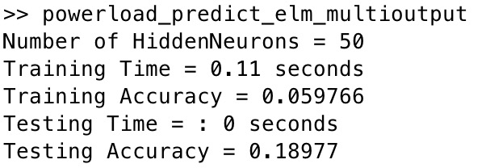
Results
ELM_Raw
for loop with rand(‘state’)

Slide 11
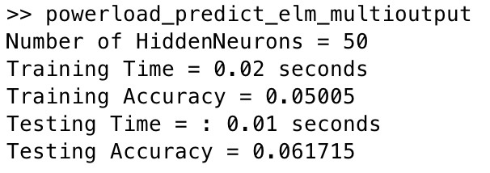
Results
ELM_Preprocessed
for loop with rand(‘state’)

Slide 12
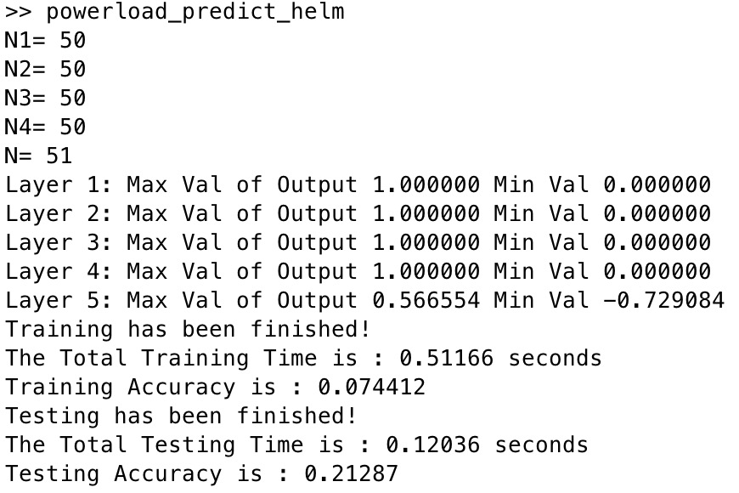
Results
HELM_Raw
for loop with rand(‘state’)

Slide 13

Results
HELM_Preprocessed
for loop with rand(‘state’)

Slide 14
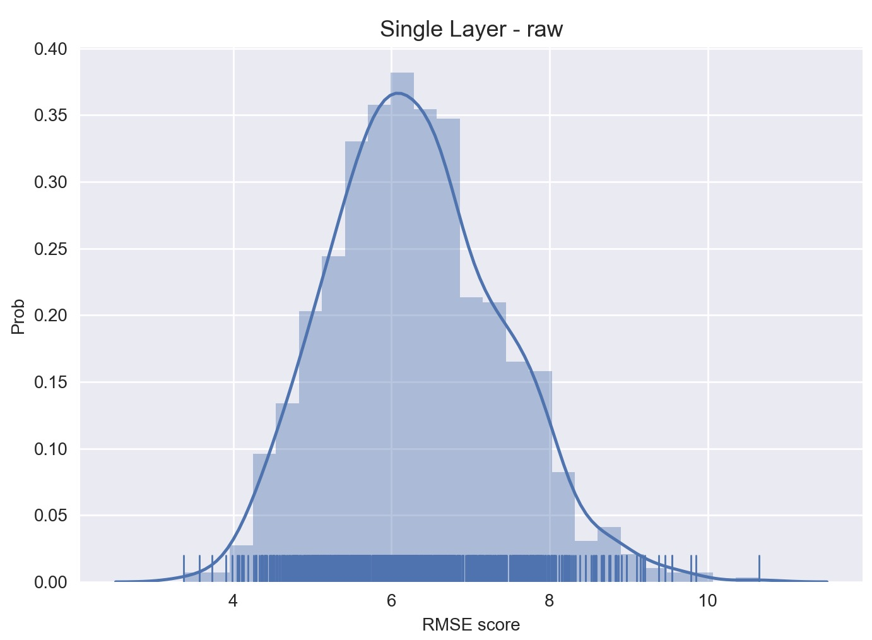
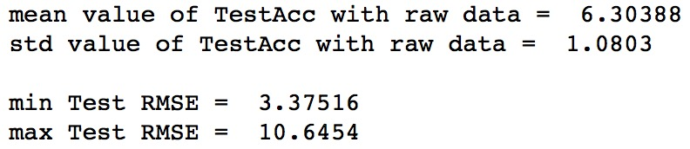
Results
SingleLayer_Raw

Slide 15
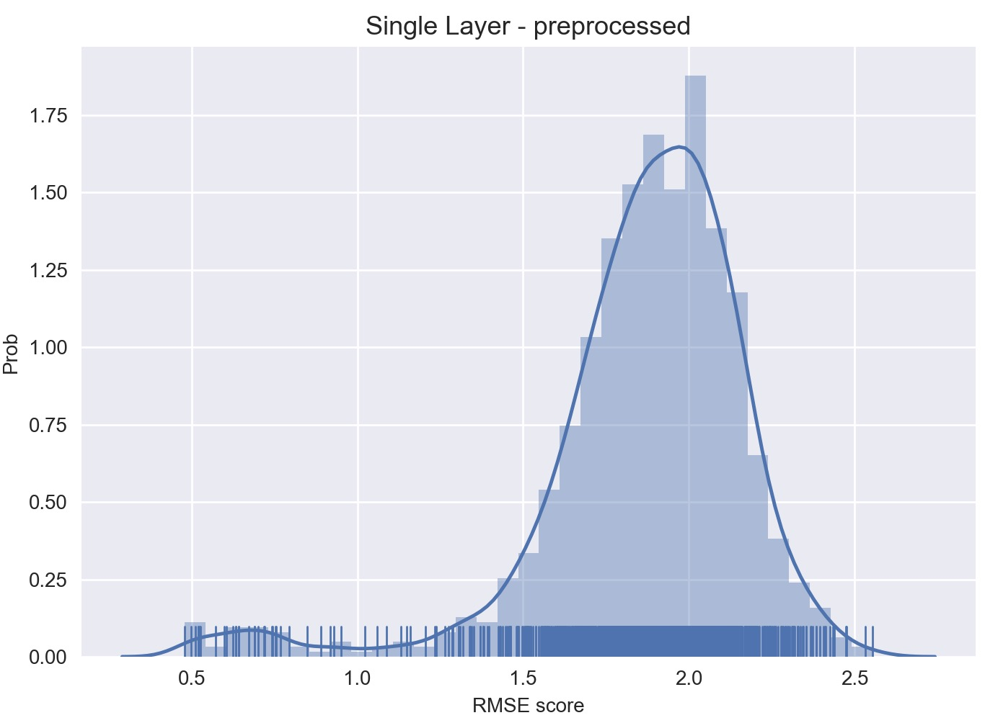
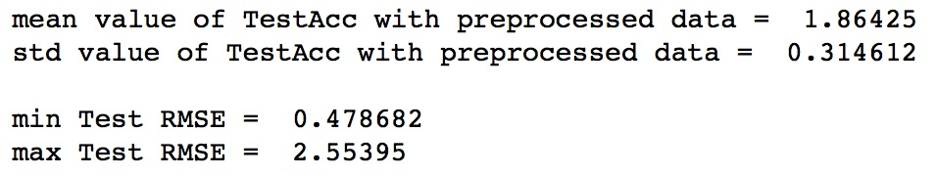
Results
SingleLayer_Preprocessed

Slide 16
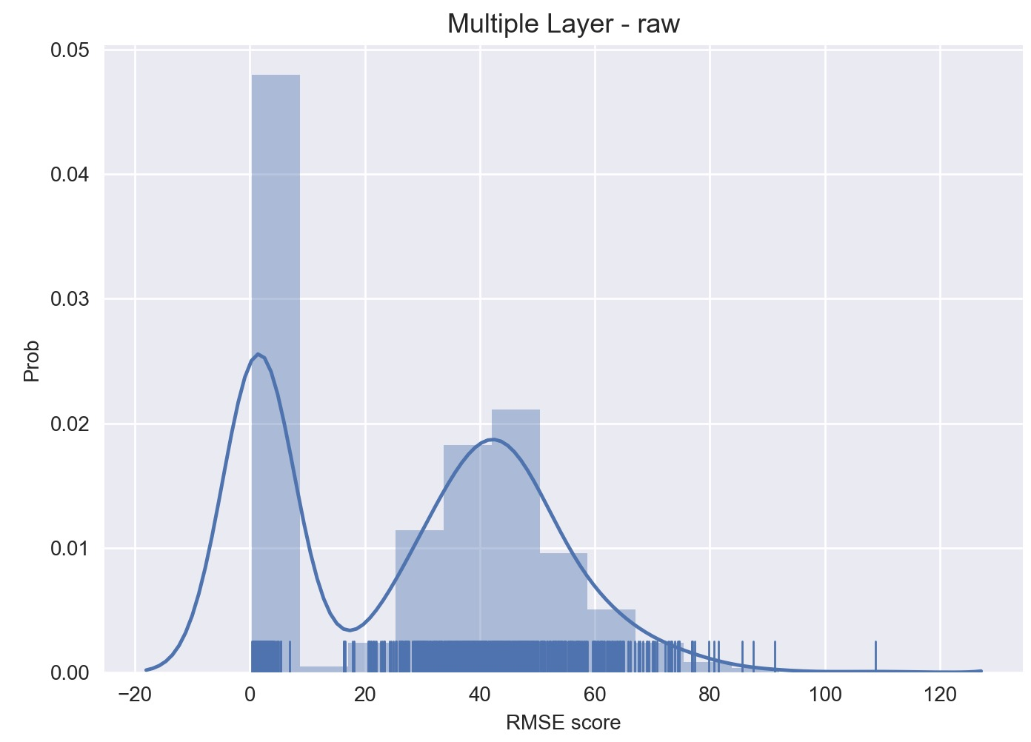
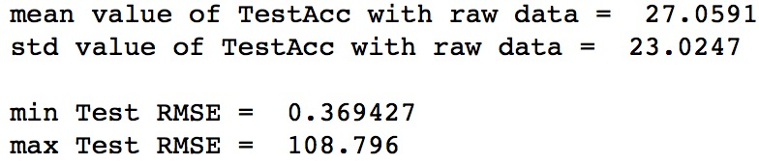
Results
MultipleLayer_Raw

Slide 17
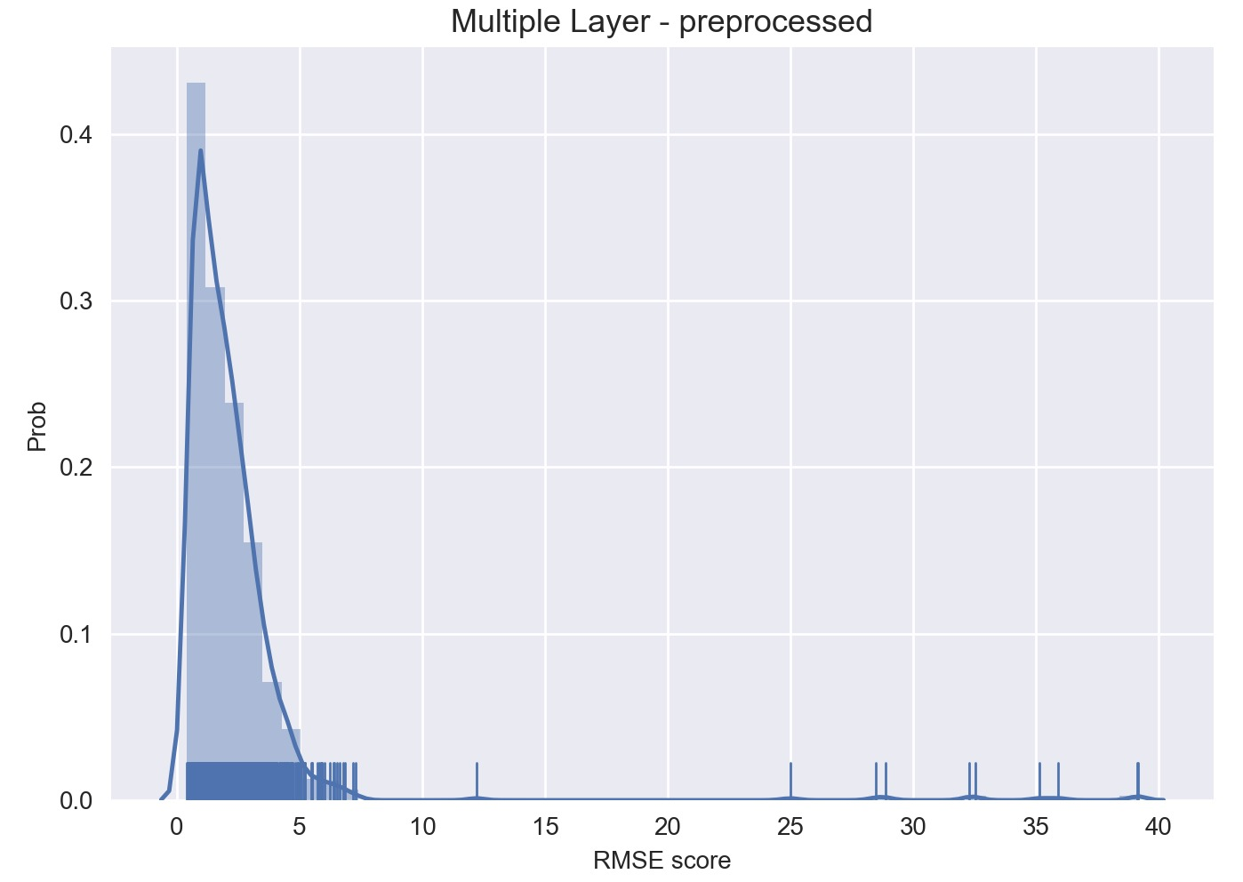
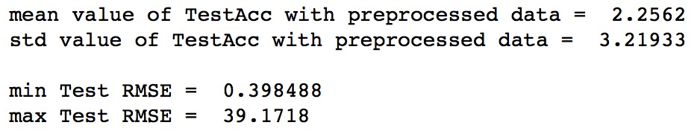
Results
MultipleLayer_Preprocessed

Slide 18
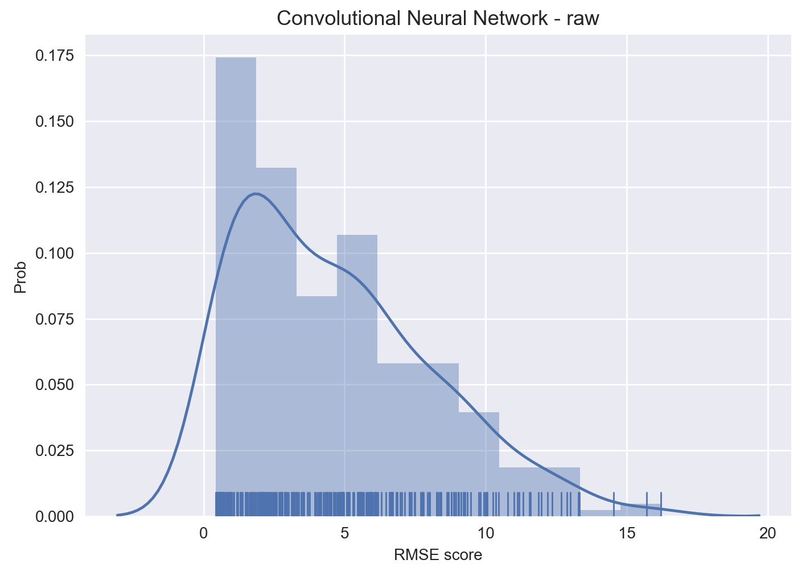
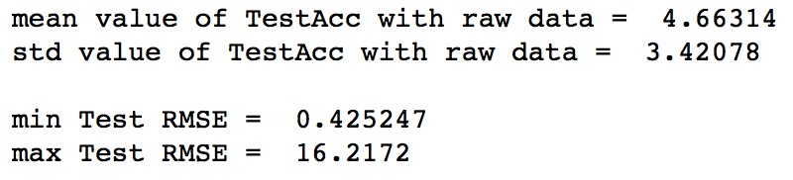
Results
CNN_Raw

Slide 19
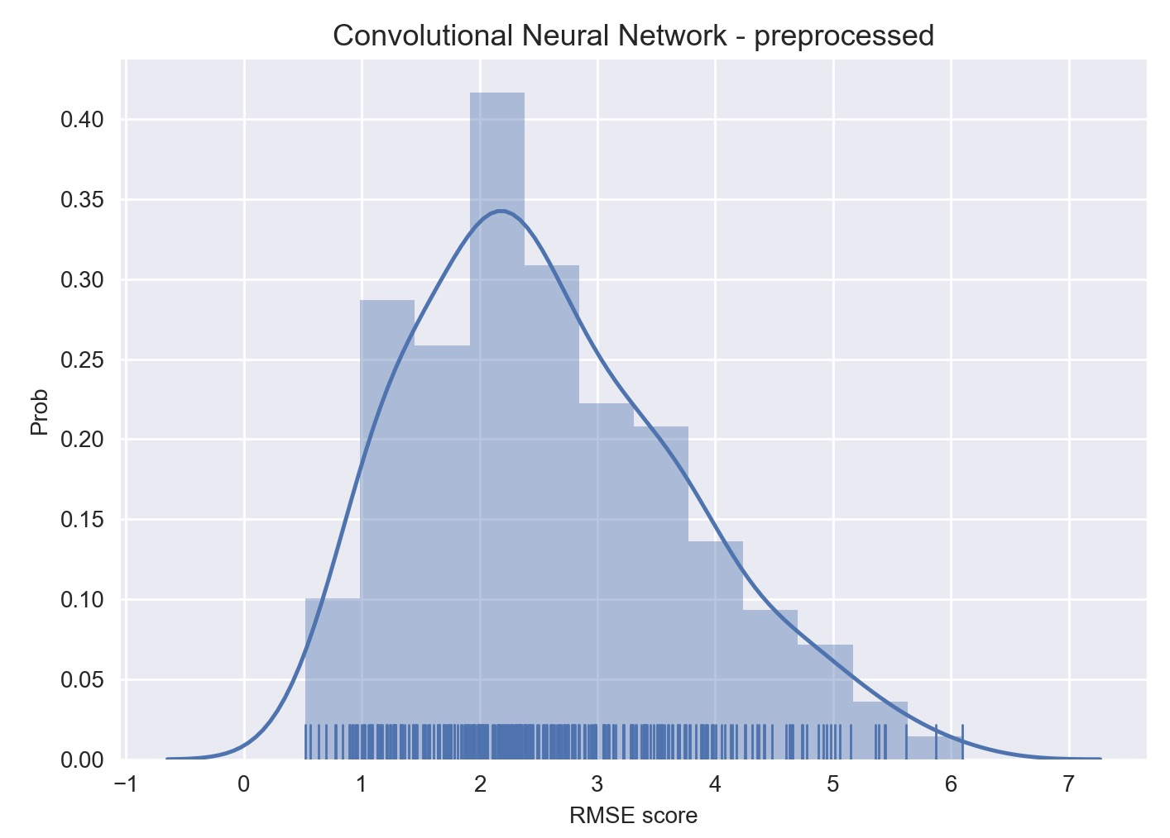
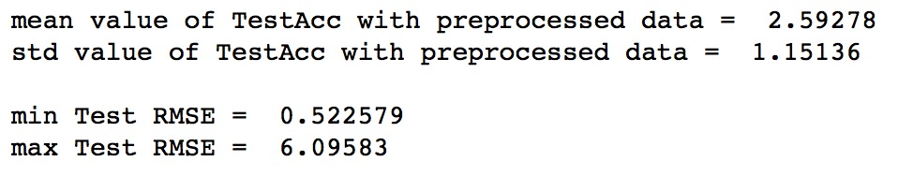
Results
CNN_Preprocessed

Slide 20
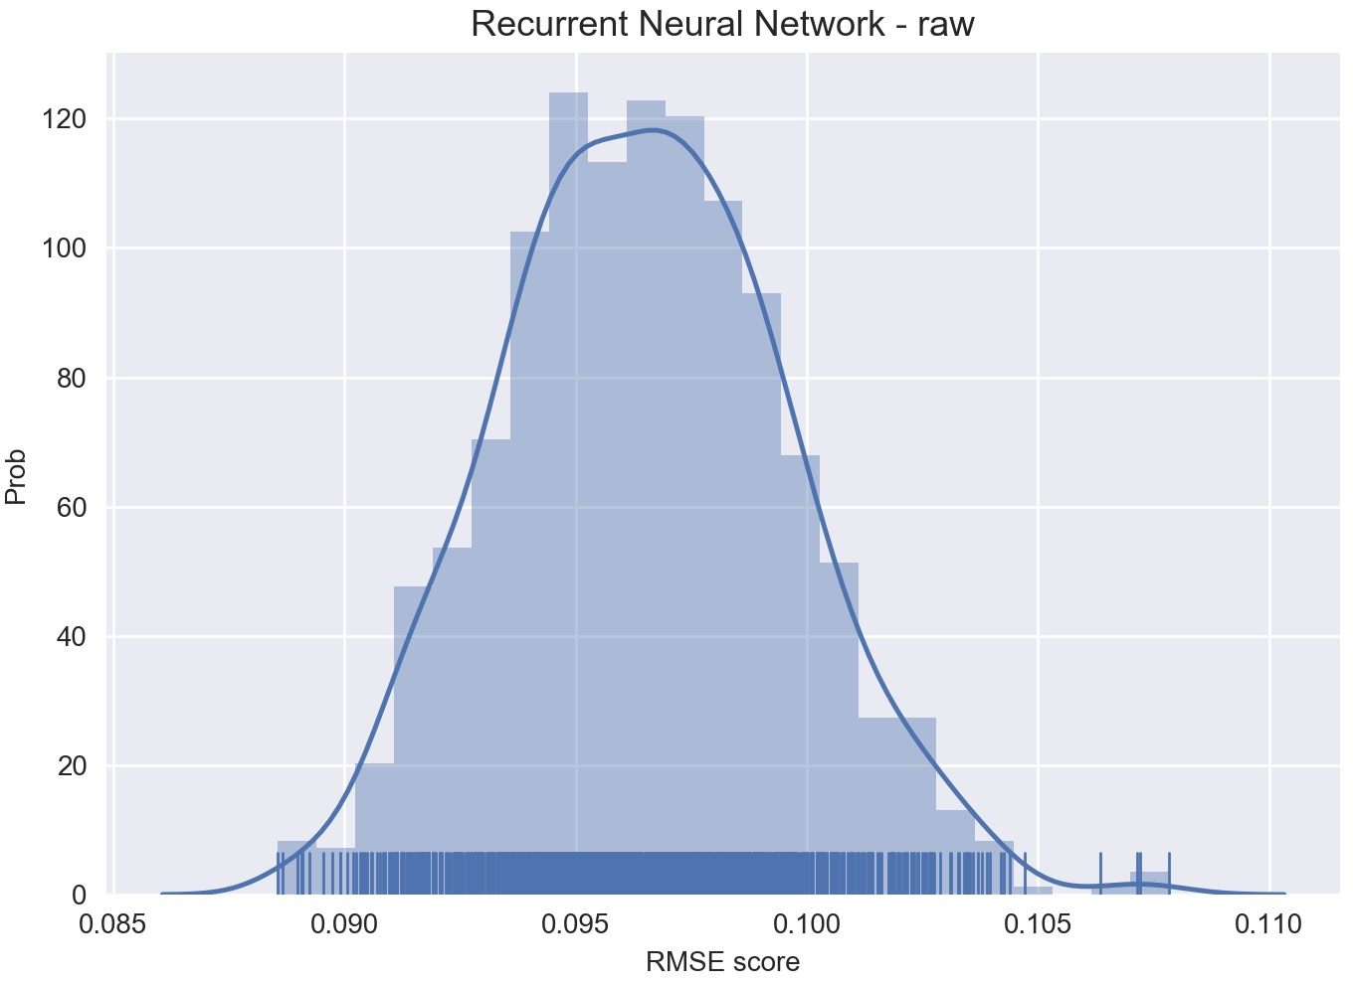
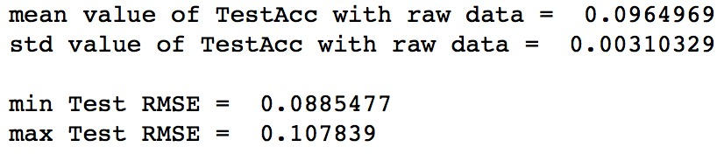
Results
RNN_Raw

Slide 21
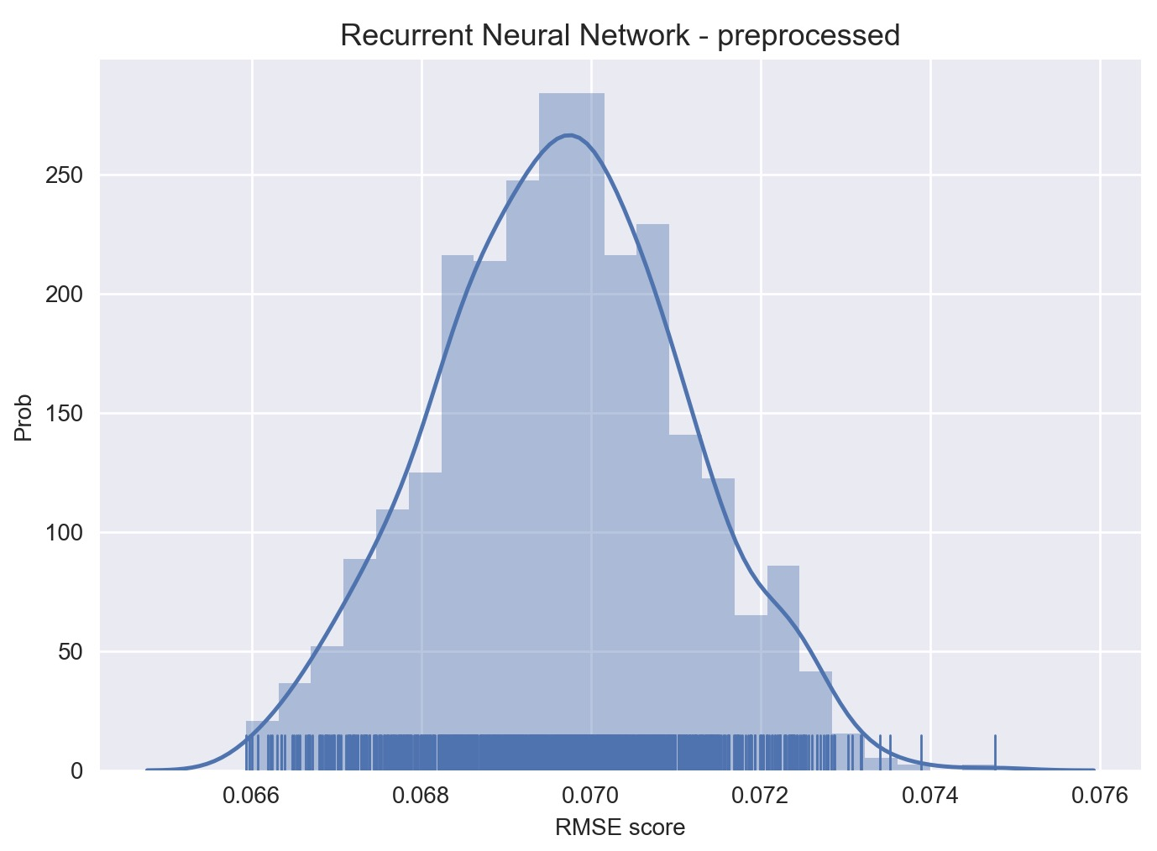
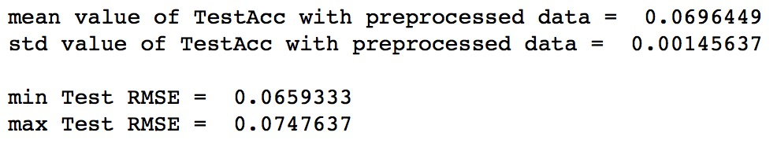
Results
RNN_Preprocessed

Slide 22
Think Backward
Why ELM and HELM are showing similar performance?
Why RNN and HELM are showing similar performance?

Slide 23
Conclusions

Slide 27
Main

Slide 28
Sub

