Slide 1
Power Load Forecasting
Park Jee Hyun
-
SungKyunGwan University
Nanyang Technological University

Slide 2
Contents
Purpose
H-ELM can outperform other Algorithms
Importance and Contribution of Preprocessing
Experiments
Conclusion

Slide 3
Purpose
H-ELM can outperform other Algorithms ➔ better engine!
Various algorithms are being developed as research on artificial intelligence proceeds.
Machine Learning(ML)
Deep Learning(DL)
Extreme Learning Machine(ELM)
Hierarchical ELM(H-ELM)
ML vs. ELM :
Better efficiency(fast learning speed )
Better generalization(random initialization)
Multi-Layer
Better accuracy
Allows us to train Machine with more abstract & complicated information
Importance and Contribution of Preprocessing ➔ better fuel!
Feature extraction algorithm
Well-refined dataset

Slide 4
H-ELM can outperform other Algorithms
Moore-Penrose inverse matrix
Randomly initialized input weight
ML
ELM
Single layer
Back-propagation based
Single layer
Feed-forward - fast learning speed
Better generalization
Multi-layer
DL
H-ELM
Multi layer - able to represent more abstract information
Feed forward
Better generalization
Multi layer - able to represent more abstract information
Back-propagation based

Slide 5
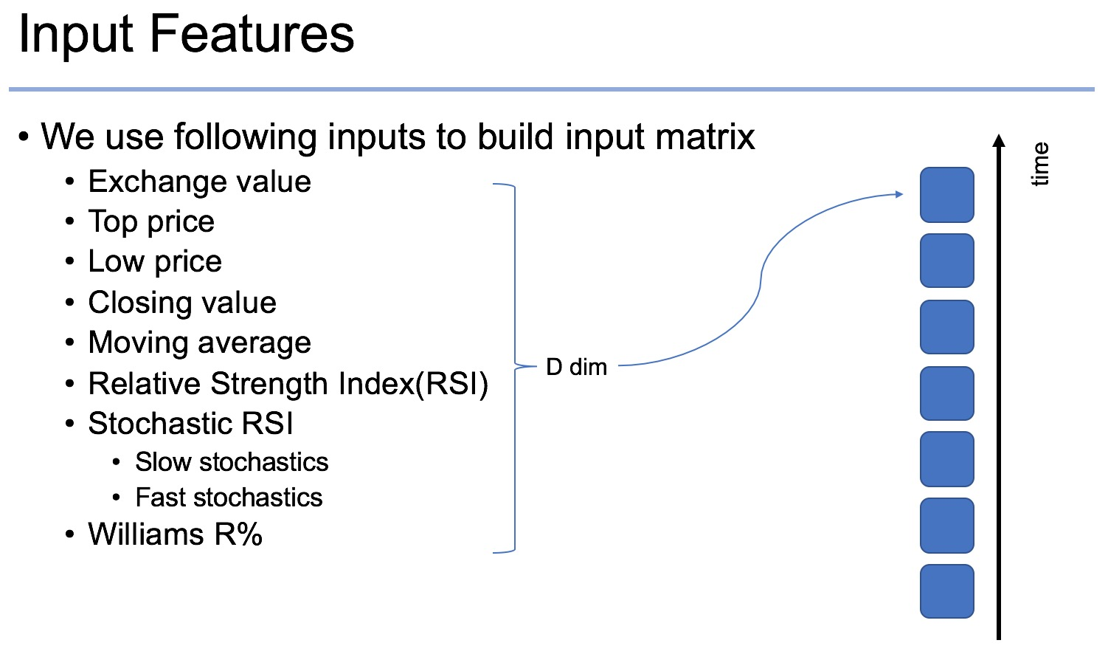
Importance and Contribution of Preprocessing
E.g. Foreign Exchange – calculate features

Slide 6
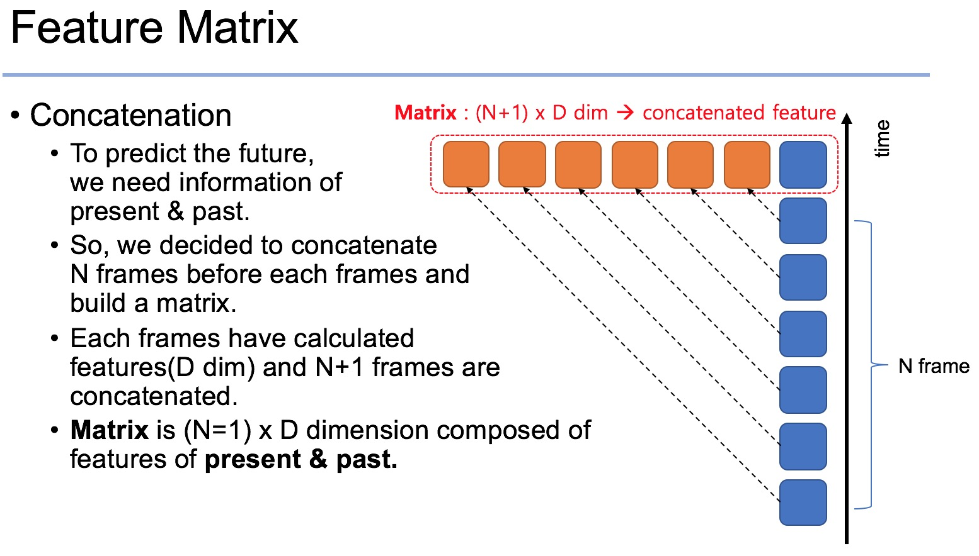
Importance and Contribution of Preprocessing
E.g. Foreign Exchange - concatenation

Slide 7
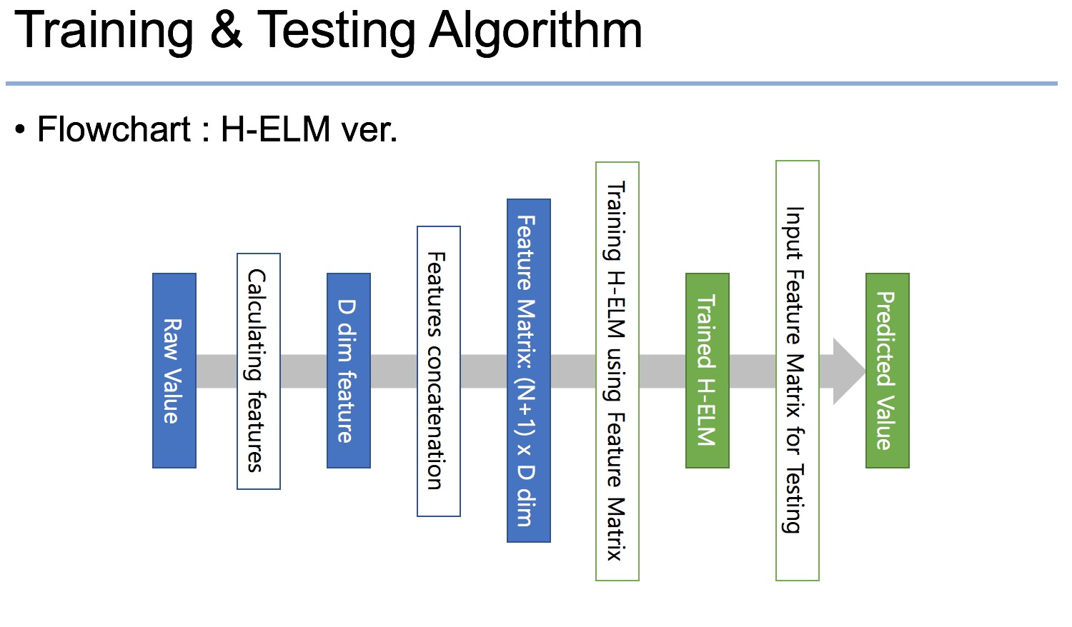
Importance and Contribution of Preprocessing
E.g. Foreign Exchange – preprocessing part

Slide 8
Experiments
Load Forecasting
- Accuracy
- Efficiency
- Generalization
H-ELM
Preprocess

Slide 9
Conclusions

Slide 11
Main

Slide 12
Sub

