Slide 1
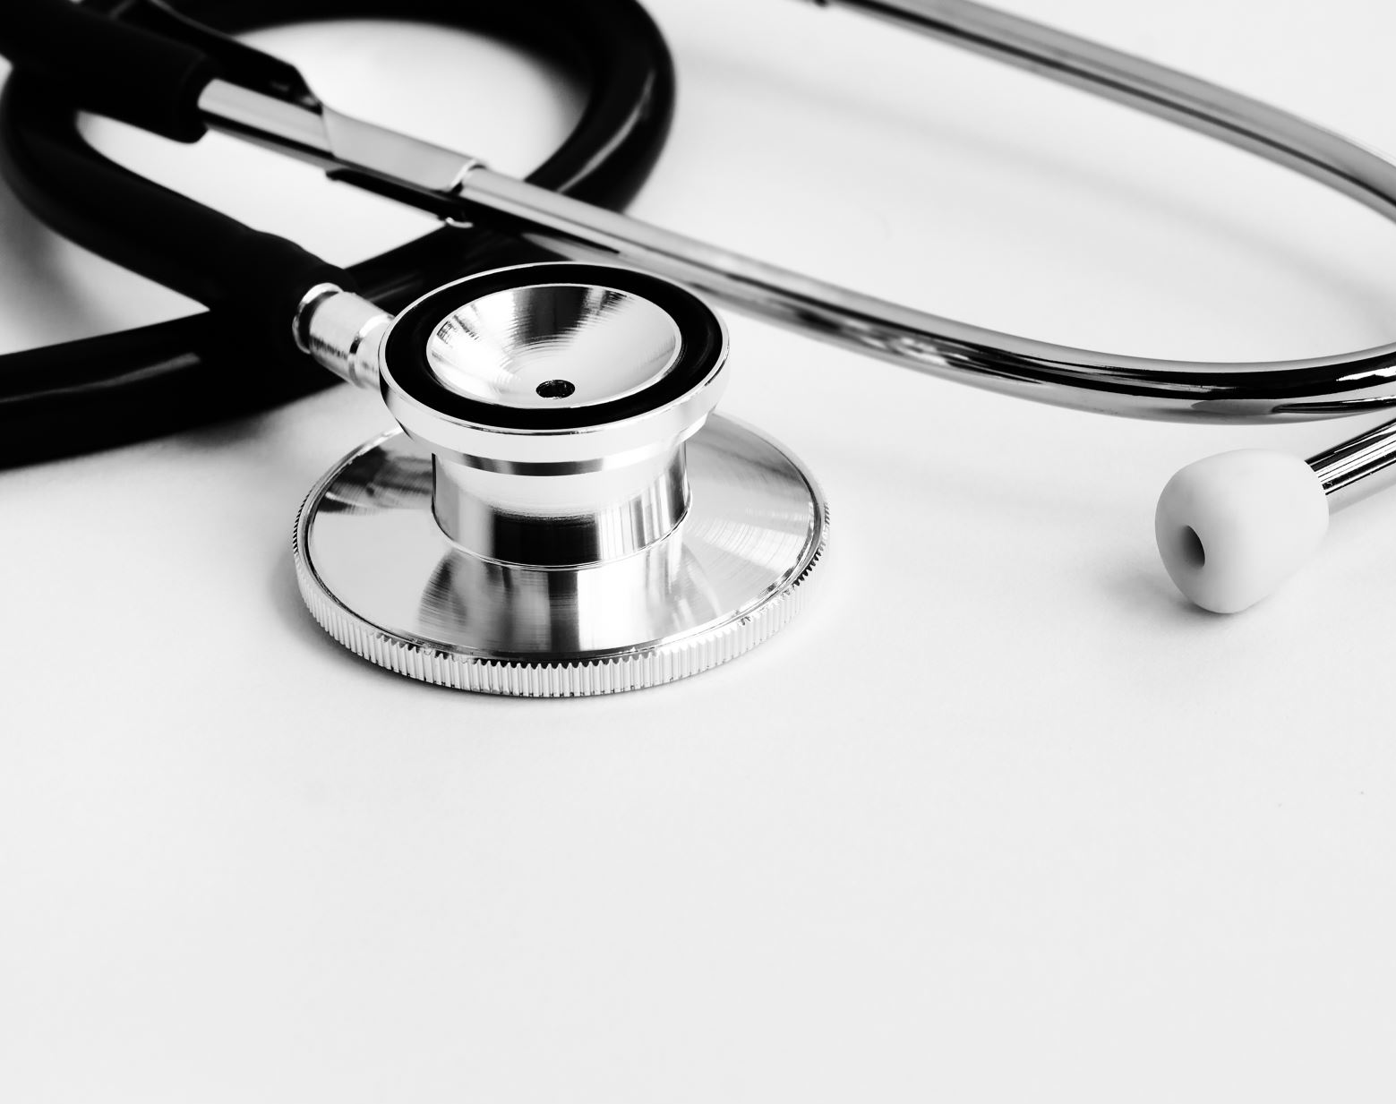
A prediction System for diagnosing

Slide 2
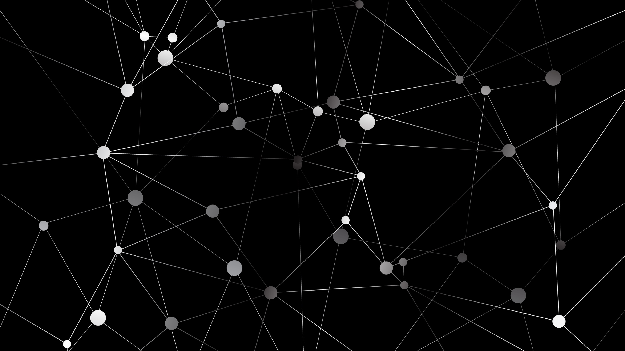
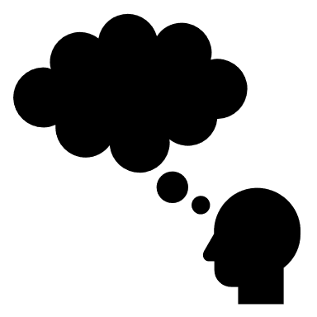
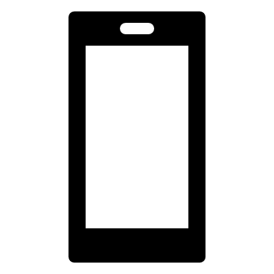
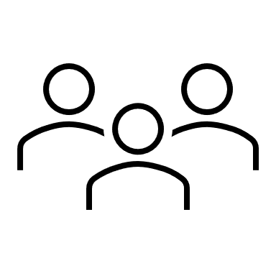
Our presentation parts:

Slide 3

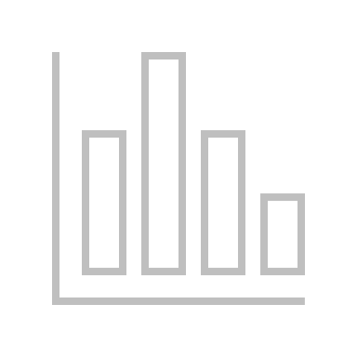



The problem discussion
ف
growing of Diabetes and heart disease
No regular visit to the doctor
Covid -19 infection
The late detection of the disease

Slide 4

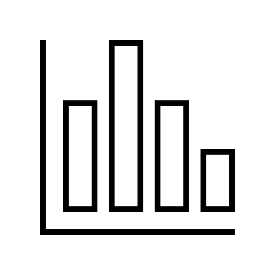
The problem discussion

Slide 5


The solution idea
Easy service
Monthly analysis
Capture your analysis image
Receive the diagnosing result

Slide 6


The appliance of the App
Our system is applicable to multi user
Predict the result of diagnosing heart disease , covid-19 and diabetes
No need to inter your data ,but just send the image of your analysis

Slide 7
The system discussion
Design part
Mechanism part

Slide 8

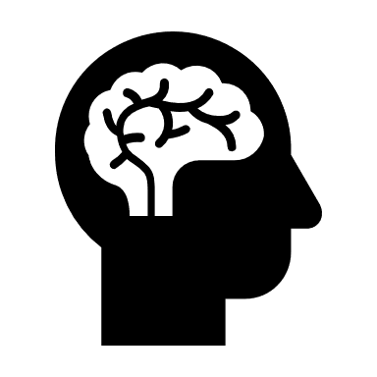
The design part
Android App
Connect to cloud
Regressive model

Slide 9



Android App mechanism :
Our APP will have two options :
input interface
capture image

Slide 10



capture image :
Android app
java
Firebase cloud
Text Recognition

Slide 11



Input interface :
Choose your method
Welcome and details page
Text input
Camera option
Result page

Slide 12
Firebase cloud
Connect our Android App to firebase API
Implementing our text recognition
Deploy our model to Firebase for served our App

Slide 13
Regressive model
Our model :
Pretrained model of the data ”logistic regression model”
Upload our training data to auto ML vision Edge to train our custom model in cloud
Dataset:
Collect our three dataset in one csv file
Train each type of our data to our model
and select the diagnosing system option

Slide 14
The diagnosing result
The prediction result will send the result after receiving the request
t
t

Slide 15


سماح داوود
سلمي خالد
محمد نصار
وضاح تيم
سارة محسن
إبراهيم محمد

