Slide 1
ICS 490: Special topics in Computer Science, Social Media and Text Analysis
Team Members:
Ibrahim BinAlshikh
Ibrahim Beladi
Mohammed Alfarraj
Omar Al-Dakhil

Slide 2
Outline
The Team Members' Contributions in the Project
Introduction to the Problem
Review of some existing work done in this problem
Problem Statement
Project Methodology
Data Collection
Data Description
Data Labeling
Machine Learning Solution
Algorithms' Description
Performance Measures Used
Experiment Design and Setup
Exploratory Data Analysis
Experiment Setup
Performance results
Conclusions and Future Work

Slide 3
Introduction to The Problem
Recently, Saudi Government allowed Cinema in KSA and there were many differing opinions on twitter.
Cinema in KSA or #السينما_في_السعودية contains many tweets between supporters and opponents and neutral

Slide 4
Review of Work Done in The problem
Twitter APIs
Sander’s Lab
Scikit
NumPy
Pandas
Matplotlib
Folium

Slide 5
Problem Statement
Many differing opinions on social media especially on Twitter.
Huge data on one single Hashtag.
Trending Hashtags.

Slide 6
Project Methodology
Data Collection
Data Description
Data Labeling
Machine Learning Solution
Algorithm Description
Performance Measures Used

Slide 7
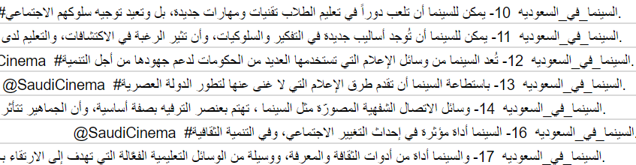
Data Description
Tweets containing the hashtag
#السينما_في_السعودية

Slide 8
Machine Learning Solution
Algorithms Description:
Support vector machines (SVM).
Random forests.
Multinomial Naïve Bayes.
Logistic Regression Classifier (SoftMax)
Voting Classifier

Slide 9
Machine Learning Solution
Performance Measures Used:
Accuracy
Classification report
Confusion Matrix

Slide 10
Experiment Design and Setup
Exploratory Data Analysis (Data Statistical Analysis)
Experiment Setup
Performance results (using performance measures + graphs + summary tables)

Slide 11
Exploratory Data Analysis
Number of gathered tweets including retweets: 19K+
of which; real Tweets: 2327 tweets
+ 3001 of tweets are gift from Mustafa’s group
Total dataset: 5328 tweets
Positive tweets : 1458 tweets
Neutral tweets: 2509 tweets
Negative tweets: 626 tweets
Spam tweets: 735 tweets

Slide 12
Experiment Setup
Tweets collections
Tweets Labeling
Tweets Cleaning
Feature Extraction
Classification

Slide 13
Data Collection
Sander’s Lab
Twitter’s APIs

Slide 14
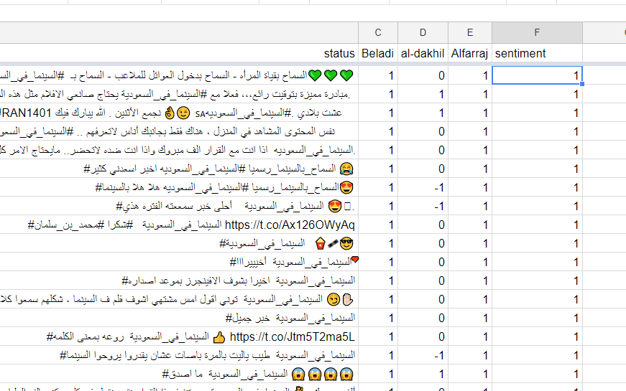
Data Labeling

Slide 15
Data Cleaning
Translating numbers from Hindu-Arabic numbers to Arabic numbers.
Replacing links, numbers, accounts with tokens (_NAME_).
Removing the punctuation and arabic diacritics.
Uniforming multiple characters to their original form.
Removing Repeated letters.

Slide 16
Features Extraction
TfidfVectorizer
(CountVectorizer followed by TfidfTransformer)

Slide 17
Performance results (Twitter)
Support Vector Machines
Accuracy: 95.87%
 | Precision | Recall | F1-score | Support
Negative | 1.00 | 0.92 | 0.96 | 64
Neutral | 0.95 | 0.98 | 0.96 | 258
Positive | 0.94 | 0.94 | 0.94 | 144
Spam | 1.00 | 0.96 | 0.98 | 67
Avg / Total | 0.96 | 0.96 | 0.96 | 533

Slide 18
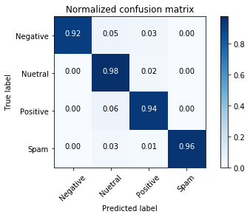
Performance results (Twitter)
Support Vector Machines
Accuracy: 95.87%

Slide 19
Performance results (Sander’s)
Support Vector Machines
Accuracy: 80.75%
 | Precision | Recall | F1-score | Support
Negative | 0.80 | 0.83 | 0.81 | 2693
Positive | 0.82 | 0.79 | 0.80 | 2615
Avg / Total | 0.81 | 0.81 | 0.81 | 5308

Slide 20
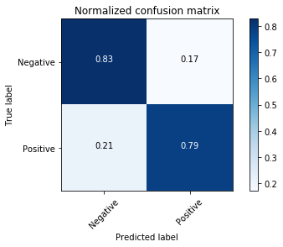
Performance results (Sander’s)
Support Vector Machines
Accuracy: 80.75%

Slide 21
Performance results (Twitter)
Multinomial Naïve Bayes
Accuracy: 95.5%
 | Precision | Recall | F1-score | Support
Negative | 1.00 | 0.95 | 0.98 | 64
Neutral | 0.93 | 0.98 | 0.96 | 258
Positive | 0.96 | 0.90 | 0.93 | 144
Spam | 0.98 | 0.97 | 0.98 | 67
Avg / Total | 0.96 | 0.95 | 0.95 | 533

Slide 22

Performance results (Twitter)
Multinomial Naïve Bayes
Accuracy: 95.5%

Slide 23
Performance results (Sander’s)
Multinomial Naïve Bayes
Accuracy: 78.07%
 | Precision | Recall | F1-score | Support
Negative | 0.79 | 0.77 | 0.78 | 2693
Positive | 0.77 | 0.80 | 0.78 | 2615
Avg / Total | 0.78 | 0.78 | 0.78 | 5308

Slide 24
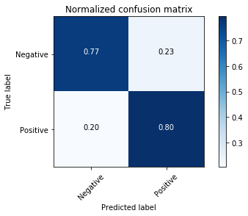
Performance results (Sander’s)
Multinomial Naïve Bayes
Accuracy: 78.07%

Slide 25
Performance results (Twitter)
Random Forests
Accuracy: 98.69%
 | Precision | Recall | F1-score | Support
Negative | 1.00 | 0.98 | 0.99 | 64
Neutral | 1.00 | 0.98 | 0.99 | 258
Positive | 0.96 | 0.99 | 0.98 | 144
Spam | 1.00 | 0.99 | 0.99 | 67
Avg / Total | 0.99 | 0.99 | 0.99 | 533

Slide 26

Performance results (Twitter)
Random Forests
Accuracy: 98.69%

Slide 27
Performance results (Sander’s)
Random Forests
Accuracy: 98.04%
 | Precision | Recall | F1-score | Support
Negative | 0.98 | 0.98 | 0.98 | 2693
Positive | 0.98 | 0.98 | 0.98 | 2615
Avg / Total | 0.98 | 0.98 | 0.98 | 5308

Slide 28
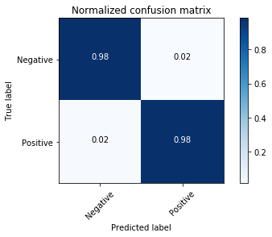
Performance results (Sander’s)
Random Forests
Accuracy: 98.04%

Slide 29
Performance results (Twitter)
Logistic Regression Classifier
Accuracy: 90.99%
 | Precision | Recall | F1-score | Support
Negative | 0.87 | 0.92 | 0.89 | 64
Neutral | 0.92 | 0.92 | 0.92 | 258
Positive | 0.90 | 0.88 | 0.89 | 144
Spam | 0.93 | 0.94 | 0.93 | 67
Avg / Total | 0.91 | 0.91 | 0.91 | 533

Slide 30
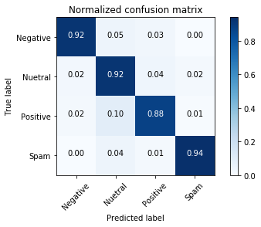
Performance results (Twitter)
Logistic Regression Classifier
Accuracy: 90.99%

Slide 31
Performance results (Sander’s)
Logistic Regression Classifier
Accuracy: 79.9%
 | Precision | Recall | F1-score | Support
Negative | 0.79 | 0.82 | 0.80 | 2693
Positive | 0.81 | 0.78 | 0.79 | 2615
Avg / Total | 0.80 | 0.80 | 0.80 | 5308

Slide 32

Performance results (Sander’s)
Logistic Regression Classifier
Accuracy: 79.9%

Slide 33
Performance results (Twitter)
Voting Classifier
Ensembling the earlier classifiers
Accuracy: 96.62%
 | Precision | Recall | F1-score | Support
Negative | 1.00 | 0.95 | 0.98 | 64
Neutral | 0.96 | 0.98 | 0.97 | 258
Positive | 0.94 | 0.94 | 0.94 | 144
Spam | 1.00 | 0.97 | 0.98 | 67
Avg / Total | 0.97 | 0.97 | 0.97 | 533

Slide 34

Performance results (Twitter)
Voting Classifier
Ensembling the earlier classifiers
Accuracy: 96.62%

Slide 35
Performance results (Sander’s)
Voting Classifier
Ensembling the earlier classifiers
Accuracy: 82.31%
 | Precision | Recall | F1-score | Support
Negative | 0.80 | 0.86 | 0.83 | 2693
Positive | 0.85 | 0.78 | 0.81 | 2615
Avg / Total | 0.82 | 0.82 | 0.82 | 5308

Slide 36
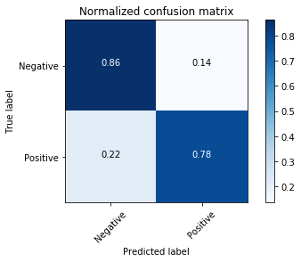
Performance results (Sander’s)
Voting Classifier
Ensembling the earlier classifiers
Accuracy: 82.31%

Slide 37
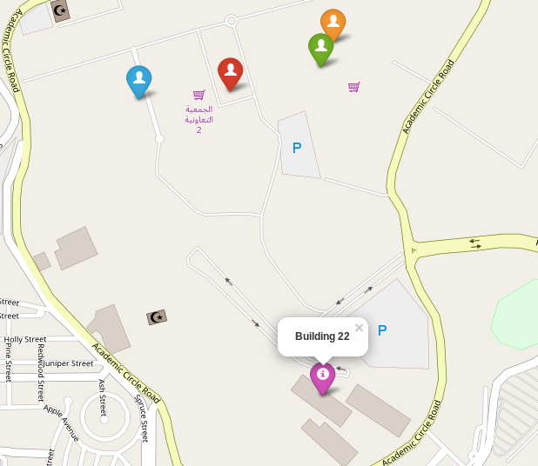
Tweets’ Geological Distribution
Unfortunately, none of the 5328 tweets contained the geological coordinates. Hence, there is no geological distribution for the tweets.

Slide 38
Conclusions and Future Work
There is no best algorithm for all datasets.
Random Forest got the best result for both datasets.
5000 Tweets are not enough dataset for most of the algorithms to work with high accuracy.
Data labeling is time consuming.

Slide 39
Team members’ contributions in the project
Ibrahim BinAlshikh: Data labeling, Ass#3 + Presentation, Report.
Ibrahim Beladi: Data collection, Data labeling, data cleaning, Data processing, Features extraction, Machine learning algorithms, Report.
Mohammed Alfarraj: Data collection, Data labeling, Processing Data, Features extraction, Machine learning algorithms, Report.
Omar Al-Dakhil: Data labeling, Machine learning algorithms, Presentation, Report.

