Slide 1
Project
Video Games Global Sales Prediction

Slide 2
Introduction
Video games have become immensely popular over the past decade. The global games market in 2019 was estimated at $148.8 billion. So , companies are very interested to understand video games trends to provide users with best and latest technology as well as to get big share of this huge market.
This dataset contains a list of video games with sales greater than 100,000 copies. It was generated by a scrape of vgchartz.com.
In this project , I did two tasks:
Exploratory Data Analysis(preprocessing)
Designing and building model prediction

Slide 3
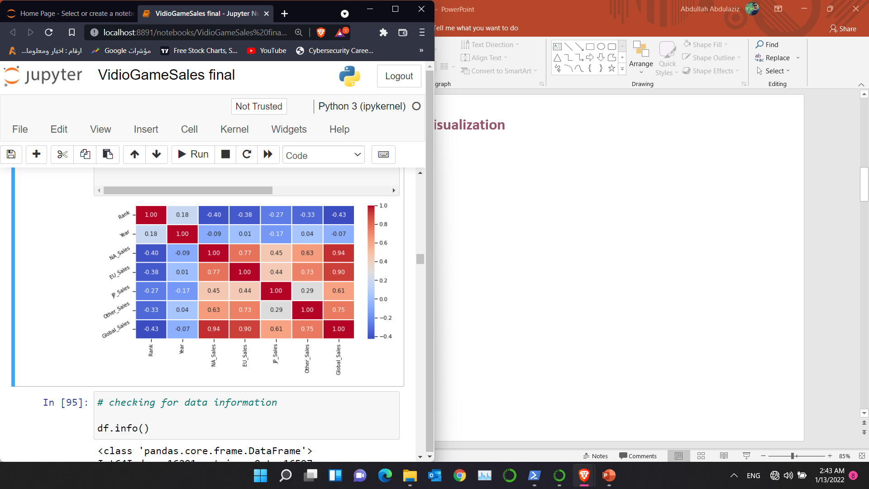
Data Visualization

Slide 4
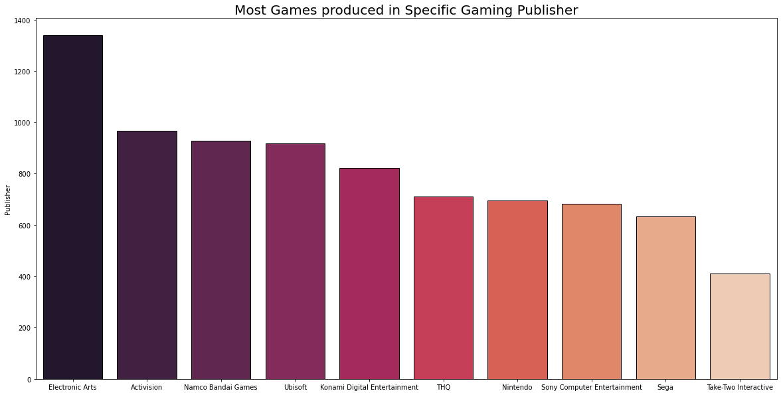
Data Visualization

Slide 5
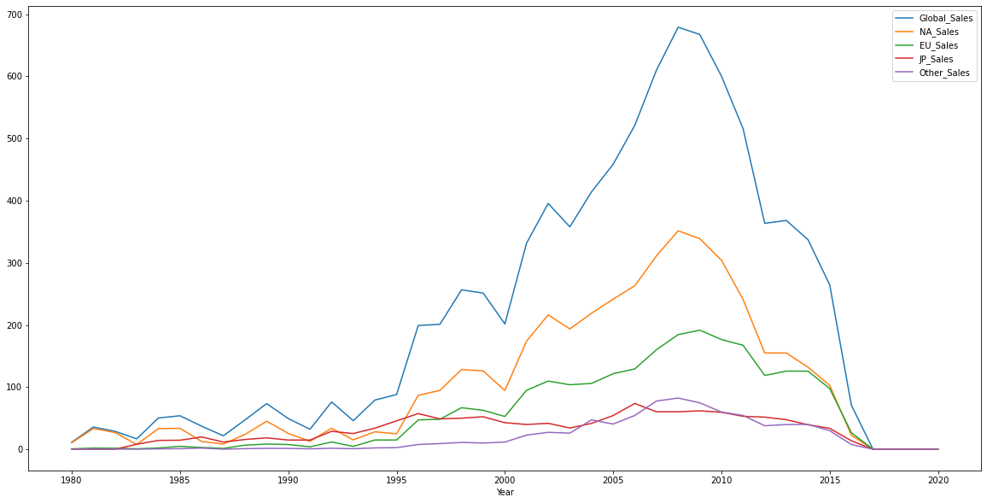
Data Visualization

Slide 6
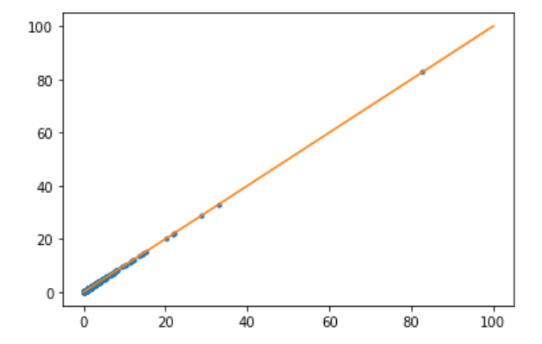
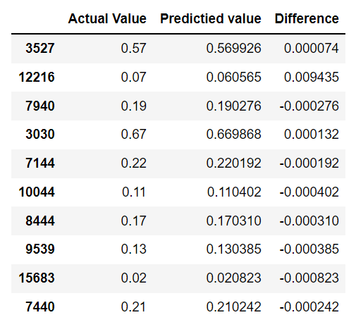
Machine Learning Models
Linear regression
Score : 0.8778473275171549

Slide 7
Machine Learning Models
Ridge model
Score : 0.8778618261424534

Slide 8
Machine Learning Models
Decision Tree Regressor model
Training Accuracy : 0.9978711000776683
Testing Accuracy : 0.8155569999939317

Slide 9
Machine Learning Models
RandomForestRegressor
Score : 0.8637738947939101

Slide 10
Machine Learning Models
xgboost
Score : 0.900210914493264

