Slide 1
NovaStore
System Analysis & Database Design
ASP.NET Core MVC · .NET 10 · Proposed SQL Server design

Slide 2
Project overview and objectives
NovaStore is a modern, responsive online retail demonstration built on an ASP.NET Core MVC / .NET 10 project. Customers browse, search and sort products, manage a session cart and place cash-on-delivery demo orders. A password-protected demo administrator maintains products, stock and order status.
1
Intuitive product discovery and a responsive shopping experience
2
Validated checkout input with recorded order totals and product snapshots
3
Basic inventory and order administration
4
A normalized SQL Server design for future persistence

Slide 3
Scope: what is built and what comes next
In scope (implemented)
Out of scope (future enhancement)
Product catalogue with search and sorting
Session cart and checkout
Cash-on-delivery (COD) demo orders
JSON persistence with stock deduction
Demo admin: product CRUD and order status
Real payment gateway and refunds
Registered customer accounts (ASP.NET Identity)
SQL Server / EF Core migration with transactional inventory
Multi-admin roles
Shipping integrations, tax and email

Slide 4
Stakeholder analysis
Stakeholder | Interest / responsibility | Influence
Customer / visitor | Find products; cart; checkout; order confirmation | High
Store administrator | Maintain catalogue, inventory and order status | High
Store owner / sponsor | Revenue visibility; usable storefront; business rules | High
Developer / maintainer | Implement MVC; test, secure and maintain the system | High
Hosting provider | Application availability and runtime environment | Medium
Delivery / payment partners (future) | Fulfilment and payment integration; not implemented | Low (current)

Slide 5
Stakeholder needs
1
Customer
2
Administrator
Responsive UI, clear prices, product availability, simple checkout and a clear confirmation.
Reliable product CRUD, stock visibility, order listing and order status updates.
3
Owner
4
Developer
Accurate totals and an understandable operational summary of the store.
Clean models, testable services, and documented persistence and security constraints.

Slide 6
Work plan: six-week schedule
1. Requirements
2. Design
3. Development
4. Testing
5. Deployment & docs
Week 1
Features, actors, scope and acceptance criteria
Week 2
Wireframes, ERD, mapping, UI and architecture
Weeks 3–4
Catalogue, cart, checkout, admin
Week 5
Validation, stock, order, UI and responsive tests
Week 6
Demo deployment, README, handover
This is a proposed six-week academic plan, not a record of actual development history.

Slide 7
Database design: current state vs proposed
Current state (demo)
Proposed (SQL Server)
Products persisted in products.json
Orders and embedded checkout data in orders.json
Cart lines held in the user session
Category stored as a text property on Product
No persistent Customer or Category tables
Five normalized tables: Category, Product, Customer, Orders, Order_Item
Customer record created at checkout (no login needed)
Order_Item keeps name, price and image snapshots
ProductId nullable so history survives product deletion
No persistent cart table: cart stays session-based

Slide 8
Business rules and key figures
5
4
200 USD
15 USD
entities in the proposed schema
one-to-many relationships
subtotal for free shipping
shipping fee below threshold
Order total = Subtotal + Shipping, computed rather than stored as an editable column
Each order item preserves name, price and image at purchase time
Constraints: Price ≥ 0, Stock ≥ 0, Quantity > 0, Shipping ≥ 0, UnitPriceSnapshot ≥ 0
Every foreign key is indexed

Slide 9
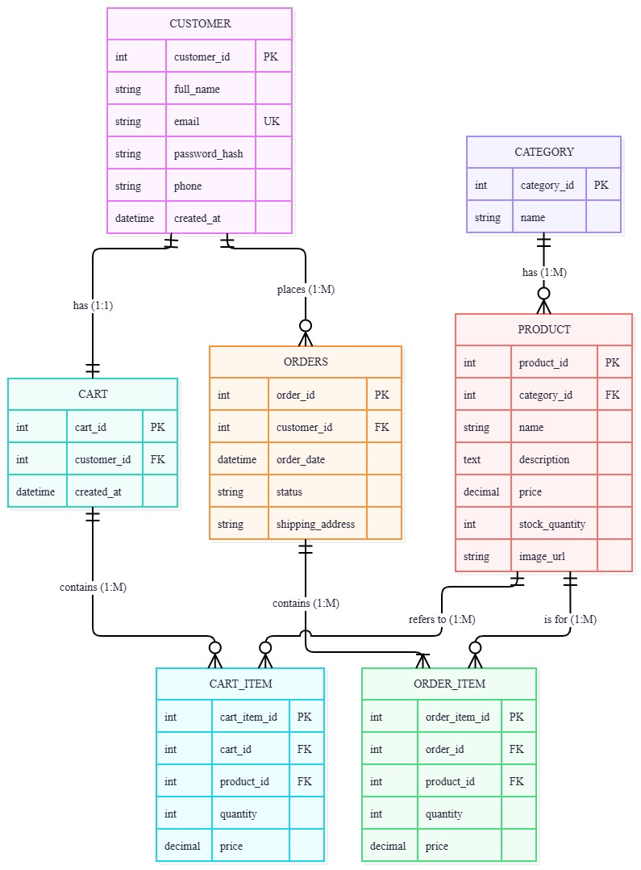
Entity relationship diagram (ERD)
How to read it
Crow's foot notation: the "many" side of each relationship
A bar marks exactly one; a circle marks zero (optional)
PK = primary key; FK = foreign key
Five core entities: Customer, Orders, Order_Item, Product, Category
The diagram also shows Cart and Cart_Item; the written mapping keeps the cart in session

Slide 10
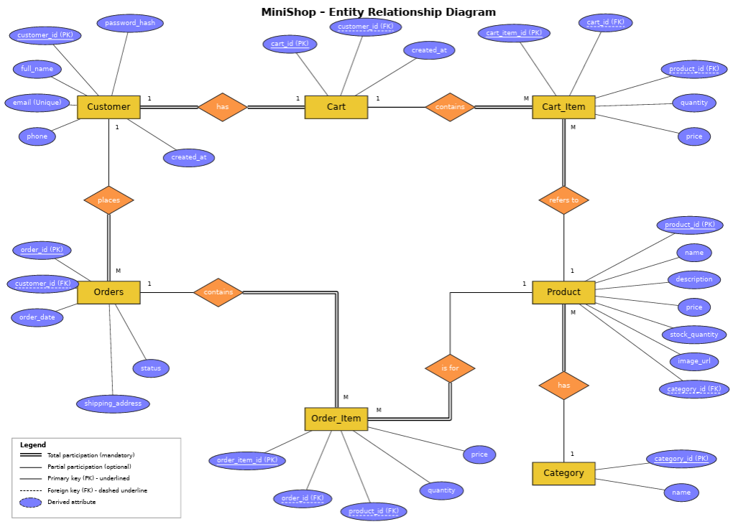
ERD from the analysis document
Chen-notation ERD embedded in the analysis document (titled "MiniShop"), shown for comparison with the crow's foot ERD above.

Slide 11
ERD-to-relational mapping
Table | Key attributes and constraints
CATEGORY | CategoryId INT PK; Name NVARCHAR(80) NOT NULL UNIQUE
PRODUCT | ProductId INT PK; CategoryId FK; Name; Description; Price DECIMAL(12,2); OldPrice; ImageUrl; Stock INT; Featured BIT; Badge; Rating
CUSTOMER | CustomerId INT PK; FullName NVARCHAR(120); Email NVARCHAR(254); Phone NVARCHAR(30)
ORDERS | OrderId VARCHAR(30) PK; CustomerId FK; CreatedAt DATETIME2; ShippingAddress; City; Notes; Subtotal; Shipping; Status
ORDER_ITEM | OrderItemId INT PK; OrderId FK; ProductId FK NULL (ON DELETE SET NULL); ProductNameSnapshot; UnitPriceSnapshot; ImageUrlSnapshot; Quantity INT
Relationships: Category → Product (1:N); Customer → Orders (1:N); Orders → Order_Item (1:N); Product → Order_Item (1:N, nullable FK).

Slide 12
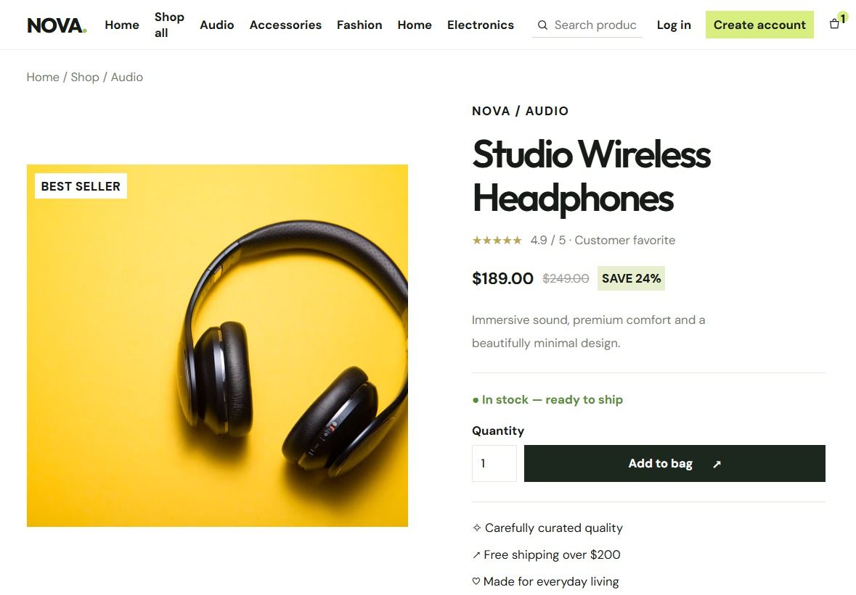
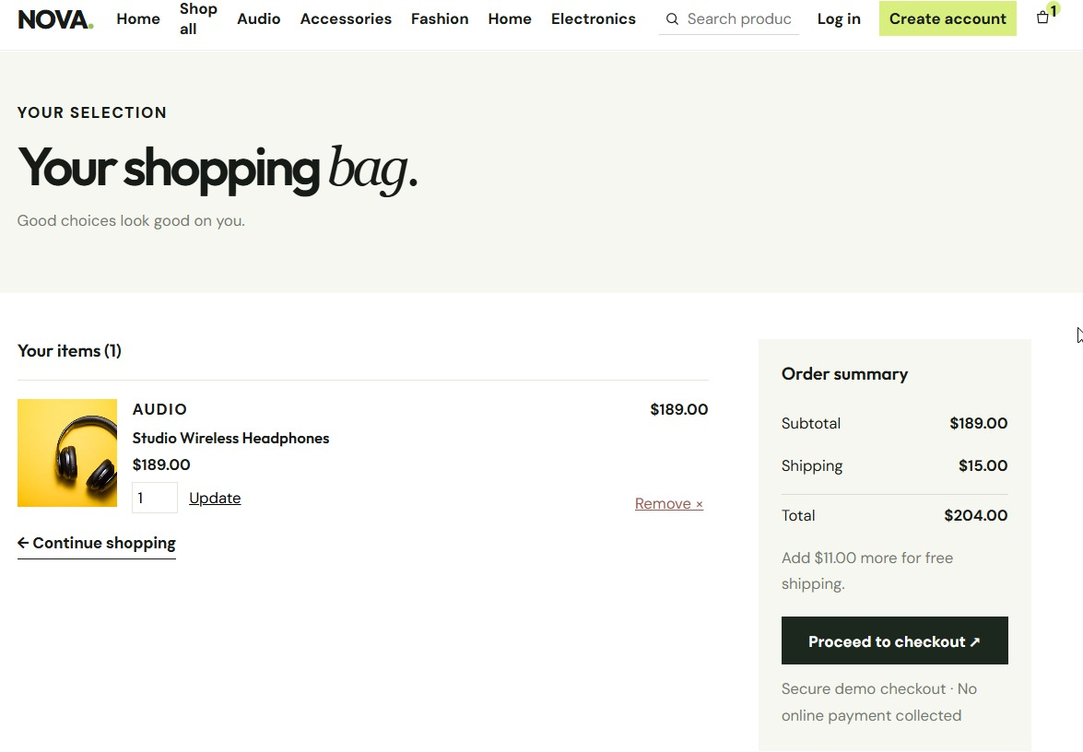
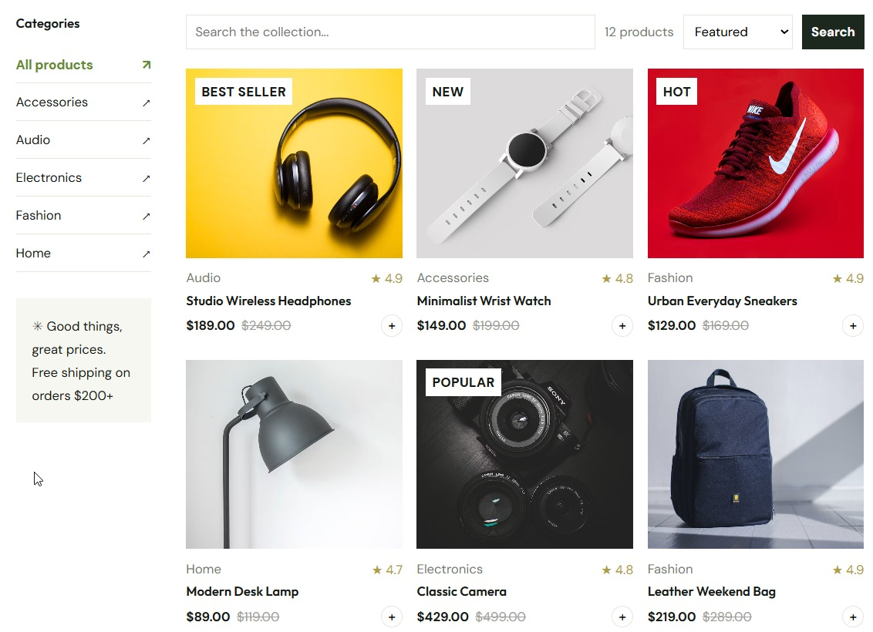
Interface screenshots
Screenshot placeholder
Screenshot placeholder
Catalogue & product details
Cart & checkout
Gallery of items

Slide 13
Technologies used
ASP.NET Core MVC
.NET 10
JSON files
Session cart
CURRENT
CURRENT
CURRENT
CURRENT
Controllers and views for shop, cart, checkout, admin
Runtime and project platform
products.json and orders.json persistence
Cart lines stored in the user session
SQL Server
EF Core
ASP.NET Core Identity
Secrets management
PLANNED
PLANNED
PLANNED
PLANNED
Relational store for the five-table schema
Migrations and transactional stock updates
Customer accounts and admin authentication
Secure admin credentials and configuration

Slide 14
Result and outcome
Working demo
Target database
Honest scope
Catalogue with search and sorting, session cart, COD checkout, and admin product and order management.
Normalized five-table SQL Server design (3NF), with deliberate order snapshots to keep history accurate.
The design supports admin, checkout and order history without claiming features that are not yet implemented.

Slide 15
Future development steps
1
2
3
4
Database migration
Customer accounts
Payments & fulfilment
Admin & security
SQL Server with EF Core; transactional orders and atomic stock updates
ASP.NET Core Identity; customer login and order history
Real payment gateway, refunds, shipping integration, tax and email
Multi-admin roles, secrets management, validation and automated tests

Slide 16
Project team
Coordinator
Omnia Abdel-Hamid
Ibrahim Aiman
Mirolla Maged
Mohamed Ragab
Maria Ramy
21174646
21132551
21147734
21036094
John Wahid
Ahmed Reda
21042738
21000890

Slide 17
Thank you
Questions & discussion

