Slide 1
A MODEL FOR CLOUD-BASED ACADEMIC ENTERPRISE RESOURCE PLANNING (CAERP) FOR A HIGHER INSTITUTION
PROGRESS REPORT
BY
IBRAHIM ADABARA
1165-04256-10227
MASTER OF SCIENCE IN INFORMATION TECHNOLOGY
SUPERVISORS:
DR. SANNI SHAMSUDEEN & DR. AJIBOYE ADELEKE RAHEEM

Slide 2
PRESENTATION OUTLINES
INTRODUCTION
STATEMENT OF THE PROBLEM
METHODOLOGY
STUDY FINDINGS
DISCUSSION OF FINDINGS
CONCLUSION
RECOMMENDATIONS
AREA OF FURTHER STUDIES
CONTRIBUTION TO KNOWLEDGE

Slide 3
INTRODUCTION
HIGHER INSTITUTION
ENTERPRISE RESOURCE PLANNING
Definition
Types
CLOUD COMPUTING
Definition
Types
Deployment
Definition
Deployments
Service Model

Slide 4
SCOPE OF THE STUDY
GEOGRAPHICAL SCOPE
Kampala International University, Kampala – Uganda (Main Campus)
CONTEXT SCOPE
Higher Institution of Learning
Enterprise Resource Planning
Security and Privacy in server-based ERP
Infrastructure Required for server based and Cloud based ERP
Security and Privacy in the Cloud
TIME SCOPE
December 2017 till date

Slide 5
STATEMENT OF THE PROBLEM
The volume of data/information produced by academic institutions grows every day.
Hardware/software procurement and maintenance cost.
Cost of employing IT specialist/Consultant.
Data theft, change of marks, and other system violations.
Securing the infrastructure from either Natural or man-made disaster
Lost of data during migration.

Slide 6
GENERAL AND SPECIFIC OBJECTIVES
GENERAL OBJECTIVE
To develop a security and privacy model for cloud-based academic enterprise resource planning (CAERP) for Kampala International University.
SPECIFIC OBJECTIVE
To determine the IT infrastructure and security requirements for the implementation of a cloud-based ERP in higher institution.
To examine the current technology and implementation models which support cloud computing in higher institution.
To analyze the potential risks associated with moving ERP from server-based to cloud-based in the higher institution.
To validate the design model using Devexpress platform.

Slide 7
RESEARCH QUESTIONS
What are the IT infrastructure and security requirements for the implementation of cloud-based ERP in a higher institution?
What are the current technologies and implementation models?
What the potential risks associated with moving ERP system from server-based to cloud-based in a higher institution?
How can the current server-based ERP system be migrated to the cloud-based ERP system in a higher institution?

Slide 8
SIGNIFICANCE OF THE STUDY
Availability, scalability, agility, elasticity, and reliability for on-demand services to make teaching, learning, research easier, collaborate and share information online.
Cloud-based technology provides the students with flexibility, accessibility, and portability of educational materials anytime and anywhere.
This research will help decision-maker, staff (academic and non-academic) and students who have interests and concerns to learn more about data and information security.
Cloud-based technology helps provide a secure infrastructure and efficient audit trail.
It will help to reduce hardware and software procurement/maintenance cost.
Help promote the adoption of cloud computing applications and provide the basis for secured ERP systems for higher educational institutions.

Slide 9
METHODOLOGY Cont…
Strategy for Sampling
Mcleod (2014) defines a sample as a group of people who take part in the investigation. The researcher used purposive sampling, according to Tongco, (2007) purposive sampling as judgmental or subjective sampling, purposive sampling relies on the researcher when selecting units of analysis
Targeted populace
Targeted populace denotes the number of participants deliberated to take part in the study. The emphasis of the study is ICT personals who use and support server-based ERP technologies in the higher institution.

Slide 10
METHODOLOGY Cont..
Methods of Collecting Data
Primary Data
The primary data was collected using archive (literature reviews, case study, and observation). Marshall and Rossman, (2011) define records archive as “records gathered from the organization and they add to other qualitative methods.
Secondary Data
Interviews and Expert panel were used to collect secondary data as done through face to face investigations. Srivastava and Rogo (2011) say Data collected using unstructured and semi-structured interviews or Expert panel are examples of qualitative research.

Slide 11
METHODOLOGY Cont…
The researcher used a qualitative case study approach. According to Burton (2000), qualitative research focuses on understanding humans from multiple perspectives, and the data collection methods were a case study, observation, semi-structured interviews, expert panel, and the validation process used an experimental method.
OBSERVATION AND CASE STUDY
According to Sekaran & Bougie in 2010. A researcher uses the observation method to observed a phenomenon in its natural setting.
A case study is “an empirical inquiry that investigates a contemporary phenomenon in-depth and within its real-life context” (Yin, 2014 ).
To identify the current opinions, trends and the cloud-based models.
To identify the current hardware and software of cloud-based technologies.
To help develop the first iteration cloud-based ERP model.

Slide 12
METHODOLOGY Cont…
SEMI-STRUCTURED INTERVIEWS (ICT DEPARTMENT)
In a semi-structured interview, the interviewer has a list of questions that serve as a guideline on the subject matter. As such additional questions are added during the interview to explore further the themes that come up during the interview. Saunders et al. (2009), state that some of the pre-coded questions might not be asked during the interview and an audio recorder will record the conversation.
To determine the current security and privacy challenges in a server-based ERP system.
To assess server-based ERP performance.
To gain insight into the infrastructure available.

Slide 13
METHODOLOGY Cont…
EXPERT PANEL
According to Daneshkhah (2004), expert judgment is another method of data collection in qualitative research. Information assessment based on the expert’s knowledge and experience relating to the quantity or quality of content in the discussion. Based on their experience, research and publications in the area of research, positions, and awards received. Daneshkhah (2004) that expert judgment is applied when data is limited and difficult to obtain because of higher costs, unknown models or data open for interpretation and feedback.
To help develop the final iteration cloud-based model
To identify the potential risk associated with moving from server-based to cloud-based
To help implement the develop cloud-based ERP model using the devexpress platform

Slide 14
METHODOLOGY
EXPERIMENTAL
According to Creswell (2014), an experiment seeks to determine if a specific treatment influences an outcome. In an experiment, the researcher seeks to discover relationships between variables. Saunders et al., (2009), says is to measure whether the change in an independent variable produces changes in two or more dependent variables.
To demonstrate how the server based System can be migrating without loss of information.
To help proffer security solution in a real-life context.
To help validate the developed ERP system.

Slide 15
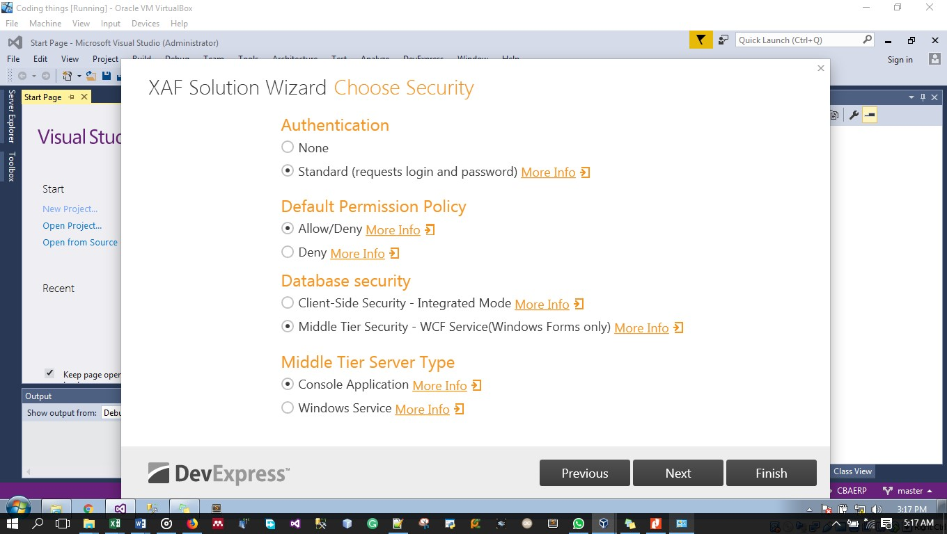
METHODOLOGY Cont..

Slide 16
RESEARCH INSTRUMENT
Do you have any ERP platform?
How often does your ERP system upgrade?
What ERP technologies do you use?
How do you use the ERP system to enhance the institution service?
Does the ERP system help to generate daily, monthly and or yearly reports?
What challenges are you facing in the using ERP system?
I understand the networking department of Uganda communications currently running a project of implementing private cloud locally. How far have they gone with the plan?
Do you have any plans to migrate or transfer the current server base ERP platform to cloud?
Just for clarity, I was considering moving the server-based ERP as a service on the cloud, and you and other systems administrators keep on administering it. Do you think there will be problems or issues regarding hardware and physical infrastructure?
If we go to the public cloud way, many stakeholders are skeptical about it. But when you go cloud, you will sign Service-level agreement (SLA) confidentiality documents so that your information will be secure. What is your comment about that?
Thank you very much for your input. Are there any other comments on what you feel about the ERP server which we did not ask but that you think is essential, and we need to be aware of that?

Slide 17
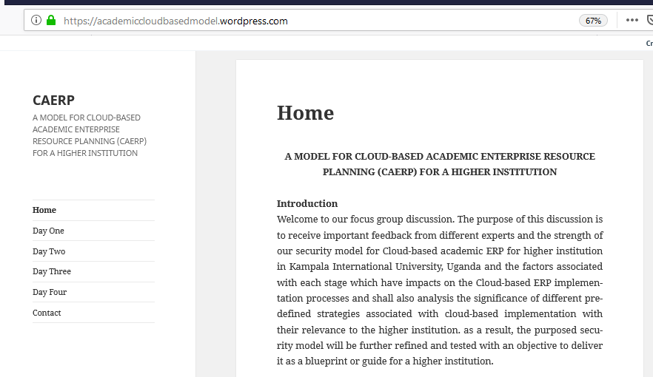
RESEARCH INSTRUMENT

Slide 18
FIELD DATA COLLECTION PLAN
OBJECTIVE ONE
The researcher interview five staffs in the ICT department, i.e., ICTD, SSA, NSA, DEO and HSA, the reason for selecting only the five staff is that they are the day to day management of the ERP in the institution.
OBJECTIVE TWO
The researcher used the interview to help know if the higher institution is aware of cloud computing, its benefits and if the institution is ready to migrate the current server-based ERP to cloud, this will help the researcher to know if the higher institution have the specialized staff to manage the cloud ERP after migration
The case study and observation was used to help review the existing research on cloud computing and its model which help the researcher to come up with the first security and privacy model and to identify the current hardware and software of cloud-based technologies.

Slide 19
FIELD DATA COLLECTION PLAN
OBJECTIVE THREE
The researcher designed a website with security future of hiding the website from an authorized person, only invited expert (Researchers in cloud computing, Data/Information Security, ERP designer) and was accepted to comment in the developed model; this process lasted for five days.
OBJECTIVE FOUR
The researcher used experimental method the demonstrate how to migrate from the server-based to cloud-based ERP without lost of data and also demonstrate how to secure the application in the cloud by using devexpress platform which has three modules (Desktop app, Mobile app and Web-based app) using virtual studio and SQL server as the back end of the application.

Slide 20
STUDY FINDINGS
OBJECTIVE ONE
Security and privacy challenges like hacking into the server to make changes to data/information (CIA).
Technical challenges, few technical staff, and power fluctuation which affect the server and information on demand.
The space on the server is becoming an issue to the university because of increase in data/information.
Crackers gaining access to one super or sub username and password mean it has it all.

Slide 21
STUDY FINDINGS
OBJECTIVE TWO
Yes, Kampala International University had a plan of migrating to the current ERP system to cloud-based but worried about the security and privacy in the cloud.
ERP server backs up itself using Random Array Independent Disks technology to back-up the data/information and offline technology.
This system has three-tier client-server architecture and comprises of the database server, an application server and presentation layer on the client side.
Requirement include a host to server to the database, network infrastructure for the various clients.

Slide 22
STUDY FINDINGS
OBJECTIVE THREE
The researcher discovered that there are two potential risk involved when moving from server-based to cloud-based which are security and privacy.
Security
Account & service traffic hijacking
Insecure Application Program Interface
Denial of service
Malicious insider
Multi-tendency environment
Data loss
Privacy
Data residency
Access
Law regulation
Data security
Data Breach
Contract termination

Slide 23
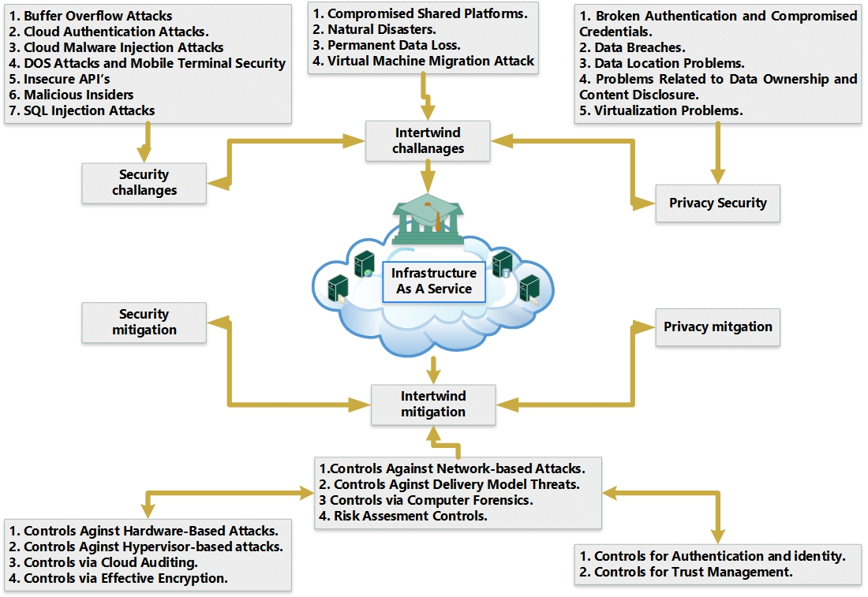
Security and Privacy Model For Cloud Based ERP

Slide 24
STUDY FINDINGS
OBJECTIVE FOUR
For any user to access the current LAN based ERP system, the following requirement must be meet i.e
For a user to access the current server-based ERP system he/she needs a laptop/desktop computer with at least 2GB RAM, dot net framework 4.0 and above, crystal reports and Microsoft window seven operation system and above.
The server configuration: HP ProLiant m1350p Gen 8 V2 (to LFF tower server, 16GB RAM, Intel Xeon E5-2697vz (2.7GHz/12 core/30mb/130w).
Deployment Models: On-Premise ERP, Hosted ERP and Cloud-based ERP.
Service models: IaaS, PaaS, and SaaS.
Deployment models, Public, Private, Community, and hybrid cloud.

Slide 25
RECOMMENDATIONS
OBJECTIVE ONE
The Study recommends that higher institution should migrate to cloud-based ERP, this will help in:
Reducing total cost of ownership
Increase flexibility in IT implementation
Competitiveness
Time to archive objective

Slide 26
RECOMMENDATIONS Cont.……
OBJECTIVE TWO
The study recommended that higher institution who have moved to the cloud should comply with the ISO27002 security standard i.e
Limit the data you collect
Limit the use of the PII (Personal Identifiable Information)
Set policies for retention
Set policies for destruction
Know where your data is store
Make someone accountable

Slide 27
RECOMMENDATIONS Cont.……
OBJECTIVE THREE
The study also recommends, Data Encryption and Data Tokenization when storing data in the cloud.
OBJECTIVE FOUR
The study recommends that IaaS should be adopted since both service provider and the client has roles to play in securing the cloud.
Simple and complex security strategy should be adopted when in the cloud.
Community cloud should be adopted which understand its client needs.

Slide 28
CONCLUSION
The higher institution should enlighten/educate staff and students on Cloud computing awareness, it security challenges, mitigation and should be made mandatory for them to appreciate the importance of utilizing cloud computing in improving performance.
The higher institution should provide a reliable power supply system (Solar and UPS), increase internet bandwidth adequately and the time to enable good respond time of the cloud-based ERP.

Slide 29
AREA OF FURTHER STUDIES
This research focuses on security and privacy in the cloud; also on how to successfully migrate from server-based ERP to cloud-based ERP using Devexpress platform to demonstrate in a higher institution, this can also be extended by using more than one universities as a case study
The content scope can also be explored by looking at Cyberlaw and policies which guide both the service provider and the client.

Slide 30
CONTRIBUTION TO KNOWLEDGE
This work has contribute to knowledge in the following ways:-
This research has created awareness and help service providers to start thinking of higher institution when designing IaaS a service by using the designed model
This research has helped both students and lecturers for on-demand services to make teaching, learning, research easier, collaborate, and share information online.
The technology provides the students with flexibility, accessibility, and portability of educational materials anytime and anywhere.
The research had provided up to date knowledge to people who are interested in security and privacy challenges and mitigation in the cloud

Slide 31
CONTRIBUTION TO KNOWLEDGE Cont….
This work has contribute to knowledge in the following ways:-
This research has help Decision-makers, staff (academic and non-academic) and students who have interest and are concerned with data and information security.
This research has contributed to knowledge serving as a guide on how a higher institution can protect both security and data privacy with little or no cost compared to the existing server-based system.
This research has created awareness of the adoption of cloud computing applications and provides the basis for secured ERP systems for higher education institutions.

Slide 32
REFERENCE
Alzaid, E. A. J., & Albazzaz, E. J. M. (2013). Cloud computing: An overview. International Journal of Advanced Research in Computer and Communication Engineering, 2(9), 3522-3525.
AlCattan, R. F. (2014). Integration of cloud computing and web 2.0 collaboration technologies in E-learning. International Journal of Computer Trends and Technology, 12(1), 46-55.
Benton, D., & Negm, W. (2010). Banking on the cloud. Retrieved from https://www.finextra.com/finextradownloads/featuredocs/accenture_banking_cloud_computing.pdf
Murphy, “ERP: The Once and Future King of Campus Computing,” in Campus Technology, Syllabus Media Group, 2016. http://www.campustechnology.com/articles/2016/01/erp-the-once-and-future-king-of-campus-computing.aspx Accessed: 20th February 2018

