Slide 1
What Should an Intelligent Analytics Tool Deliver?
By the end of the hackathon, each team will deliver:
A functional prototype of an intelligent analytics tool that:
Processes real data
NLQ interface for advanced analytics
Applies intelligent techniques (forecasting, clustering, anomaly detection, NLP, or XAI….)
Provides clear, interactive and automated insights
A live, functional demo that:
Evidence of engineering rigor:
Shows the tool in action
Walks through key features and user interactions
Validates results
Highlights the intelligent component (prediction, pattern detection, automation…)
Clean, documented code
15 minute pitch that explains what the
tool does, for whom and how it works.
The goal is not a production-ready product but a smart, working proof of concept that showcases innovation, analytical depth, and technical excellence.

Slide 2
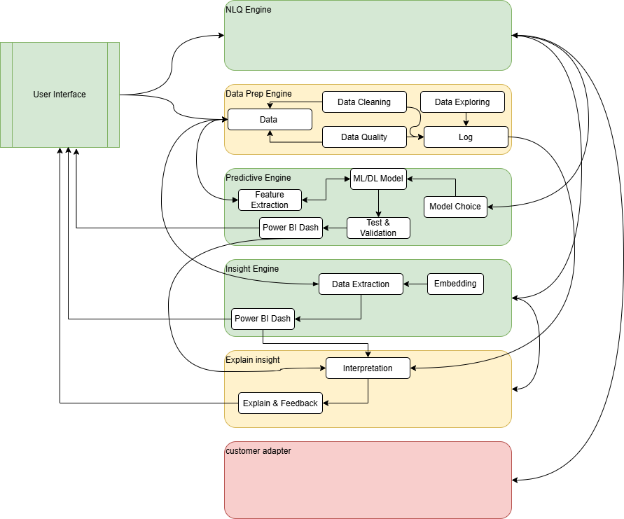
What Should the Target Architecture Look Like?
Must
Nice to have
Bonus ++

Slide 3








What Technologies You May Use?

Slide 4



What Methodology Will Guide Your Work?
Ideation & Squad Formation
Generate and share creative ideas
Evaluate and prioritize features
Form squads by aligning skills
Define initial goals & responsibilities
Conception & Prototyping
Translate ideas into concrete concept & design
Build quick prototypes to visualize solution
Create a development plan to guide the next implementation steps
Why Agile Scrum
A hackathon is an intensive innovation sprint. Scrum helps teams to deliver fast, learn, adapt, and collaborate.
The Scrum Pillars
Transparency : Clear visibility of work, goals, and progress.
Inspection : regular review of the product and process.
Adaptation : quick adjustments for continuous improvement.
Sprint Planning
Review the Backlog and select items
Define the Sprint Goal and clarify priorities
Breakdown items into tasks and estimate effort
Define a plan how to achieve the objectives
Daily Meeting
Session of 15 to 30 min to say focused
What did I do yesterday ? What will I do Today
Highlight any obstacles affecting progress
Catch-up
30 min at the end of the day
Share completed work and key realizations
Gather feedback from experts
Adjust plans of priorities
Sprint Review
Demo completed work to stakeholders
Review successes and challenges
Collect feedback & suggestions
Update backlog and plan next steps

