Slide 1
Project Presentation
Course: AE 581
Title: Simulations of a Front-Wheel Bicycle/Robot Drive
By: Ibrahim Aljalal

Slide 2
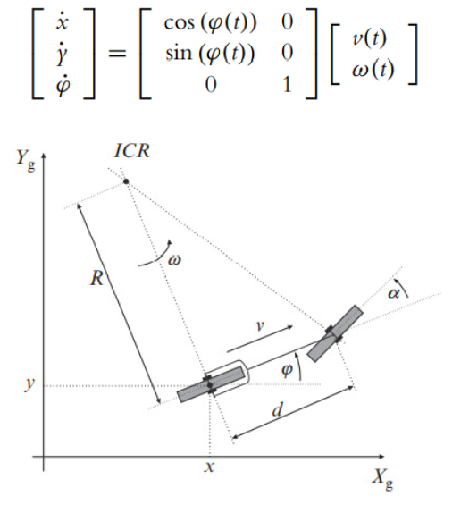
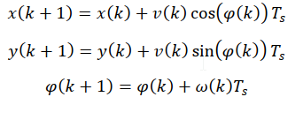

Problem Specifications
Given: v(t)=r*ωs(t)*cos(α(t)), ω(t)=(r*ωs(t))/d*sin(α(t))
r= 2 cm, d= 15 cm, real φ(t) is incremented by 1 degree
Inputs: $ω_{s}\left(t\right) and α(t)$

Slide 3
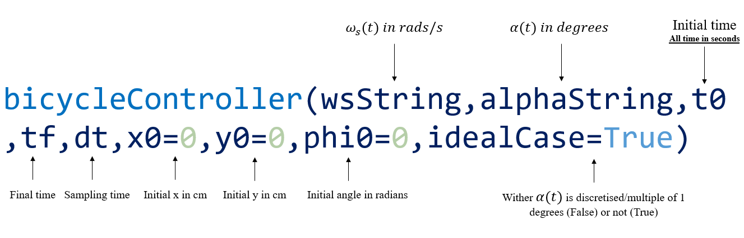
Project Main Function Input

Slide 4
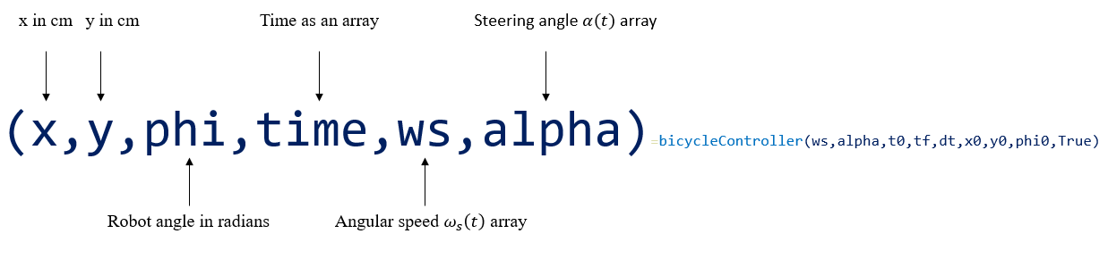
Project Main Function Output

Slide 5
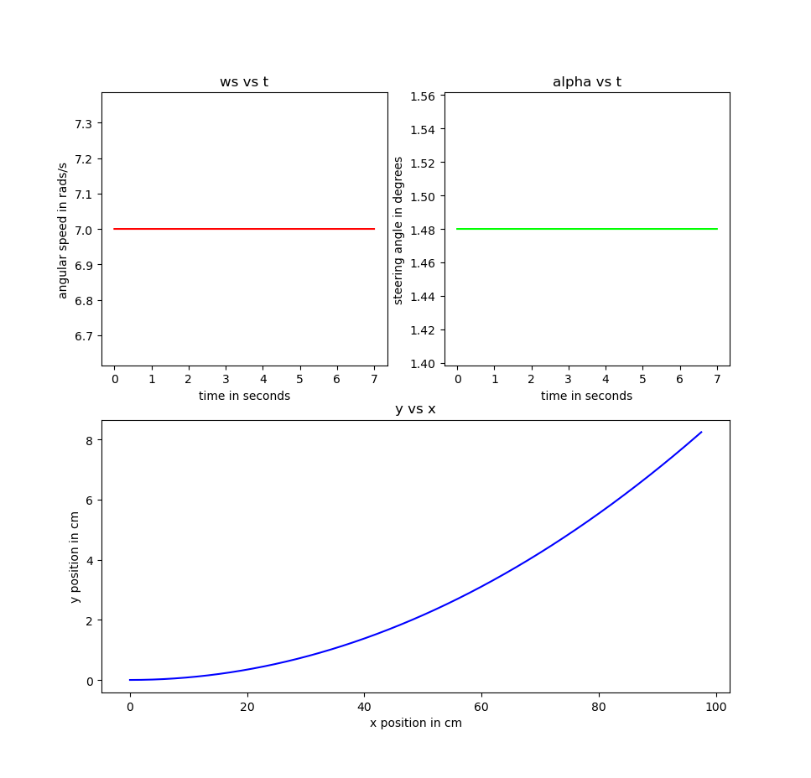
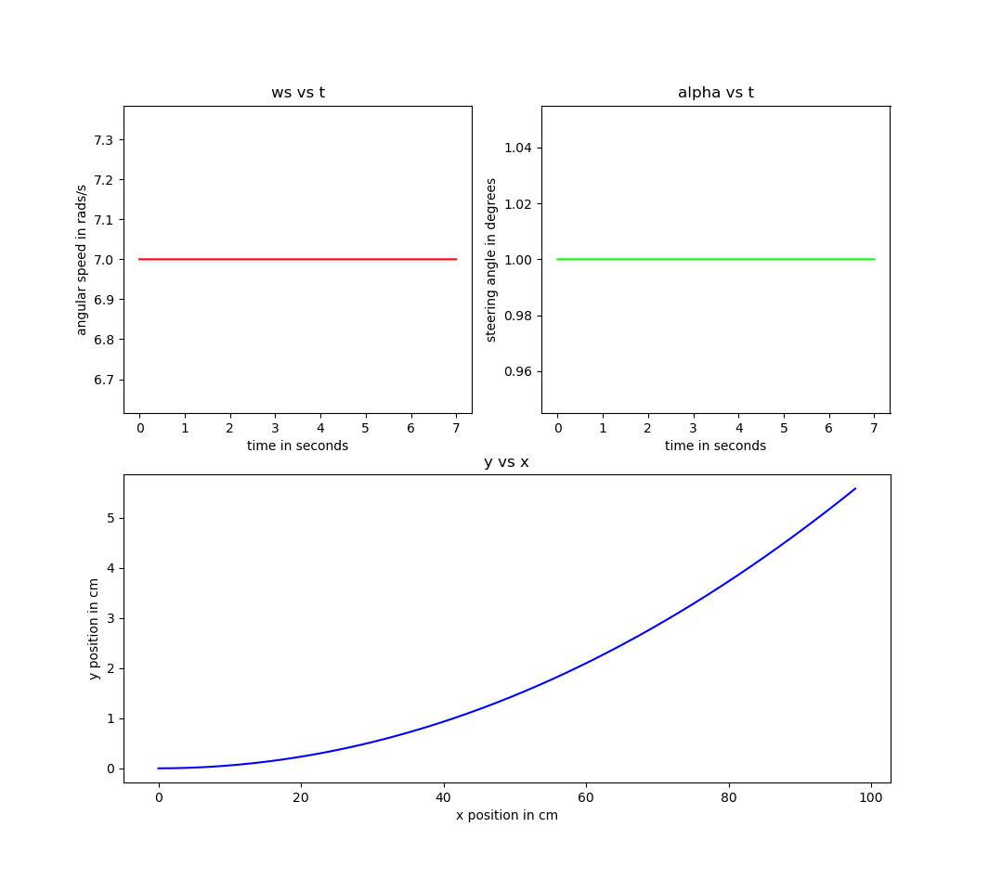

Results for $ω_{s}\left(t\right)="7" and$ $α\left(t\right)="1.48"$
Ideal Case
Real Case

Slide 6
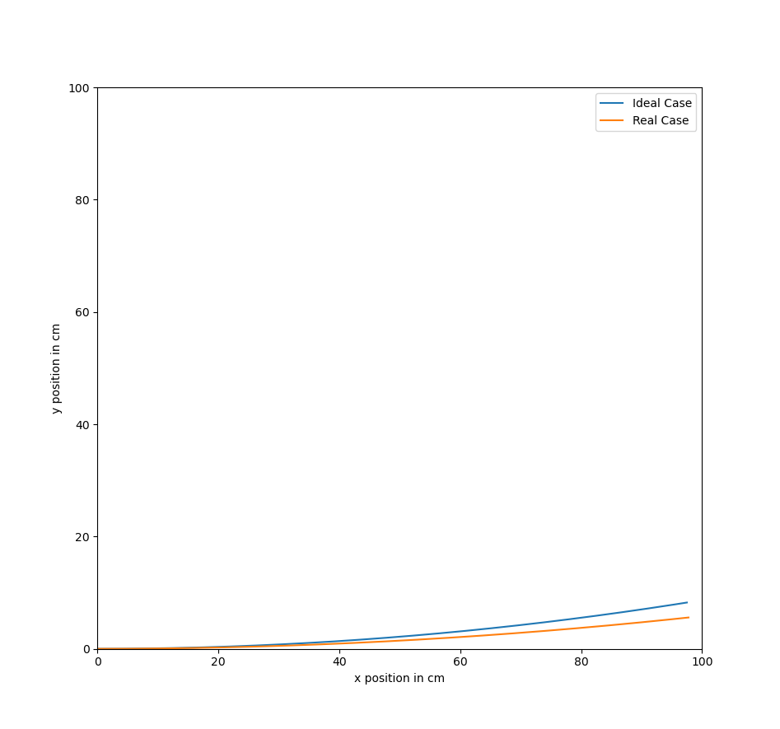
Results for $ω_{s}\left(t\right)="7" and$ $α\left(t\right)="1.48"$
Ideal Case vs Real Case
The difference between the ideal and actual final positions
is 2.68 cm.

Slide 7
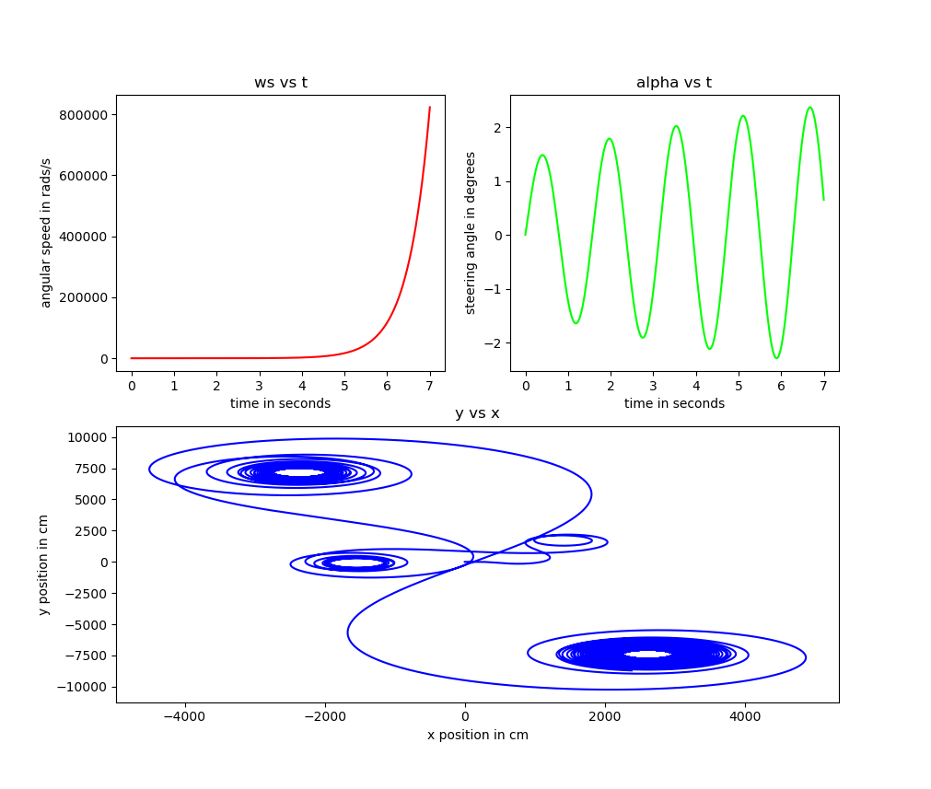
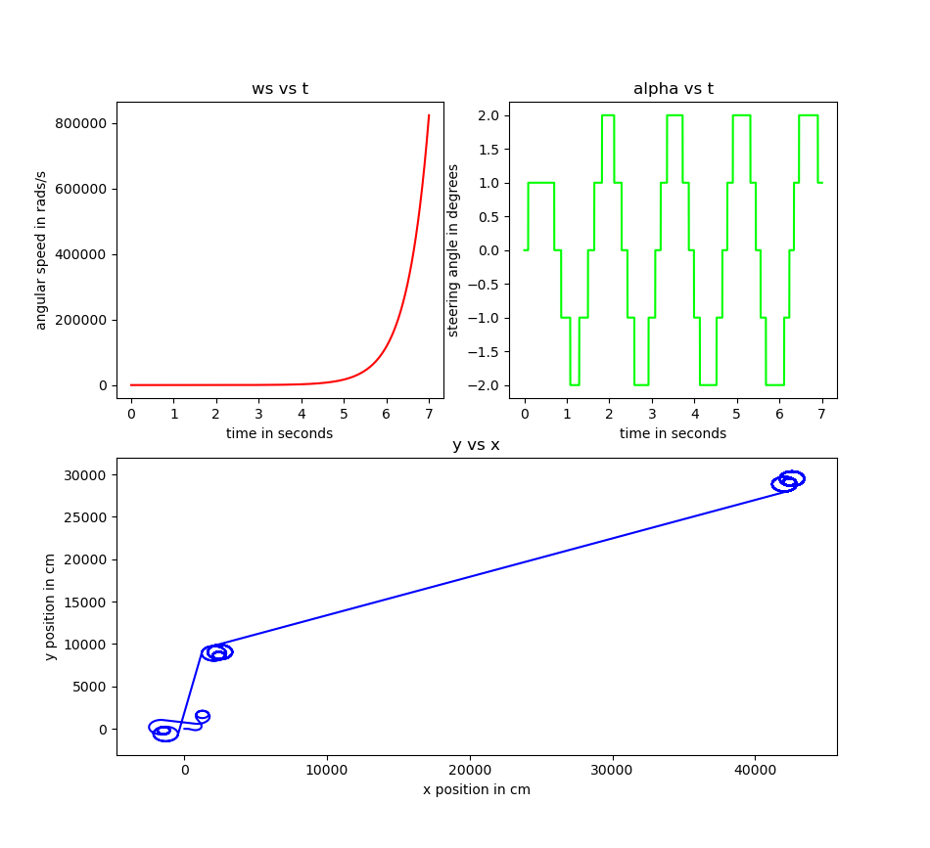
Results for $ω_{s}\left(t\right)="7∗∗t" and$ $α\left(t\right)="log(t+4)∗sin(4∗t)"$
Ideal case
Real Case Ideal case

Slide 8
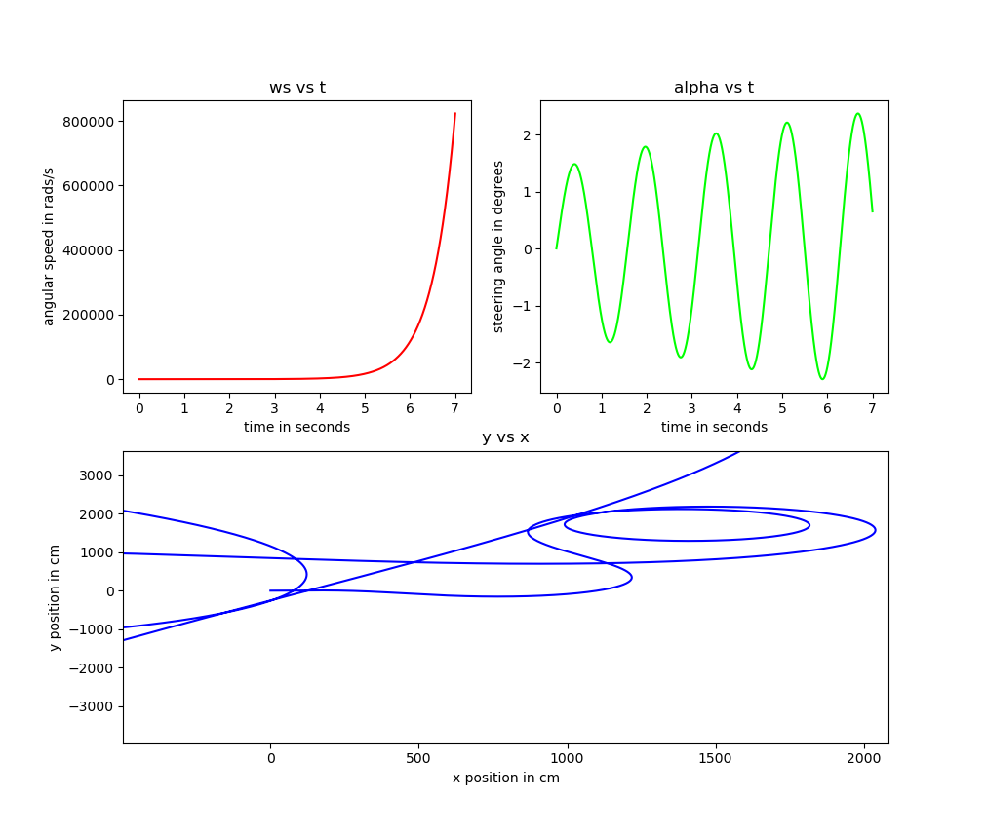
Results for $ω_{s}\left(t\right)="7∗∗t" and$ $α\left(t\right)="log(t+4)∗sin(4∗t)"$
Ideal case (zoomed at the starting point)
Real Case Ideal case (zoomed at the starting point)

Slide 9
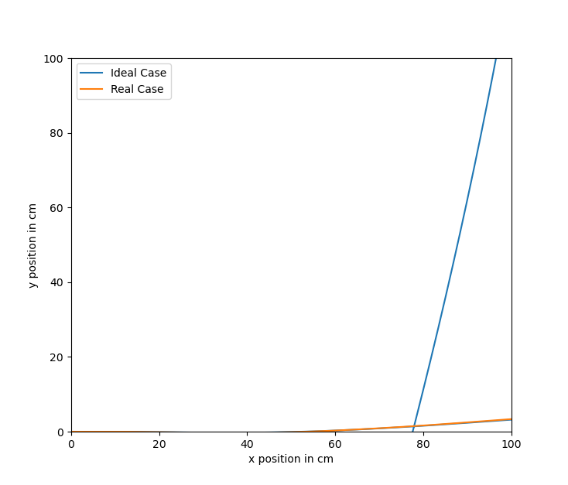
Results for $ω_{s}\left(t\right)="7∗∗t" and$ $α\left(t\right)="log(t+4)∗sin(4∗t)"$
Ideal Case vs Real Case
The difference between the ideal and actual final positions
is 54664.73 cm.

Slide 10


AE581.exe File
QR Code:
Or URL:
https://drive.google.com/drive/folders/1TVt0TEHlBd1e0lPAyhht08lNzCN3sauv?usp=sharing

Slide 11

AE581.mkv 3D simulation (in Blender software)
QR Code:
Or URL:
https://drive.google.com/drive/folders/1EbIEYm7_R0kmDSTeHw1_qPPw-3BGzfxD?usp=sharing

Slide 12
References
1-https://www.iconarchive.com/show/matrilineare-icons-by-sora-meliae/Mimes-image-x-ico-icon.html
2- https://www.youtube.com/user/schafer5
3- https://www.youtube.com/user/sentdex
4-https://www.youtube.com/watch?v=UZX5kH72Yx4
5- https://www.blender.org/

