Slide 1
Reinforcement Learning for Autonomous Intersection Management (AIM)
ITS Research Team
Quarter
2 October 2025
Team Members:
Kazi Shakkhar Rahman
Ibrahima Mamadou
Muntasir Hossain

Slide 2
Motivation
ITS Research Team
DRL Based AIM
“Intersections = Bottlenecks of traffic flow”
“Rule-based → brittle in unseen cases”
“RL → learns adaptive, safe policies”

Slide 3
Why AIM Matters
ITS Research Team
DRL Based AIM
Safety (avoiding collisions)
Efficiency (reducing delay)
Scalability (handling mixed traffic)

Slide 4
Paper 1: 2018 – Navigating Occluded Intersections with Deep RL
ITS Research Team
DRL Based AIM
Contributions
RL effective for AIM → better than heuristics
RL agents adapt in unforeseen scenarios

Slide 5
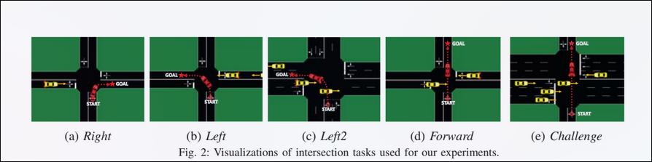
Experiment Scenario
ITS Research Team
DRL Based AIM
T-intersection setting
5 maneuvers:
Turn Right
Turn Left (single lane)
Turn Left (double lane)
Go Straight
Go Straight (multi-lane, heavy traffic)

Slide 6
State Space
ITS Research Team
DRL Based AIM
DQN Time-to-Go: 18×26 grid
DQN Sequential: 5×11 grid

Slide 7
Action Space
ITS Research Team
DRL Based AIM
DQN Time to Go
A = {Wait, Go}
DQN Sequential
A = { Accelerate, Decelerate, Constant Velocity}

Slide 8
Reward & Algorithm
ITS Research Team
DRL Based AIM
Reward function:
+1 (success)
−10 (collision)
−0.01 (step cost)
Algorithm: Standard DQN

Slide 9
Paper 2: 2019 – DCL-AIM: Decentralized Coordination Learning
ITS Research Team
DRL Based AIM
Contributions
Multi-agent RL for AIM
Coordinated + independent decision making

Slide 10
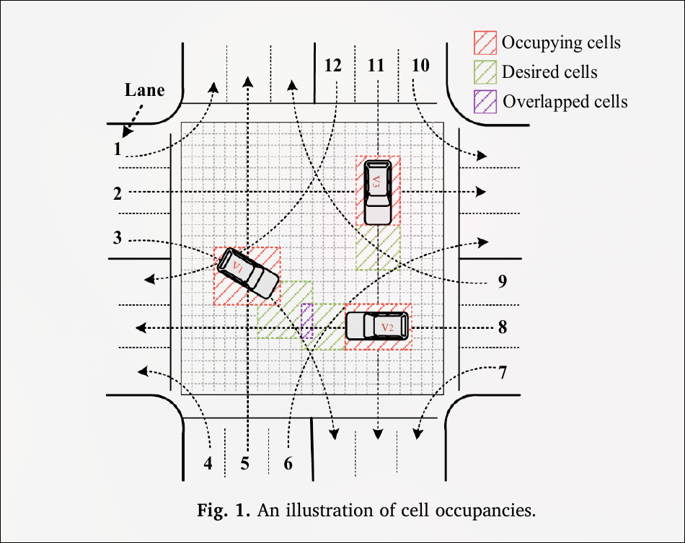
State Representation
ITS Research Team
DRL Based AIM
Vehicle → reserved grid cells
Faster cars = more reserved cells
Number of reserved cells ∝ vehicle speed

Slide 11
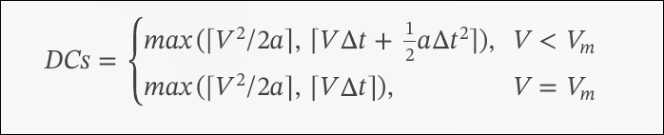
State Representation
ITS Research Team
DRL Based AIM

Slide 12
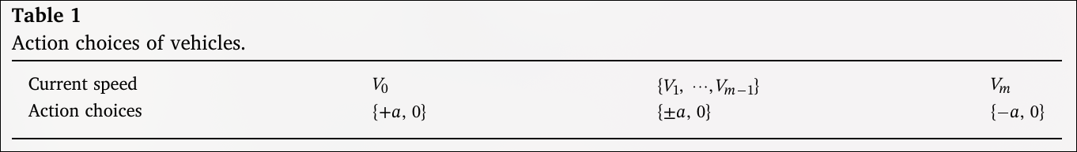
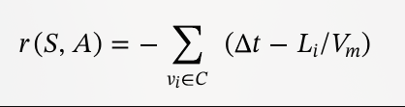
Action & Reward
ITS Research Team
DRL Based AIM

Slide 13
Algorithm
ITS Research Team
DRL Based AIM
New algorithm: DCL-AIM (Q-learning variant)
Dual Q-table:
Independent Q-table → when vehicles act alone
Joint Q-table → when coordination needed

Slide 14
Paper 3: 2020 – Multi-Task RL for Unsignalized Intersections
ITS Research Team
DRL Based AIM
Contributions
Unified RL framework for all navigation tasks
Handles Left, Right, Straight in one model

Slide 15
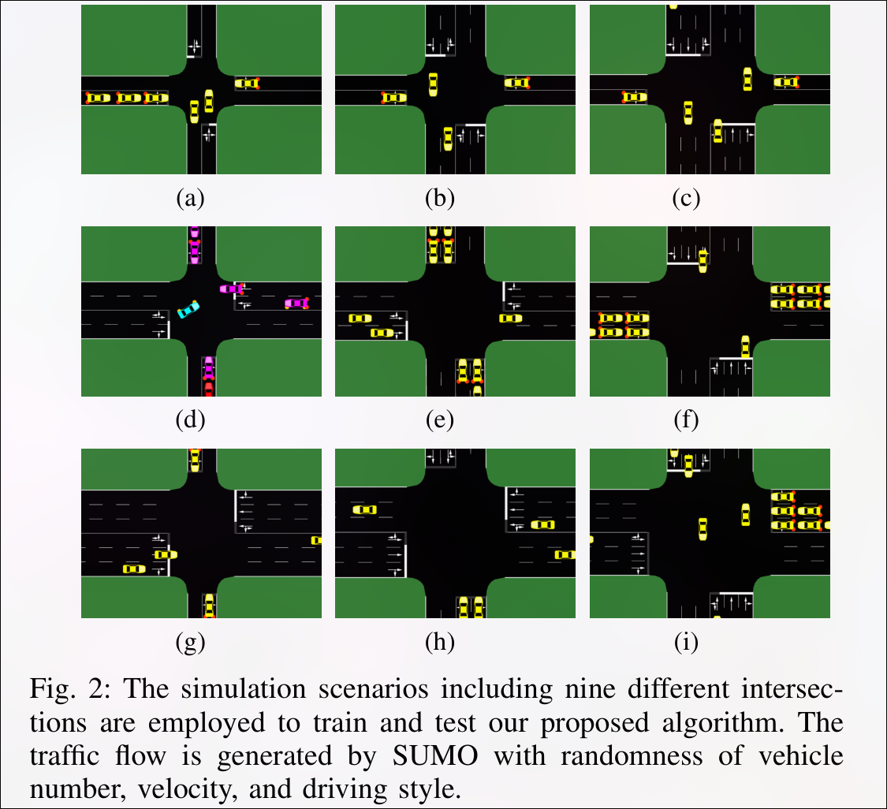
Experiment Scenario
ITS Research Team
DRL Based AIM
Video Link: https://youtu.be/S7HDtlQt73E

Slide 16
Task Representation
ITS Research Team
DRL Based AIM
Task vector: G = [gl, gr, gs, gc]
gl = Left turn
gr = Right turn
gs = Straight
gc = common task: minimize delay (always 1)

Slide 17
State Space
ITS Research Team
DRL Based AIM
Ego vehicle state: Ve
Surroundings: 5 nearest vehicles
Each Si = [Xi, Yi, Vi, cosθi, sinθi]

Slide 18
Action Space & Reward
ITS Research Team
DRL Based AIM
Actions: {0, 3, 6, 9 m/s}
Reward function:
+50 (success)
−500 (collision)
−0.15 (step cost)

Slide 19
Algorithm
ITS Research Team
DRL Based AIM
Multi-task DQN
Learns across tasks simultaneously

Slide 20
Paper 4: Deep Reinforcement Learning for Autonomous Vehicles at Unsignalized Intersections
ITS Research Team
DRL Based AIM
Contributions:
POSG formulation of multi-CAV navigation
Proposed CMAPPO Algorithm
Simulations with SUMO → improved coordination

Slide 21
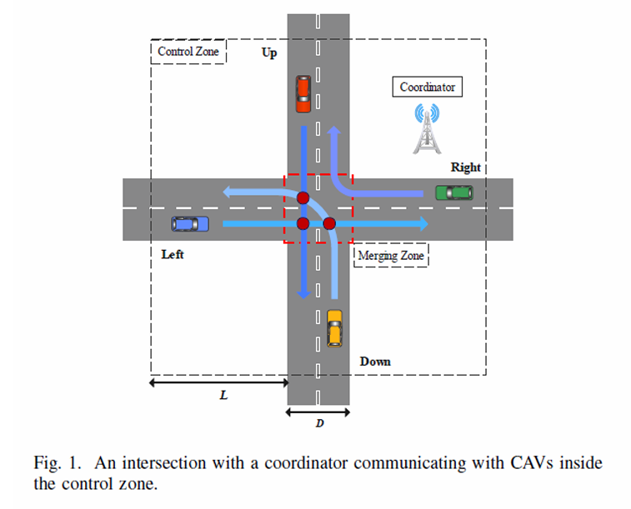
Experiment Setup
ITS Research Team
DRL Based AIM
4-way unsignalized intersection
Vehicles: left, right, straight
Decision-making via V2V communication

Slide 22
Decision Framework
ITS Research Team
DRL Based AIM
Hierarchical controller
High-level: RL-based decision
Low-level: Tracking + Lateral control

Slide 23
Reward Design
ITS Research Team
DRL Based AIM
Efficiency: Minimize delay
Comfort: Smooth acceleration
Terminal: Success / Collision / End

Slide 24
Algorithm
ITS Research Team
DRL Based AIM
Cooperative Multi-agent PPO (CMAPPO)
Centralized training, decentralized execution
Uses GAE + Adam optimizer (LR=0.0001)

Slide 25
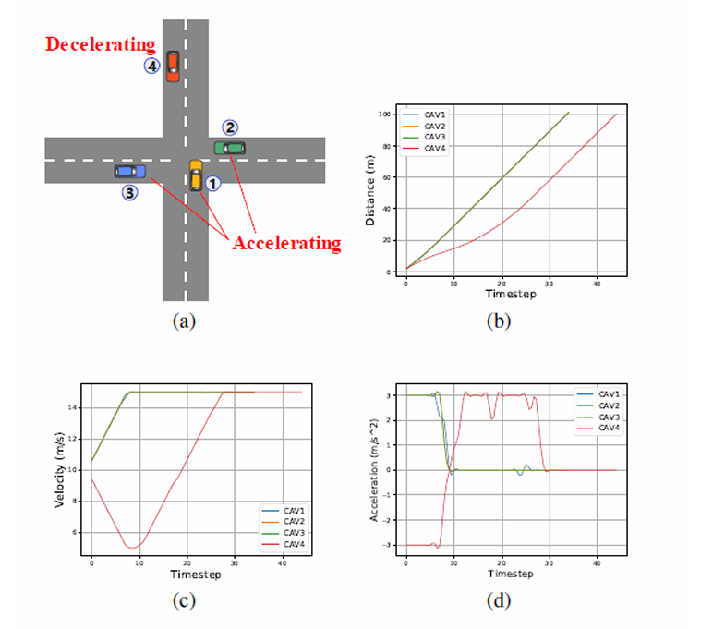
Results
ITS Research Team
DRL Based AIM
Improved efficiency & coordination
Reduced collisions

