Slide 1
Cyclistic case-study : How can bike-sharing improve?
Ibrahim Ayman
Feb/2024

Slide 2
Background
In 2016, Cyclistic launched a successful bike-share offering. Since then, the program has grown to a fleet of 5,824 bicycles that are geo-tracked and locked into a network of 692 stations across Chicago. The bikes can be unlocked from one station and returned to any other station in the system anytime
There are two types of users casual riders and members with annual subscriptions , The marketing team believes that maximizing the number of annual members is the key to future growth

Slide 3
Problem
What is the best way to convert casual riders into annual riders?
How do annual riders and casual riders use Cyclistic bikes differently?

Slide 4
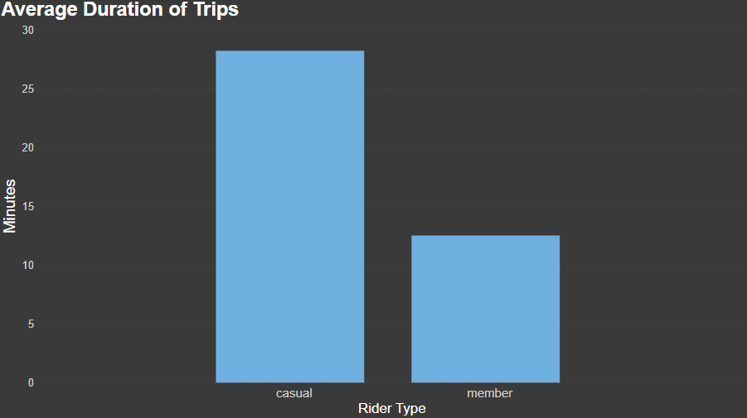
Key Findings:
- Casual riders tend to have longer trips than annual members

Slide 5
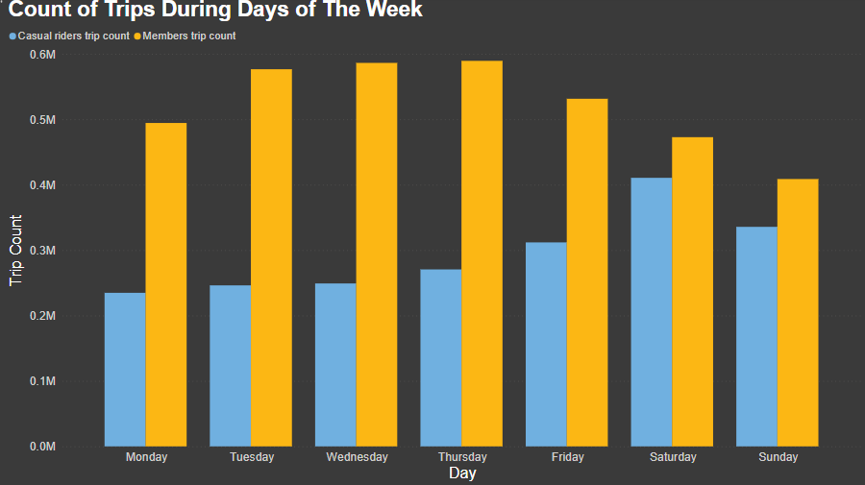
Key Findings:
- Casual riders tend to have longer trips than annual members
- Casual riders have higher trip count in the weekends than the rest of the week while annual members ride more in the middle of the week

Slide 6
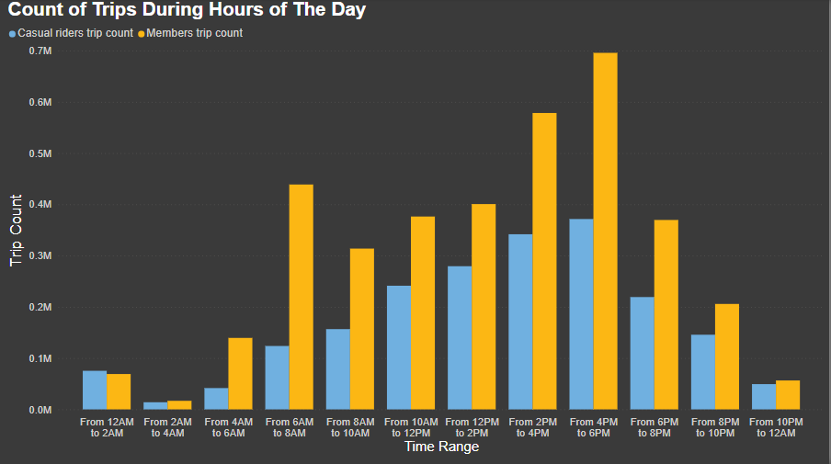
Key Findings:
- Casual riders tend to have longer trips than annual members
- Casual riders have higher trip count in the weekends than the rest of the week while annual members ride more in the middle of the week
- Both casual riders and annual members ride the most in the middle of the day before the evening

Slide 7
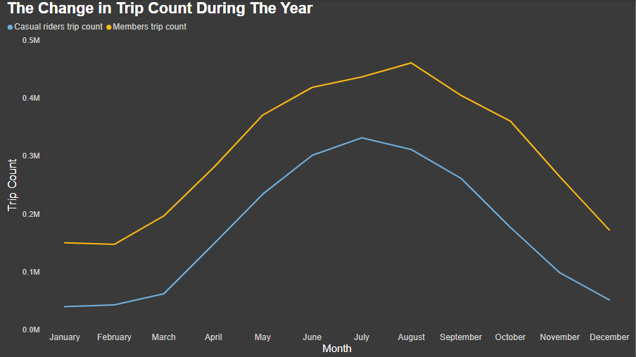
Key Findings:
- Casual riders tend to have longer trips than annual members
- Casual riders have higher trip count in the weekends than the rest of the week while annual members ride more in the middle of the week
- Both casual riders and annual members ride the most in the middle of the day before the evening
- Both casual riders and annual members ride the most during summer time in Chicago

Slide 8
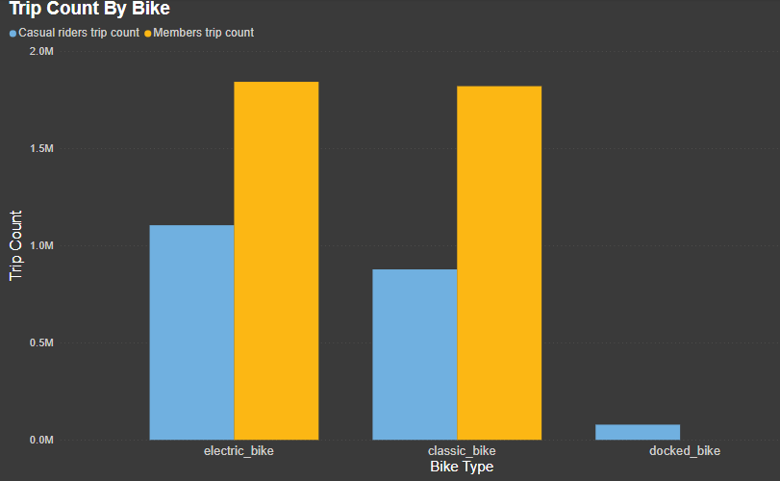
Key Findings:
- Casual riders tend to have longer trips than annual members
- Casual riders have higher trip count in the weekends than the rest of the week while annual members ride more in the middle of the week
- Both casual riders and annual members ride the most in the middle of the day before the evening
- Both casual riders and annual members ride the most during summer time in Chicago
- Casual riders have slightly more rides with electric bikes than classic bikes while members have nearly equal number of rides using both

Slide 9
Recommendations
Introducing plans that may be interesting for casual riders during the summer-time. The marketing for these plans should be done in the winter.
Introducing plans that cover just the weekends with lower prices than other plans.
Introducing plans that cover only electric bikes with lower prices as it is more in-demand

Slide 10
Sources
Data Source
Jan 2023 – Dec 2023 Bike Trips- Divvy
https://divvy-tripdata.s3.amazonaws.com/index.html

