Slide 1
Android-Based Serious Game for Pre-Screening of Parkinson Disease
Ibrahim Azam
FA13-BCS-093
Moiz Imran
FA13-BCS-080
Supervisor:
Prof. Dr. Muaz A. Niazi

Slide 2
Summary
Parkinson Disease is a Progressive neurological disorder.
There are no accurate medical tests (invasive test) or applications available for detection of Parkinson Disease.
Our Application provides non-invasive Static Spiral test, Dynamic Spiral test and Balance test to detect Parkinson Disease which provides a pre-checkup to the user before referring to the doctor
It will be helpful for research papers and research groups of Parkinson Disease. It will be uploaded on Google Play Store after testing and verifying the application from neurologists/doctors.

Slide 3
Introduction
Proposed system will diagnose Parkinson’s disease
Proposed Solution
Technique / Test’s:
Android Application
Static Spiral Test
Dynamic Spiral Test
Balance Test

Slide 4
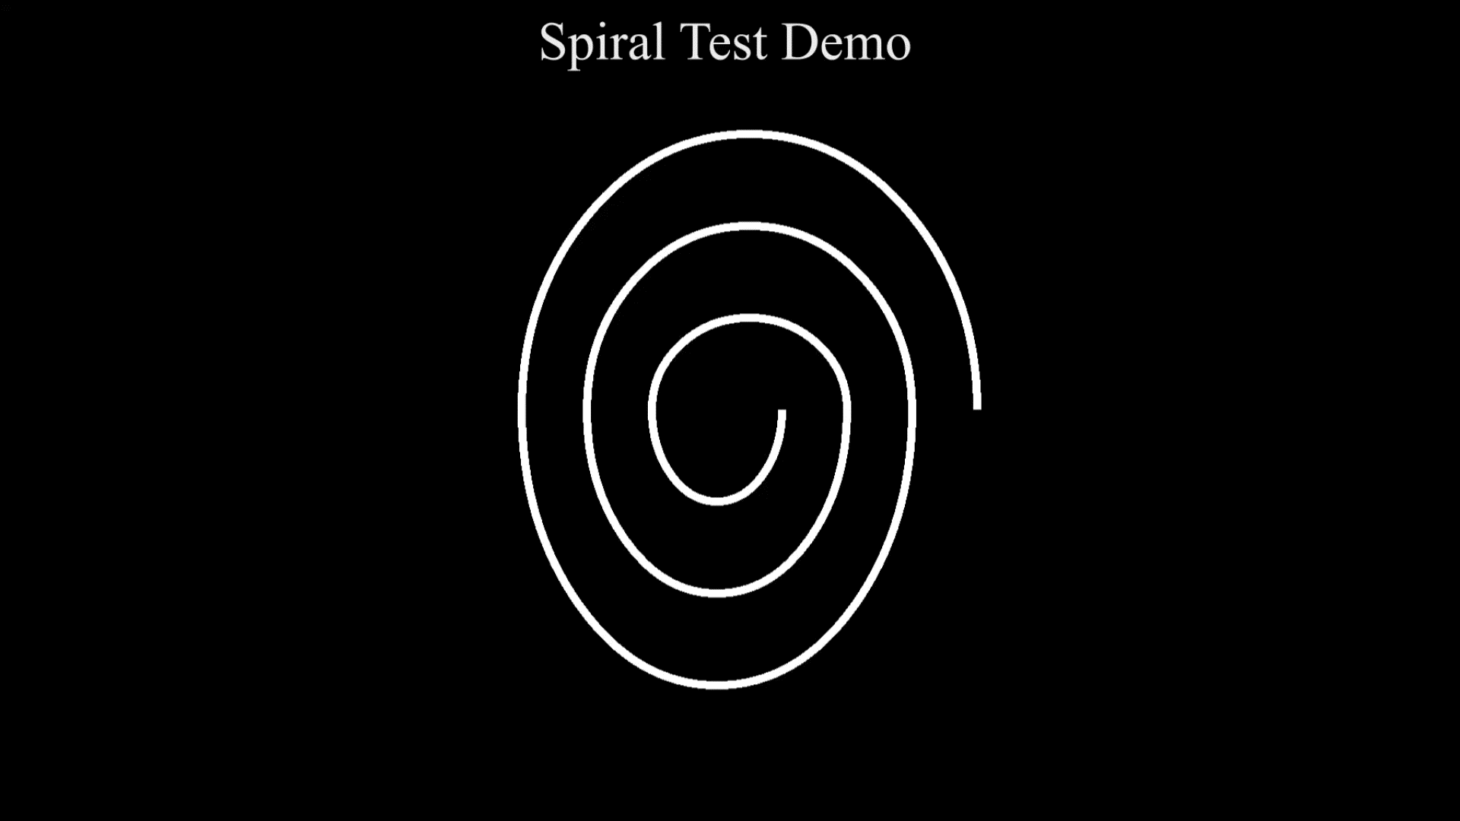
BACK

Slide 5
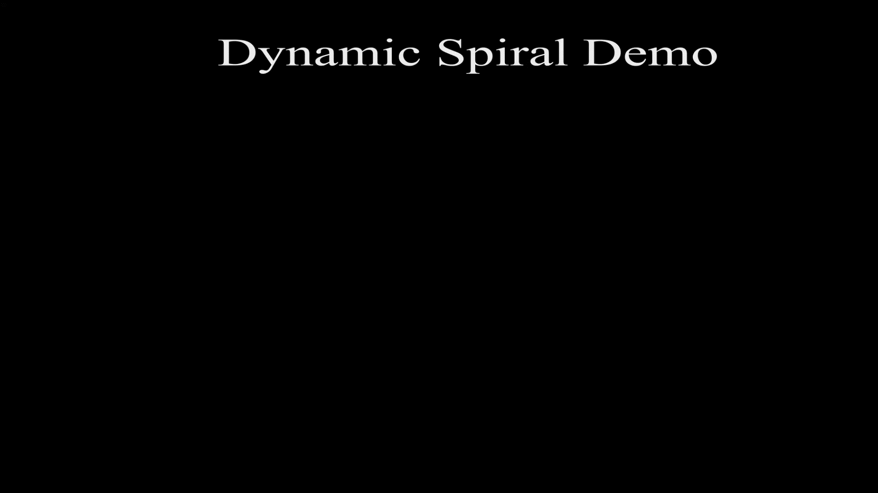
BACK

Slide 6
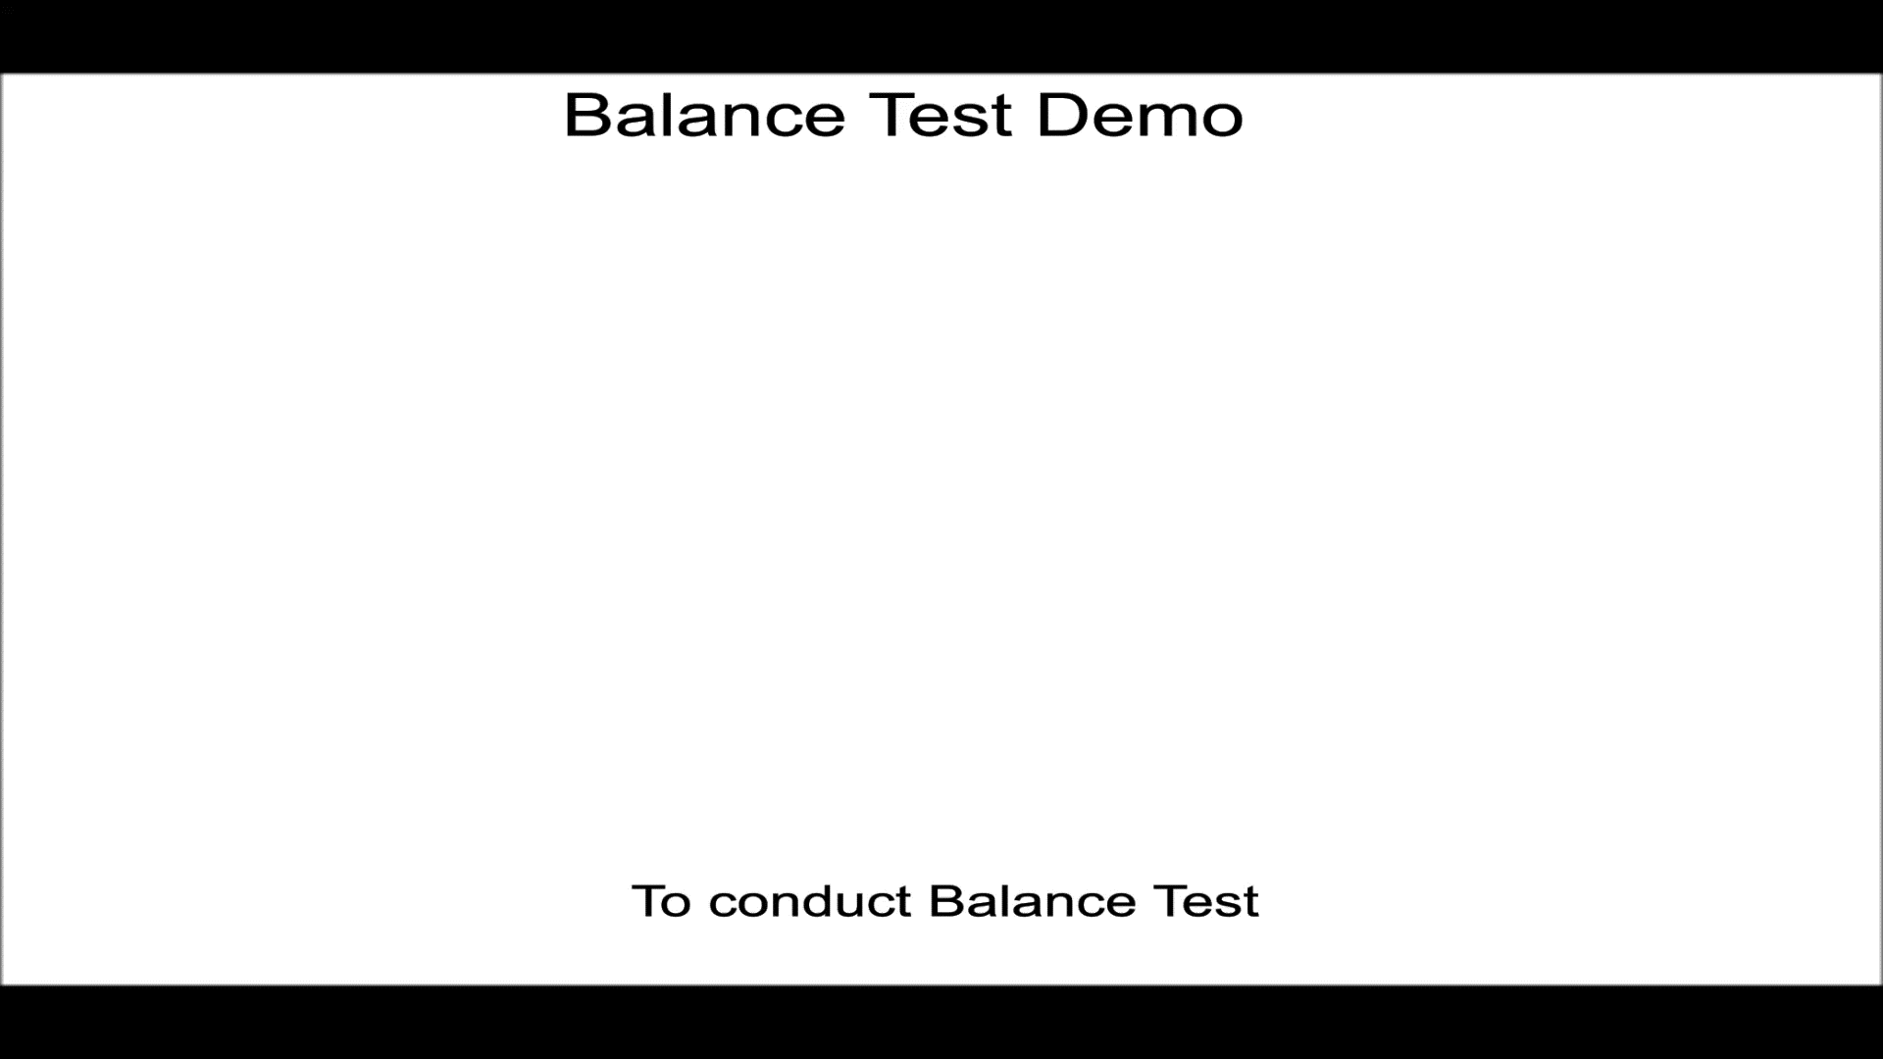
BACK

Slide 7
Introduction
Admin Portal
Admin will be able to view:
Total number of users registered
Total number of Parkinson and non Parkinson users
Insert User
User’s information
Delete User

Slide 8
Introduction
Research Portal
The research portal meant to be used by researchers and scientists
Users can access:
Total number of users (Age wise, Gender wise, Country wise and monthly reports)
Total number of users with Parkinson disease (Age wise, Gender wise, Country wise and monthly reports)
Total number of users without Parkinson disease (Age wise, Gender wise, Country wise and monthly reports)

Slide 9
Modules of the Project
Module 1: Android Application
Module 2: Data Analytics Portal
Module 3: Admin Web Portal
Module 4: Data Collection Web service
Module 5: Database
Module 6: Data Analytics Web service

Slide 10
Introduction
Tools and Technologies
Tool Name | Tool Description
Android Studio | To develop Android Application
Visual Studio 2015 | To develop Web Portals
Flask | To create web server for spiral tests
PyCharm | To build Python code for AI and Machine Learning
Adobe After Effects | To create test demos (animations)

Slide 11
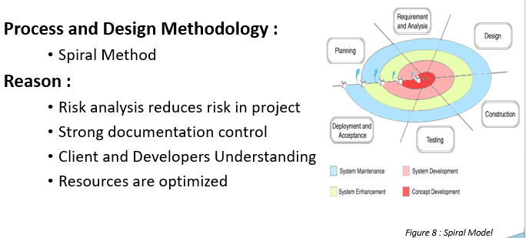
Design Methodology

Slide 12
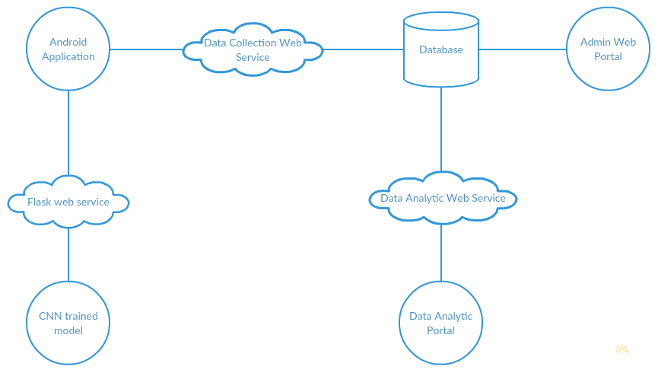
System Block Diagram
Figure 1: Module Diagram

Slide 13
Use Case Diagram

Slide 14
Data Representation

Slide 15
Class Diagram

Slide 16
Algorithm & Implementation
Convolutional Neural Network
Convolutional layer
Pooling Layer
ReLU Layer
Fully Connected Layer
Linear Regression
Thershold=Math.sqrt((avgX*avgX)+(avgY*avgY)+(avgZ*avgZ))

Slide 17
DEMO 100 %

Slide 18
Question and Answers

Slide 19
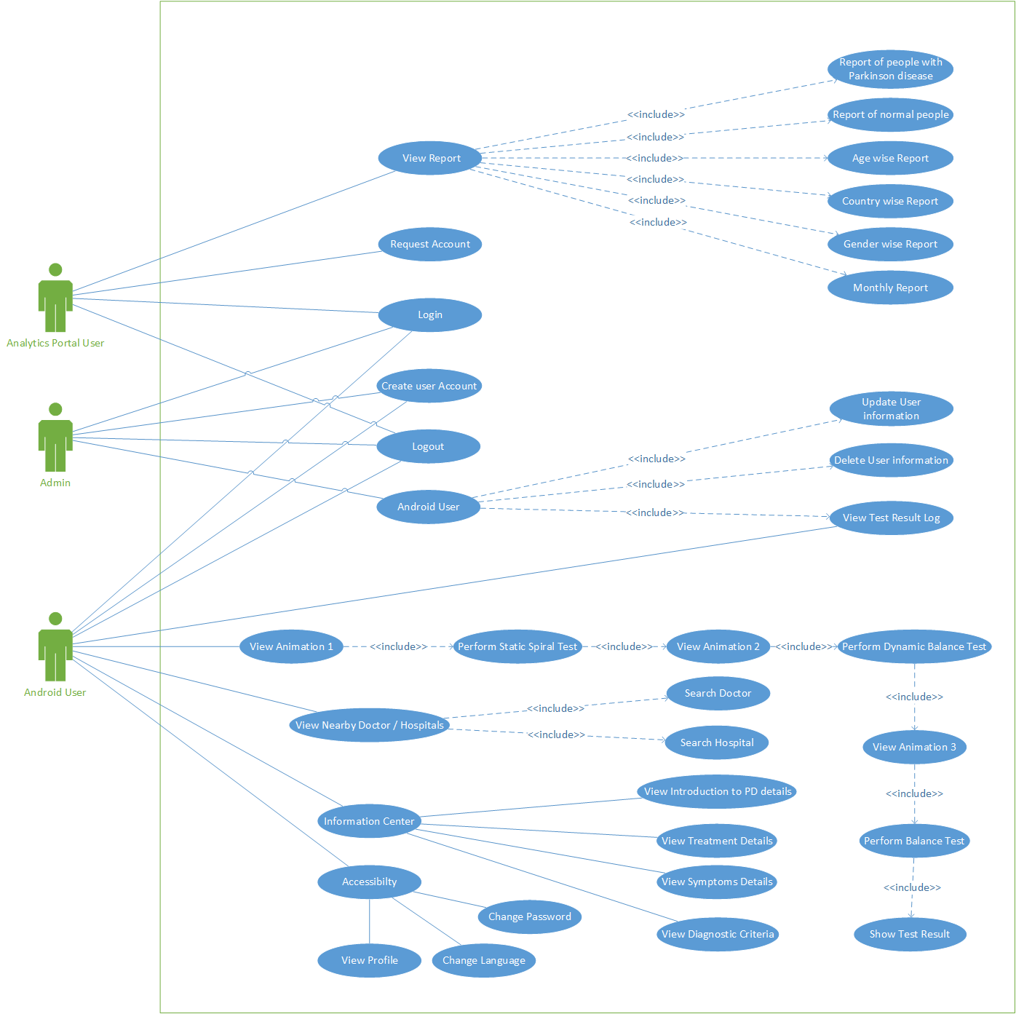

Slide 20
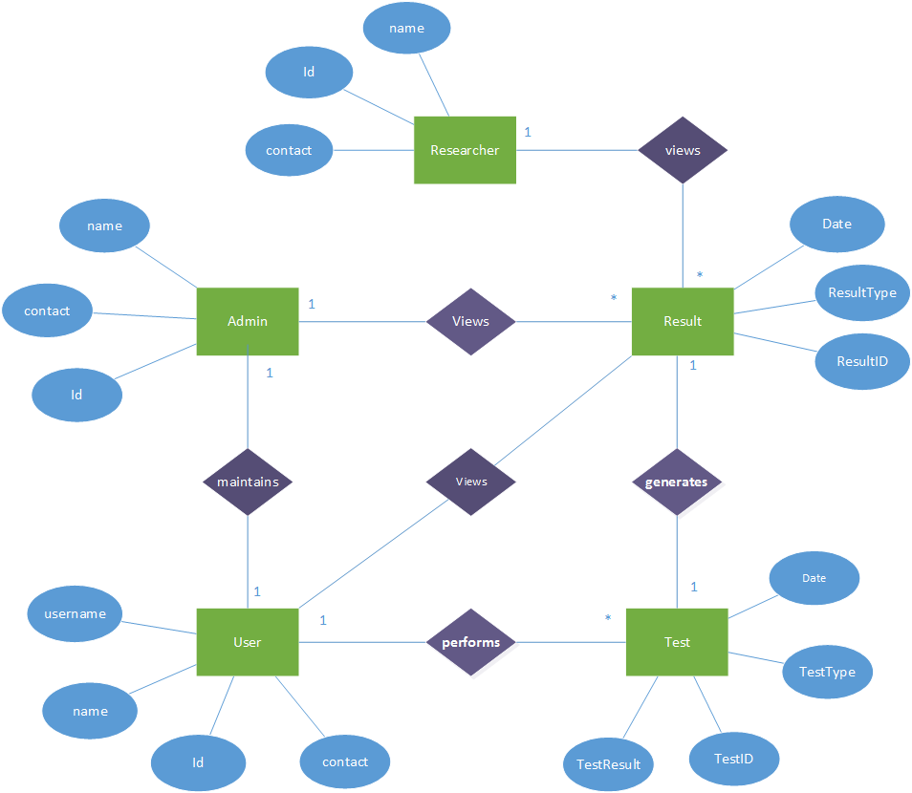

Slide 21
