Slide 1



DATA STRUCTURES & ALGORITHMS
SMART METRO NETWORK SYSTEM: AUTOCOMPLETE & INFRASTRUCTURE OPTIMIZATION
Team Members
  Ibrahim Aziz - BSCE24027
  Kashif Saeed - BSCE24029
  Abdur Rabb - BSCE24003

Slide 2




PROBLEM STATEMENT & MOTIVATION
  Problem 1 (User Experience): Commuters need fast, error-tolerant station search and autocompletion while typing.
  Problem 2 (Network Planning): Transit authorities need to connect all metro stations with the minimum track distance to reduce layout cost.
  Solution: A unified system combining a Trie Time complexity of O(N) prefix search and Kruskal's Algorithm Time Complexity for O(NlogN) optimal network coverage.

Slide 3


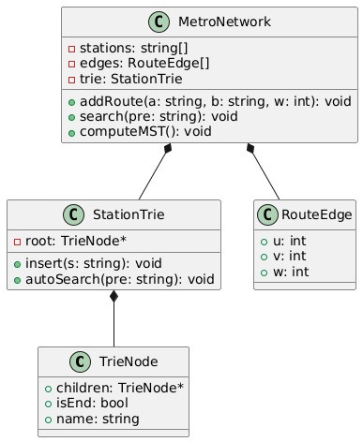
OUR UML DIAGRAM
EXPLAINED
MetroNetwork → Main controller
Stores stations, routes, and search structure
Functions: add routes, search stations, compute MST
StationTrie → Fast station name search
Root node of trie
Functions: insert names, autocomplete search
RouteEdge → Represents a route
Start station (u), end station (v), weight (w)
TrieNode → Building block of search
Children links, end marker, station name
Relationships
MetroNetwork uses RouteEdge (routes) + StationTrie (search)
StationTrie is built from TrieNodes

Slide 4
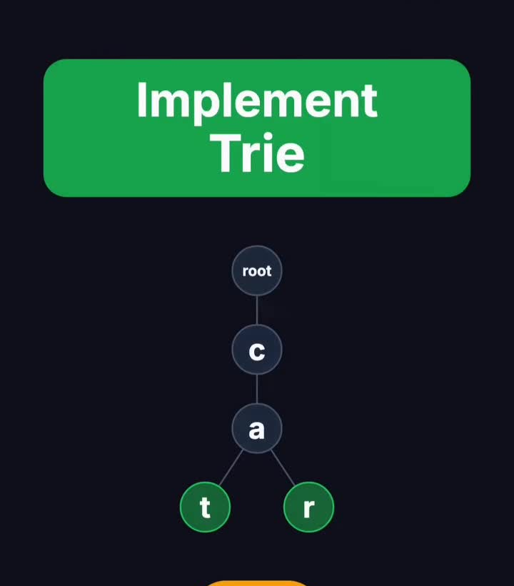
ALGORITHM - 1
VIDEO ANIMATION
TRIE
ALGORITHM
Insert station names character by character into a tree structure. Traverse down to the prefix node, then perform a Depth-First Search (DFS) or Breadth-First Search (BFS) from that node to retrieve all matching station suggestions.
Time Complexity: O(L + K)
Why?
L → You insert a word character by character. If the word length is L, you make L steps.
K → Time to collect all matching words from that node.

Slide 5
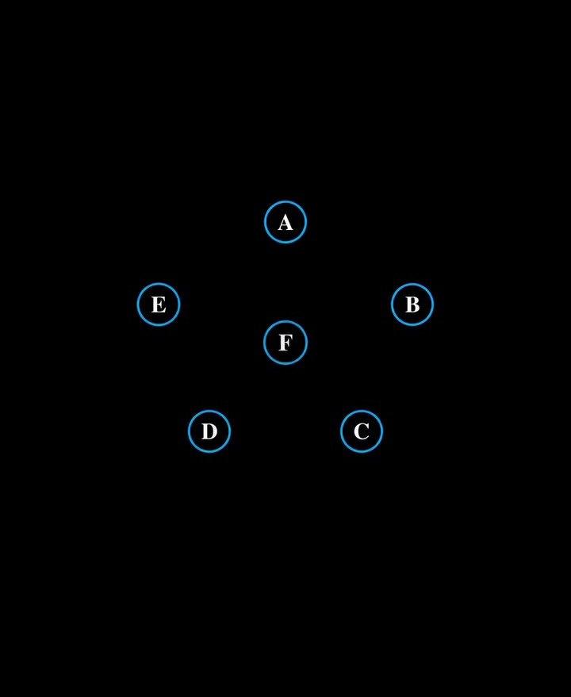
ALGORITHM - 2
VIDEO ANIMATIONS
KRUSKAL
ALGORITHM
  Sort the routes → Line up all train tracks (edges) from shortest to longest.
  Check for loops → Use DSU (Find‑Union) to make sure adding a track doesn’t create a cycle.
  Connect stations → Keep adding the shortest track that links two separate groups until all stations are connected.
Time Complity = O(E logE)
Why?
  Suppose you have E=16 edges.
  Sorting splits them: 16 → 8 → 4 → 2 → 1.
  That’s about log₂(16) = 4 steps of splitting.
  For each split, you still handle all E edges.
  So total work = E×logE.

Slide 6


THANK YOU

