Slide 1
UE24CS320A – Capstone Project Approval
Project Title
:
ChokePoint: A Graph-Based Spatio-Temporal Framework for Structural Bottleneck-Aware Crowd Risk Prediction and Intervention
Team Number
:
169
Project Guide
:
Prof. Swathi Priya N
Project Team
:
Rehan S Bawakhan – PES2UG25CS820
Yellapantula Venkata Prateek – PES2UG24CS617
Yellapantula Venkata Pranav – PES2UG24CS616
Yaseen Mulla – PES2UG24CS607
Notes:
Good morning. We are presenting ChokePoint, our capstone project. It is a graph-based spatio-temporal framework that predicts crowd-crush risk at structural bottlenecks such as stairs, gates and foot-over-bridges, and recommends actions minutes before danger. I will introduce the team and guide, and then walk you through the problem, our approach and the plan for three phases.

Slide 2
Outline
1
Problem Statement
6
Applications / Use Cases
2
Scope and Feasibility Study
7
Expected Deliverables
3
Background
8
Capstone (Phase-I, II & III) Project Timeline
4
Background Work
9
Effort Split by Team Member
5
Proposed Approach
10
Any Other Information
Notes:
Here is the flow of the talk. We start with the problem and its scope, then the background and the existing work. Next we explain our approach and the signals we measure. After that we cover applications, deliverables, the timeline and how the work is split across the four of us. We close with datasets and evaluation.

Slide 3
Problem Statement
Existing AI crowd-safety systems predict stampede risk over the whole camera frame or a uniform grid, treat each zone independently, and stop at an alert. They do not measure risk where crushes physically start, do not model how it spreads through a venue, and do not tell authorities what to do.
1. Wrong unit of risk
ICMF: whole frame. Crowd Guardian: 6×6 grid. AURORA: zones not tied to structure. None ties risk to stairs, gates or FOBs, where crushes start.
2. Zones treated in isolation
No reviewed system models how congestion at one gate pushes pressure into the next corridor, although this is how stampedes cascade.
3. Alerts, not actions
Systems stop at a warning. Staff must decide under time pressure which gate to open or where to redirect the crowd.
Objective: Develop a computer-vision based system that (i) defines risk zones on real structural chokepoints, (ii) models risk propagation across connected zones with a graph neural network, (iii) predicts, for each zone, the probability that density reaches that zone’s Danger threshold within the next 3, 5 or 10 minutes, and (iv) recommends ranked interventions, e.g. “Open Gate 4”, “Hold inflow at Stairs A”, with simulation-estimated risk reduction as a stretch goal.
Notes:
The core problem: current AI crowd-safety systems look at the whole frame or a uniform grid. That causes three gaps. First, the wrong unit of risk: a grid cell has nothing to do with why a crush happens, but a staircase or a gate does. Second, zones are treated in isolation, so nobody models how pressure at one gate spills into the next corridor, which is exactly how stampedes cascade. Third, systems stop at an alert and leave staff to decide what to do under pressure. Our objective addresses all four points on the slide: structural zones, graph propagation, a 3, 5 or 10-minute forecast per zone, and ranked interventions. Estimating each action’s risk reduction in simulation is a stretch goal.

Slide 4
Scope and Feasibility study
In scope
Feasibility
Challenges → Mitigation
Fixed CCTV feeds, overhead angles
Zones annotated once per camera
Zone risk forecast 3–10 min ahead
GNN propagation over zone graph
Ranked actions, checked in simulation
Dashboard prototype
Technical: open-source stack – YOLOv8, CSRNet / DM-Count, OpenCV optical flow, PyTorch, PyTorch Geometric, JuPedSim, Streamlit.
Compute: pretrained detector; LSTM and GNN are small, one GPU / Colab is enough.
Data: video – FDST, CroHD, Jülich bottleneck experiments, HAJJv2; images – ShanghaiTech, JHU-CROWD++ (counter only); self-recorded chokepoints; JuPedSim simulation.
Team: four members, one module each, with clear interfaces between modules.
Rare Danger events → JuPedSim crowds calibrated on Jülich data
Occlusion in dense crowds → density-map counter (CSRNet / DM-Count) in dense zones
Pixel → m² conversion → one-time per-camera calibration
Risk-reduction figures cannot be verified on real incidents → report as simulation estimates only
Short public clips limit lead-time tests → longer self-recorded sequences
Privacy and consent → consent, face blurring, no identity data
Out of scope
Live deployment at a real event
Automatic gate actuation
Face recognition / identity tracking
Drone or moving-camera feeds
Notes:
In scope: fixed CCTV with overhead angles, zones drawn once per camera, a 3 to 10-minute forecast, graph propagation, ranked actions checked in simulation, and a dashboard prototype. Out of scope: live deployment, automatic gate control, face recognition and drone feeds. It is feasible because the whole stack is open source and the models are small enough for a single GPU or Colab. The main challenges are on the right, each with a mitigation. The most important one: real danger events are rare, so we use JuPedSim crowds calibrated on Jülich experiments, and we report any risk-reduction number as a simulation estimate only.

Slide 5
Background
Why this problem
~140
92%
~14 s
lives lost every year to stampedes at public and religious events in India
of past Mahakumbh stampede sites were linked to narrow riverbank access routes
early-warning lead time of a recent predictor – too little to open a gate or redirect a crowd
NCRB 2001–22; Kumar, GIEST 2025
Pratap, arXiv 2502.03120 (2025)
AURORA, IEEE ICAUC 2026
Domain context
Crowd safety sits between computer vision and crowd dynamics. Crush risk rises sharply above ~4 persons/m², and it builds at structural bottlenecks – staircases, gates, foot-over-bridges and narrow corridors – where inflow exceeds outflow. Railway stations, melas and stadiums already have fixed CCTV, but feeds are watched manually. A useful system must warn minutes early, point to the exact chokepoint, and say what to do.
Notes:
Why this problem. About 140 people die every year in India in stampedes, which matches NCRB data of 3,074 deaths from 2001 to 2022 at public and religious events. A study of Mahakumbh found 92 percent of past stampede sites were linked to narrow riverbank access routes, so crushes start at chokepoints, not at random. A recent predictor, AURORA, gives about 14 seconds of warning, which is too short to open a gate. For domain context: risk rises sharply above about 4 persons per square metre and builds where inflow exceeds outflow. Stations and melas already have CCTV, but it is watched by people. A useful system has to warn minutes early, point to the exact chokepoint and say what to do.

Slide 6
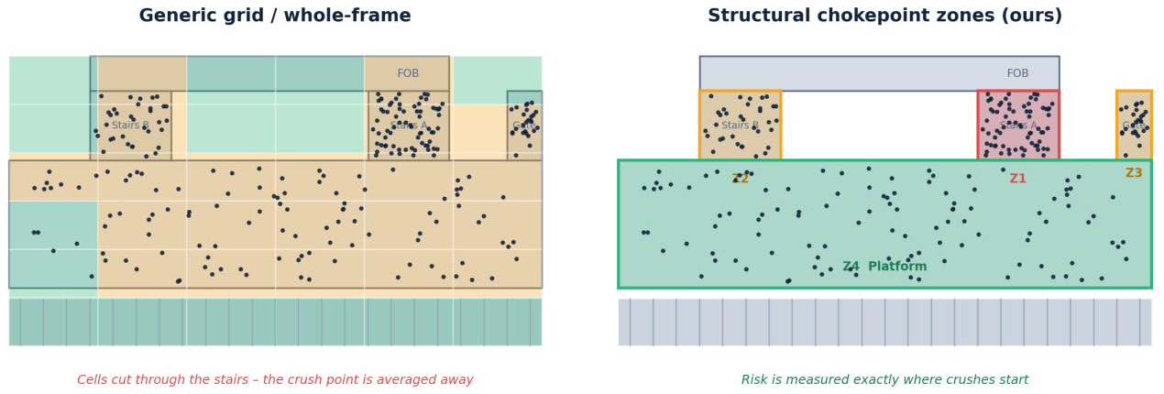
Background Work
System | Unit of risk | Models spread between zones | Turns forecast into actions
ICMF (2026) – base paper | Whole frame: Safe / Warning / Danger | No | No
Crowd Guardian (2026) | Uniform 6×6 grid | No | No
GIEST predictor (2025) | Density grid cells | No | No
AURORA (2026) | Zone-wise, not tied to structure | No | Rule-based safety layer only
ChokePoint (ours) | Structural chokepoints: stairs, gates, FOBs | Yes – GNN (proposed) | Yes – ranked actions (proposed)
Research gap
Density estimation, LSTM forecasting and grid aggregation each exist in prior work. No reviewed system combines chokepoint zoning, inter-zone propagation and ranked interventions in one framework. We propose this combination and will validate it through ablation.
Left: grid cuts through stairs. Right: chokepoint zones. Base paper: ICMF (Parashar et al., IJCTT 2026).
Notes:
This table compares the closest recent systems on three questions. What is the unit of risk? Do they model spread between zones? Do they turn the forecast into actions? ICMF works on the whole frame, Crowd Guardian uses a 6 by 6 grid, the GIEST predictor uses density cells, and AURORA is zone-wise but not tied to structure, with only a rule-based safety layer. None models spread between zones. The image shows the difference: grid cells cut through the stairs and average the crush away, while our zones are drawn on the chokepoints. Our contribution is the combination of all three, which we will validate through ablation. ICMF is our base paper, and we re-implement it as the main baseline in phase three.

Slide 7
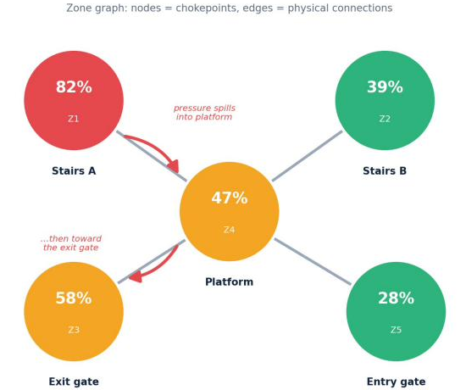
Proposed Approach
CCTV video
Fixed camera feed
Count people
YOLOv8 (sparse) + density map (dense)
Map to zones
Point-in-polygon on chokepoints
Extract features
Density, rate of change, net flux, entropy
Forecast per zone
P(Danger in 3/5/10 min), LSTM
Propagate risk
GNN (GCN/GAT) on zone graph
Recommend action
Ranked interventions
Blue boxes = novel contribution
Zone graph
Node = chokepoint zone; feature = its LSTM forecast
Edge = physical connection (stairs → platform → gate)
GNN revises each zone's risk from its neighbours
Signals per zone
Density (persons / m²)
Density rate of change
Net flux: inflow − outflow at zone boundary
Direction entropy (moving pixels only)
Formulas, prediction target and thresholds on the next slide.
Stack: Python | OpenCV | Ultralytics YOLOv8 | CSRNet / DM-Count | PyTorch | PyTorch Geometric | JuPedSim | Streamlit
Notes:
The pipeline runs left to right. Fixed CCTV video comes in. We count people with YOLOv8 in sparse areas and a density-map model in dense areas. Each person is mapped to a chokepoint zone by point-in-polygon. Per zone we extract density, its rate of change, net flux and direction entropy. An LSTM forecasts the probability of reaching danger in 3, 5 or 10 minutes. A graph neural network then revises each zone's risk using its connected neighbours. Finally, the system ranks interventions. The blue boxes are our novel parts. On the graph, each node is a zone and each edge is a physical connection such as stairs to platform to gate.

Slide 8
Signals, Target and Thresholds
Signal | Definition | Why it matters
Density ρ | people in zone / zone area (m²); area from per-camera calibration | Core crush indicator
Density rate of change | (ρ now − ρ N s ago) / N | Early trend: rising density before it looks dangerous
Net flux | people entering − people leaving across zone boundary, per minute | Bottleneck pressure; also the edge feature for the GNN
Direction entropy H | −Σ pᵢ ln pᵢ over 8 flow-direction bins, vectors below a minimum speed ignored | Disorder / counter-flow; a standing crowd is not mistaken for panic
Prediction target
For each zone z and horizon H ∈ {3, 5, 10} min, predict
P( ρ_z ≥ θ_z within the next H minutes )
Binary label from observed / simulated density. Output shown as zone risk %.
Zone-aware thresholds θ_z
Starting point: Warning 2, Danger 4 persons/m² (GIEST 2025; Still’s crowd-safety limits)
Stairs, gates and FOBs set lower than open platforms, as their safe flow per metre is lower (Fruin Level-of-Service)
Final θ per zone type tuned on validation data and Jülich bottleneck measurements
Notes:
These are the four signals per zone. Density is people divided by zone area, using a one-time camera calibration. The rate of change catches a rising trend before it looks dangerous. Net flux, inflow minus outflow at the boundary, measures bottleneck pressure and also serves as the edge feature for the graph. Direction entropy measures disorder; we ignore slow vectors so a standing crowd is not mistaken for panic. The prediction target is the probability that a zone's density crosses its own danger threshold within H minutes. Thresholds start at 2 for Warning and 4 for Danger, and are set lower for stairs, gates and FOBs because their safe flow is lower. They are tuned on validation data.

Slide 9
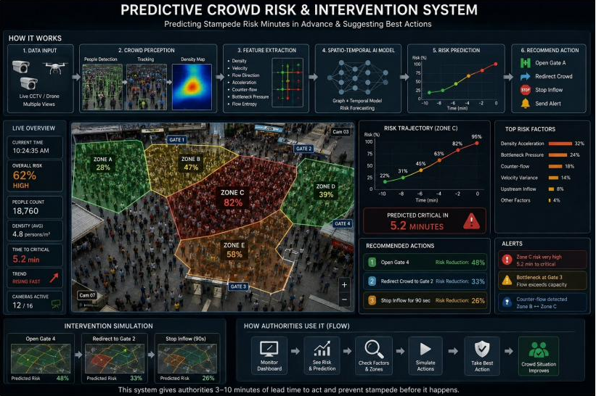
Applications/Use cases
Station and venue managers
See zone risk, act on ranked suggestions
Police, RPF, crowd control
Open a gate, redirect flow, hold inflow
Emergency responders
Minutes of lead time to pre-position
Civic authorities, planners
Post-event audit of recurring bottlenecks
Where: railway stations and FOBs, Kumbh and religious melas, stadiums, concerts, rallies, metro interchanges, temple queues.
Dashboard concept mockup; all values illustrative.
Notes:
The users are the people who must act. Station and venue managers see zone risk and ranked suggestions. Police, RPF and crowd-control teams carry out the actions: open a gate, redirect flow or hold inflow. Emergency responders get minutes of lead time to pre-position. Civic authorities and planners can audit recurring bottlenecks after an event. Typical venues are railway stations and FOBs, Kumbh and other melas, stadiums, concerts, rallies, metro interchanges and temple queues. The dashboard shown is a concept mockup, and all values are illustrative.

Slide 10
Expected Deliverables
Capstone-I – Foundation
Capstone-II – Core novelty
Capstone-III – Application and paper
Literature survey, problem statement
Curated datasets; CVAT zones; JuPedSim set-up; dashboard skeleton
Counting: YOLOv8 + density-map model; zone mapping
Features: density, rate of change, net flux, entropy
LSTM baseline: P(Danger in 3/5/10 min) per zone
Zone-adjacency graph design
GNN propagation model (GCN / GAT)
3-way ablation: LSTM vs LSTM + neighbour features vs LSTM-GNN
Workshop-paper draft if results hold
Intervention engine with ranked actions
Stretch: simulation-estimated risk reduction per action
Dashboard, integration; real-time demo on recorded / webcam video
Evaluation vs ICMF (base paper) and reviewed systems
Research paper, report, final demo
Milestone: Baseline per-zone forecast
Milestone: Proof the graph helps
Milestone: End-to-end system and paper
Notes:
Deliverables follow the three phases. Phase one is the foundation: literature survey, datasets, zone annotation, counting, features and an LSTM baseline per zone. The milestone is a working per-zone forecast. Phase two is the core novelty: the zone graph and the GNN, tested with a three-way ablation. That compares the LSTM alone, the LSTM with neighbour features, and the LSTM with the GNN, so we can show the graph itself helps. Phase three adds the rule-based intervention engine, a real-time demo on recorded or webcam video, the integrated dashboard and the full evaluation against ICMF, our base paper, ending in a research paper and final demo. Simulation-estimated risk reduction per action is a stretch goal.

Slide 11
Capstone (Phase-I, II & III) Project Timeline
Phase-I (2026)
Phase-II (2027)
Phase-III (2027)
Task
Aug
Sep
Oct
Nov
Jan
Feb
Mar
Apr
Aug
Sep
Oct
Nov
Owner
Literature review, problem statement
All
Datasets + zone annotation (CVAT)
M1
Detection + density counter + zones
M1, M3
Features (density, flux, entropy)
M2
LSTM baseline per zone
M2
Zone-adjacency graph design
M3
GNN propagation model
M3
3-way fair ablation
M3, M2
Workshop-paper draft
All
JuPedSim scenarios + interventions
M4
Dashboard v0 → v1 → v2 + real-time
M4, M1
Evaluation vs ICMF + reviewed systems
All
Research paper + final demo
All
M1 Rehan – Detection & data | M2 Prateek – Features & forecasting | M3 Pranav – Graph modelling | M4 Yaseen – Actions & dashboard
Notes:
This Gantt chart maps tasks to months and owners across the three phases. Phase one runs from August to November 2026 and covers data, detection, features and the LSTM baseline. Phase two runs from January to April 2027 and covers the graph design, the GNN and the ablation, with a workshop paper if the results hold. Phase three runs from August to November 2027 and covers interventions, the dashboard, evaluation and the final paper. The owner column links each task to a member: M1 Rehan, M2 Prateek, M3 Pranav, M4 Yaseen. The dashboard and the simulator start in phase one, so every model has a place to show results.

Slide 12
Effort Split by Team Member
Member / Role | Phase-I | Phase-II | Phase-III | Share
M1 – Rehan Detection & data | YOLOv8 + density-map counter; CVAT zones; dataset curation | Data for graph experiments; detection robustness | ICMF baseline re-implementation; real-time video input | 25%
M2 – Prateek Features & forecasting | Optical flow; density, rate of change, net flux, entropy; LSTM baseline | LSTM and LSTM + neighbour baselines; forecast tuning | Real-time optimisation; latency, lead-time and false-alarm tests | 25%
M3 – Pranav Graph modelling | Camera calibration; point-in-polygon zone mapping; zone-graph schema | Zone-adjacency graph; GCN/GAT in PyG; 3-way ablation | Risk-source attribution; final evaluation and error analysis | 25%
M4 – Yaseen Actions & dashboard | Dashboard skeleton; JuPedSim set-up (Jülich-calibrated); action catalogue | Simulated Danger scenarios; dashboard v1 (live risk + alerts) | Rule-based ranked interventions; dashboard v2; demo | 25%
Shared by all four: literature review, own section of the paper, joint evaluation, review presentations and final demo.
Notes:
Work is split equally, 25 percent each, with one module per member and clear interfaces between modules. Rehan owns detection and data, and re-implements the ICMF baseline. Prateek owns features, forecasting and real-time performance. Pranav owns calibration and zone mapping, the graph model and the ablation. Yaseen owns simulation, interventions and the dashboard. All four of us share the literature review, our own sections of the paper, joint evaluation and the reviews.

Slide 13
Any Other Information: Data and Evaluation
Dataset | What it actually provides | Used for
FDST | CCTV video, 100 clips, 13 scenes, head points | Counter training; zone density time series
CroHD (HT21) | Very dense video, 25 fps, head tracks | Dense detection, flow, entropy
Jülich PedDyn archive | Bottleneck and platform experiments; video + trajectories | Chokepoint ground truth; net flux; simulator calibration
HAJJv2 | 18 Hajj videos (9 train / 9 test); abnormal-behaviour labels | Real mass-gathering stress test; entropy check
Mall, UCSD | Single-camera clips, ~2,000 frames each | Early LSTM debugging
ShanghaiTech, JHU-CROWD++ | Still images with head points – no motion | Density-map counter training only
Self-recorded | Campus stairs, platforms, entrances; faces blurred | Target-venue zones and testing
JuPedSim | Simulated crowds on our zone layouts | Rare Danger cases; “what if” interventions (simulated)
Evaluation
Precision | Recall | F1 | PR-AUC | Lead time (min before Danger) | False alarms per hour
Fair ablation: LSTM vs LSTM + neighbour features vs LSTM-GNN – same features, splits and model size. Baseline: ICMF (base paper). Target lead time 3–10 min vs ~14 s (AURORA).
Notes:
These are the datasets and what each one actually gives us. FDST and CroHD provide video for counting, flow and tracking. The Jülich PedDyn archive gives bottleneck ground truth and simulator calibration. HAJJv2 has 18 real Hajj videos, which we use as a mass-gathering stress test. ShanghaiTech and JHU-CROWD++ are still images, so we use them only to train the counter. Self-recorded clips cover our own target zones, and JuPedSim supplies rare danger cases and what-if interventions. For evaluation we report precision, recall, F1, PR-AUC, lead time and false alarms per hour. The key experiment is the fair three-way ablation with the same features, splits and model size, with ICMF as the base-paper baseline. Our target lead time is 3 to 10 minutes, compared with about 14 seconds for AURORA.

Slide 14
Literature Review
Work | Approach | Gap ChokePoint addresses
Helbing et al. – Nature 2000 | Social-force model of escape panic | Simulation only; no video forecast
Seyfried et al. 2009 (Jülich) | Flow and density through bottlenecks | Data, not a predictor; used to calibrate
CSRNet 2018 / DM-Count 2020 | Density-map crowd counting | Counting only; no risk forecast
STGCN – IJCAI 2018 | Graph + temporal conv for traffic forecasting | Idea we adapt to crowd zones
Pratap – arXiv 2025 | Mahakumbh stampede-site analysis | 92% at narrow access routes → chokepoints
Kumar et al. – IEEE GIEST 2025 | Grid density; alert 3.5, critical 4 /m² | Grid cells; no spread, no actions
ICMF – IJCTT 2026 (base paper) | Whole-frame Safe / Warning / Danger | No zones, spread or actions
Crowd Guardian (2026) | Risk on a uniform 6×6 grid | Grid not tied to structure
AURORA – IEEE ICAUC 2026 | Zone-wise, ~14 s lead, rule-based layer | Seconds of warning; no ranked actions
Backup slide for Q&A – hidden in slide show.
Notes:
Backup slide, hidden in the slide show. Use it only if the panel asks about the literature. Helbing's social-force model and the Jülich bottleneck experiments are the crowd-dynamics foundation; we use the Jülich data for calibration. CSRNet and DM-Count give us density counting in dense crowds. STGCN shows that forecasting on a graph works for traffic, and we adapt that idea to crowd zones. The remaining rows are the recent crowd-risk systems from the previous slide, plus the Mahakumbh study that motivates chokepoint zones.

Slide 15
Thank You
Notes:
Thank you. To sum up, ChokePoint predicts risk where crushes actually start, models how it spreads between connected zones, and turns the forecast into ranked actions minutes ahead. We are happy to take your questions.

