Slide 1
UE24CS320A – Capstone Project Approval
Project Title
: A Comparative Framework for Early Sepsis Prediction Using Ensemble and Explainable Deep Learning on ICU Data
Project ID
: 186
Project Guide : Prof. Lakshmi Satya Vani N
Project Team : Kiran BG (PES2UG24CS227),
Mohammad Anan(PES2UG24CS278),
Ibrahim Khaleel (PES2UG24CS809),
Nikhil KR (PES2UG25CS815)

Slide 2
Outline
Problem Statement
Scope and Feasibility study
Applications/Use cases
Background work
Expected Deliverables
Capstone (Phase-I Phase-II, Phase-III) Project Timeline
Any other information

Slide 3

Problem Statement
Sepsis is a life-threatening organ dysfunction where mortality rises every hour treatment is delayed, making early prediction 6 to 12 hours before onset critical. Machine learning models achieve strong performance — ensemble methods reach AUROC 0.85 to 0.91 and LSTM around 0.85 — with SHAP as the default explanation method. However, two gaps remain: ensemble and deep learning models are compared across different datasets and protocols, making fair comparison impossible; and no study evaluates whether SHAP explanations are stable, faithful, and robust under clinical conditions where features are correlated, lab values have 85 to 95 percent missingness, and theoretical work proves no ranking can be simultaneously faithful, stable, and complete. This means SHAP explanations are mathematically guaranteed to be unstable under retraining, yet clinicians receive them with no reliability indicator. Therefore, our project builds a unified comparison of ensemble and deep learning models under identical conditions, and a reliability layer that detects, diagnoses, and mitigates unreliable SHAP explanations, abstaining when reliability remains too low.

Slide 4

Scope and Feasibility study
The scope of this project covers early sepsis prediction 6 to 12 hours before clinical onset using the PhysioNet/CinC Challenge 2019 dataset, comparing ensemble models (XGBoost, Random Forest) against deep learning (LSTM) under identical preprocessing, patient-level splits, and evaluation protocols. Explanation methods include TreeSHAP, Kernel SHAP, and Integrated Gradients. The reliability layer detects unstable, unfaithful, or non-robust explanations, diagnoses failure modes (feature correlation, missingness, model instability, temporal shift), applies targeted mitigation, and abstains when reliability remains low. Feasibility is threefold. Implementation is feasible because all components have mature implementations. Evaluation is feasible because independent failure labels are defined before detection, avoiding circularity. Systematic feasibility is grounded in the Attribution Impossibility result, which proves detection — not elimination — is the correct goal under feature collinearity.

Slide 5
Scope and Feasibility study
Model Landscape
Early sepsis prediction has been approached with two model families. Ensemble methods such as XGBoost, Random Forest, and LightGBM perform well on structured ICU data, achieving AUROC between 0.85 and 0.91 on PhysioNet/CinC Challenge 2019. Deep learning models such as LSTM, GRU, and Transformer capture temporal dependencies in patient trajectories, achieving AUROC around 0.85, with hybrid architectures like LSTM-GAT reaching 0.853 with five-seed validation. However, these models are evaluated on different preprocessing pipelines, data splits, and labeling strategies — making direct cross-paper comparison unreliable. No study compares both model families head-to-head under identical conditions.
Explainability Landscape
SHAP has become the default method for explaining sepsis prediction models. A 2026 systematic review of 37 sepsis XAI studies found explainability adoption growing at approximately 67 percent per year, with SHAP dominating both global and local explanation tasks. The review confirmed that XAI-enhanced models maintain predictive accuracy and highlight clinically meaningful features. However, the same review identified a critical problem: key sepsis biomarkers such as procalcitonin and CRP rarely appear in high-importance feature rankings. Instead, explanations tend to highlight vital signs — the features measured most frequently in the ICU. This suggests SHAP explanations may reflect data collection patterns rather than pathophysiological truth.

Slide 6

Background
Multimodal agents accept text, images, and voice, and in a multi-agent pipeline several of them are chained: a vision agent reads an image, a planner decides what to do, and an executor acts. Each agent's output becomes the next one's input, often with more privilege. Image-based prompt injection exploits this by hiding instructions inside an image, such as overlaid text, steganographic patterns, or crafted visual structures, which a vision-enabled agent may follow as if they were legitimate.
The risk grows as the image moves down the chain. The first agent typically converts the image into a caption or summary, and this step can "launder" the instruction: the image is gone, but the reworded command survives inside plain text that looks ordinary to downstream filters. By the time it reaches an agent with real privileges, such as one that can send emails, query a database, or run code, no visual trace of its origin is left.
Attacks on a single multimodal model are well studied, but how an injected image travels across two to four cooperating agents, and whether a lightweight guard layer can catch it along the way, is still largely unmeasured. This makes the problem practical for us: it needs no model training, only a small instrumented pipeline built on existing injection techniques.

Slide 7

Applications/Use cases
1. ICU Clinical Decision Support
When a doctor sees a sepsis risk score, they simultaneously receive an explanation reliability label. If the explanation is unstable, the doctor knows not to over-rely on feature attributions and can use clinical judgment instead.
2. Model Auditing and Quality Control
Hospital AI governance teams can use this framework to regularly audit deployed sepsis models, detecting explanation drift over time as patient populations or data collection practices change.
3. XAI Method Comparison Research
Provides researchers with tools to evaluate the reliability of different explanation methods — SHAP, Integrated Gradients, and others — on clinical time-series data, filling a gap in current XAI evaluation practice.
4. Regulatory Submission Support
Provides quantitative reliability evidence for explainability requirements in AI medical device submissions, helping demonstrate that explanations are not just plausible but measurably trustworthy.
5. Generalizable Reliability Pattern
The detect-diagnose-mitigate-abstain pattern is reusable beyond sepsis — applicable to any clinical prediction task with correlated features and missing data, including mortality prediction, readmission risk, and treatment response.

Slide 8
Applications/Use cases
Security Tooling / Red-Teaming for Agentic AI Products
Beyond any single deployment, the benchmark itself is a reusable artifact: a lightweight, open test suite that other developers or researchers building multi-agent systems could run against their own pipelines to measure injection survivability similar to how standard prompt-injection benchmarks are used today, but filling the specific gap of image-to-text propagation across agent hops.
Guard-Agent Pattern as a General Defense Primitive
Independent of the specific attack, the "Observer/Guard agent inserted between pipeline stages" pattern we build and benchmark is a reusable architectural component- not just for image injections, but potentially generalizable (with further work) to catching other forms of laundered or propagated malicious instructions in agent-to-agent handoffs.

Slide 9
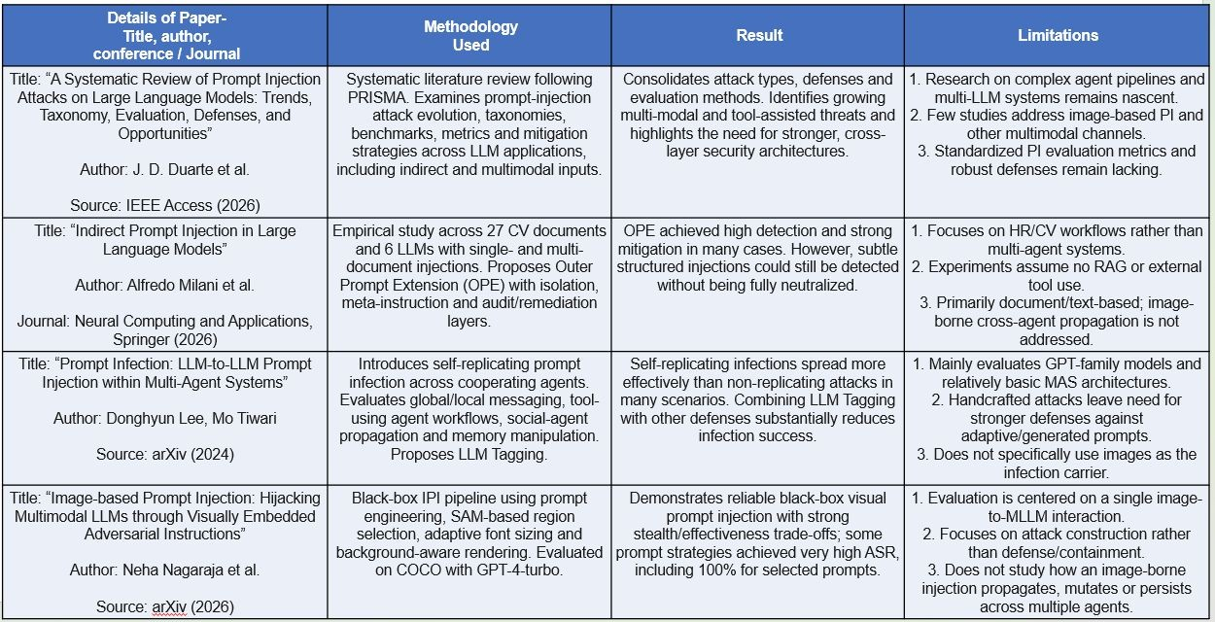
LITERATURE SURVEY/EXISTING SYSTEM

Slide 10
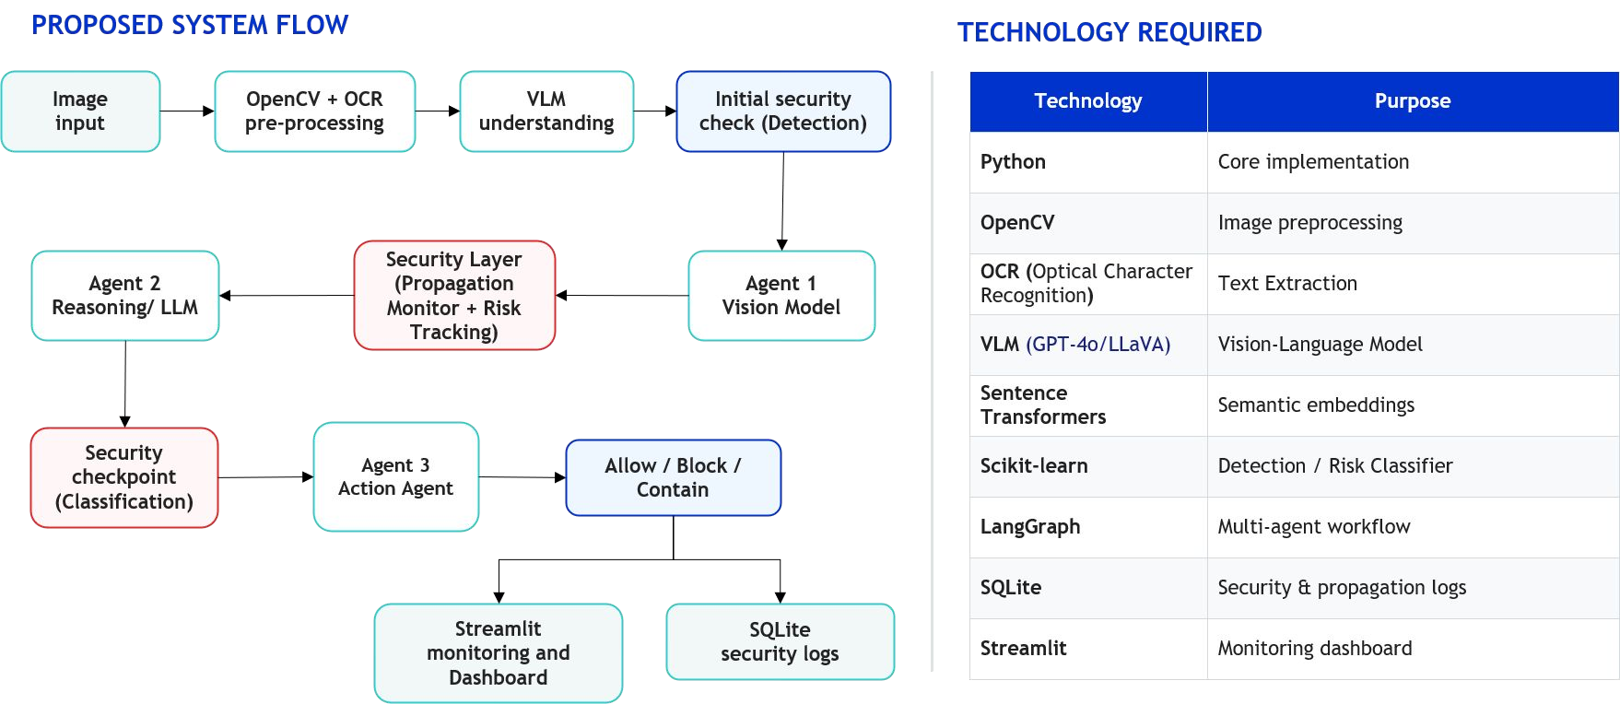
Technology Required & Proposed Architecture

Slide 11

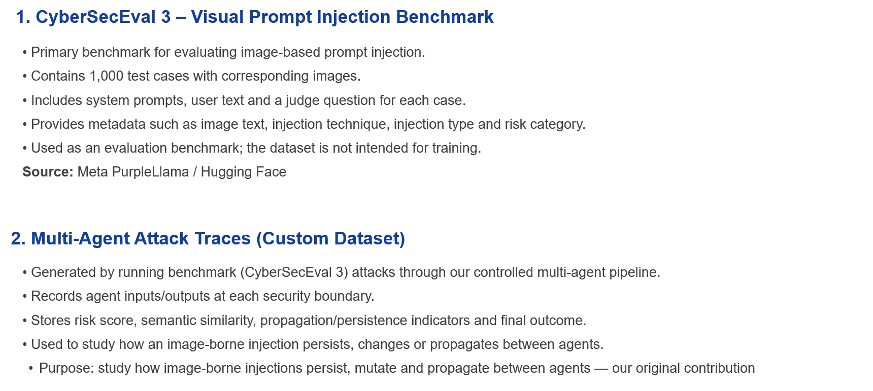
Datasets/ Benchmarks

Slide 12

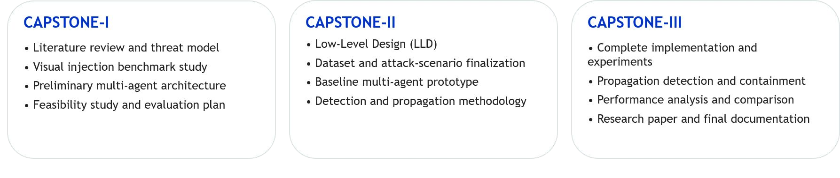
Expected Deliverables

Slide 13
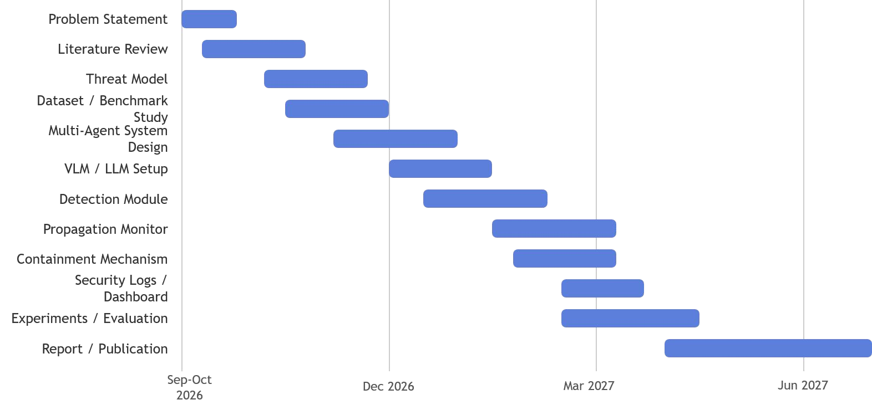
Project Gantt Chart

Slide 14

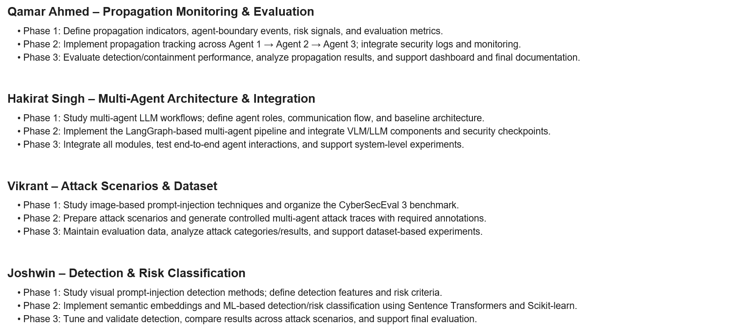
Member Wise Task BreakDown

Slide 15
Thank
You

