Slide 1
Software Testing Methods
A Demo for a Spring Boot Project

Slide 2
Content
About me
Software Testing Methods
Demo
Q&A

Slide 3














About Me
linkedin: ibrahimhalici
github: ibrahimhalici
ibrahimhalici.com
IBRAHIM HALICI
BACKEND DEVELOPER
beytek.org

Slide 4

Software Testing
Software testing is the process of assessing the functionality of a software program. The process checks for errors and gaps and whether the outcome of the application matches desired expectations before the software is installed and goes live.
To test a program is to try to make it fail - Bertrand Meyer
Testing is planned by defining “Test Cases” in a systematic way.
A test case is a collection of input data and expected output.
Verification: Are we building the product right?
Validation: Are we building the right product?

Slide 5
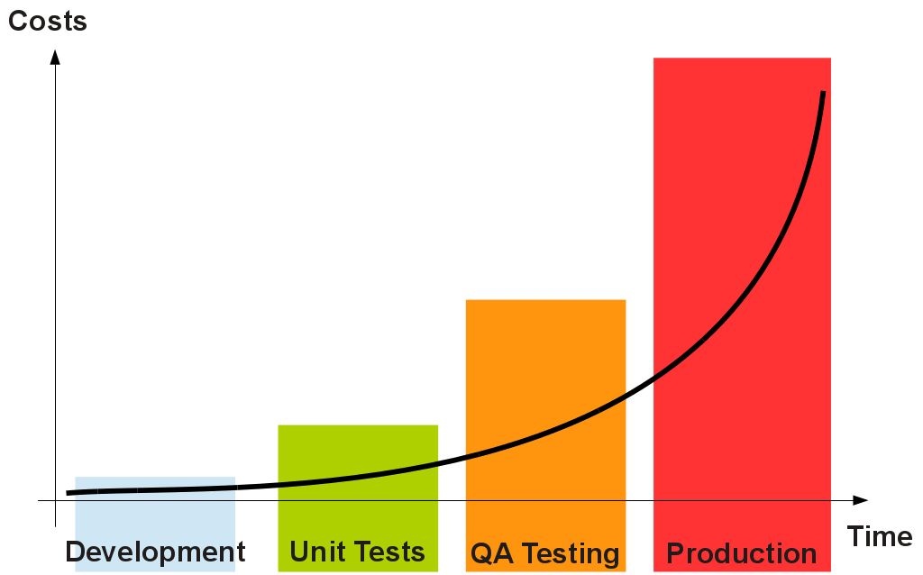
Cost of fixing a bug

Slide 6

Importance/Advantages of Software Testing
Identifies defects early.
Improves product quality.
Increases customer trust and satisfaction.
Confidence
Saves money.

Slide 7
Testing Types
Functional Testing
Unit Testing
Integration Testing
Acceptance Testing
White Box – Black Box Testing
Non-Functional Testing
Regression Testing

Slide 8
Testing Types
Automation Tests
Performance Tests
Stress Tests
Security Tests
Mutation Tests
TDD
Smoke Tests

Slide 9
Unit Testing
Unit testing is a method of testing individual units or components of a software application. It is typically done by developers and is used to ensure that the individual units of the software are working as intended.
Does each module do what it supposed to do?

Slide 10
Integration Testing
Integration testing is a method of testing how different units or components of a software application interact with each other. It is used to identify and resolve any issues that may arise when different units of the software are combined. Integration testing is typically done after unit testing.
Do you get the expected results when the parts are put together?

Slide 11
System Testing
System testing is a type of software testing that evaluates the overall functionality and performance of a complete and fully integrated software solution. It tests if the system meets the specified requirements and if it is suitable for delivery to the end-users.
Does it work within the overall system?
Does the program satisfy the requirements ?

Slide 12
Acceptance Testing
Acceptance Testing is an important aspect of Software Testing, which guarantees that software aligns with user needs and business requirements. The major aim of this test is to evaluate the compliance of the system with the business requirements and assess whether it is acceptable for delivery or not.
UAT- Alpha- Beta etc.

Slide 13
Alpha – Beta Testing
Alpha Test
customer tests
software
developer site
customer site
Beta Test
customer tests
software
developer reviews
developer site
customer site

Slide 14
Testing Web Based Systems
Browser compatibility
Functional correctness
Usability
Security
Reliability
Performance
Recoverability

Slide 15
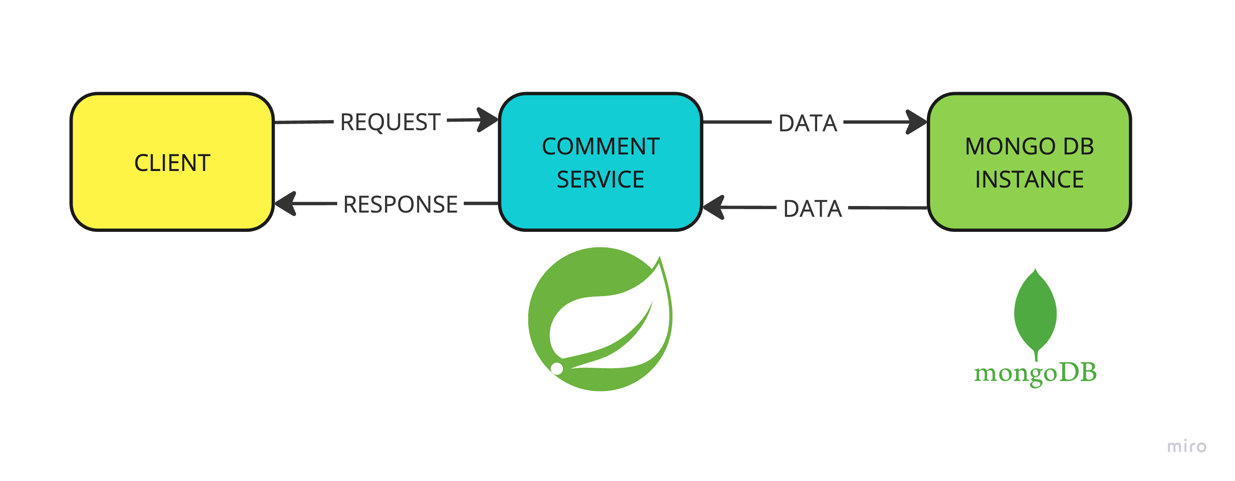
DEMO
SPRING BOOT PROJECT WITH MONGODB CONNECTION, SYSTEM- SMOKE-UNIT TESTS AND INTEGRATION TESTS WITH MONGODB TEST CONTAINER

Slide 16

Q&A

Slide 17
THANKS

Slide 18
REFERENCES
ITU, information technologies master program, software engineering lesson
ITU, information technologies master program, software quality lesson
Geeks For Geeks, software testing
Spring Boot documentation
https://mbahardogan.medium.com/unit-test-62e648255aac
https://serengetitech.com/tech/integration-testing-in-spring-boot-application/

