Slide 1



MyHR.
Employee Management System
MUHAMMAD IBRAHIM SHOEB
Project Lab - Spring 2025 - 2026
Supervisor: Dr. Husam Al-Magsoosi

Slide 2




MyHr - Employee Management System
M. I. SHOEB | SPRING 2026
WHY MyHR?
Designed to manage personnel records, organizational structure, and promotion progress without cloud infrastructure.
OFFLINE
ACCOUNTABILITY
PROMOTION TRACKING
No server
No internet
Runs on any Windows PC
Immutable audit trail
Username snapshots
Role Separation
Promotion race calculated
Live from raw records
Never stored in DB

Slide 3
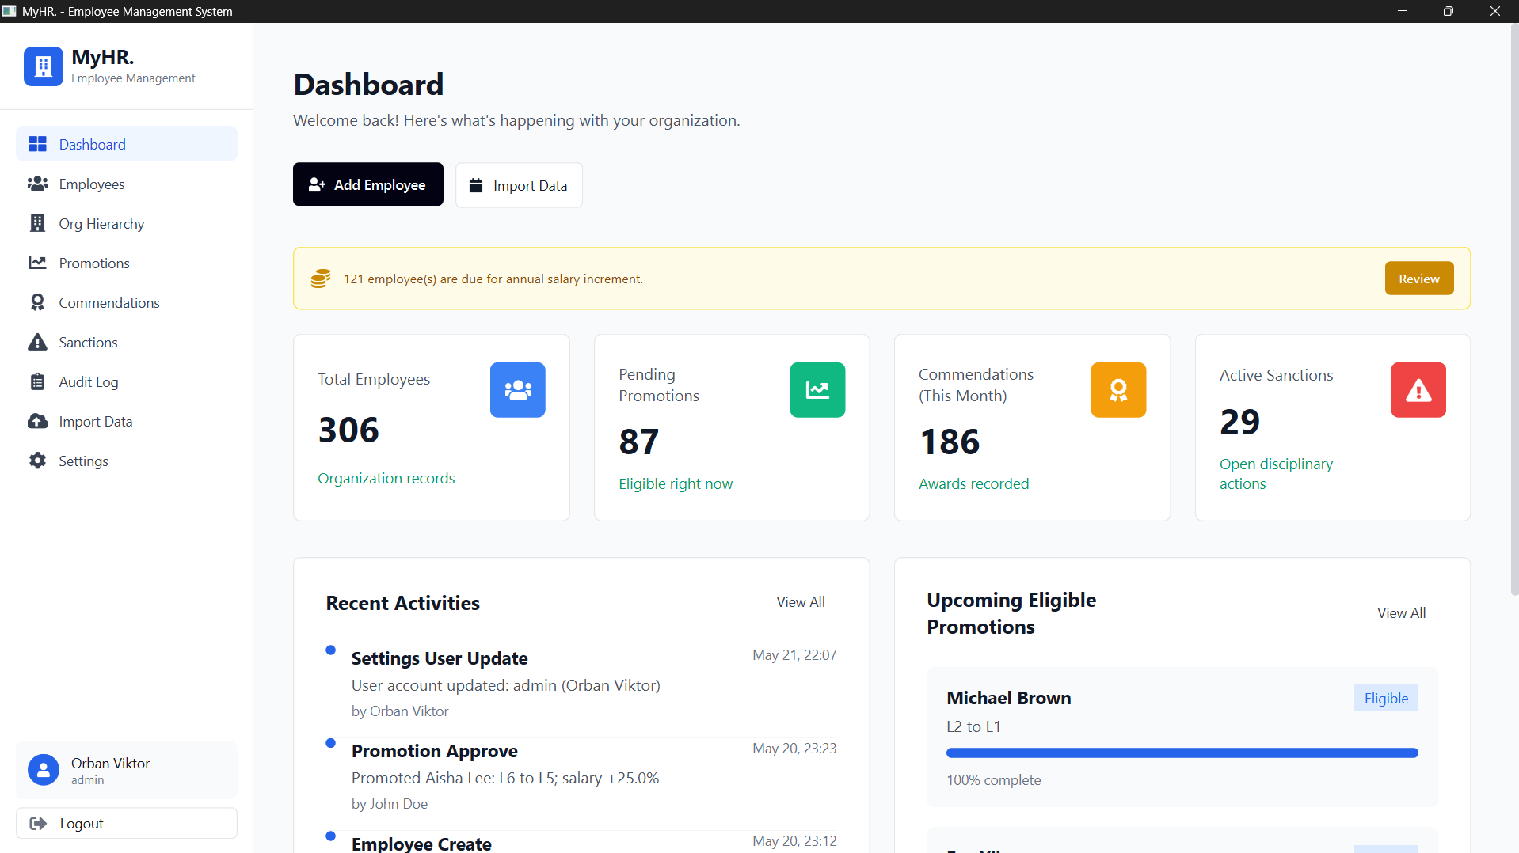
MyHr - Employee Management System
M. I. SHOEB | SPRING 2026
SYSTEM OVERVIEW
Employee Statistics
Promotion Monitoring
Recent Activity
Salary Alerts

Slide 4

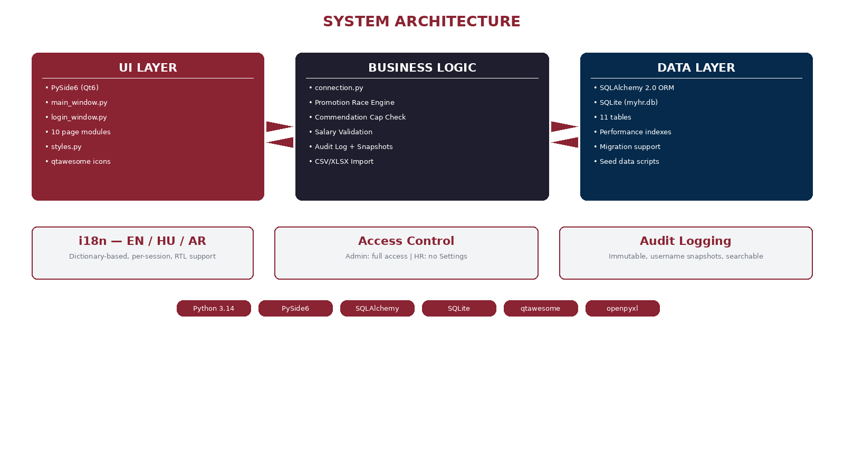
MyHr - Employee Management System
M. I. SHOEB | SPRING 2026
SYSTEM ARCHITECTURE
UI LAYER
BUSINESS LAYER
DATA LAYER
Authentication
Employee Management
Administration
Reporting
Promotion Engine
Audit Services
Salary Workflow
Import / Export
SQLite Database
ORM Layer
Persistence Services
11 Tables

Slide 5
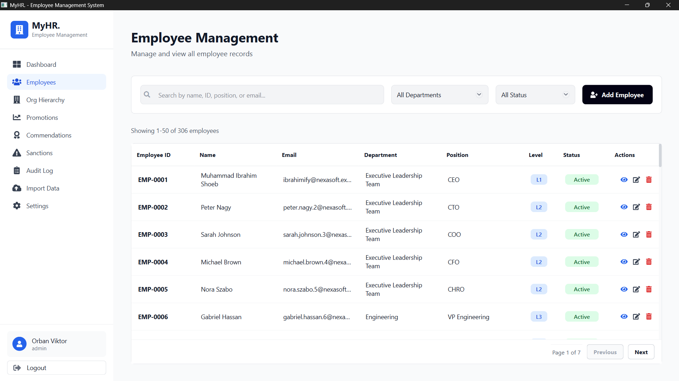
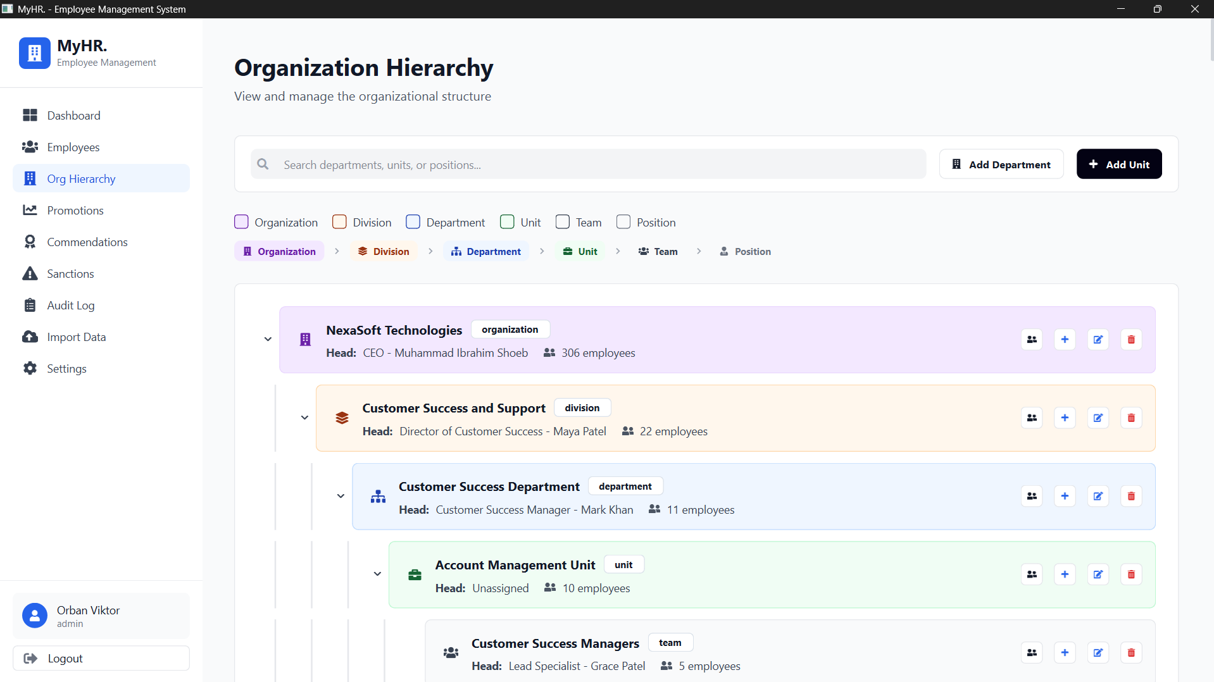
MyHr - Employee Management System
M. I. SHOEB | SPRING 2026
EMPLOYEE MANAGEMENT & ORG HIERARCHY
Employee lifecycle
BSc→L7, MSc→L6, PhD→L5 auto-assignment
Search, filter, paginated list
Profile with live promotion race status
Unlimited hierarchy depth
Head assignment
Inline add/edit/delete + dependency checks
OTHERS branch for misc employees

Slide 6
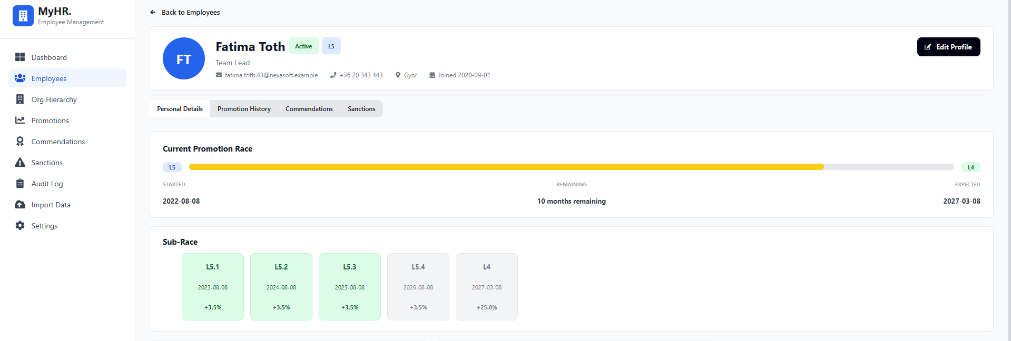
MyHr - Employee Management System
M. I. SHOEB | SPRING 2026
PROMOTION RACE ENGINE
1. Current Progress
Track Promotion status between levels
2. Real Time Calculation
Computed dynamically from records
3. Sub-Race Milestones
Annual progression checkpoints
1
2
3
L7 → L6 → L5 → L4 → L3 → L2 → L1
36mo 48mo 60mo 60mo 72mo 84mo
Clock resets after each promotion · Sub-race milestones (L7.1, L7.2) for annual tracking

Slide 7
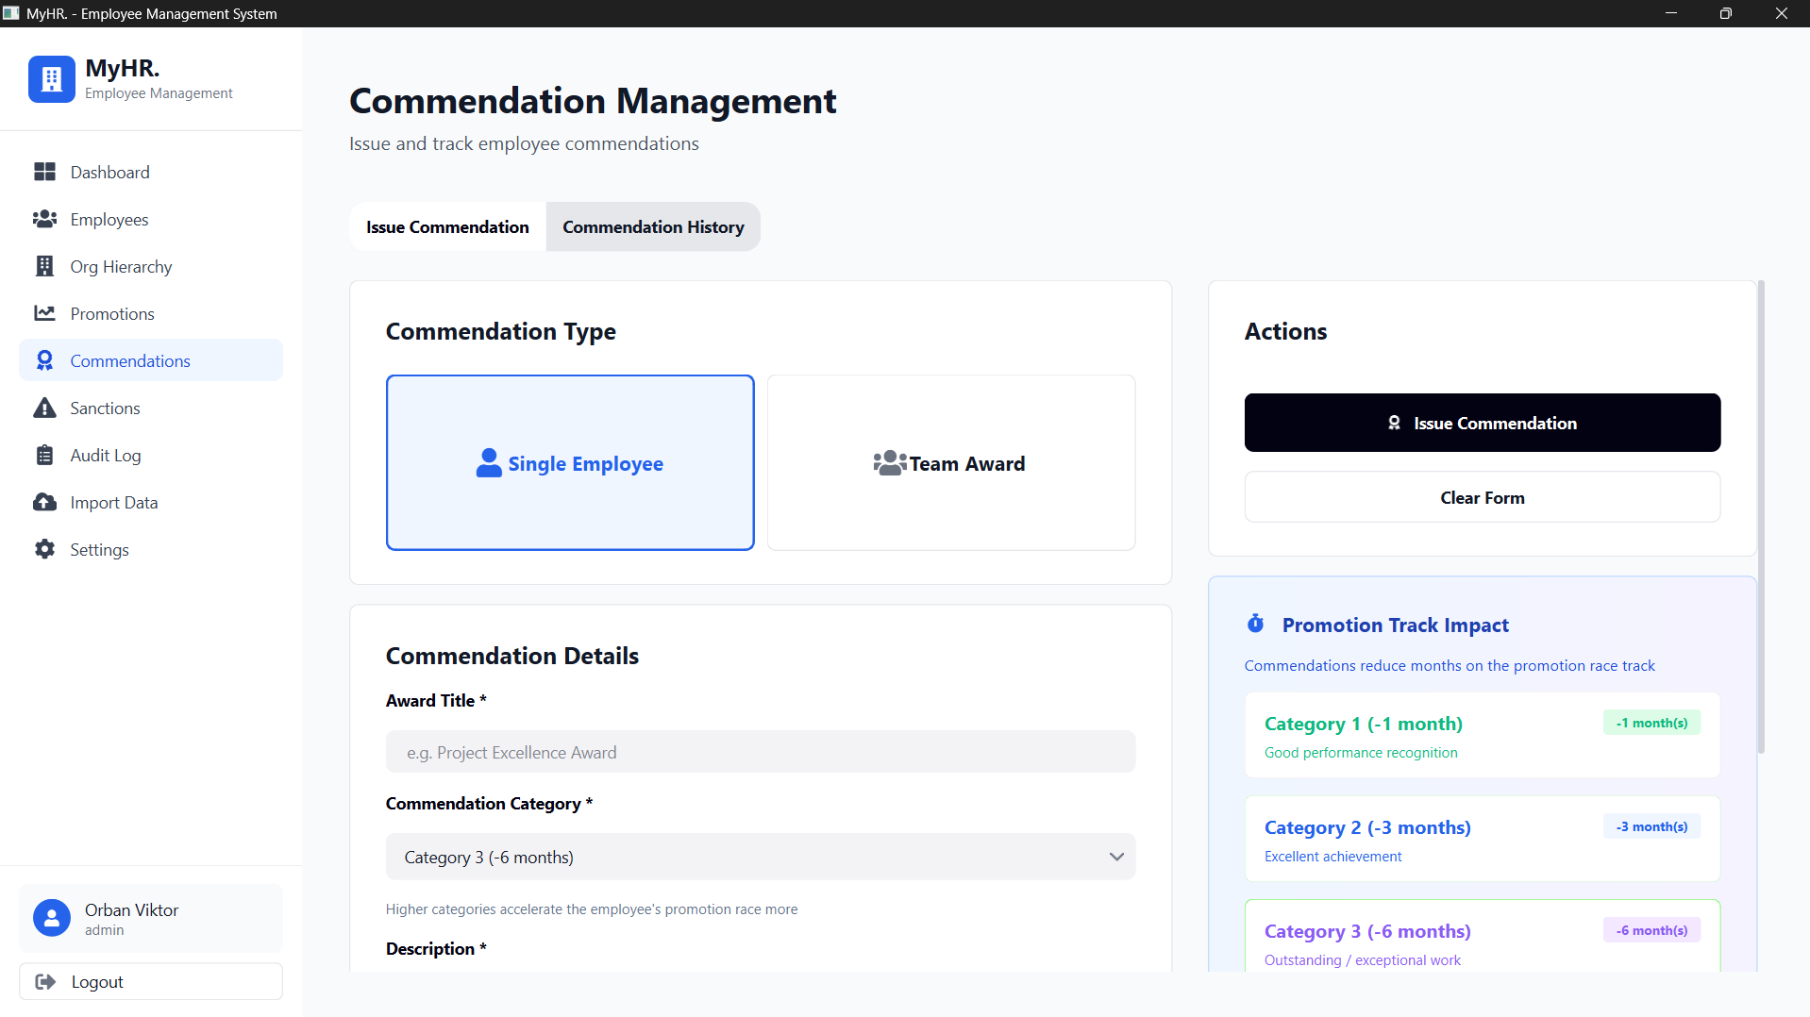
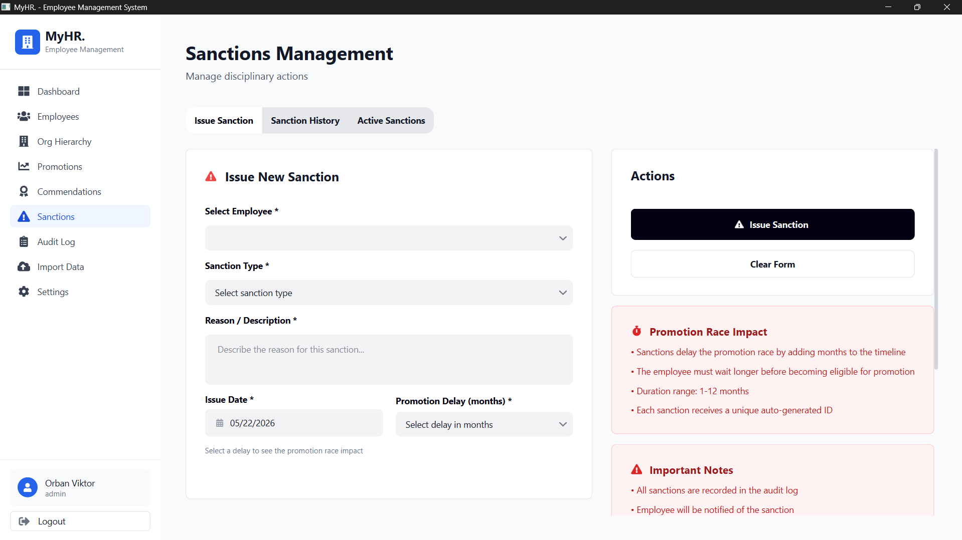
MyHr - Employee Management System
M. I. SHOEB | SPRING 2026
COMMENDATIONS
SANCTIONS
Accelerate promotion race
3 categories · Max 3 per role · Bulk team awards
Delay promotion race
+1 to +12 months · Active/resolved tracking

Slide 8
MyHr - Employee Management System
M. I. SHOEB | SPRING 2026
ADMINISTRATION FEATURES
IMMUTABLE AUDIT LOG
USER MANAGEMENT
MULTI-LANGUAGES SUPPORT
Every action recorded
Username snapshot
Searchable & filterable history
Role-based accounts
Soft deletion
Admin handover
Past logs keep old username
English, Hungarian, Arabic
RTL layout for Arabic via Qt
Per-session, resets on logout

Slide 9
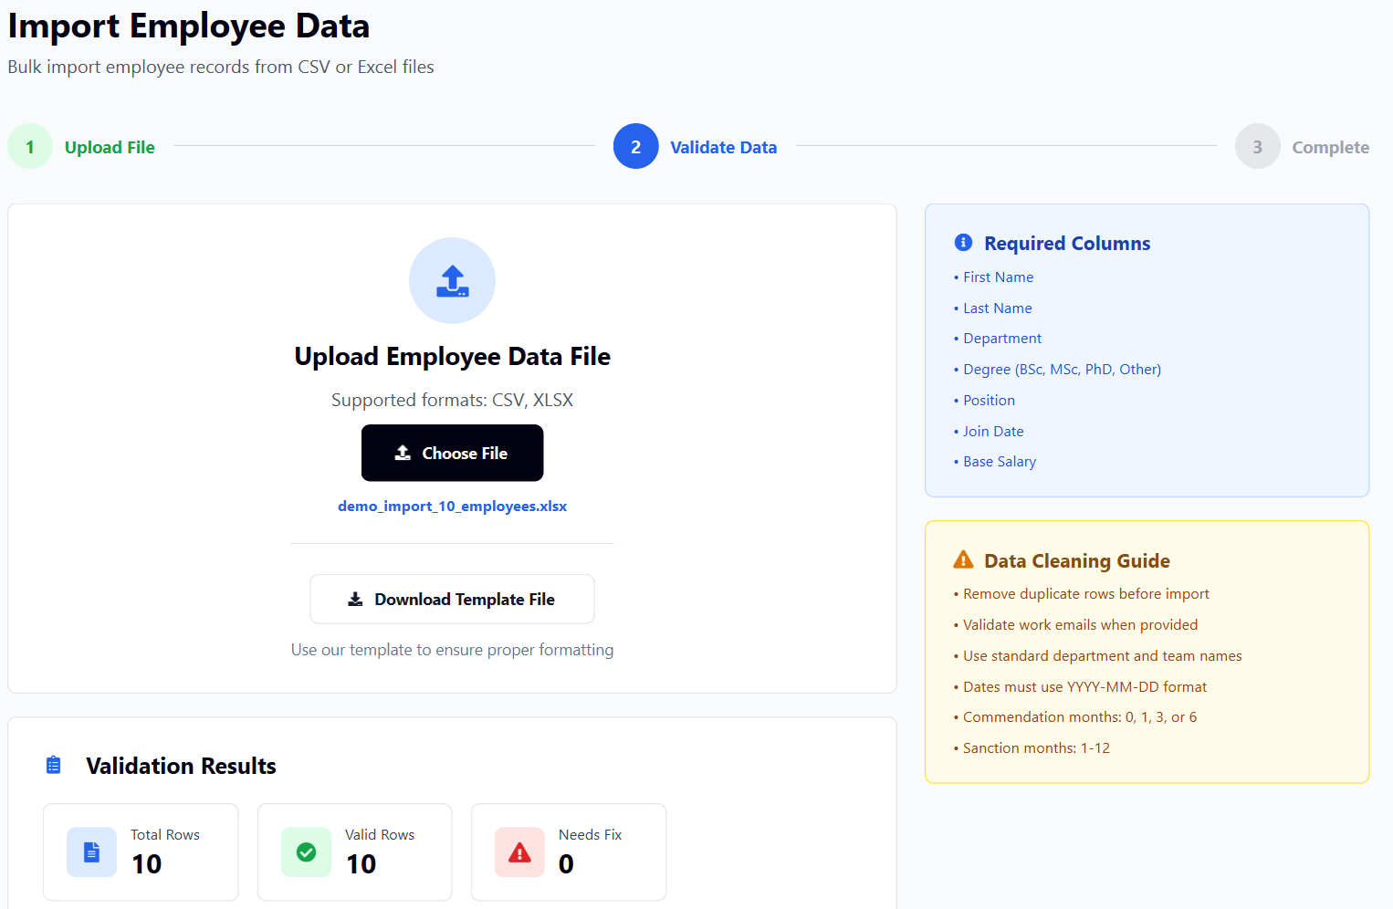
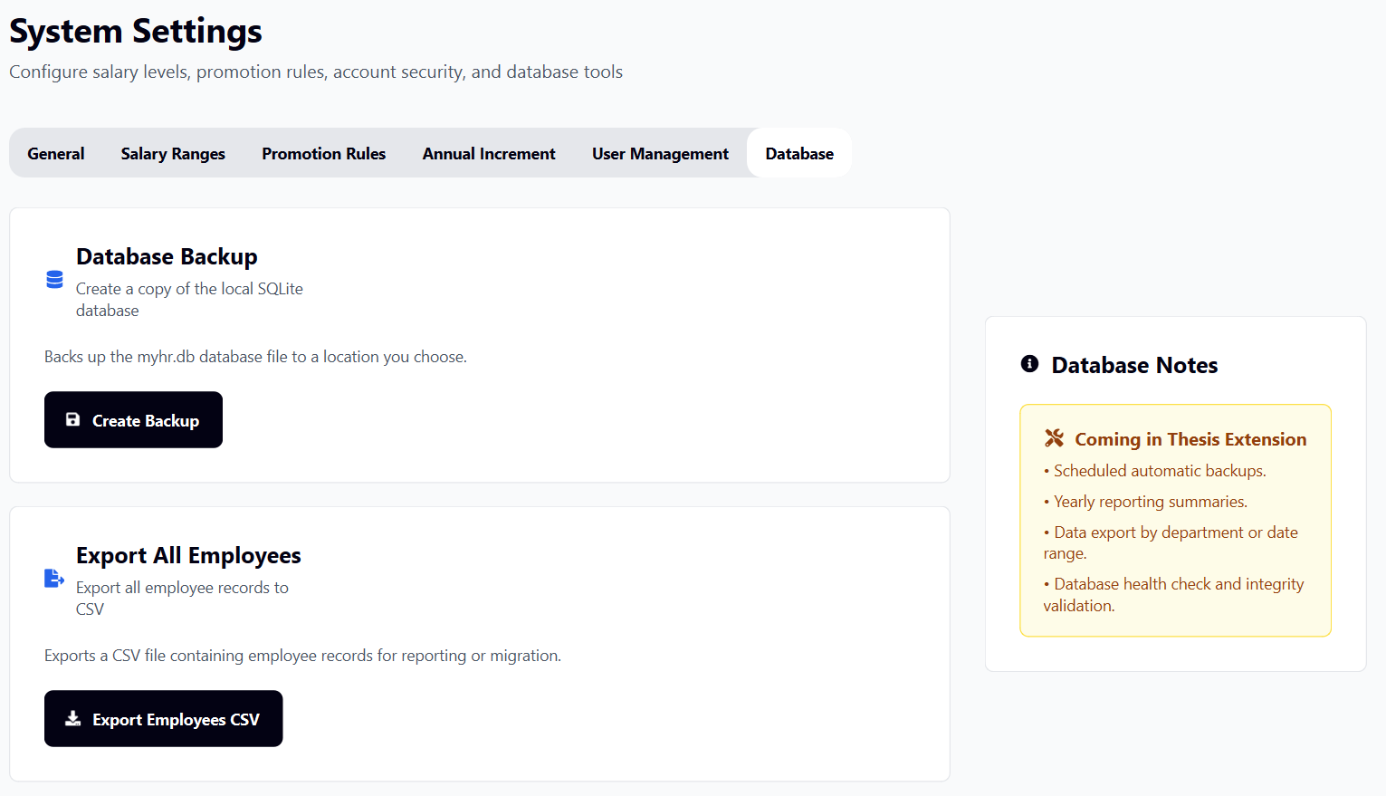
MyHr - Employee Management System
M. I. SHOEB | SPRING 2026
DATA MANAGEMENT
Import
CSV / XLSX employee import
Import Template-based formatting
Validation before saving
Export & Backup
Employee CSV export
Local database backup
Reporting and migration support

Slide 10
MyHr - Employee Management System
M. I. SHOEB | SPRING 2026
SEMESTER 1 - RESULTS
10
11
563
3
6
Application Pages
DB Tables
Translation Keys
Supported Languages
Promotion Levels
Employee CRUD
Audit logging
Organizational Hierarchy
Import/export tools
Promotion race engine
Multi-language support (EN/HU/AR)

Slide 11
FUTURE SCOPE
Configurable promotion policies via UI editor
Record history and enhanced audit logging
PDF export and yearly reporting
Improved input validation and error UX
Dark mode + extended multi-language
Improved data consistency and error handling
Desktop application packaging and deployment

Slide 12

Thank
You.
MyHR - Employee Management System
github.com/
Project Lab · Spring 2025–2026
ibrahimify/MyHR
Muhammad Ibrahim Shoeb
Supervisor: Dr. Husam Al-Magsoosi

