Slide 1



27/02/2026
myHR.
Employee Management System
PRESENTED BY:
PRESENTED TO:
Muhammad Ibrahim Shoeb
Dr. Husam Al-Maghoosi

Slide 2


03 | Overview
04 | Tech Stack
05 | Core Module
06 | Functional Requirement
07 | Non-Functional Requirement
08 | Development Methodology
09 | Timeline
10 | Future Scope
Agenda

Slide 3

01
Development of a standalone Employee Management System (EMS) for structured government-like organizations.
03/10
02
Supports full hierarchy management, employee lifecycle, and rule-based promotion logic.
Overview
03
Replaces manual HR processes with structured, auditable, and consistent digital workflows.

Slide 4

Technology | Component | Why
Primary: Flet Secondary: PySide6 | UI (Desktop) | Flet: modern UI fast, clean admin UX. PySide6: industry-standard desktop toolkit if required.
Python + SQLite | Backend | Local SQL DB, no server/network, handles 5k+ easily
SQLAlchemy | ORM | Clean data modeling and scalable
PlantUML/Graphor | Modeling | UML (Use Case, Sequence, Activity)
GitHub | Version Controlling | Repository for progress tracking, commits, and sprint updates.
Tech Stack

Slide 5

05/10
Core Modules
Friendly GUI
Authorized Access:
Audit Records
Modern, intuitive administrative interface
Multi-user roles (Admin, Employee)
Maintains structured employment history, service records, and status tracking

Slide 6
06/10
Functional Requirements
Organization hierarchy: Organization → Department → Sub-department → Unit + leadership roles.
Employee management: CRUD, title progression, commendations, sanctions.
Rule-based promotion system (time threshold + early promotion via commendation).

Slide 7
07/10
Non-Functional Requirements
Support for at least 5,000 employee records (indexed database design).
Clean, responsive, user-friendly GUI.
Data consistency, validation, and error handling.

Slide 8
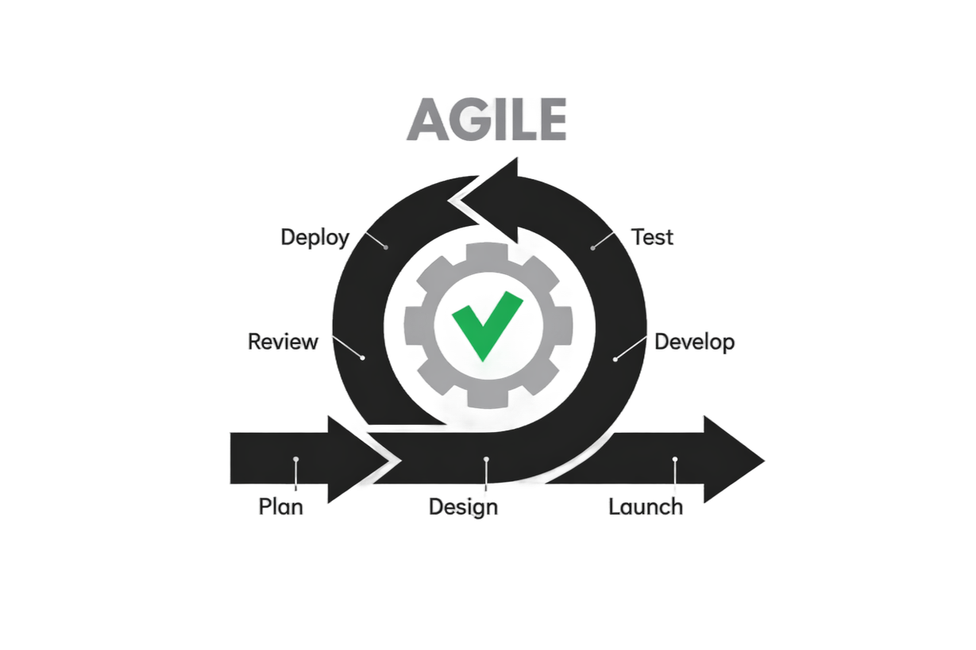
Development Methodology
08/10
Agile methodology with sprint-based iteration
Incremental feature delivery and testing at each sprint cycle
Continuous feedback integration and refinement.

Slide 9


Timeline
09/10
February
March
April
May
Requirements finalization
Database schema, UML design
Core development (CRUD + hierarchy + promotion logic).
Testing, validation, documentation, final refinement.

Slide 10
Future Scope
Configurable promotion & allowance policies
Audit logging & historical tracking enhancements
Data export & yearly reporting summaries
Multi-language support & dark mode UI

Slide 11
Thank you
CONTACT US
E-mail
muhammadibrahimshoeb@gmail.com
Webpage
ibrahimify.dev
Github
@ibrahimify
Phone
+36 20 628 9542
PROJECT WILL BE MAINTAINED IN A SHARED GITHUB REPOSITORY WITH VERSION CONTROL

