Slide 1
Image Recognition Application
Python Foundation Final Project
Umut Berkgun Nebioglu
Omar Ben Khayatiya
Ibrahim Ilhan, Ph.D.
July 12, 2023

Slide 2
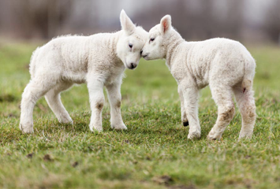
Objective
To build a Python-based Image Recognition App that utilizes machine learning techniques to classify and identify objects within digital images.
Functionality
The app aims to provide users with a user-friendly interface to upload images and receive accurate predictions about the contents of those images.
Can we build an application that detects an object from a given image?

Slide 3
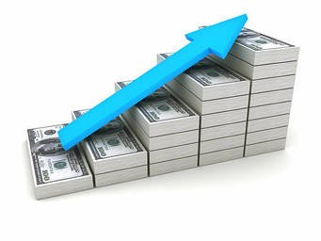
Dataset
Sheep image
Non-sheep image

Slide 4
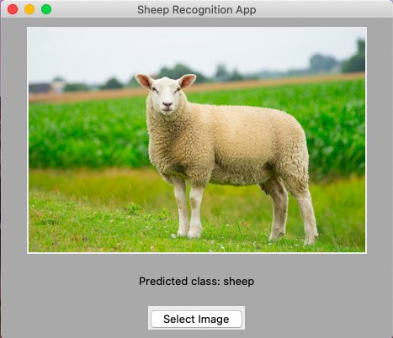
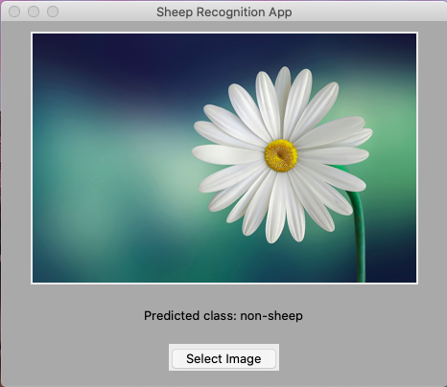
Workflow
Split the dataset into training and validation sets
Use Machine learning frameworks: TensorFlow, Keras to train a convolutional neural network model
sheep_classifier_model.h5
Increase the number of images to fine-tune or retrain the model
Test the app
make_predictions_a.py
Use tkinter to provide a user friendly graphical user interface
make_predictions_b.py

Slide 5
Thank You!
July 12, 2023

