Slide 1
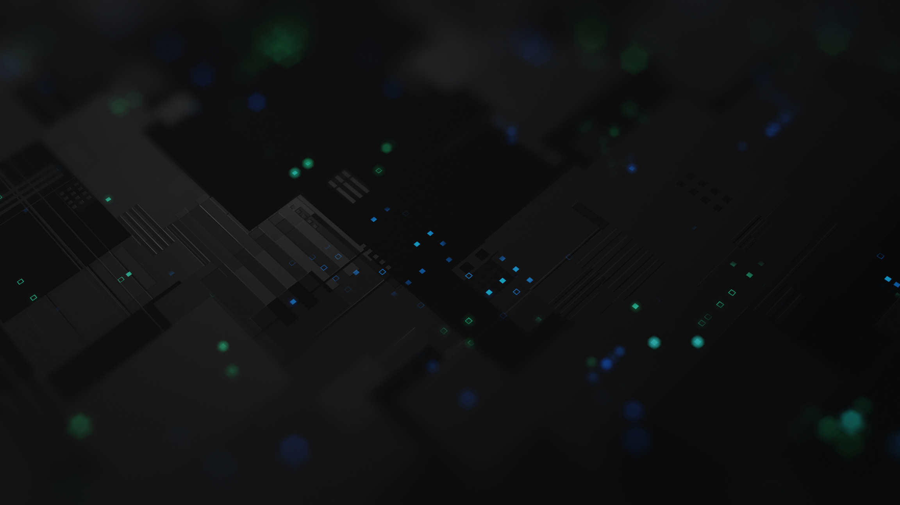

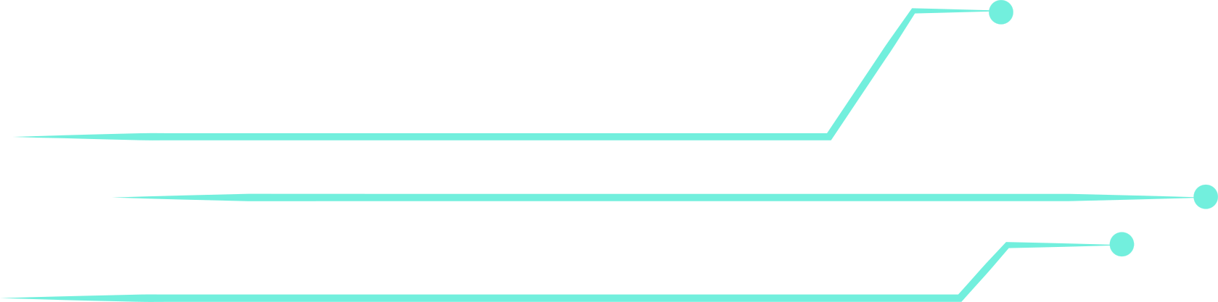
Finetuning StableDiff
to enhance animations
LoRA-based finetuning of image-gen pipelines

Slide 2
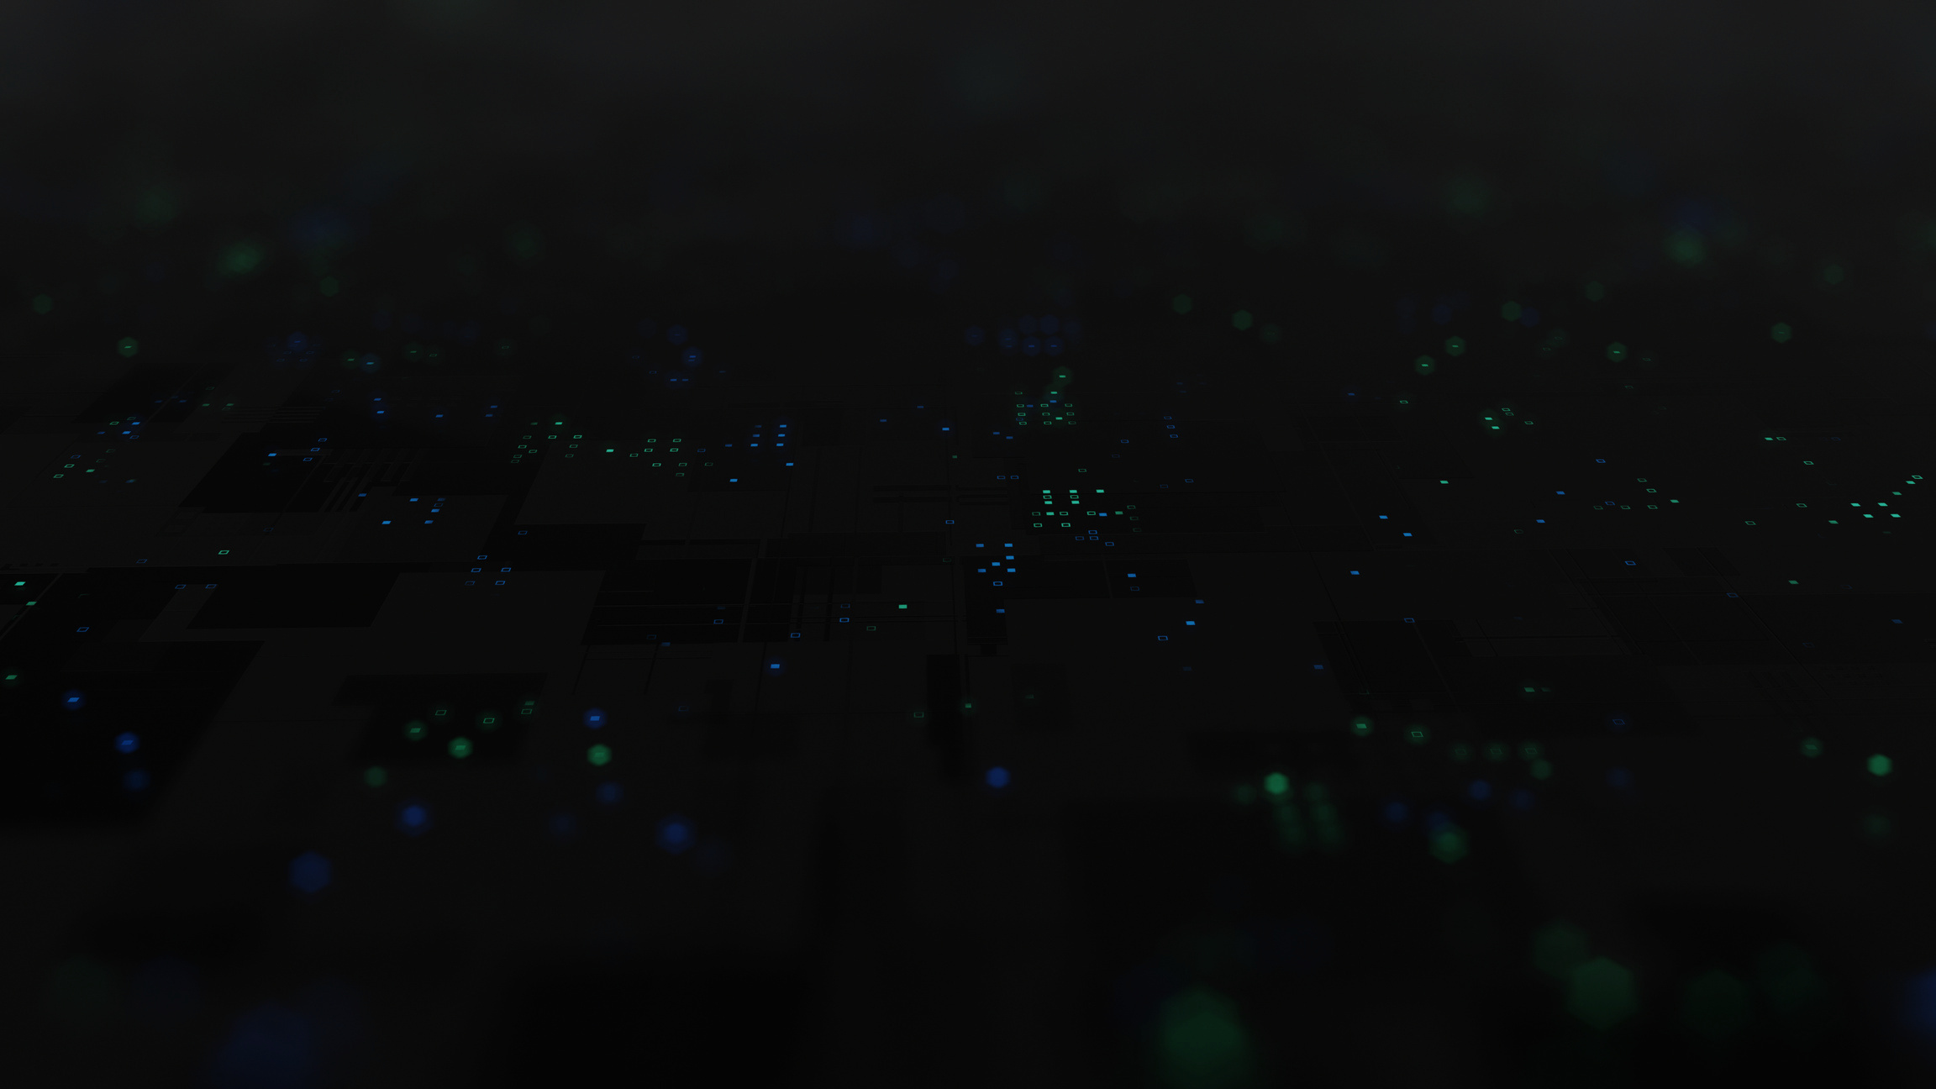
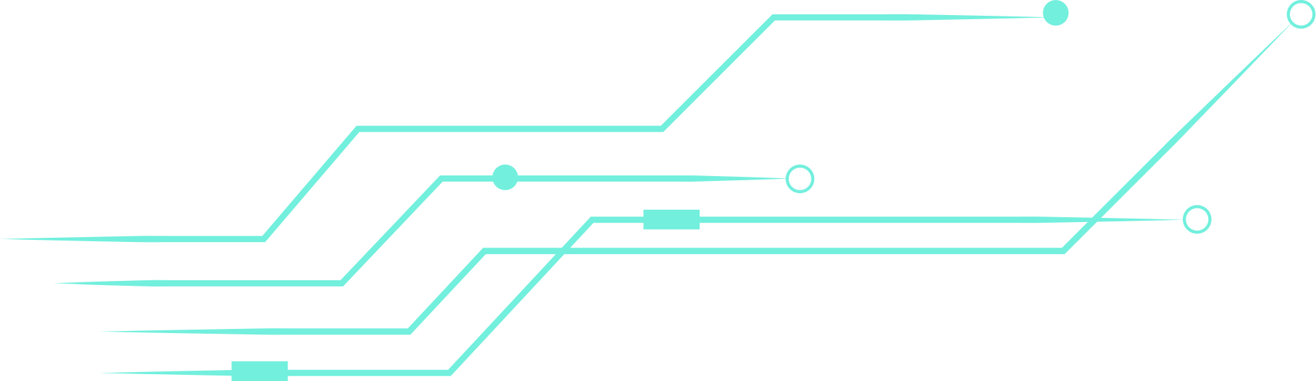
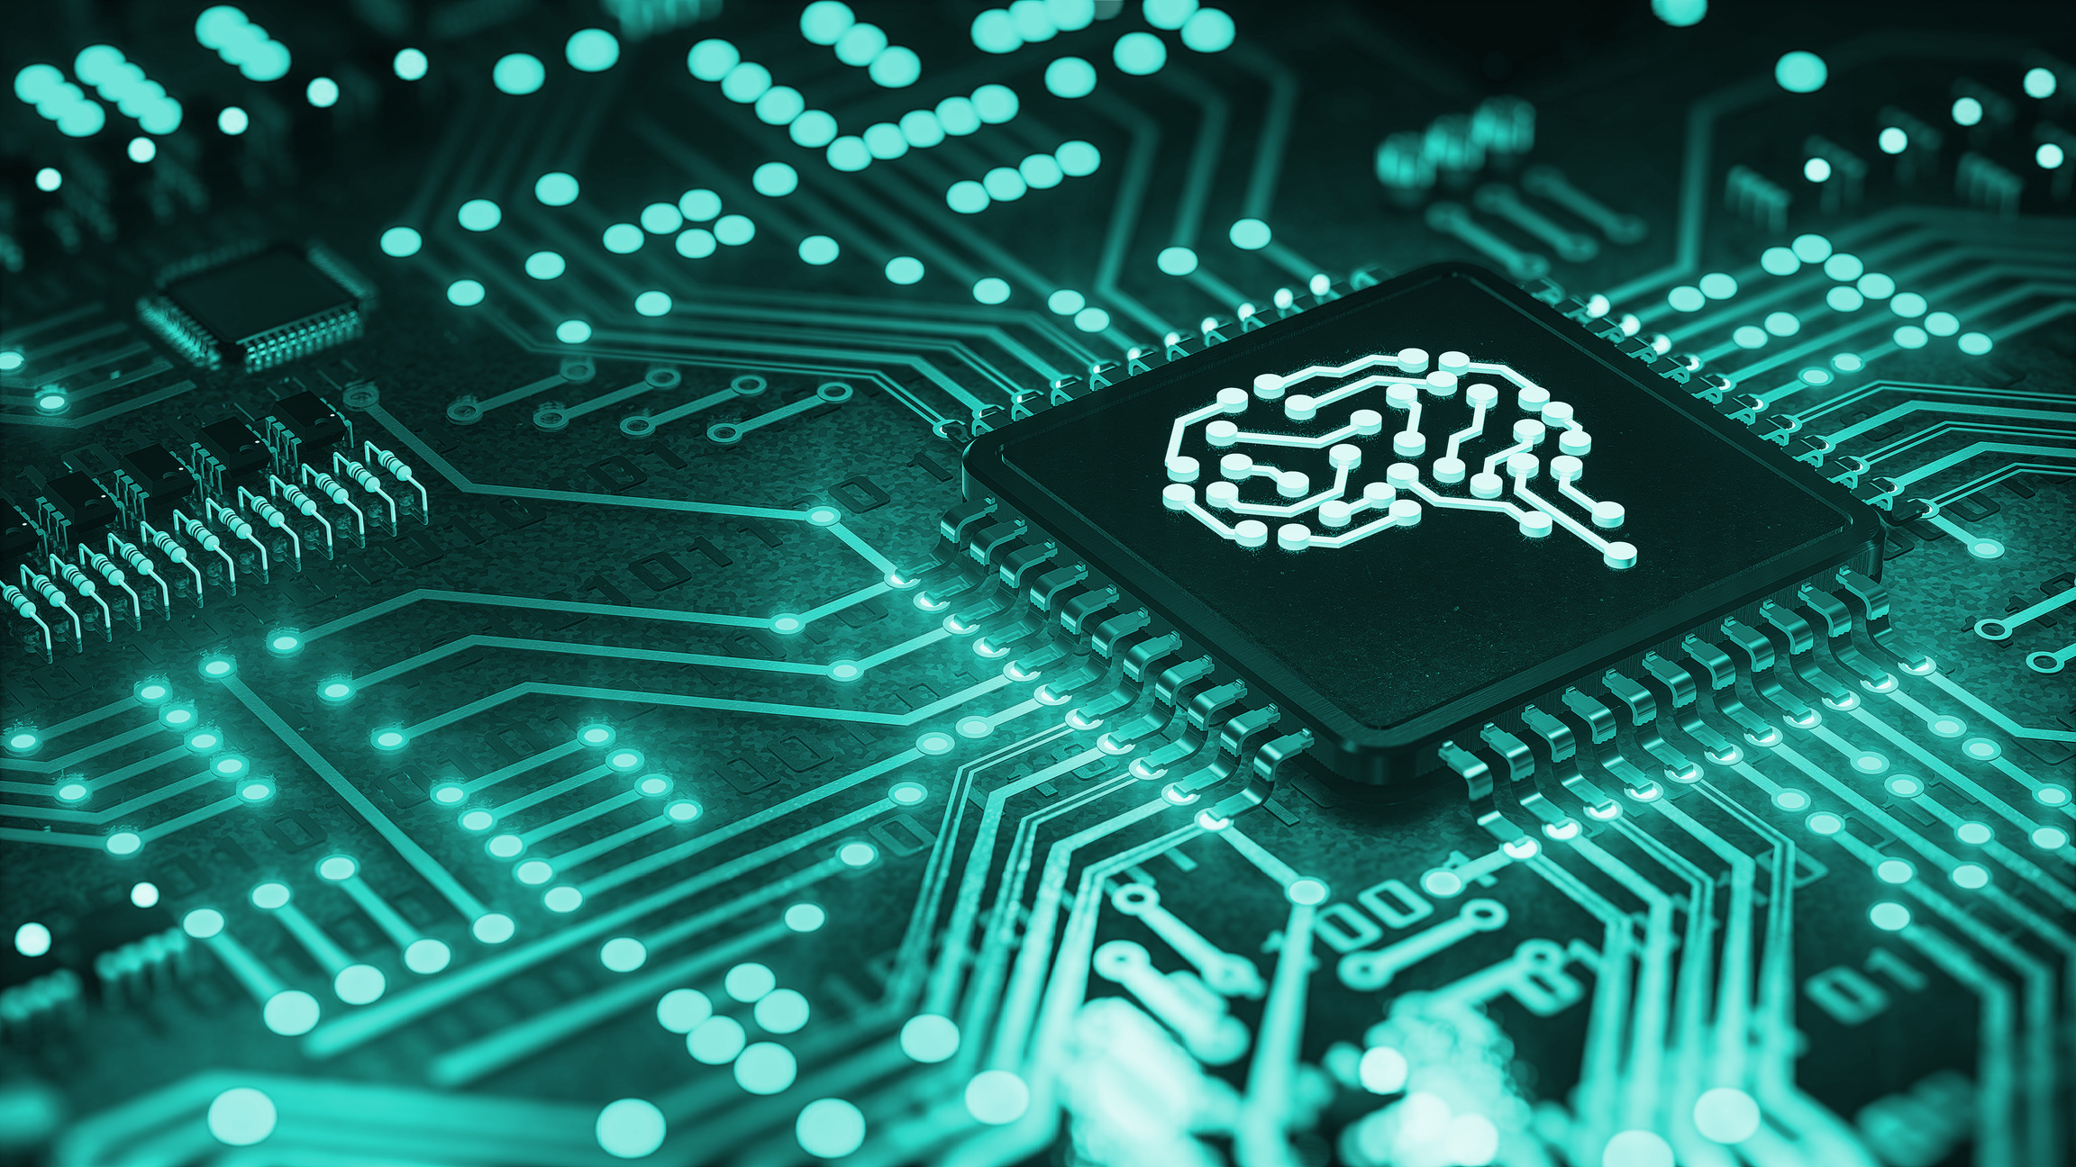
Model Architecture
VAE Encoder
UNet (Denoising Network)
CLIP (Contrastive Language-Image Pretraining)

Slide 3
VAE Encoder
Compresses a high-resolution image (like 512×512×3) into a compact, latent representation (like 64×64×4).
Process:
1. Input: An image (e.g. 512×512×3)
2. It passes through multiple convolutional layers (CNNs)
3. It learns to output two things: a mean vector (μ) and a standard deviation vector (σ)
4. From these, a latent vector z is sampled: z = μ + σ * ε, where ε ~ N(0, 1)
5. This sampled z is the latent code: a compressed, meaningful version of the input image.
This “sampling” step is what makes it variational — it adds randomness, allowing the model to generalize better and learn a smooth latent space.

Slide 4
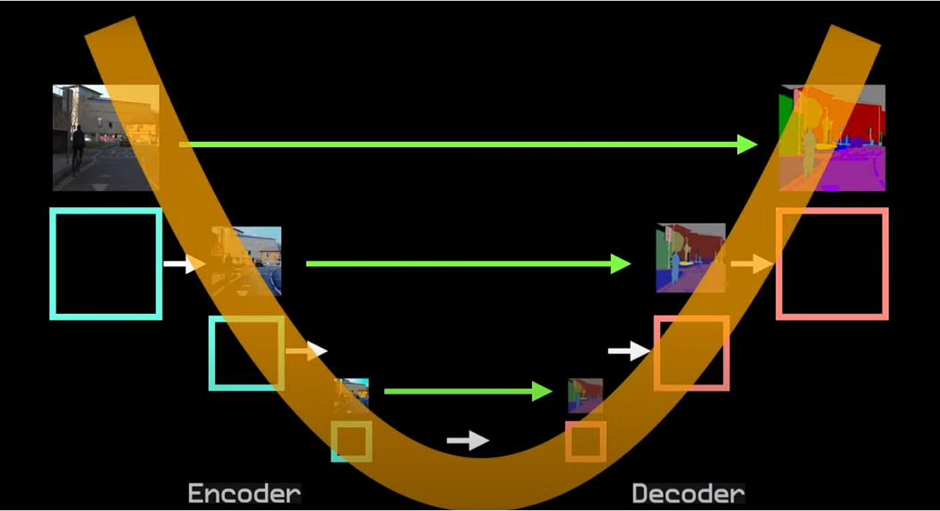
UNet

Slide 5
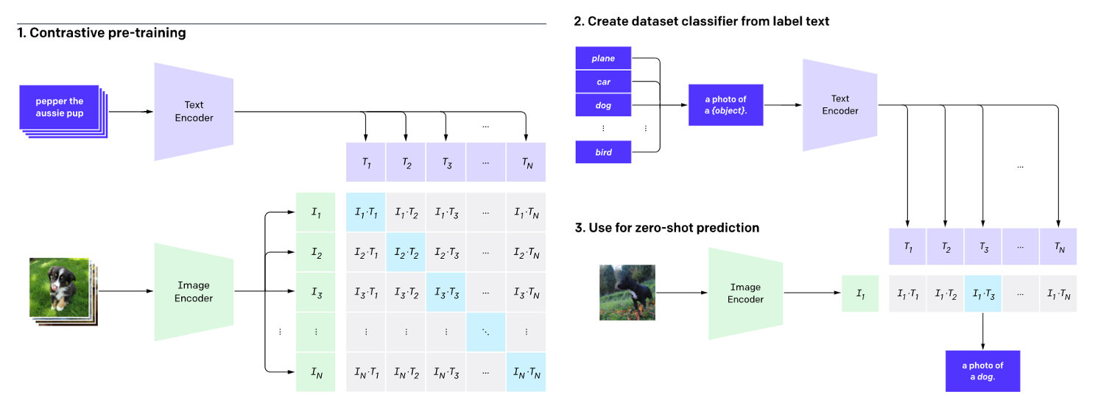
CLIP

Slide 6
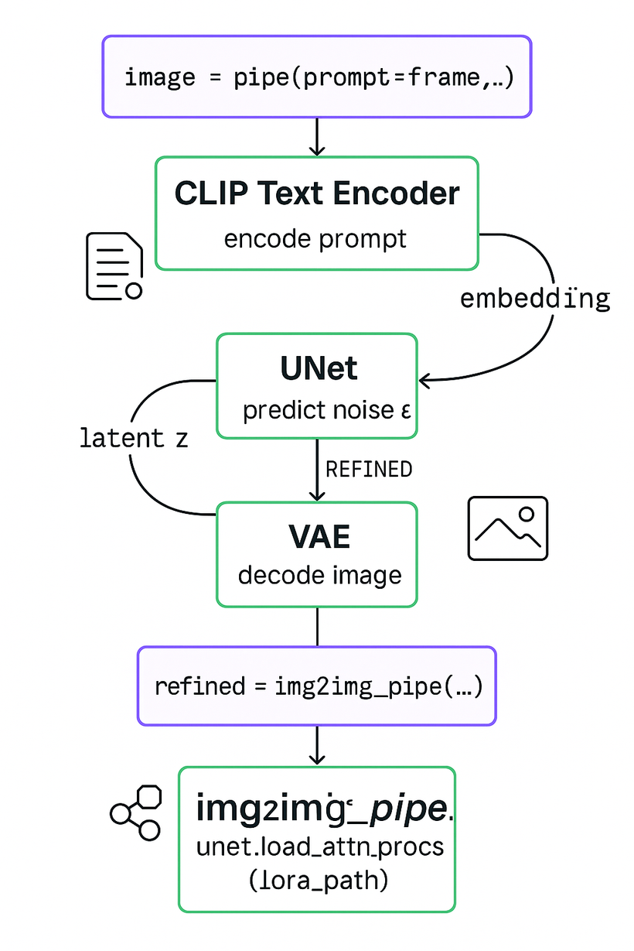

Slide 7
Animation Generation
Steps
Gathering image data to create a finetuning set via Web Scraping and Automation scripts.
Applying finetuned model to two SD pipelines: txt-to-img & img2img.
txt-to-img (prompt) → img2img (prompt + image).
01
04
Finetuning the underlying SD-1.5 model using LoRA.
Implementing a smooth animation creator that puts together the frames in a consistent manner, produces a .gif.
02
05
03
Creating a prompt handler & narrative sequencer using Mistral-Instruct-7B.
06
Improvement:
ControlNet
Better data (manual annot.)
Tweaking params (strength, guidance_scale, steps)
Blended frames (cross-fading)

Slide 8
Thank You

