Slide 1
SALES PERFORMANCE ANALYSIS
A data-driven review of 100,000 transactions — cleaning, validation, and what the numbers actually show
Jan 1 – Sep 10, 2024 · Python (pandas, SciPy) + Power BI

Slide 2
Seven questions this analysis answers
01
What is gross vs. net revenue, and what do discounts cost us?
02
How does revenue move over time — monthly, weekly?
03
Which product category earns the most — and is the gap real or noise?
04
Do bigger discounts lead to bigger orders?
05
Which customers (age / gender) order at a higher value?
06
Is any day of week or part of month stronger than another?
07
Is revenue concentrated in a few categories, or spread out?
Framing
2

Slide 3
Cleaning the data — with evidence, not guesswork
THE PROBLEM
ADDITIONAL QUALITY CHECKS
10,000 rows (10%) were missing Sales_Amount, Discount, Customer_Age and Customer_Gender — all four, in the same rows.
Discount range: 0 – 50, confirming it's a % not a flat amount
Duplicate rows: 0 found
Sales_ID uniqueness: confirmed unique across all rows
THE TEST
Text values: case/whitespace checked — no hidden splits
Chi-square test checked whether missingness was linked to month or category, before deciding how to handle it:
High-cardinality columns: Region (38,107) & Rep (71,060) excluded from grouping
p-value (by month) = 0.73
p-value (by category) = 0.50
QUALITY REPORT — BEFORE / AFTER
Both far above 0.05 — the gaps are missing at random, not tied to a specific month or category.
 | Before | After
Rows | 100,000 | 90,000
Rows w/ missing values | 10,000 | 0
Duplicate rows | 0 | 0
THE DECISION
Rows were dropped, not imputed — with 4 columns missing at once, there was no reliable basis to estimate values.
Methodology
3

Slide 4
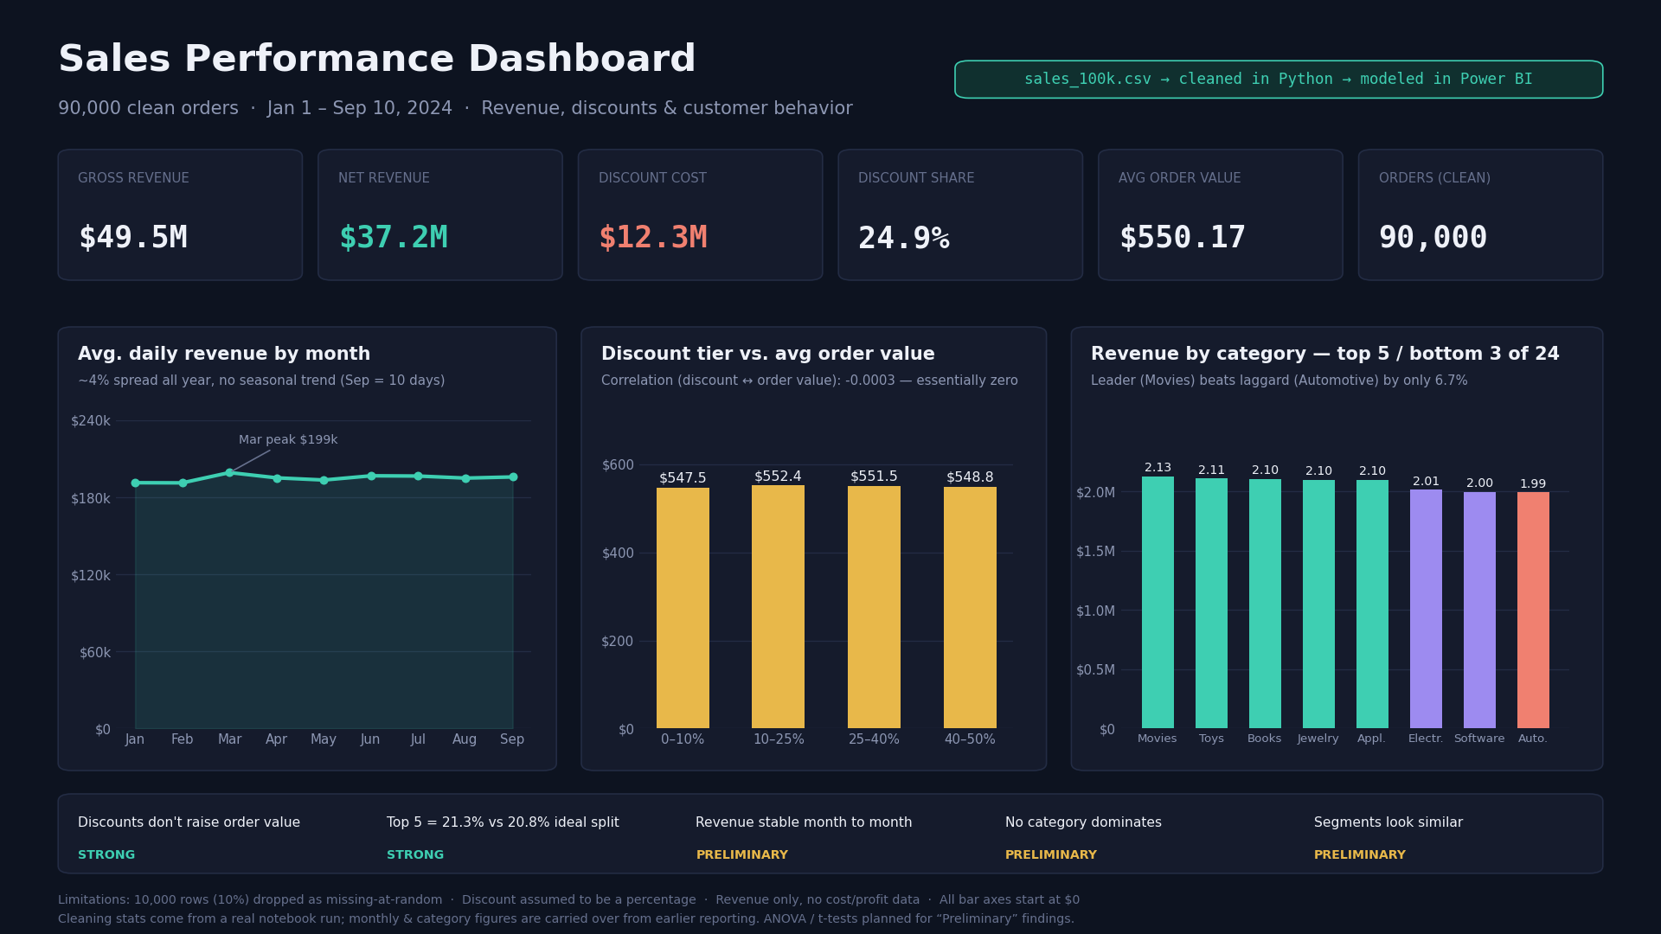
The dashboard — verified against the cleaned data
Results
4

Slide 5
Discounts are not buying bigger orders
$12.3M
AVG ORDER VALUE BY DISCOUNT TIER
Discount tier | Orders | Avg order value
0 – 10% | 18,211 | $547.5
10 – 25% | 18,143 | $552.4
25 – 40% | 17,789 | $551.5
40 – 50% | 17,780 | $548.8
spent on discounts — about 24.9% of gross revenue
-0.0003
correlation between discount size and order value, across 90,000 orders — effectively zero
Every tier lands within $5 of the same ~$550 average — the size of the discount simply doesn't move the order value.
STRONG EVIDENCE
Recommended next step: run a controlled A/B test with a smaller discount on a sample of customers before changing policy across the board.
Backed by a large sample and a clear statistical measure, not a one-off observation.
Key finding
5

Slide 6
Every finding, labeled by how sure we are
Discounts don't raise order value
Correlation -0.0003 on 90,000 orders
STRONG
Revenue spread evenly, no concentration
Top 5 categories = 21.3% vs. 20.8% ideal split
STRONG
Revenue is stable month to month
~4% spread across 9 months
PRELIMINARY
No category clearly dominates
6.7% gap between the top and bottom of 24 categories
PRELIMINARY
Customer segments look similar
Under 1% gap across age and gender groups
PRELIMINARY
"Strong" = backed by a formal statistical test or an unambiguous gap on a large sample. "Preliminary" = a real pattern that still needs ANOVA / t-tests to rule out chance.
Findings
6

Slide 7
What we recommend doing next
Test a smaller discount
1
Run a controlled A/B test on a sample of customers before cutting the discount program company-wide.
Use current revenue as a baseline
2
Treat ~$550/day per-order average as the norm; flag any month that drifts more than ~5% from it.
Spread budget evenly across categories
3
No single category is winning big — don't over-invest chasing a "hero" category that isn't there.
Confirm the preliminary findings
4
Run ANOVA / t-tests on the category, month, and segment gaps before acting on them as fact.
Recommendations
7

Slide 8
Where this analysis has boundaries
10,000 rows (10%) were dropped — every figure here reflects 90,000 orders, not the original 100,000.
Category-level and monthly revenue figures were not recomputed from raw rows in this session (no direct CSV access) — they are carried over from earlier reporting, while the cleaning statistics on the previous slides come directly from this run.
Discount is assumed to be a percentage (validated range: 0–50); if it's ever an absolute amount instead, all net-revenue figures would need recalculating.
This is revenue only — no cost or profit data was available, so we can't say which categories are actually the most profitable.
No repeat-purchase data — we can't yet tell whether discounts affect customer loyalty over time.
ANOVA / t-tests for the "Preliminary" findings (category, month, segment gaps) are planned but not yet run.
Limitations
8

