Slide 1


SMART INDIA HACKATHON 2026
JalGuard - Smart Field Water Surveillance
  Problem Statement ID – SIH26252
  Problem Statement Title- Development of Field Test Kits for Detection and Monitoring of Emerging Contaminants (PFAS, Microplastics, etc.) in Drinking Water Sources and Water Supply Systems
  Theme- Clean & Green Technology
  PS Category- Hardware
  Team ID- 196353
  Team Name – AQUARENEW

Slide 2


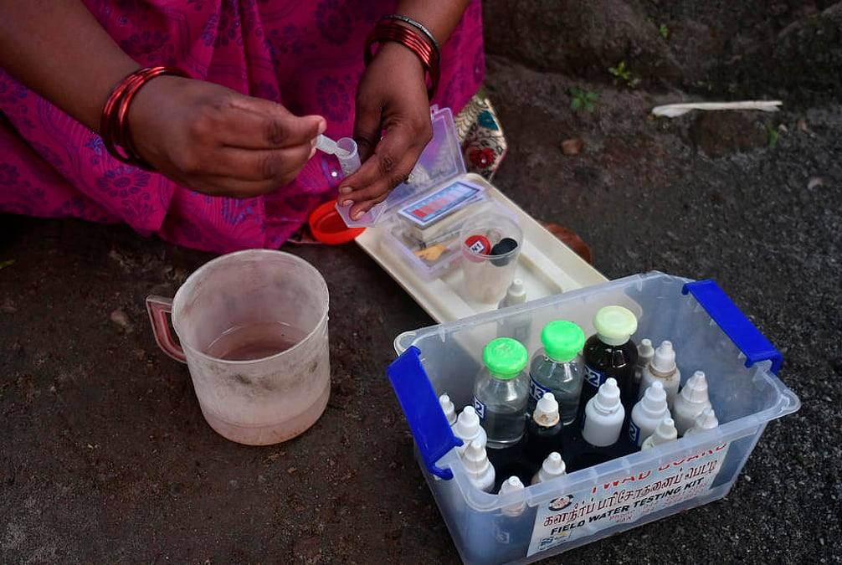
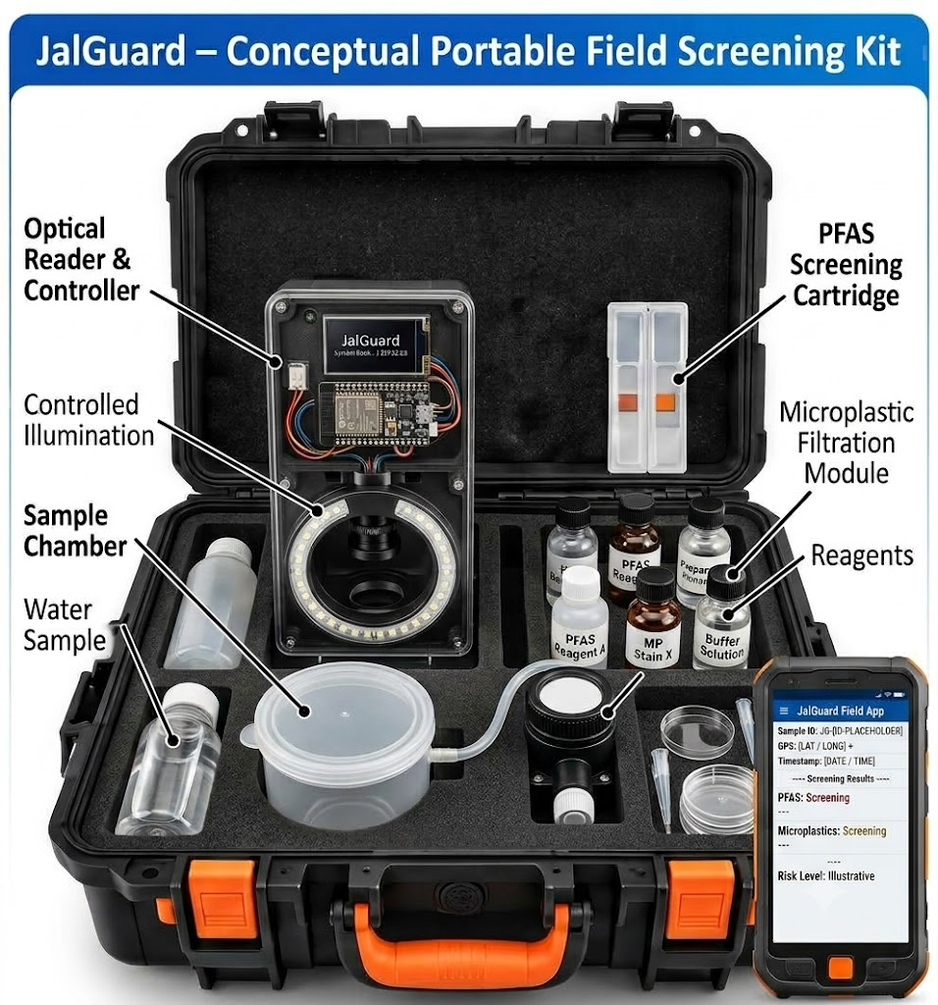
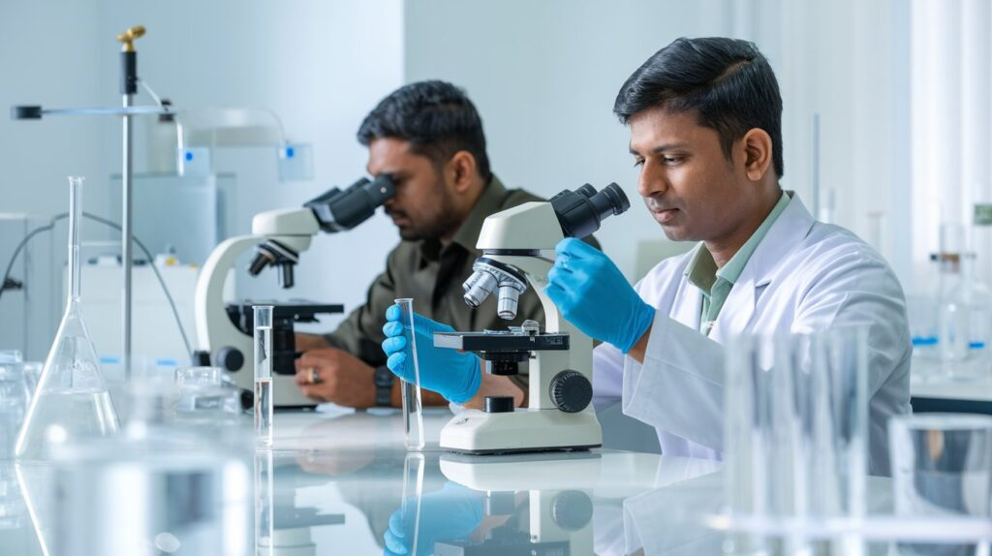



Development of Field Test Kits for Detection and Monitoring of Emerging Contaminants (PFAS, Microplastics, etc.) in Drinking Water Sources and Water Supply Systems
INNOVEXA 007
⚠ Problem ⚠
Proposed Solution
1. Hard to Detect
PFAS and microplastics are difficult to screen quickly in the field.
2. Lab Dependency
Testing often requires specialized laboratories and costly instruments.
3. Limited Field Monitoring
Remote water sources cannot be checked frequently or easily.
4. No Connected Visibility
Test results are often not linked with location, history, and trends for timely follow-up.
Dual-Mode Screening
Rural Water Source & Field Testing
Target-specific PFAS screening + Microplastics (Filtration + Staining + Optical Imaging + AI Analysis)
Detect + Locate
Every test gets Sample ID + GPS + Timestamp
Risk-Based Surveillance
AI-assisted trend analysis identifies rising-risk sources and prioritizes follow-up testing.
Laboratory-Based Water Testing
Offline-First Rural Design
Unique Edge
Test → Save locally → Sync when connectivity returns
Beyond a Testing Kit
Continuous surveillance of many sources, not just one sample.
Screening + Confirmation Model
Dual-Mode Screening
Field screening → Risk assessment → Follow-up / Laboratory confirmation
PFAS (Target-Specific Screening)) and Microplastics (Filtration + Staining + Optical Imaging + AI Analysis)
Smartphone as Field Reader
Test Cartridge → Smartphone Camera/Reader → Signal Analysis
Filter → Staining/Illumination → Camera → AI-assisted analysis
❗ PROBLEM
💡 IDEA
🚀 UNIQUE EDGE
Expensive + Lab Dependent
+ Infrequent +
Poor Rural Coverage
🧠 INNOVATION
Portable Field Screening
+ Smartphone AI
GPS + Offline App + GIS
+ AI Trends + Risk Alerts
Repeated Field Screening → Source-Level Digital Surveillance
DETECT → LOCATE → VERIFY → PREDICT → ACT

Slide 3
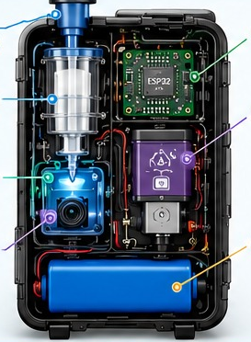























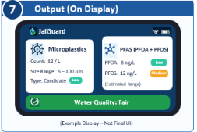




















TECHNICAL APPROACH
Cleaner Water
Healthier Communities
1
System Overview
2
Inside the Device (Hardware View)
3
Detection Modules
JalGuard is a portable, multi-parameter water quality monitoring device that detects:
Water Inlet
ESP32 Controller
A. Microplastic Detection Module
1
(Sample Collection)
5
(Data Processing &
Communication)
2
Filter Chamber
6
Proposed PFAS Sensor Module
Filtered
Sample
(0.45 μm)
Camera
(High Resolution)
LED
Illumination
(White / Optional UV)
AI/ML
Analysis
(with 0.45 μm filter)
Microplastics
PFOA & PFOS
(visual + AI/ML)
(proposed sensing module)
Optical Chamber
(PFOA + PFOS)
Output: Microplastic count, size (approx.), and type (candidate)
Screening Result
Screening Result
(with estimated range)
3
(LED Illumination)
(Target-specific sensing
cartridge + signal reader)
B. PFAS Detection Module (Proposed)
7
Battery & Power
Management
4
Camera Module
Portable
Real-time
Analysis
Cloud Sync
(Optional)
User Friendly
Interface
(High Resolution)
(Rechargeable Li-ion)
PFAS Cartridge
(PFOA + PFOS)
(Target-specific)
Signal Reader
(Electrochemical /
(Optical / MIP-based)
Data Processing
& Calibration
Result
(Estimated Range /
Screening)
Output: PFOA & PFOS – Present / Not Present + Estimated Range (Low/Medium/High)
4
Data Flow
5
Software & AI Pipeline
Image Processing
(OpenCV)
AI/ML Model
Data Processing
Mobile / Web App
Water Sample
Collection
Filtration
(0.45 μm)
Imaging
& Sensing
Signal
Processing
Analysis
& Validation
Result
Display / App
Noise reduction
Feature extraction
Particle detection
Classification
Type / Non-type
Confidence score
Calibration
Risk assessment
Result generation
Live results
History & reports
Cloud sync (optional)
6
Key Components & Technologies
8
Important Notes
Hardware
Software & AI
PFAS Module (Proposed)
Microplastic detection: Feasible with current components (camera + image processing).
ESP32 Development Board
Python (Programming)
Target-specific Cartridge
PFAS detection (PFOA & PFOS): Proposed module. Requires existing research-based sensing approach and proper validation.
OpenCV (Image Processing)
(PFOA + PFOS)
Camera Module
AI / ML (Classification)
Signal Reader
LED Light (White)
(Electrochemical / Optical / MIP-based)
Concentration values: Approximate and depends on calibration and testing (range: ng/L).
Filter Holder + 0.45 μm Filter
Data Analytics
Data Processing
Battery & Power Circuit
Mobile / Web App
(Calibration & Validation)
Final accuracy depends on sensor selection, calibration, real-water testing and interference handling.

Slide 4

FEASIBILITY AND VIABILITY
🟢 Technical Feasibility
🟢 Product Viability
🔴 Risks & Mitigation
Can it become a practical solution?
Can we build it?
Challenge
→ Our Approach
Hardware
💰 Affordable
PFAS sensitivity / selectivity
→
Start with selected targets + laboratory validation
Portable enclosure · Camera + controlled illumination · Controller + battery · Sample chamber
Reusable core + replaceable sensing consumables
PFAS contamination
→
Controlled sampling + blanks + QC
Microplastic Screening
📦 Scalable
Microplastic false positives
Controlled imaging + QC + validation
Filtration · Controlled imaging · Image-based particle analysis
One source → Village → District → State
→
PFAS Screening
🔧 Adaptable
Different water matrices
→
Matrix-specific validation
Target-specific cartridge · Recognition chemistry · Measurable signal · Laboratory comparison for validation
PFAS → Microplastics → Future modules
Rugged enclosure + guided workflow
Field conditions
→
Software
👤 Easy to Use
Controlled storage + shelf-life testing
QR/source ID · Offline data capture · Risk dashboard · Cloud synchronization
QR → Guided Test → Result → Action
Cartridge stability
→
Technically feasible with staged validation
The reusable device is designed for repeated field use, while sensing cartridges/cassettes are replaced per testing workflow.
Scientific acceptance
Compare against reference laboratory methods
→
Development Roadmap
V0.1
→
V0.2
→
V0.3
→
V0.4
→
V1.0
→
Next
Core Hardware
Microplastic Module
PFAS Module
Lab Validation
Field Pilot
Scale-up
Build → Validate → Pilot → Scale
JalGuard is positioned as a field-screening and surveillance platform, not a replacement for accredited laboratory confirmation.

Slide 5




IMPACT & BENEFITS
Borewell
Screening data flows up
Safe / routine
Village
Block
District
State
Hand pump
Monitor / retest
Community water point
Priority / lab confirmation
Every screening event, from source to state
Safer Water Monitoring
Faster Risk Identification
Source-Level Traceability
Data-Driven Governance
Earlier identification of potentially contaminated sources.
Reduce dependence on waiting for every sample to reach a central laboratory before prioritization.
Every screening event linked to source identity, location and history.
Authorities can identify trends and prioritize follow-up.
Benefits
SOCIAL
ECONOMIC
ENVIRONMENTAL
Better rural water surveillance
Faster identification of potentially risky sources
Supports field workers
Reduces unnecessary laboratory testing through prioritization
Reusable core device
Modular consumables
Supports emerging-contaminant monitoring
Enables source-level trend tracking
Helps identify priority contamination hotspots
Screen in the field
Prioritize intelligently
Confirm in the lab
Act at the source
Notes:
Impact slide: JalGuard moves water-quality work from testing water to protecting water sources. Field screening flags sources as safe/routine, monitor/retest, or priority/lab confirmation; data flows Village to Block to District to State.

Slide 6
Research & References
Research Paper and References
Microplastic Detection using AI
P. Thota, K. Challapalli, H. Garikapati, V. M. S. Adusumilli, S. Anamalamudi and M. K. Enduri, "Microplastic Detection in Drinking Water: A Comparative Analysis of CNN-SVM and CNN-RF Hybrid Models," 2024 OITS International Conference on Information Technology (OCIT), Vijayawada, India, 2024, pp. 24-29, IEE Excess
Machine Learning for PFAS
N. Andraju, G. Curtzwiler, Y. Ji, E. Kozliak and P. Ranganathan, "Machine Learning Models for PFAS Tracking, Detection and Remediation: A Review," 2023 IEEE International Conference on Electro Information Technology (eIT), Romeoville, IL, USA, 2023, pp. 137-142, IEE Excess
Technical Reference
IoT + Cloud Water Quality Monitoring
R. Raman and A. Deshpande, "Real-time Monitoring System for Safe Drinking Water Safety Using IoT and Cloud Computing," 2024 International Conference on Advances in Data Engineering and Intelligent Computing Systems (ADICS), Chennai, India, 2024, pp. 1-6, IEE Excess
Portable IoT Water Testing
P. K. Manda, K. Katarapu, V. Kurakula, S. P and S. R. Ammana, "Compact IoT-Enabled Water Testing Kit for E.coli and Coliform Contamination," 2025 8th International Conference on Trends in Electronics and Informatics (ICOEI), Tirunelveli, India, 2025, pp. 565-570, IEE Excess

