Slide 1
Speech Enabled Smart Technologies
We work to keep you one step ahead

Slide 2
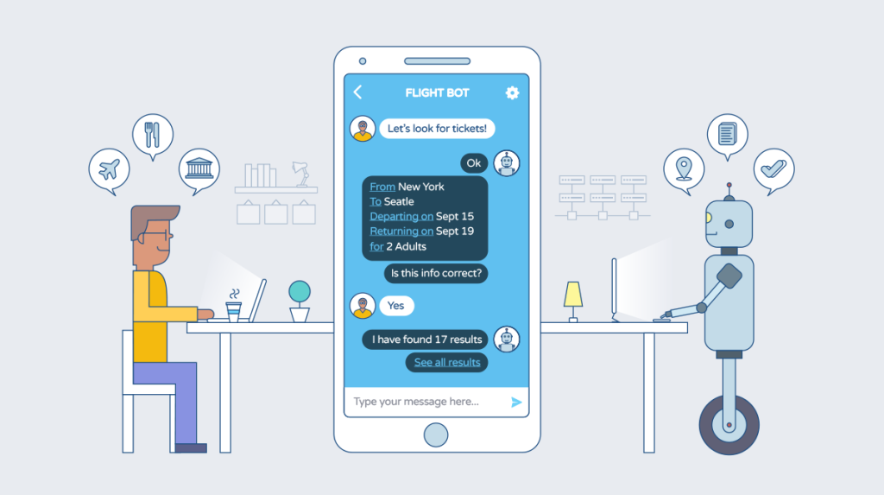
Chatbot Development-101: Building A Conversational AI Bot with Sestek

Slide 3
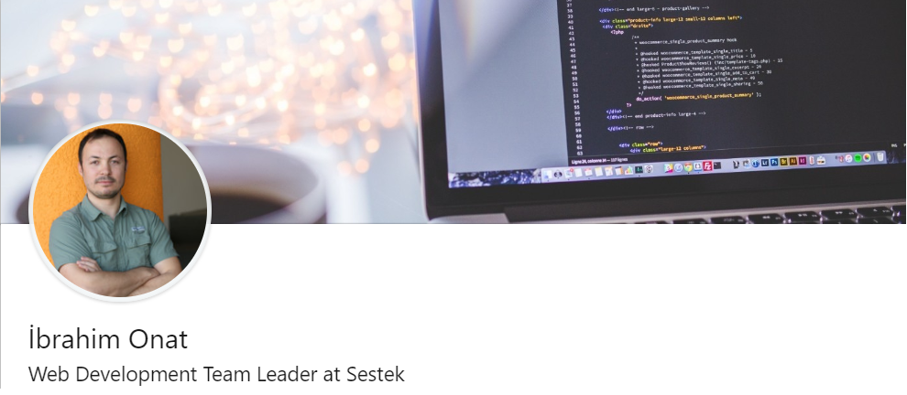
Hakkımda
GitHub: @ibrahimonat
Twitter: @ibrahimonat
Email: ibrahim.onat@sestek.com

Slide 4
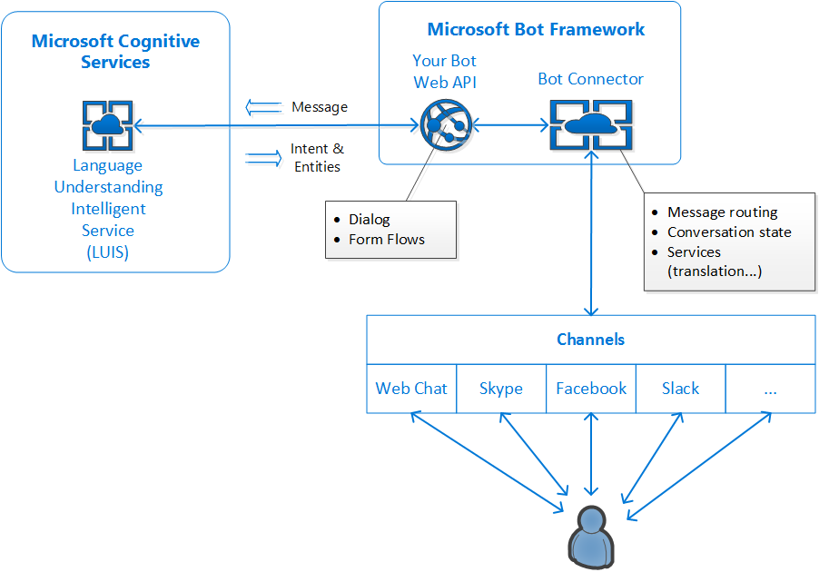

Slide 5
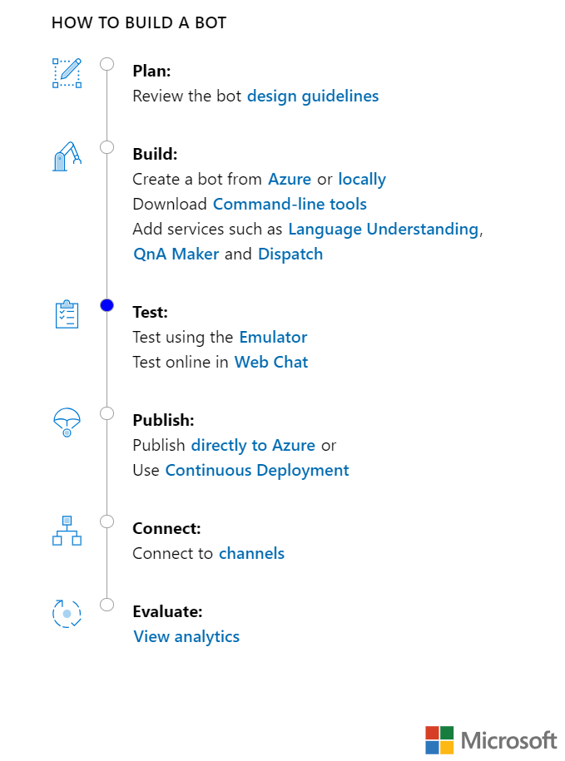

Slide 6

Görev & Servisler

Slide 7

Young Talent Recruitment Program
You can build a solid and valuable career in Sestek. So, we encourage you to apply to become a member of our organization like many employees whose first concern is career development.
You can apply by sending your resume to hr@sestek.com until the end of April 30th, if you are:
A senior student at the university, just graduated or with at least one year of work experience,
A person who wants to have a career in software development, R&D and business analysis,
Inquisitive, assertive, idealist and promoter,
Ambitious, sociable and analytical thinker.
For more info: www.sestek.com/careers

Slide 8
Speech Enabled Smart Technologies
Teşekkür ederiz...

