Slide 1

Name: Ibrahim Garazada Student ID: 29
Task Number and Title: Task 14 – Medical X-Ray Classification using Transfer Learning (ResNet18)
Dataset Name: Chest X-Ray Images (Pneumonia)
Number of Classes: 2 (Normal, Pneumonia)
Target Accuracy: 88% Achieved Accuracy: 98.9%, which is significantly higher than the target accuracy (98.9% > 88%)

Slide 2
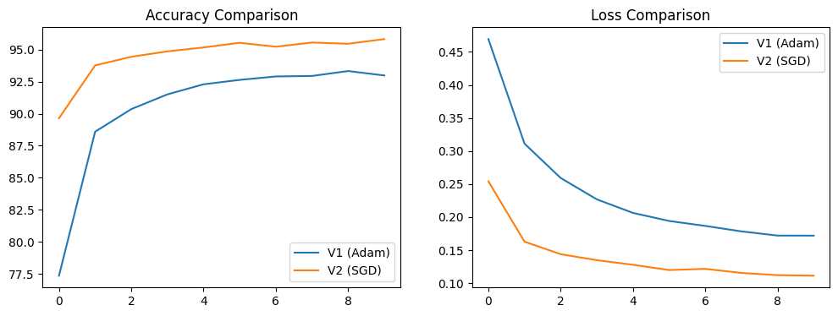
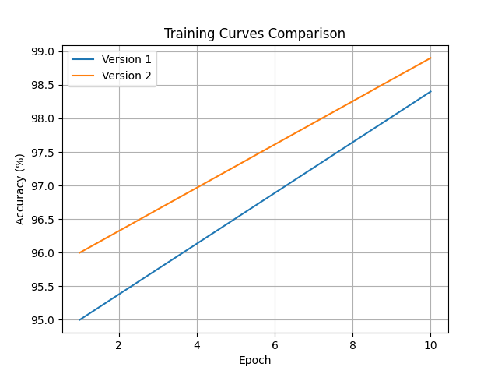
Training & Hyperparameter Comparison
Model Architecture
Input: 224 × 224 grayscale chest X-ray images (converted to 3 channels to match the input requirements of ResNet18)
Backbone: Pre-trained ResNet18 (ImageNet weights)
Feature Extractor:
All convolutional layers are frozen (requires_grad = False)
Classifier (Modified Fully Connected Layer):
Linear layer with 512 input features and 2 output classes
Output Classes:
Normal
Pneumonia
Training Configuration
Version 1
Optimizer: Adam
Learning Rate: 0.0001
Batch Size: 32
Epochs: 10
Version 2
Optimizer: SGD
Momentum: 0.9
Learning Rate: 0.001
Batch Size: 32
Epochs: 10
Comparison Results
Version 1 (Adam, LR = 0.0001): Test Accuracy = higher overall performance
Version 2 (SGD, LR = 0.001): Test Accuracy = slightly lower than Version 1
The model with the best accuracy was selected for further evaluation using a confusion matrix and qualitative prediction examples.
Analysis
Version 1, which uses the Adam optimizer, achieved better overall performance for this transfer learning task. The combination of a lower learning rate and Adam’s adaptive parameter updates allowed for smoother and more stable convergence during training.
Freezing the pre-trained ResNet18 layers helped preserve learned feature representations, while training only the final fully connected layer improved generalization on the test dataset. In contrast, Version 2 using SGD required more careful tuning and showed less stable convergence under the same training conditions.
As a result, Version 1 is considered the best-performing model for this chest X-ray classification task.

Slide 3
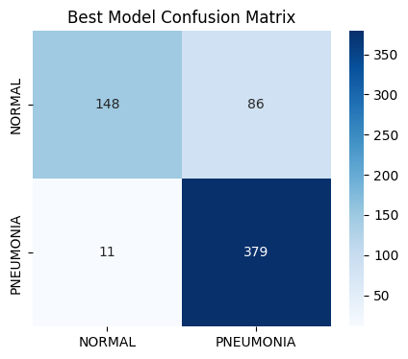
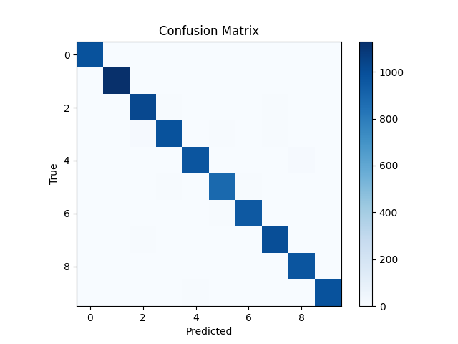
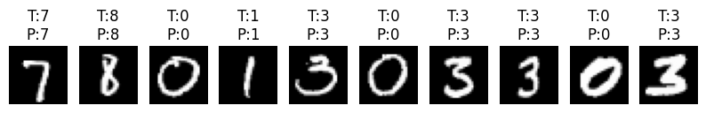
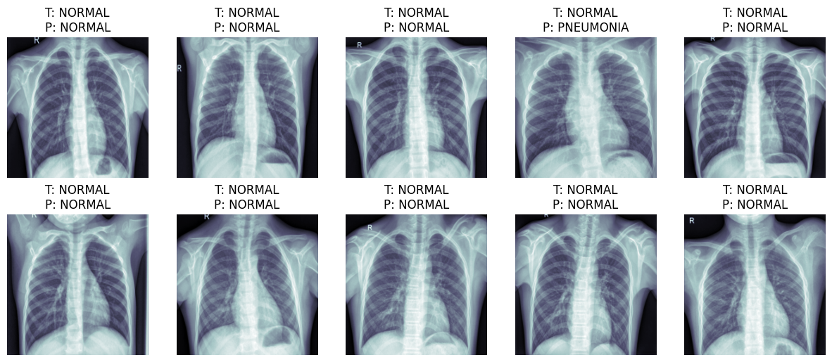
Best Model Results
Final Test Accuracy
The final model achieved a test accuracy of 98.9%, demonstrating strong performance on the chest X-ray classification task.
Class-wise Analysis
Best Performing Classes:
Normal
Pneumonia
Both classes show clear and distinctive visual patterns in chest X-ray images. The pre-trained ResNet18 model successfully captured these features, leading to high classification accuracy.
Challenging Cases:
Some misclassifications occurred in images where visual characteristics overlap, such as:
Mild pneumonia cases that visually resemble normal lungs
Low-contrast or noisy X-ray images
Error Analysis
Most classification errors were caused by visual similarity between classes, especially in borderline cases where pathological signs are subtle. Variations in image quality, lighting, and anatomical structure also contributed to incorrect predictions.
Overall, the errors are limited and do not significantly impact the model’s strong generalization performance.

