Slide 1
5
C Functions

Slide 2
OBJECTIVES
In this chapter you will learn:
To construct programs modularly from small pieces called functions.
The common math functions available in the C Standard Library.
To create new functions.
The mechanisms used to pass information between functions.
Simulation techniques using random num­ber generation.
How to write and use recursive functions, i.e., functions that call themselves.

Slide 3
5.1 Introduction
Why functions?
Break longer jobs into conceptually smaller jobs which are precisely defined.
C program generally consists of many small functions.
A piece of a code which repeats at many places can be written only once and used again and again.
Debugging and maintenance is easy

Slide 4
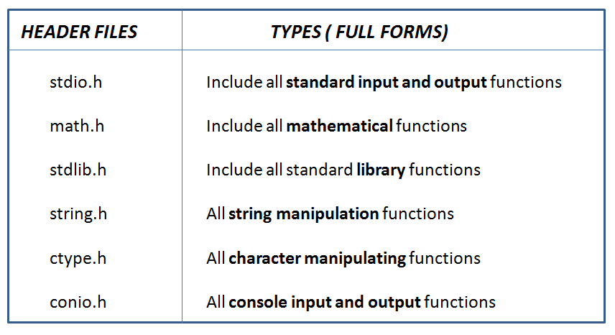
5.2 Functions in C
C standard library has a wide variety of functions

Slide 5
5.3 Math Library Functions
Math library functions
perform common mathematical calculations
#include <math.h>
Notes:
printf function takes two arguments. Returns number of printed characters.
#include <math.h> statement adds all the codes (functions) from the math.h file into our code. Therefore, all the functions which are defined in math.h file are ready for our usage.

Slide 6
Fig. 5.2 | Commonly used math library functions. (Part 1 of 2.)

Slide 7
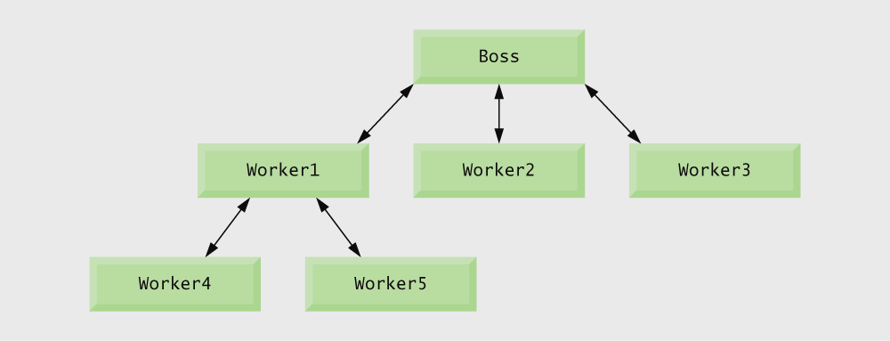
Boss asks worker to complete task, Worker gets information, does task, returns result. Information hiding: boss does not know details.
Fig. 5.1 | Hierarchical boss function/worker function relationship.

Slide 8
#include <math.h>
statement adds (preprocessor directive ) all the codes (functions) from the math.h file into our code.
Therefore, all the functions which are defined in math.h file are ready for our usage.
Notes:
#include <math.h> is a preprocessor directive loads the file into our code. Then, the compiler compiles the final code.

Slide 9
For example: If you want to use sqrt() function, the header file <math.h> should be included.
#include <stdio.h>
int main() {
// If you use sqrt() function without including the <math.h> // header file, this program will show an error.
sqrt(900);
}

Slide 10
Format for calling functions
functionName ( argument );
If multiple arguments, use comma-separated list
sqrt(900.0);
Calls function sqrt, which returns the square root of its argument
All math functions return data type double
Arguments may be constants, variables, or expressions
Notes:
printf function takes two arguments. Returns number of printed characters.
#include <math.h> statement adds all the codes (functions) from the math.h file into our code. Therefore, all the functions which are defined in math.h file are ready for our usage.

Slide 11
Good Programming Practice 5.1
Familiarize yourself with the rich collection of functions in the C Standard Library.
Avoid reinventing the wheel. When possible, use C Standard Library functions instead of writing new functions.

Slide 12
Portability Tip 5.1
Using the functions in the C Standard Library helps make programs more portable.

Slide 13
Software Engineering Observation 5.2
All C programs must have one, and only one, main function

Slide 14
5.5 Function Definitions
if we want to define a new function
Return-value-type: data type of the result (default int). void – indicates that the function returns nothing
function-name: any valid identifier
return-value-type function-name( parameter-list ) { declarations and statements }
Parameter-list: comma separated list, declares parameters

Slide 15
5.5 Function Definitions
return-value-type function-name( parameter-list ) { declarations and statements }
function body
Variables can be defined inside blocks (function body)
Functions can not be defined inside other functions
// function definition
int max(int a){
int b=100;
return a>b ? a : b;
}

Slide 16
5.5 Function Definitions
return-value-type function-name( parameter-list ) { declarations and statements
return; }
return-value-type function-name( parameter-list ) { declarations and statements
}
nothing returns

Slide 17
5.5 Function Definitions
// function definition
int max(int a){
int b=100;
return a>b ? a : b;
}
returns an integer value

Slide 18
Function Definition Example
int max(int a, int b);
int main() {
int x;
x = max(5,8);
x = max(x,7);
} // end of main function
// function definition
int max(int a, int b){
return a>b ? a : b;
}
Function prototype indicates function will be defined later in the program
Function is called
Function definition

Slide 19
Outline
Function prototype indicates function will be defined later in the program
Call to square function
Place a blank line between function definitions to separate the functions and enhance program readability.
Function definition

Slide 20
Common Programming Error 5.1
Omitting the return-value-type in a function definition is a syntax error if the function prototype specifies a return type other than int.
double sample_f (parameter-list );
int main {
… }
sample_f ( parameter-list ) { declarations and statements, calculations of x
return x; }

Slide 21
Common Programming Error 5.2
Forgetting to return a value from a function that is supposed to return a value can lead to unexpected errors. The C standard states that the result of this omission is undefined.
double sample_f (parameter-list );
int main {
… }
double sample_f ( parameter-list ) { declarations and statements
}

Slide 22
Common Programming Error 5.3
Returning a value from a function with a void return type is a syntax error.
void sample_f (parameter-list );
int main {
… }
Void sample_f ( parameter-list ) { declarations and statements, calculations of x
return x; }

Slide 23
Good Programming Practice 5.3
Even though an omitted return type defaults to int, always state the return type explicitly.
sample_f (parameter-list );
int main {
… }
sample_f ( parameter-list ) { declarations and statements, calculations of x
return x; }

Slide 24
Common Programming Error 5.4
Specifying function parameters of the same type as double x, y instead of double x, double y might cause errors in your programs. The parameter declaration double x, y would actually make y a parameter of type int because int is the default.
double sample_f (double x, y );
int main {
… }
double sample_f ( double x, y ) { declarations and statements, calculations of x
return x; }
y is declared as integer

Slide 25
Good Programming Practice 5.4
Include the type of each parameter in the parameter list, even if that parameter is of the default type int.
double sample_f (int x, int y );
int main {
… }
double sample_f ( int x, int y ) { declarations and statements, calculations of x
return x; }

Slide 26
Common Programming Error 5.7
Defining a function inside another function is a syntax error.

Slide 27
Good Programming Practice 5.6
Choosing meaningful function names and meaningful parameter names makes programs more readable and helps avoid excessive use of comments.

Slide 28
Software Engineering Observation 5.6
Programs should be written as collections of small functions. This makes programs easier to write, debug, maintain and modify.

Slide 29
Outline
Function prototype
fig05_04.c
(1 of 2 )
Function call
Function prototype indicates function will be defined later in the program

Slide 30
Outline
Function definition
fig05_04.c
(2 of 2 )

Slide 31
5.6 Function Prototypes
Function prototype
Function name
Parameters – what the function takes in
Return type – data type function returns (default int)
Used to validate functions
Prototype only needed if function definition comes after use in program
The function with the prototype
int maximum ( int x, int y, int z );
Takes in 3 ints
Returns an int
Notes:
Function prototype indicates function will be defined later in the program.

Slide 32
Common Programming Error 5.8
Forgetting the semicolon at the end of a function prototype is a syntax error.
;
double sample_f (int x,int y )
int main {
… }
double sample_f ( int x, int y ) { declarations and statements, calculations of x
return x; }

Slide 33
higher data types
Converting to lower data types can lead to errors
Fig. 5.5 | Promotion hierarchy for data types.
Notes:
If long double format is converted into int format, this conversion can change the data value because of data loss

Slide 34
Common Programming Error 5.9
Converting from a higher data type in the promotion hierarchy to a lower type can change the data value.
int sample_f (double x, double y );
int main {
… }
int sample_f (double x, double y );
{ declarations and statements, calculations of x
return x; }

Slide 35
Common Programming Error 5.10
Forgetting a function prototype causes a syntax error if the function definition appears after the function call in the program.
int main {
sample_f (3,4); /* function call */
… }
// function definition
int sample_f ( int x, int y ) { declarations and statements, calculations of x
return x; }

Slide 36
Software Engineering Observation 5.9
A function prototype placed in a function applies only to calls made in that function.
int main {
int sample_f (int x,int y );
sample_f(3,4);
… }
int sample_f ( int x, int y ) { declarations and statements, calculations of x
return x; }
function prototype

Slide 37
5.7 Function Call Stack and Activation Records
Program execution stack
A stack is a last-in, first-out (LIFO) data structure
Anything put into the stack is placed “on top”
The only data that can be taken out is the data on top
C uses a program execution stack to keep track of which functions have been called
When a function is called, it is placed on top of the stack
When a function ends, it is taken off the stack and control returns to the function immediately below it
Calling more functions than C can handle at once is known as a “stack overflow error”

Slide 38
5.8 Headers
Header files
Contain function prototypes for library functions
<stdlib.h> , <math.h> , etc
Load with #include <filename>
#include <math.h>
Custom header files
Create file with functions
Save as filename.h
Load in other files with #include "filename.h"
Reuse functions

Slide 39
Fig. 5.6 | Some of the standard library headers. (Part 1 of 3.)

Slide 40
Fig. 5.6 | Some of the standard library headers. (Part 2 of 3.)

Slide 41
Fig. 5.6 | Some of the standard library headers. (Part 3 of 3.)

Slide 42
5.9 Calling Functions: Call-by-Value and Call-by-Reference
call by value
Call by value
Copy of argument passed to function
Changes in function do not effect original
Use when function does not need to modify argument
Avoids accidental changes
Call by reference
Passes original argument
Changes in function effect original
Only used with trusted functions
For now, we focus on call by value
int main {
sample_f(3,4); /* function call */
… }
int sample_f ( int x, int y ) { declarations and statements, calculations of x
return x; }

Slide 43
5.10 Random Number Generation
rand function
Load <stdlib.h>
Returns "random" number between 0 and RAND_MAX (at least 32767)
i = rand();
Pseudorandom
Preset sequence of "random" numbers
Same sequence for every function call

Slide 44
To get a random number between 1 and n
1 + ( rand() % n )
rand() % n returns a number between 0 and n - 1
Add 1 to make random number between 1 and n
1 + ( rand() % 6)
returns number between 1 and 6

Slide 45
Computers and Random Numbers
Computers are “deterministic” machines
Computers are not capable of true randomness
Instead, pseudo-random numbers are used
Pseudo-random numbers are generated using a mathematical formula
There is a pattern in pseudo-random numbers
The pattern is nearly impossible to observe

Slide 46
Advantage of Psuedo-Randomness
It would be difficult to debug programs that use truly random numbers (can’t recreate error cases on demand)
By providing the same start-value (seed) to the generator, the same sequence results on each run and error cases can be observed
When you are through debugging, you can use a different seed each time.
Often, this is done by using the system clock

Slide 47
Outline
fig05_07.c
Generates a random number between 1 and 6
rand() function returns same sequence for every function call

Slide 48
Outline
fig05_08.c
(1 of 3 )
If you roll a six sided die 6000 times, this program counts how many times you get 1, how many times you get 2 and so on.. .
frequency1 variable is used to count 1,
frequency2 variable is used to count 2 and so on…
If face=1, frequency1 is incremented by one.

Slide 49
Outline
fig05_08.c
(2 of 3 )
If face=6, frequency6 is incremented by one.

Slide 50
Outline
fig05_08.c
(3 of 3 )

Slide 51
5.10 Random Number Generation
rand() function returns same sequence for every function call. srand function is used to get different sequences.
srand function
<stdlib.h>
Takes an integer seed and jumps to that location in its "random" sequence
srand( seed );
srand( time( NULL ) );/*load <time.h> */
time( NULL )
Returns the number of seconds that have passed since January 1, 1970
“Randomizes" the seed
Notes:
We have another function named srand. As we know from the previous slides, rand() function always generates same number sequences. srand function takes an integer seed value and jumps to a random sequence according to this seed value.

Slide 52
Outline
fig05_09.c
(1 of 2 )
Seeds the rand function

Slide 53
Outline
Notes:
According to different seed values, rand() function generates different number sequences.

Slide 54
Using Time to Seed the Generator
If you hard code the seed or allow the user to enter a seed, simulated randomness is lost.
Most programmers use the “time” function to seed the generator.

Slide 55
Using Time to Seed the Generator
Must include the <time.h> library
Provides function “time( )”
Calling function “time( )”:
time( NULL )
Returns the current time from the system clock
Expressed in number of seconds elapsed since 00:00 hours, Jan 1, 1970 UTC
srand( time( NULL );

Slide 56
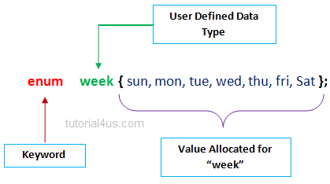
Enumeration Constants
#include<stdio.h>
enum week {sun, mon, tue, wed, thu, fri, sat};
void main() {
enum week today;
today=tue;
printf("%d day",today+1); }
Here, week is data type and sun, mon, tue, wed, thu, fri and sat are the enumeration constants having values 0, 1, 2, 3, 4, 5 and 6 respectively.
today is variable name

Slide 57
Enumeration Constants (Cont.)
To number the days 1 to 7, use the following enumeration:
enum week {sun=1, mon, tue, wed, thu, fri, sat};
Since the first value in the preceding enumeration is explicitly set to 1, the remaining values are incremented from 1, resulting in the values 1 through 7.

Slide 58
Common Programming Error 5.12
Assigning a value to an enumeration constant after it has been defined is a syntax error.

Slide 59
Good Programming Practice 5.9
Use only uppercase letters in the names of enumeration constants to make these constants stand out in a program and to indicate that enumeration constants are not variables.

Slide 60
5.11 Example: A Game of Chance
Craps simulator
Rules
Roll two dice
7 or 11 on first throw, player wins
2, 3, or 12 on first throw, player loses
4, 5, 6, 8, 9, 10 - value becomes player's "point"
Player must roll his point before rolling 7 to win

Slide 61
Outline
fig05_10.c
(1 of 4 )
enum (enumeration) assigns numerical values to CONTINUE, WON and LOST
Notes:
Here, we see a different data type. Gamestatus is the name of enumeration constant and can take only predefined values. Continue, Won and Lost

Slide 62
Outline
fig05_10.c
(2 of 4 )

Slide 63
Outline
fig05_10.c
(3 of 4 )

Slide 64
Outline
fig05_10.c
(4 of 4 )

Slide 65
Outline
fig05_11.c

Slide 66
5.12 Storage Classes
Every variable in C programming has two properties:
type and storage class.
Storage class determines the scope and lifetime of a variable.

Slide 67
Local Variable
The variables declared inside the function are automatic or local variables.
The local variables exist only inside the function in which it is declared. When the function exits, the local variables are destroyed.
int main() {
int n; // n is a local variable to main() function
... .. ...
}
void func() {
int n1; // n1 is local to func() function
}
In the above code, n1 is destroyed when func() exits. Likewise, n gets destroyed when main() exits.

Slide 68
Global Variable
Variables that are declared outside of all functions are known as global variables. Global variables are accessible to any function.
#include <stdio.h>
void display();
int n = 5; // global variable
int main() {
++n; // variable n is not declared in the main() function
display();
return 0;}
void display() {
++n; // variable n is not declared in the display() function
printf ("n = %d", n); }

Slide 69
Automatic storage
Object created and destroyed within its block
Automatic storage is default for local variables
auto double x, y;
Or
double x,y
Automatic storage is a means of conserving memory, because automatic variables exist only when they are needed. They are created when the function in which they are defined is entered and they are destroyed when the function is exited.

Slide 70
Static storage
Variables exist for entire program execution
Default value is zero
The static storage class instructs the compiler to keep a local variable in existence during the life-time of the program.
Therefore, making local variables static allows them to maintain their values between function calls.
Notes:
static storage variables are created with zero value. There are two different static type storage.

Slide 71
5.13 Scope Rules
File scope
Identifier defined outside function, known in all functions
Used for global variables, function definitions, function prototypes
Block scope
Identifier declared inside a block
Block scope begins at definition, ends at right brace
Used for variables, function parameters (local variables of function)
Outer blocks "hidden" from inner blocks if there is a variable with the same name in the inner block

Slide 72
Outline
fig05_12.c
(1 of 4 )
Global variable with file scope
Variable with block scope
Variable with block scope

Slide 73
Outline
fig05_12.c
(2 of 4 )
Variable with block scope

Slide 74
Outline
fig05_12.c
(3 of 4 )
Static variable with block scope
Global variable

Slide 75
Outline
fig05_12.c
(4 of 4 )

Slide 76
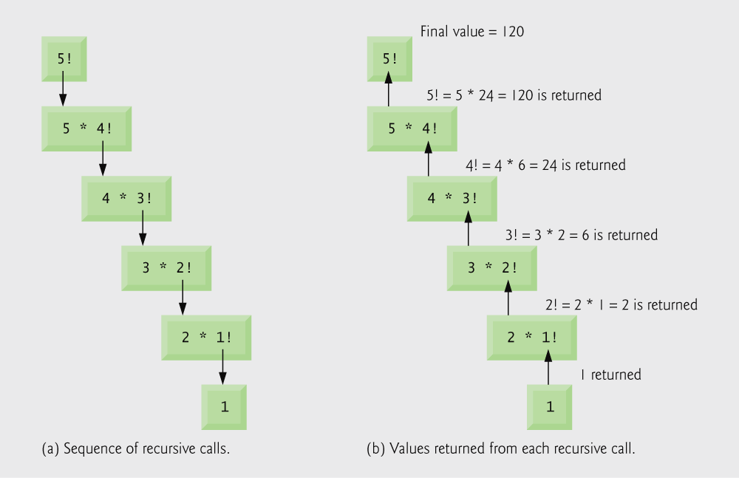
5.14 Recursion
Recursive functions
Functions that call themselves.The function launches a new copy of itself (recursion step) to solve what it cannot do
Example: factorials
5! = 5 * 4 * 3 * 2 * 1
Notice that
5! = 5 * 4!
4! = 4 * 3! ...
Can compute factorials recursively
Solve base case (1! = 0! = 1) then plug in
2! = 2 * 1! = 2 * 1 = 2;
3! = 3 * 2! = 3 * 2 = 6;
Fig. 5.13 | Recursive evaluation of 5!.

Slide 77
Outline
DataType | Size in memory (bytes)
char | 1
int | 4
short | 2
long | 8
float | 4
double | 8
integer data types

Slide 78
Outline
Omitting the base case will cause infinite recursion, eventually exhausting memory.

Slide 79
5.15 Example Using Recursion: Fibonacci Series
Fibonacci series: 0, 1, 1, 2, 3, 5, 8...
Each number is the sum of the previous two
Can be solved recursively:
fib( n ) = fib( n - 1 ) + fib( n – 2 )
Code for the fibonacci function
long fibonacci( long n )
{
if (n == 0 || n == 1) // base case
return n;
else
return fibonacci( n - 1) + fibonacci( n – 2 );
}

Slide 80
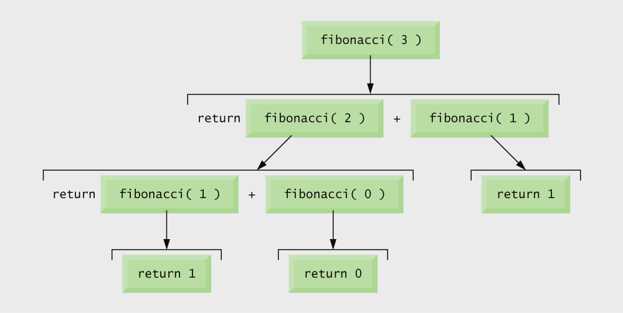
Fig. 5.16 | Set of recursive calls for fibonacci(3).

Slide 81
Outline
fig05_15.c
(1 of 4 )

Slide 82
Outline
fig05_15.c
(2 of 4 )

Slide 83
Outline
fig05_15.c
(3 of 4 )

Slide 84
Outline
fig05_15.c
(4 of 4 )

Slide 85
5.16 Recursion vs. Iteration
Repetition
Iteration: explicit loop
Recursion: repeated function calls
Termination
Iteration: loop condition fails
Recursion: base case recognized
Both can have infinite loops
Balance
Choice between performance (iteration) and good software engineering (recursion)

Slide 86
Software Engineering Observation 5.13
Any problem that can be solved recursively can also be solved iteratively (nonrecursively).
A recursive approach is normally chosen due to it is easier to understand and debug.
Another reason to choose a recursive solution is that an iterative solution may not be apparent.

Slide 87
Performance Tip 5.5
Avoid using recursion in performance situations.
Recursive calls take time and consume additional memory.

