Slide 1
Twitter
Sentiment Analysis
"Trump" & "Biden"
Natural Language Processing
"Covid" & "Vaccine" & "Stimulus"
Positive?
Neutral?
Negative?

Slide 2
Importing Data
Preprocessing
Data Wrangling
Modeling
Findings
Twitter API

Slide 3
Data (Twitter)
Biden
Trump
Covid-19
Vaccine
Stimulus Relief Package
API Key
API Secret
Access Token
Access Token Secret

Slide 4
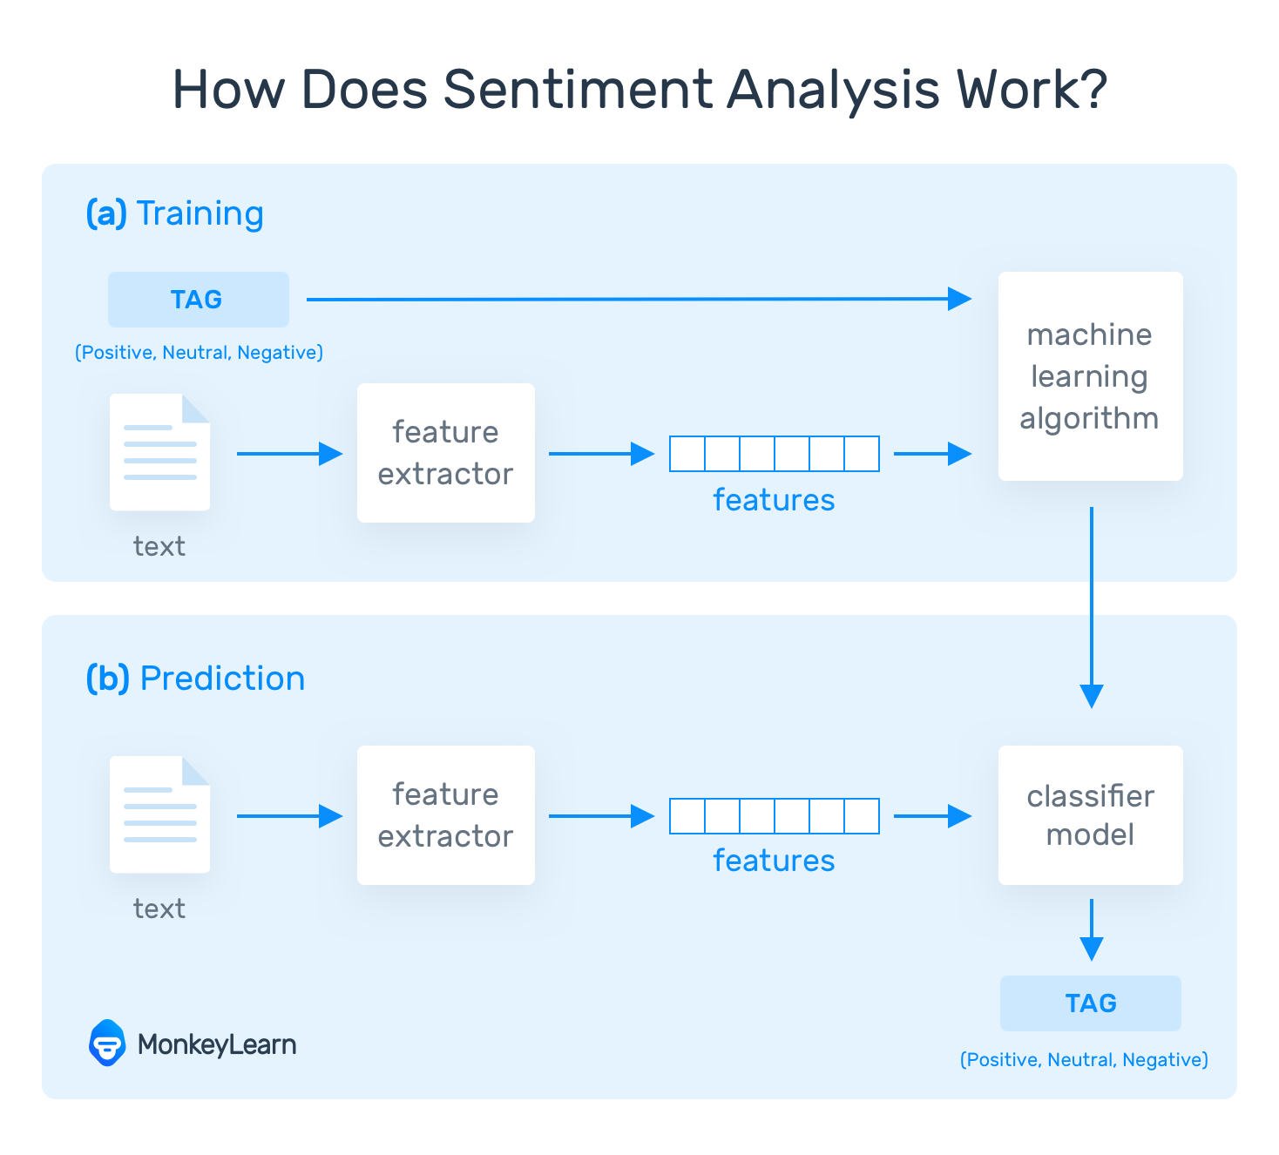

Slide 5
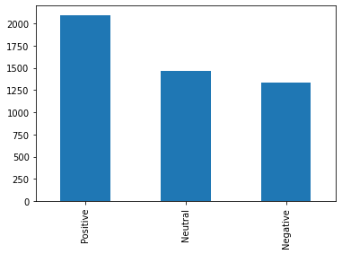
TRUMP
Positive => %43
Neutral => %30
Negative => %27

Slide 6
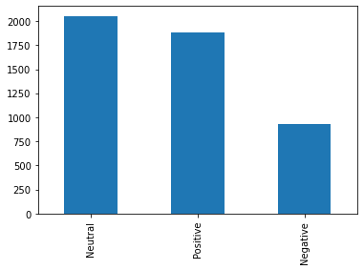
BIDEN
Positive => %39
Neutral => %42
Negative => %19

Slide 7
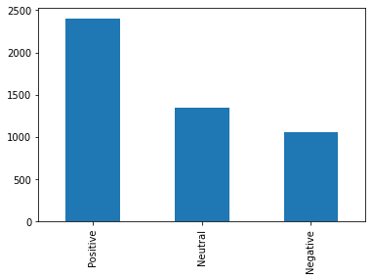
Covid 19
Positive => %50
Neutral => %28
Negative => %22

Slide 8
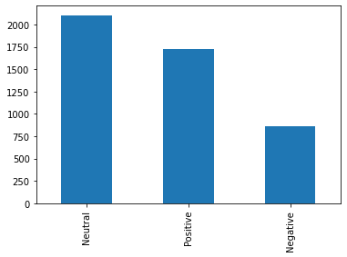
Stimulus
Positive => %36
Neutral => %45
Negative => %19

Slide 9
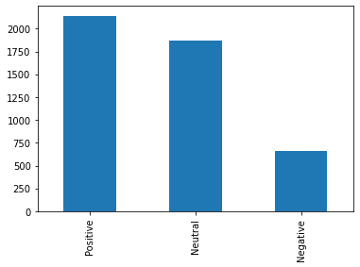
Vaccine
Positive => %46
Neutral => %40
Negative => %14

Slide 10
CONCLUSION
Real-Time response in the social media is essential for various fields.
Sentiment Analysis Model of NLP is an important tool to get outcomes precisely.
Unorganized, unstructured media data can be analyzed via Sentiment Analysis effectively.
Data Scientists are getting better at creating more accurate sentiment classifiers.
There is still long way to go….

