Slide 1
Pandemic (Covid-19)
Cutting Budget
Interest in
Used Car
Unemployment
Price Allocation
Best Price?
(Buyer & Seller)

Slide 2
Linear Regression
Random Forest
Decision Tree
Ridge Regression
Lasso Linear Regression
Best Prediction?

Slide 3
Data (Ford)
17965 Entry
Model
Transmission
Fuel Type
6
Numerical
4 Integer Type
2 Float Type
Year
Mileage
Price
Tax
Engine Size
Mpg
9 Features
3
Categorical
Object Type

Slide 4
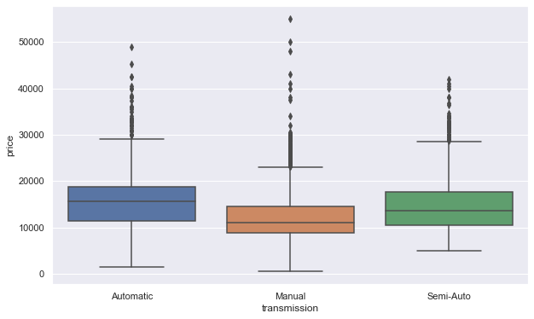
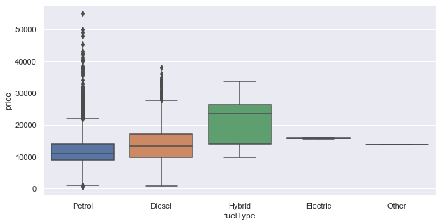
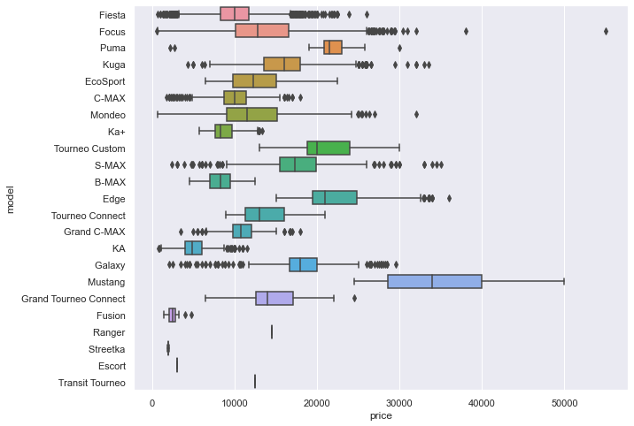
EXPLORATORY ANALYSIS OF DATA (EDA)
Categorical Variables
Transmission & Price Fuel Type & Price Model & Price
Manual = 15517
Automatic = 1361
Semi-Auto = 1087
Fiesta = 6557
Focus = 4588
Kuga = 2225
Eco-Sport = 1143
C-Max = 543
Petrol = 12178
Hybrid = 22
Diesel = 5762
Other = 3

Slide 5
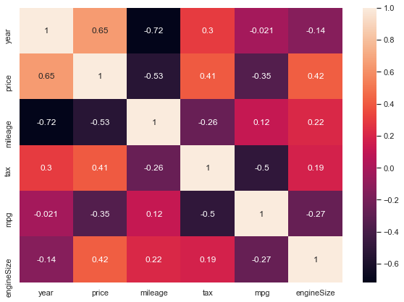
EXPLORATORY ANALYSIS OF DATA (EDA)
Numerical Variables
Correlation Heat Map
Positive correlation between year and price
Negative correlation between mileage and price
Negative correlation between mileage and year
Positive correlation between engine size and price
Negative correlation between engine size and mpg
Positive correlation between tax and price

Slide 6
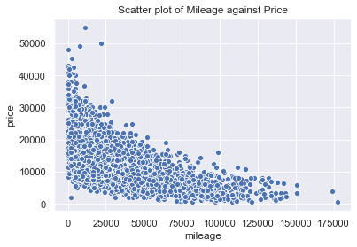
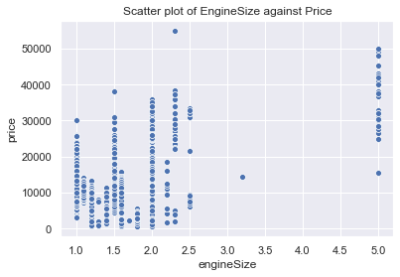
Higher number of mileage on a vehicle has the most negative impact on the price..
As the engine size of the vehicle increases, the price tends to increase…

Slide 7
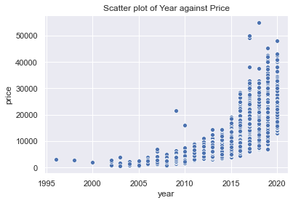
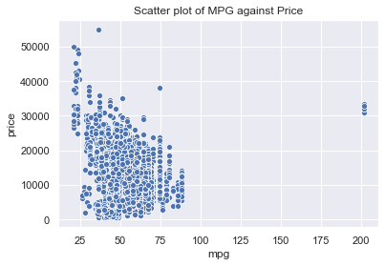
The new vehicles are much expensive than the older vehicles…
There is a positive relationship between price and mpg and cheaper cars usually have higher mpg…

Slide 8
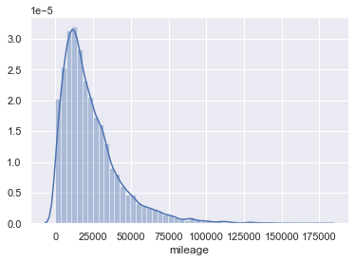
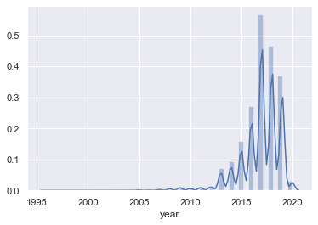
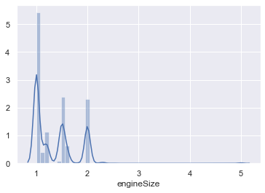
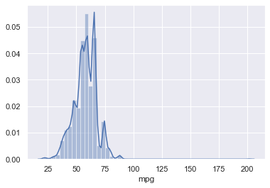
Distribution of Numerical Variables

Slide 9
INFERENTIAL STATISTICS
Hypothesis Testing
Null = There is no difference between the mean of prices of automatic and non-automatic vehicles
Alternative = There is difference between automatic and non-automatic vehicles
T-test = How significant the difference between two groups
The value of the test statistic and then its probability (the p-value)
If the p-value is equal or lower than the significance level 0.05, the null hypothesis is going to be rejected.

Slide 10
Hypothesis Testing Result
P-value=4.195386605160137e-174
The p-value in calculation is lower than 0.05. It appears that there is a difference between how much is the price of automatic vehicles versus how much non-automatic vehicles prices.
As a result, our hypothesis testing result is we are going to reject null hypothesis and accept the alternative one.

Slide 11
Preprocessing and Training Data Development
Scaling the Data = Standard Scaler
s_scaler = StandardScaler()
X_train = s_scaler.fit_transform(X_train)
X_test = s_scaler.transform(X_test)
Creating Training and Test Sets
X = Features w/out target variable
y = Target Variable (price)
test-size = 0.25
train-size = 0.75
random_state = random

Slide 12
Modeling
Continuous Dependent Variable => Regression Analysis
Algorithms:
Decision Tree Regressor
Ridge Regressor
Linear Regression
Random Forest
Lasso Linear Regression
Output
R-Square
Root Squared Mean Error
Average 5-Fold CV Score

Slide 13
PREDICTIONS
Output | Decision Tree | Random Forest | Ridge Regressor | Linear Regression | Lasso Linear Regression
R Square | 0.8957 | 0.9224 | 0.8099 | 0.8526 | 0.8526
RMSE | 1513.5 | 1240.6 | 2043.5 | 1799.23 | 1799.2
Cross-Validation | 0.8789 | 0.9224 | 0.7887 | 0.8264 | 0.8263

Slide 14
LIMITATIONS, FUTURE IMPROVEMENTS
This project used a data with comprised of 100.000 samples from different manufacturers of the vehicles.
We only focus on to brand of Ford vehicles and only for England as a country.
This project tried to reflect the nature of the used car features and how they can affect the price of it.
These predictions may also be occurred in different countries with different models and different features than we have in this data set.

