Slide 1
Authentication & Authorization

Slide 2
Authentication
Authentication technology provides access control for systems by checking to see if a user's credentials match the credentials in a database of authorized users or in a data authentication server.

Slide 3
Authentication types
Password-Based Authentication
Passwordless Authentication
Third-party authentication

Slide 4
1)Authentication types (Password-Based)
single-factor authentication (SFA).
two-factor authentication (2FA).
multifactor authentication (MFA).

Slide 5
single-factor authentication (SFA)
The practice of requiring a user ID and password.

Slide 6


Slide 7
2)two-factor authentication (2FA).
unique code that is provided to a user over a mobile device

Slide 8
3)multifactor authentication (MFA).
personal question the user must answer

Slide 9


Slide 10
2) Passwordless Authentication
The user authentication is identified with face recognition, retina scan, fingerprints, hardware token code, etc.

Slide 11
Encryption
In cryptography, encryption is the process of encoding information.
This process converts the original representation of the information, known as plaintext, into an alternative form known as ciphertext. Ideally, only authorized parties can decipher a ciphertext back to plaintext and access the original information.

Slide 12
types of encryption
Symmetric
Asymmetric

Slide 13
Symmetric
In symmetric encryption the same key is used for encryption and decryption.

Slide 14
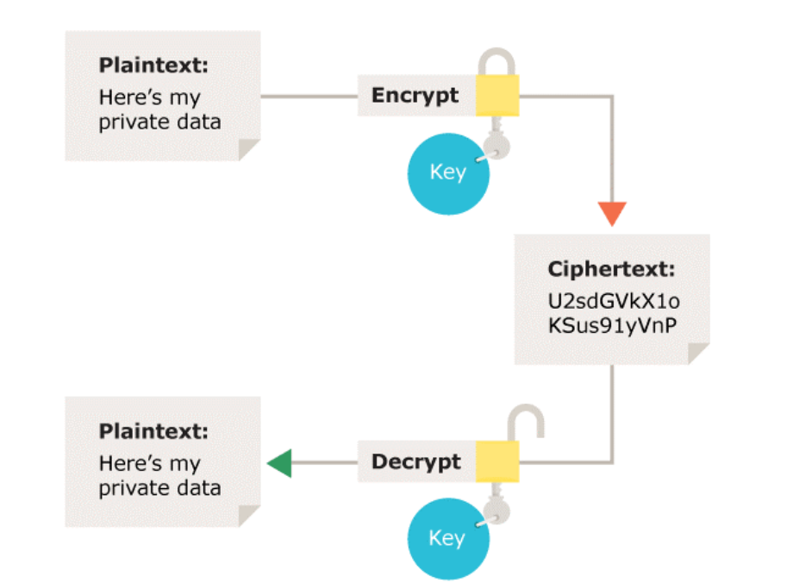

Slide 15
Asymmetric
Asymmetric encryption uses the notion of a key pair: a different key is used for the encryption and decryption process. One of the keys is typically known as the private key and the other is known as the public key.

Slide 16
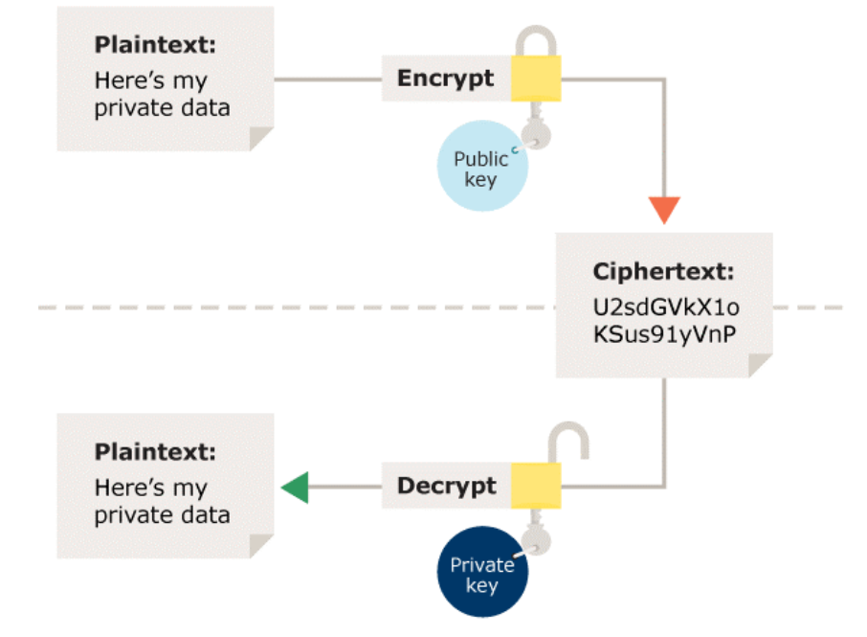

Slide 17
Web site to encryption
https://www.online-toolz.com/tools/text-encryption-decryption.php

Slide 18
Hash
Hashing is the process of changing a plain text or a key to a hashed value by applying a hash function

Slide 19
Usage of Hash
Hashing is used in encryption to secure the information shared between two parties

Slide 20
Website to make hash
https://www.tools4noobs.com/online_tools/hash/

Slide 21
Hashing helps protect the integrity of the information and Encryption is used to secure the data from the reach of third parties.

Slide 22
session management approaches
Session or Cookies based approach
JWT (JSON Web Tokens) based approach

Slide 23
JWT (JSON Web Token)
securely transfer information between two parties.

Slide 24
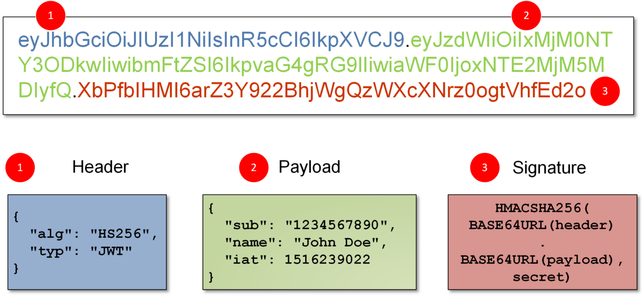
This Entire JWT is embedded in a type of string and these 3 parts are separated by dots(.).
This Entire JWT is embedded in a type of string and these 3 parts are separated by dots(.).

Slide 25
Structure of JWT
Headers
Payload
Signature

Slide 26
Headers
Consist of:
Algorithm used to encode JWT
type of the token which is JWT by-default.

Slide 27
Payload
which consists of User Data, which is passed between Client and Server.

Slide 28
Signature
which is created by server, and used to validate the requests
To create the signature, the base-64 encoded header and payload are taken, along with a secret key and signed with algorithm specified in the header.

Slide 29
This Entire JWT is embedded in a type of string and these 3 parts are separated by dots(.).
This Entire JWT is embedded in a type of string and these 3 parts are separated by dots(.).

Slide 30
Any Question?

Slide 31
Authorization
Authorization is the security process that determines a user or service's level of access.

Slide 32
Any Question?

