Slide 1
CYBERSECURITY • IoT-23 DATASET
Detecting IoT
Botnet Attacks
A machine learning pipeline for classifying real-world malware traffic
TEAM
Thabo Ibrahim Traore • Jordan Barnes • Zizwe Mtonga • Tapiwa Musinga
IoT Botnet Detection • Linux Team Project • Alabama A&M University
01 / 10

Slide 2
01 • OBJECTIVE
What problem are we solving?
THE PROBLEM
OUR GOAL
IoT devices are easy targets
Automate intrusion detection
Smart cameras, routers, and home gear get hijacked into botnets and used for DDoS attacks, data theft, and malware propagation. Detecting infections by hand is impossible at the scale of modern networks — automation is required.
▸ Classify network connections as benign or malicious
▸ Identify which features best predict attacks
▸ Run the pipeline on the ASAX supercomputer
▸ Hit high accuracy on real-world malware traffic
IoT Botnet Detection • Linux Team Project • Alabama A&M University
02 / 10

Slide 3
02 • DATASET
IoT-23 — Real Malware Traffic
23 IoT infection scenarios captured by Stratosphere Lab
1.88M
23
▸ Source: Stratosphere Laboratory, Czech Technical University
▸ 1.88 million labeled network connections
▸ Captured from real malware — not simulated
▸ Includes Mirai, Torii, and Hajime botnets
▸ 23 capture scenarios + benign device baseline
▸ 37 features per connection (flow stats, protocol, ports)
CONNECTIONS
SCENARIOS
37
192 MB
FEATURES
DATA SIZE
stratosphereips.org/datasets-iot23
IoT Botnet Detection • Linux Team Project • Alabama A&M University
03 / 10

Slide 4
03 • THREAT LANDSCAPE
What we're detecting
CATEGORY
CONNECTIONS
DESCRIPTION
Benign
120,499
Normal IoT device traffic
DDoS
1,643,228
Distributed denial-of-service flood attacks
PortScan
74,139
Scanning for open ports / vulnerable services
C&C
22,502
Command & Control - infected device 'phones home'
Botnet
15,252
Mirai / Okiru botnet propagation
Attack
9,366
Other generic attack categories
⚠ HEAVILY IMBALANCED — 93.6% of traffic is malicious (mostly DDoS)
IoT Botnet Detection • Linux Team Project • Alabama A&M University
04 / 10

Slide 5
04 • METHODOLOGY
The data pipeline
01
02
03
04
05
06
07
Load
Preprocess
Explore
Split
Train
Evaluate
Visualize
Read 23 CSV files, combine into 1.88M-row dataset
Drop dead columns, fill missing values, encode labels
Generate distribution charts and protocol breakdowns
70% train (1.32M) / 30% test (565K), stratified
Random Forest classifier — 100 decision trees
Accuracy, precision, recall, confusion matrix
Save all results as PNGs in results/
TECH STACK
Python 3 • pandas • scikit-learn • matplotlib • seaborn
End-to-end runtime on full dataset: under 30 seconds
IoT Botnet Detection • Linux Team Project • Alabama A&M University
05 / 10

Slide 6
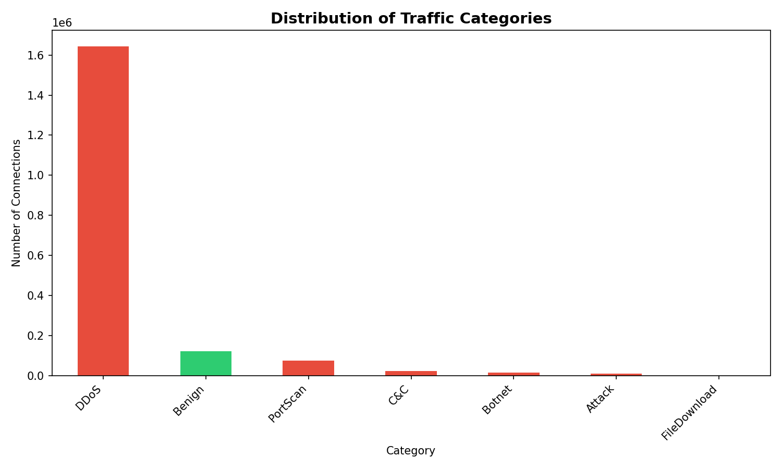
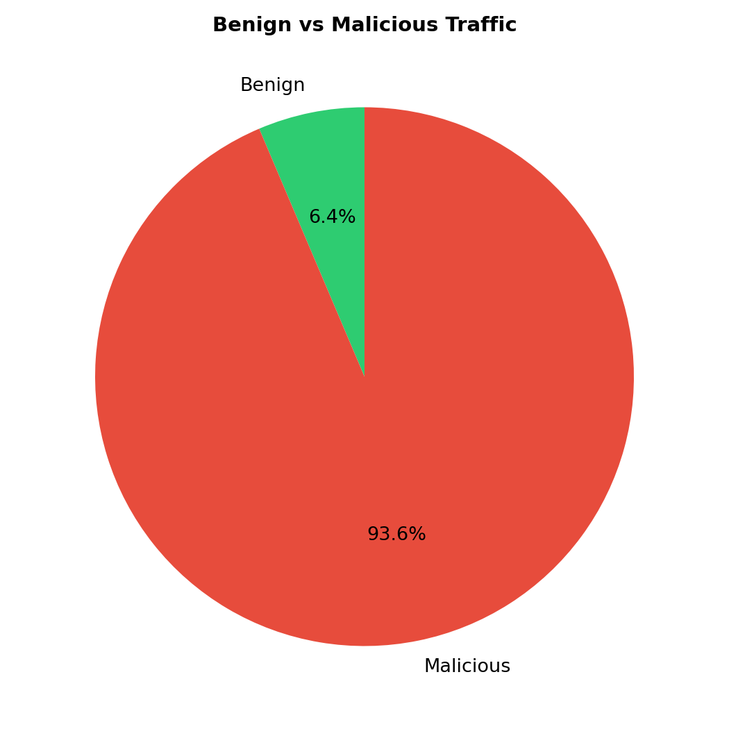
05 • EXPLORATION
What does the data look like?
Benign traffic is the minority — model must learn to spot the rare case
IoT Botnet Detection • Linux Team Project • Alabama A&M University
06 / 10

Slide 7
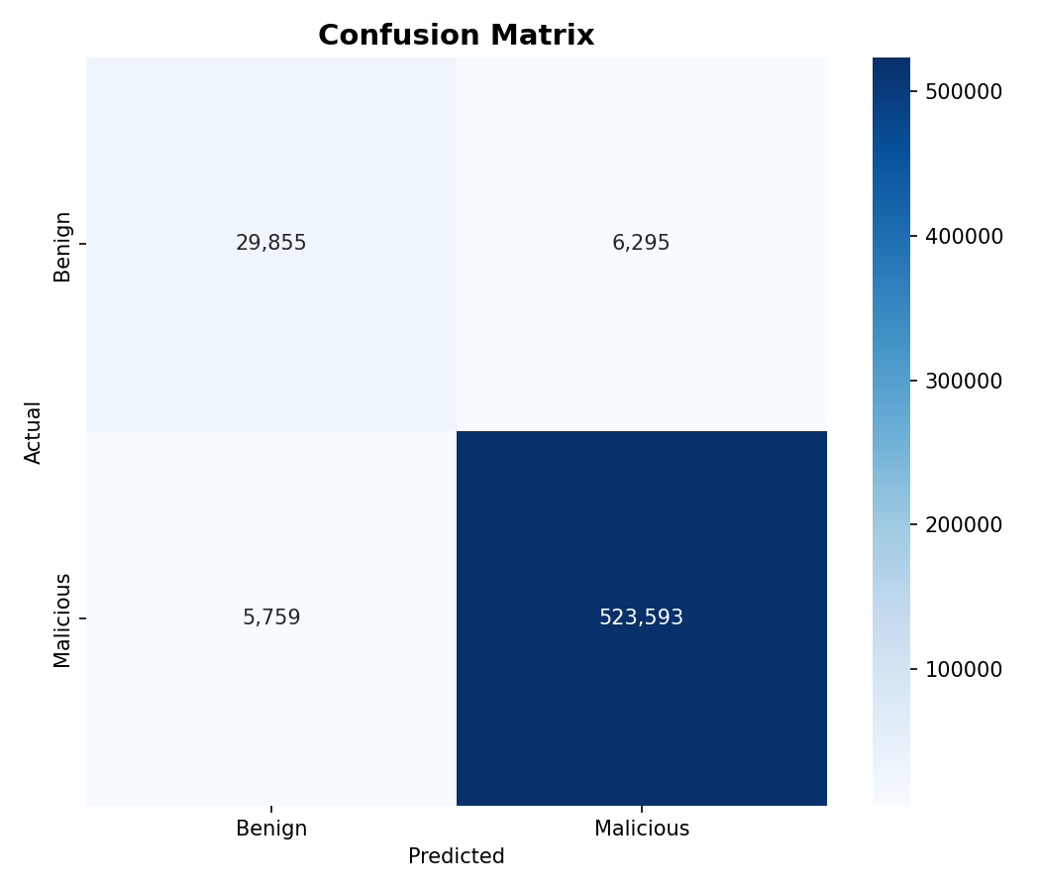
06 • RESULTS
Random Forest performance
OVERALL ACCURACY
97.87%
565,502 test connections classified correctly
0.83
0.99
BENIGN F1
MALICIOUS F1
23.4s
0.7s
TRAINING TIME
PREDICTION TIME
IoT Botnet Detection • Linux Team Project • Alabama A&M University
07 / 10

Slide 8
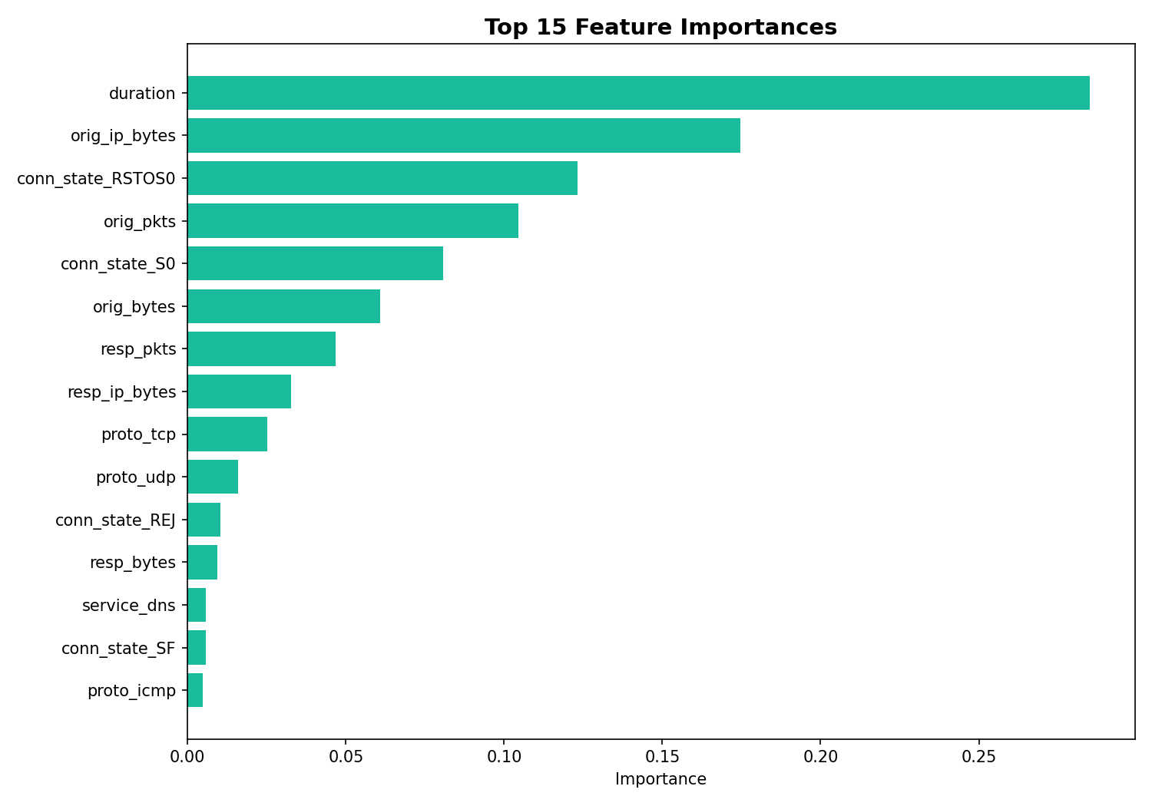
07 • INSIGHTS
Which features matter most?
KEY INSIGHT
Volume tells the story
TOP PREDICTORS
orig_pkts
orig_ip_bytes
resp_bytes
DDoS and port-scan attacks send unusual packet volumes; C&C traffic shows distinctive byte signatures. The model rediscovered what real-world security analysts already know.
IoT Botnet Detection • Linux Team Project • Alabama A&M University
08 / 10

Slide 9
08 • DEPLOYMENT
Running on the ASAX supercomputer
One shell script handles everything
● ● ● asax terminal
▸ Loads Python modules via 'module load python3'
▸ Installs dependencies (pandas, scikit-learn, matplotlib...)
▸ Auto-downloads IoT-23 dataset from Kaggle
▸ Combines 23 CSV files into a single dataset
▸ Runs the Python analysis pipeline
▸ Saves all charts and reports to results/ folder
# submit as SLURM job
$ sbatch run_analysis.sh
Submitted batch job 84291
● ● ● local terminal
# or run interactively
$ bash run_analysis.sh
Accuracy: 0.9787 ✓
IoT Botnet Detection • Linux Team Project • Alabama A&M University
09 / 10

Slide 10
09 • WRAP UP
Conclusion & Demo
ACCURACY
CONNECTIONS
AUTOMATED
97.87%
1.88M
100%
On 565K real test connections from real malware
Network flows analyzed end-to-end in under 30s
Single shell command runs the entire pipeline
WHY IT MATTERS
IoT security is one of the fastest growing threats in cybersecurity.
The same techniques shown here protect real networks from real attacks.
▸ LIVE DEMO github.com/ibrahimt39/AAMU-Linux-Project
IoT Botnet Detection • Linux Team Project • Alabama A&M University
10 / 10

