Slide 1
Introduction to Artificial Intelligence
Section 3 Symbolic Knowledge Representation
Litty Tressa George
Lecturer FICT
Litty Tressa George
Lecturer FICT
Section 3 PPT 2

Slide 2
PROPOSITIONAL LOGIC IN AI
Propositional logic (PL) is the simplest form of logic where all the statements are made by propositions. A proposition is a declarative statement which is either true or false. It is a technique of knowledge representation in logical and mathematical form.
Example:
a) It is Sunday.
b) The Sun rises from West (False proposition)
c) 5 is a prime number.

Slide 3
Following are some basic facts about propositional logic:
Propositional logic is also called Boolean logic as it works on 0 and 1.
In propositional logic, we use symbolic variables to represent the logic, and we can use any symbol for a representing a proposition, such A, B, C, P, Q, R, etc.
Propositions can be either true or false, but it cannot be both.
Propositional logic consists of an object, relations or function, and logical connectives.
These connectives are also called logical operators.
The propositions and connectives are the basic elements of the propositional logic.

Slide 4
Connectives can be said as a logical operator which connects two sentences.
A proposition formula which is always true is called Tautology, and it is also called a valid sentence.
A proposition formula which is always false is called Contradiction.
Statements which are questions, commands are not propositions such as "Where is Rohini", "How are you", "What is your name", are not propositions.

Slide 5
SYNTAX OF PROPOSITIONAL LOGIC
The syntax of propositional logic defines the allowable sentences for the knowledge representation. There are two types of Propositions:
Atomic Propositions
Compound propositions
Atomic Proposition: Atomic propositions are the simple propositions. It consists of a single proposition symbol. These are the sentences which must be either true or false.
Example:
a) 2+2 is 4, it is an atomic proposition as it is a true fact.
b) "The Sun is cold" is also a proposition as it is a false fact.

Slide 6
Compound proposition: Compound propositions are constructed by combining simpler or atomic propositions, using parenthesis and logical connectives.
Example:
a) "It is raining today, and street is wet."
b) "Ankit is a doctor, and his clinic is in Mumbai."

Slide 7
Logical Connectives
Logical connectives are used to connect two or more simpler propositions or representing a sentence logically. We can create compound propositions with the help of logical connectives. There are mainly five connectives, which are given as follows:
1. Negation: A sentence such as ¬ P is called negation of P. A literal can be either Positive literal or negative literal.
2. Conjunction: A sentence which has ∧ connective such as, P ∧ Q is called a conjunction.
Example: Rohan is intelligent and hardworking. It can be written as,
P= Rohan is intelligent,
Q= Rohan is hardworking. → P∧ Q.
3. Disjunction: A sentence which has ∨ connective, such as P ∨ Q. is called disjunction, where P and Q are the propositions.
Example: "Ritika is a doctor or Engineer",
Here P= Ritika is Doctor. Q= Ritika is Engineer, so we can write it as P ∨ Q.

Slide 8
4. Implication: A sentence such as P → Q, is called an implication.
Implications are also known as if-then rules.
Example: If it is raining, then the street is wet.
Let P= It is raining, and Q= Street is wet, so it is represented as P → Q
5. Biconditional: A sentence such as P⇔ Q is a Biconditional sentence,
Example: If I am breathing, then I am alive
P= I am breathing, Q= I am alive, it can be represented as P ⇔ Q.

Slide 9
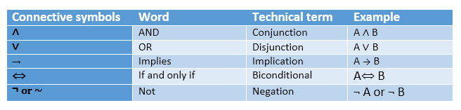
Summarized Table For Propositional Logic Connectives

Slide 10
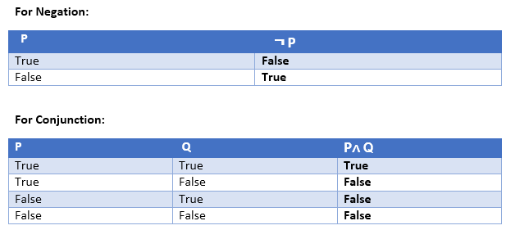
TRUTH TABLE
In propositional logic, we need to know the truth values of propositions in all possible scenarios. We can combine all the possible combination with logical connectives, and the representation of these combinations in a tabular format is called Truth Table. Following are the truth table for all logical connectives:

Slide 11
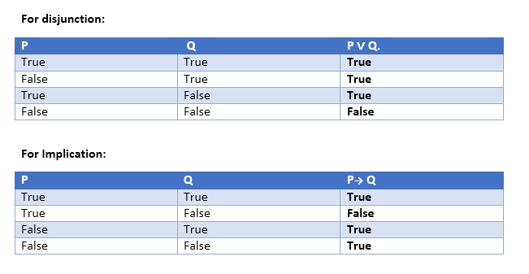
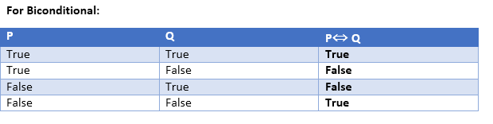

Slide 12
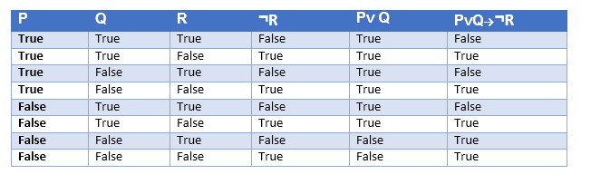
Truth Table With Three Propositions We can build a proposition composing three propositions P, Q, and R. This truth table is made-up of 8n Tuples as we have taken three proposition symbols.

Slide 13
PRECEDENCE OF CONNECTIVES:
Just like arithmetic operators, there is a precedence order for propositional connectors or logical operators. This order should be followed while evaluating a propositional problem. Following is the list of the precedence order for operators:
Precedence | Operators
First Precedence | Parenthesis
Second Precedence | Negation
Third Precedence | Conjunction(AND)
Fourth Precedence | Disjunction(OR)
Fifth Precedence | Implication
Six Precedence | Biconditional
For better understanding use parenthesis to make sure of the correct interpretations. Such as ¬R∨ Q, It can be interpreted as (¬R) ∨ Q.

Slide 14
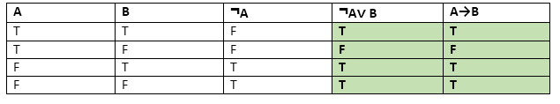
Logical Equivalence
Logical equivalence is one of the features of propositional logic. Two propositions are said to be logically equivalent if and only if the columns in the truth table are identical to each other.
Let's take two propositions A and B, so for logical equivalence, we can write it as A⇔B. In below truth table we can see that column for ¬A∨ B and A→B, are identical hence A is Equivalent to B

Slide 15
LIMITATIONS OF PROPOSITIONAL LOGIC
We cannot represent relations like ALL, some, or none with propositional logic. Example:
a. All the girls are intelligent.
b. Some apples are sweet.
Propositional logic has limited expressive power.
In propositional logic, we cannot describe statements in terms of their properties or logical relationships.

Slide 16
First-order Logic In AI
But unfortunately, in propositional logic, we can only represent the facts, which are either true or false. PL is not sufficient to represent the complex sentences or natural language statements. The propositional logic has very limited expressive power. Consider the following sentence, which we cannot represent using PL logic.
We cannot represent relations like ALL, some, or none with propositional logic
"Some humans are intelligent.”
“ All the girls are intelligent.”
“ Some apples are sweet.”
To represent the above statements, PL logic is not sufficient, so we required some more powerful logic, such as first-order logic.

Slide 17
FIRST-ORDER LOGIC
First-order logic is another way of knowledge representation in artificial intelligence. It is an extension to propositional logic.
FOL is sufficiently expressive to represent the natural language statements in a concise way.
First-order logic is also known as Predicate logic or First-order predicate logic. First-order logic is a powerful language that develops information about the objects in a more easy way and can also express the relationship between those objects.

Slide 18
First-order logic (like natural language) does not only assume that the world contains facts like propositional logic but also assumes the following things in the world:
Objects: A, B, people, numbers, colors, wars, theories, squares, ......
Relations: It can be unary relation such as: red, round, is adjacent, or n-any relation such as: the sister of, brother of, has color, comes between
Function: Father of, best friend, third inning of, end of, ......
As a natural language, first-order logic also has two main parts:
Syntax
Semantics

Slide 19
Syntax of First-Order logic
The syntax of FOL determines which collection of symbols is a logical expression in first-order logic.
The basic syntactic elements of first-order logic are symbols.
We write statements in short-hand notation in FOL.

Slide 20
Basic Elements of First-order logic
Following are the basic elements of FOL syntax:
Constant | 1, 2, A, John, Mumbai, cat,....
Variables | x, y, z, a, b,....
Predicates | Brother, Father, >,....
Function | sqrt, LeftLegOf, ....
Connectives | ∧, ∨, ¬, ⇒, ⇔
Equality | ==
Quantifier | ∀, ∃

Slide 21
Atomic sentences:
Atomic sentences are the most basic sentences of first-order logic. These sentences are formed from a predicate symbol followed by a parenthesis with a sequence of terms.
We can represent atomic sentences as Predicate (term1, term2, ......, term n).
Example: Ravi and Ajay are brothers: => Brothers(Ravi, Ajay).
Chinky is a cat: => cat (Chinky).

Slide 22
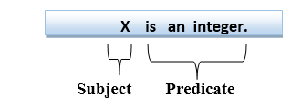
Complex Sentences
Complex sentences are made by combining atomic sentences using connectives.
First-order logic statements can be divided into two parts:
a. Subject: Subject is the main part of the statement.
b. Predicate: A predicate can be defined as a relation, which binds two atoms together in a statement.
Consider the statement: "x is an integer.", it consists of two parts, the first part x is the subject of the statement and second part "is an integer," is known as a predicate.

Slide 23
REASONING
The reasoning is the mental process of deriving logical conclusion and making predictions from available knowledge, facts, and beliefs.
"Reasoning is a way to infer facts from existing data.“
It is a general process of thinking rationally, to find valid conclusions.
In artificial intelligence, the reasoning is essential so that the machine can also think rationally as a human brain, and can perform like a human.

Slide 24
REASONING
When a system is required to do something, that it has not been explicitly told how to do, it must reason.
It must do inference and arrive at a conclusion from what it already knows.
Example: Fact-1 : Robins are birds,
Fact-2 : All birds have wings.
Then we can ask: DO ROBINS HAVE WINGS?

Slide 25
LOGICAL REASONING
In artificial intelligence, logical reasoning methods can be divided into the following categories:
Deductive reasoning
Inductive reasoning
Abductive reasoning

Slide 26
DEDUCTIVE REASONING
Deductive reasoning is deducing new information from logically related known, valid information.
It is the form of valid reasoning, which means the argument's conclusion must be true when the premises are true.
It is sometimes referred to as top-down reasoning, and contradictory to inductive reasoning.
In deductive reasoning, the truth of the premises guarantees the truth of the conclusion.

Slide 27

Example:
Premise-1: All the human eats veggies
Premise-2: Suresh is human.
Conclusion: Suresh eats veggies.
The general process of deductive reasoning is given below:

Slide 28
INDUCTIVE REASONING
Inductive reasoning is a form of reasoning to arrive at a conclusion using limited sets of facts by the process of generalization.
Inductive reasoning is a type of propositional logic, which is also known as cause-effect reasoning or bottom-up reasoning.
In inductive reasoning, premises provide probable supports to the conclusion, so the truth of premises does not guarantee the truth of the conclusion.

Slide 29

INDUCTIVE REASONING
Example:
Premise: All of the pigeons we have seen in the zoo are white.
Conclusion: Therefore, we can expect all the pigeons to be white.
The general process of inductive reasoning is given below:

Slide 30
ABDUCTIVE REASONING
Abductive reasoning is a form of logical reasoning which starts with single or multiple observations then seeks to find the most likely explanation or conclusion for the observation.
Abductive reasoning is an extension of deductive reasoning, but in abductive reasoning, the premises do not guarantee the conclusion.
Example:
Implication: Cricket ground is wet if it is raining
Axiom: Cricket ground is wet.
Conclusion : It is raining.

Slide 31
Inference Mechanism
The inference engine is the component of the intelligent system in artificial intelligence, which applies logical rules to the knowledge base to infer new information from known facts.
To recommend a solution, the Inference Engine uses the following strategies
Forward Chaining
Backward Chaining

Slide 32
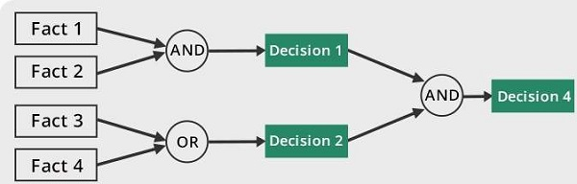
Forward Chaining
It is a strategy of an expert system to answer the question, “What can happen next?”
Here, the Inference Engine follows the chain of conditions and derivations and finally deduces the outcome. It considers all the facts and rules, and sorts them before concluding to a solution.
This strategy is followed for working on conclusion, result, or effect. For example, prediction of share market status as an effect of changes in interest rates.

Slide 33
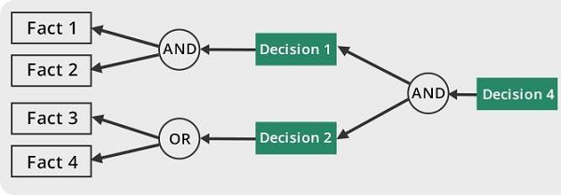
Backward Chaining
With this strategy, an expert system finds out the answer to the question, “Why this happened?”
On the basis of what has already happened, the Inference Engine tries to find out which conditions could have happened in the past for this result. This strategy is followed for finding out cause or reason. For example, diagnosis of blood cancer in humans.

Slide 34
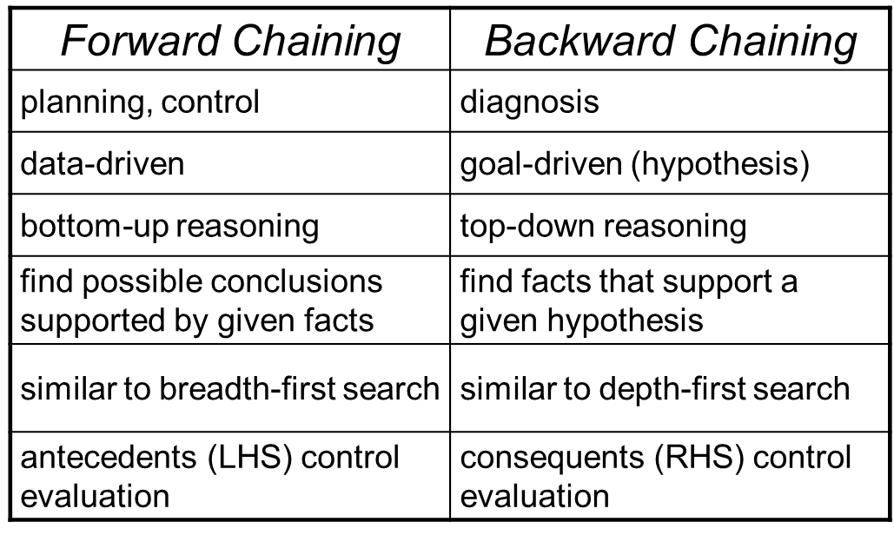
Forward vs. Backward Chaining

Slide 35
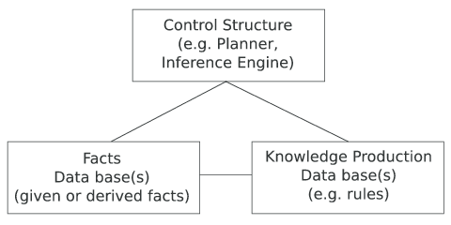
RULE-BASED SYSTEM
Two main components:
Rule Base
Inference Engine
Structure Of A Rule-based System

Slide 36
RULE-BASED SYSTEMS
Rule-based systems or production systems are computer systems that use rules to provide recommendations or diagnoses, or to determine a course of action in a particular situation or to solve a particular problem.
A rule-based system consists of a number of components:
■ a database of rules (also called a knowledge base)
■ a database of facts
■ an interpreter, or inference engine
In a rule-based system, the knowledge base consists of a set of rules that represent
the knowledge that the system has.
The database of facts represents inputs to the system that are used to derive conclusions, or to cause actions.
The interpreter, or inference engine, is the part of the system that controls
the process of deriving conclusions. It uses the rules and facts, and combines them together to draw conclusions.

