Slide 1
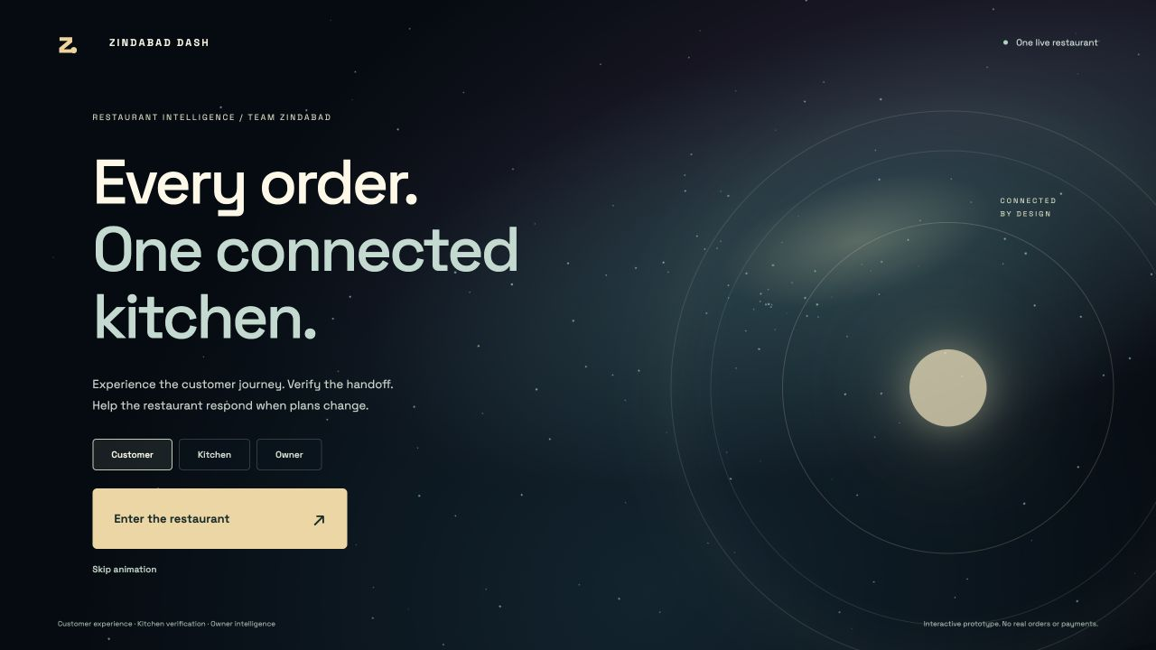
RESTAURANT INTELLIGENCE
Zindabad Dash
Every order, from counter to doorstep.
One shared workflow.
Visible evidence at handoff.
Recovery when plans change.
TEAM ZINDABAD / NOVA HACKATHON / INTERACTIVE PROTOTYPE
01
Notes:
0:00–0:20. We are Team Zindabad. Zindabad Dash connects the customer, kitchen and owner around the same live order. Our entry point is packing reliability, with AI assistance for the rest of the shift.

Slide 2
THE NOVA CHALLENGE
Peak service makes small mistakes expensive
Front of house: prep timing, missing items and wrong handoffs.
Back of house: stock uncertainty, skill gaps and scattered records.
Our focus: catch a mismatch before it becomes a customer problem.
TEAM ZINDABAD / NOVA HACKATHON / INTERACTIVE PROTOTYPE
02
Notes:
0:20–0:45. Source: NOVAOpeningSlides.pdf, pages 13–15. Front of house faces overlapping orders and unreliable packing or pickup. Back of house combines inventory, staffing and scattered financial records. We focus on handoffs, then support the decisions around them.

Slide 3
THE SOLUTION
Three perspectives share one live order
Customer / Walk, order, track and confirm receipt.
Kitchen / Prepare, photograph, verify and release.
Owner / Review stock, staffing, cash and recovery plans.
Changes sync across connected views. Delivery movement is simulated.
TEAM ZINDABAD / NOVA HACKATHON / INTERACTIVE PROTOTYPE
03
Notes:
0:45–1:10. Customer walks to the counter, orders and follows delivery. Kitchen prepares and verifies. Owner sees stock, staffing, scenarios and financial estimates. Two Macs can act as customer and operator. The third display is optional.

Slide 4
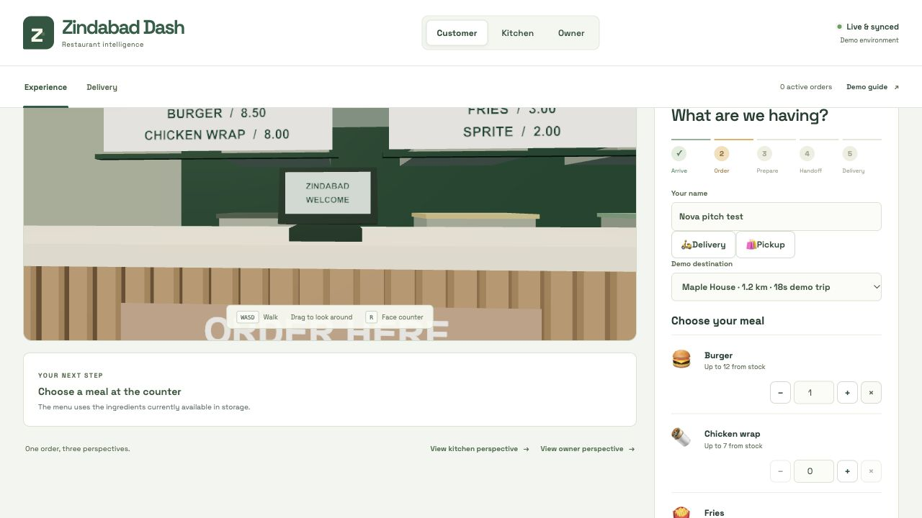
EXPERIENCE
A customer journey that makes the workflow tangible
Walk to the counter
Choose from available stock
Follow the same ticket
Live customer ordering perspective.
TEAM ZINDABAD / NOVA HACKATHON / INTERACTIVE PROTOTYPE
04
Notes:
1:10–1:30. Walk through the first-person restaurant or switch to floor plan. Place a burger, fries and Sprite order. Quantities depend on available stock. The restaurant and delivery views share the same order state.

Slide 5
HAPPY PATH AND SAD PATH
A missing drink blocks the handoff
1 Missing Sprite: report the mismatch and keep the order unconfirmed.
2 Complete clear bag: compare counts, then ask a person to confirm.
3 At the house: upload another photo before confirming receipt.
Unclear, hidden or unrecognizable items require a new photo.
Synthetic test images demonstrate behavior, not production accuracy.
TEAM ZINDABAD / NOVA HACKATHON / INTERACTIVE PROTOTYPE
05
Notes:
1:30–2:00. Show a synthetic clear bag photo missing the Sprite. The model reports visible counts, code compares them with the ticket and the app blocks approval. Next, upload the complete bag. A clear match allows human confirmation. Repeat the photo check at the doorstep. Generated images are fixtures, not evidence of real-world accuracy.

Slide 6
AI APPLICATIONS
AI advises at six points in the workflow
Vision checks / Count visible bag contents at packing and delivery.
Prep and inventory / Suggest timing and flag stock to replenish.
Staff and scenarios / Interpret absences and explain recovery options.
Finance and receipts / Summarize estimates and draft receipt fields.
TEAM ZINDABAD / NOVA HACKATHON / INTERACTIVE PROTOTYPE
06
Notes:
2:00–2:30. OpenRouter provides actual model calls. Packing and doorstep vision produce structured counts. Prep planning proposes eligible tickets. Inventory estimates near-term demand. Staff and scenario AI interpret disruptions. Finance explains computed evidence. Receipt AI drafts extracted fields for human review. These are prototype advisory tools, not autonomous purchases or certified accounting.

Slide 7
PROMPT COVERAGE
Five sponsor opportunities, one focused prototype
NOVA opportunity | Prototype response | Next requirement
Prep timing | AI prep advice and shared queue | Real POS channels
Packing and pickup | Photo checks and reference matching | Real bag validation
Inventory | Reservations, alerts and restock workflow | Demand history
Financial health | Receipt review and demo margin estimates | Accounting data
Staffing and skills | Absence scenarios and qualified recovery | Shift and skill history
TEAM ZINDABAD / NOVA HACKATHON / INTERACTIVE PROTOTYPE
07
Notes:
2:30–2:55. Source: NOVAOpeningSlides.pdf, pages 14–15. We address all five opportunities at prototype depth. Packing is the strongest complete demonstration. Forecasting, finance and staffing still require real integrations and pilot data.

Slide 8
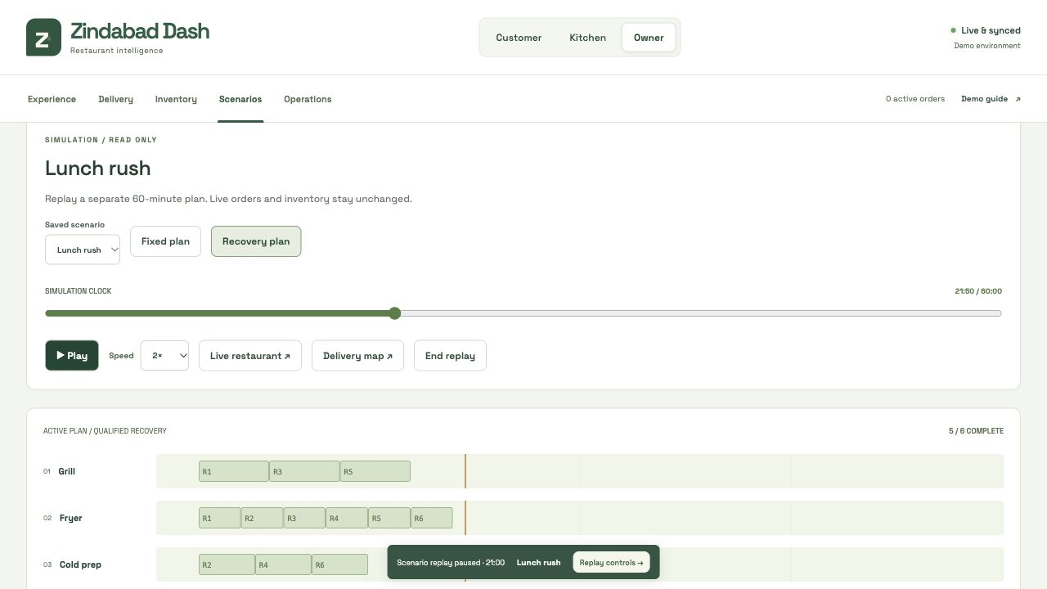
WHAT-IF SIMULATION
A disruption becomes a plan the owner can inspect
Absent worker
Ingredient shortage
Equipment outage
Six-order rush
Shared replay with pause, seek and speed controls. Outcomes are simulated.
TEAM ZINDABAD / NOVA HACKATHON / INTERACTIVE PROTOTYPE
08
Notes:
2:55–3:20. Remove a skilled worker, add a rush or model a shortage. Compare the fixed schedule with qualified recovery under stock, station and skill constraints. Pause, seek or change replay speed. AI explains the computed outcomes. Simulation outputs are predictions, not measured business results.

Slide 9
TECHNICAL APPROACH
Structured evidence keeps AI output reviewable
Input: ticket, photo or current operational evidence.
Model: structured observations and advisory recommendations.
Code: validate schema, compare counts and enforce state rules.
Person: approve a match, restock or recovery action.
Keys stay on the server. Uploaded photos are not retained by the app.
TEAM ZINDABAD / NOVA HACKATHON / INTERACTIVE PROTOTYPE
09
Notes:
3:20–3:45. React and Three.js render the experience. Server endpoints own the state. Hosted Worker and D1 persist shared data. OpenRouter calls remain server-side. The vision model does not receive expected counts and cannot approve a bag itself. Code compares observed counts, rejects uncertainty and stale evidence. The owner approves operational actions.

Slide 10
DEMO SETUP AND VALIDATION
A practical pilot with two Macs and one phone
Mac 1: customer ordering, tracking and receipt photo.
Mac 2: kitchen packing, owner operations and disruption replay.
Phone: optional photos. Clear bags and demo food are enough.
Pilot measures: missing-item rate, handoff accuracy and staff time.
TEAM ZINDABAD / NOVA HACKATHON / INTERACTIVE PROTOTYPE
10
Notes:
3:45–4:15. Mac one is customer. Mac two is kitchen and owner. A phone provides photos or Continuity Camera if available, and synthetic bags are included for repeatable testing. No dedicated webcam is necessary. The automated suite checks state transitions, stock, mismatch handling, replay and concurrency. This does not replace real service testing.

Slide 11
PILOT PROPOSAL
The next step is one real packing station
A connected workflow is ready to test.
Validate real bags, lighting and uncertainty.
Connect order, inventory and shift data.
Measure reliability before expanding automation.
github.com/ibrahimwichka/nova
TEAM ZINDABAD / NOVA HACKATHON / INTERACTIVE PROTOTYPE
11
Notes:
4:15–5:00. Start with a controlled pilot of real transparent bags, varied lighting, clutter and occlusion. Measure false approvals and recheck rate. Add POS, stock and shift data only after packing is dependable. We demonstrate a coherent workflow and honest constraints. Repository: https://github.com/ibrahimwichka/nova. Live URL retains its original Nova slug.

Slide 12
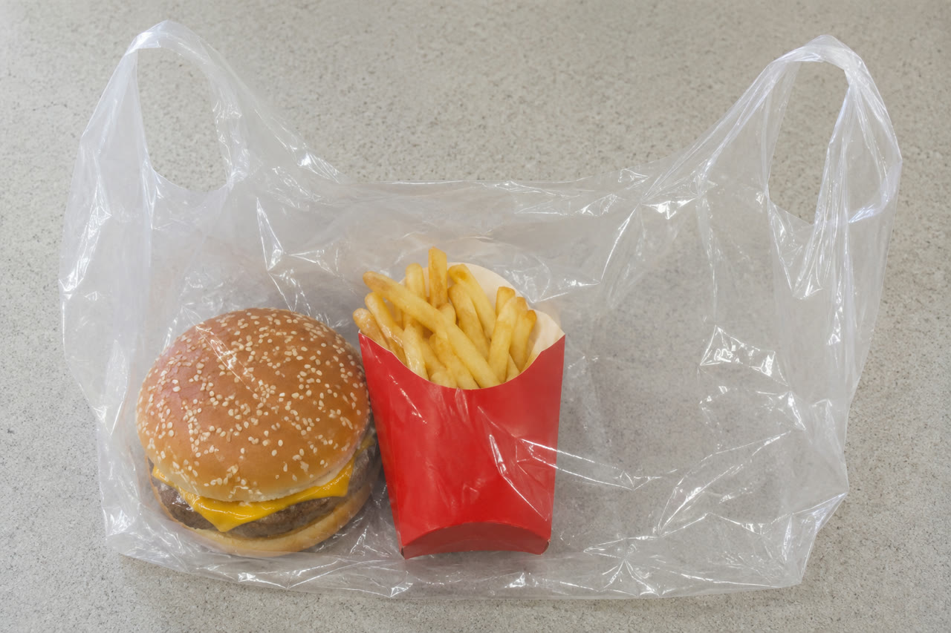
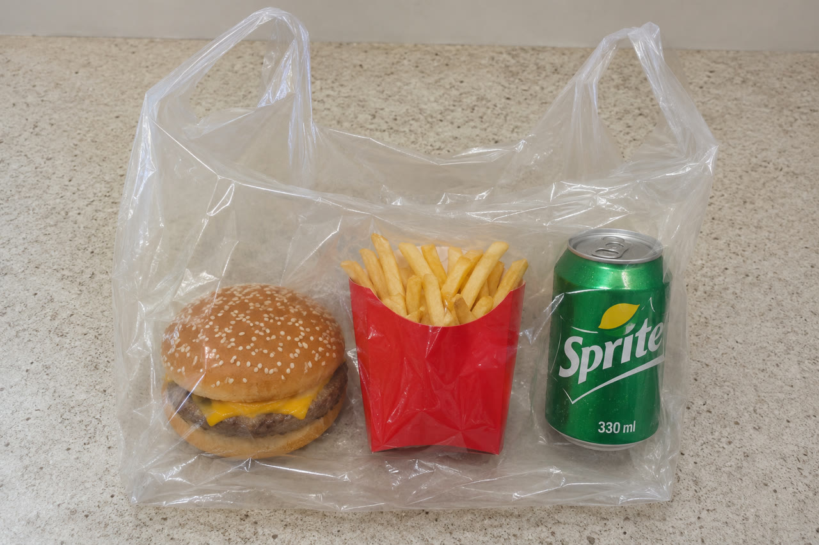
PHOTO DEMO FIXTURES
The clear-bag test is repeatable
MISSING SPRITE / 0 of 1 visible
COMPLETE BAG / 1 of each item
Next replaces the test image and runs a fresh AI analysis. Synthetic test data.
TEAM ZINDABAD / NOVA HACKATHON / INTERACTIVE PROTOTYPE
12
Notes:
Appendix. Generated with built-in ImageGen. Both images use a transparent takeaway bag. Real OpenRouter calls returned red for missing Sprite and green for the complete bag at packing and at the doorstep. These are two synthetic fixtures, not an accuracy benchmark.

