Slide 1
Facebook Developer Circles
Data Science Study Group Meet up

Slide 2
👉 Data Science and its impact in all industry verticals
Finance
Management consultancy
Risk assessment
Banking
Online Shopping
On-demand services
Insurance
Healthcare
Textile
Advertisement

Slide 3
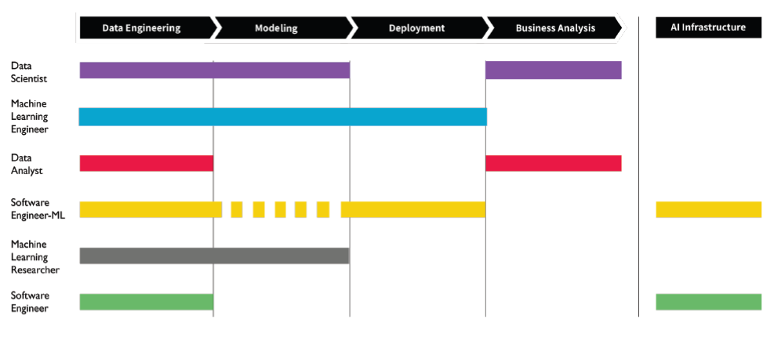
👉 AI Career Pathways - Responsibilities

Slide 4
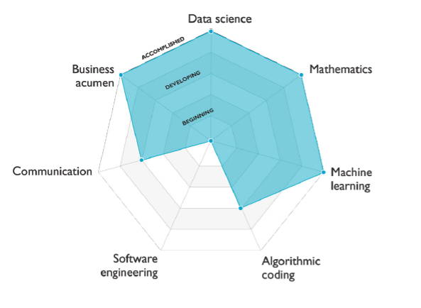
Data Scientist

Slide 5
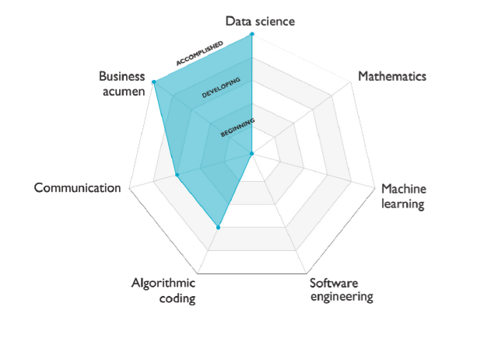
Data Analyst

Slide 6
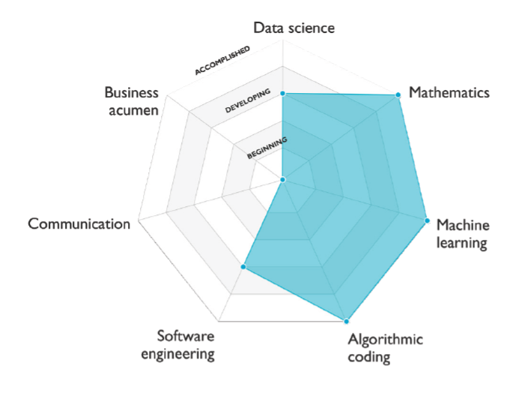
Machine Learning Engineer

Slide 7
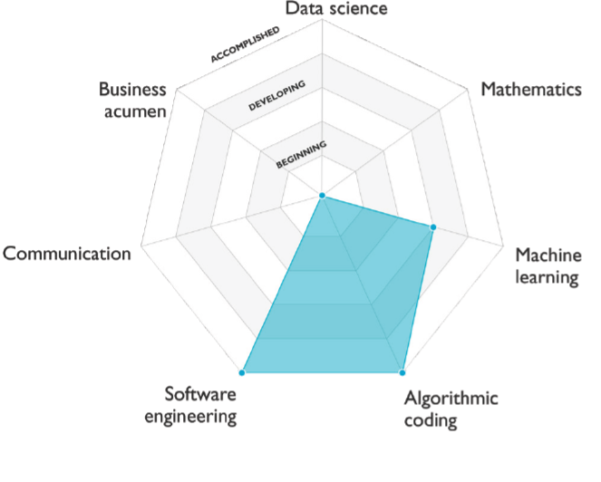
Software Engineer – Machine Learning

Slide 8
👉 Companies working in Data Science (in Pakistan)
McKinsey
Hashoo Group
Nishat Group
Packages Group
Descon Engineering
Indus Motors
TetraPak
Bykea
Foodpanda
Airlift
Swvl
Finca
xIQ
Folio3
Datic.ai
Audit xprt
VisionX
Omno AI
Tkxel
Starcom Mediavest
i2c
Xavor
Teradata
Confiz
7 Vals
IBM
Addo AI
VentureDive
KeepTruckin
Zameen.com
Afiniti
Unilever
PWC
Deloitte
Nestle
Coca Cola Intl.

Slide 9
👉 Worth of Datacamp's certifications
Online Learning is not just desirable, it is indispensable
Problem
Few people with Data Science skills VS. growing demand for these skills
Universities unable to equip students with in-demand skills
Solution
1. Companies train employees in-house
2. Students/Professionals gain skills from online courses

Slide 10
28th February - End of Track 1
3 days left. Make the most of your time!
Year long subscription worth ~40,000 PKR

Slide 11
Credits
AI Career Pathways Workera
https://d2wahc834rj2un.cloudfront.net/Workera%20Report.pdf

