Slide 1
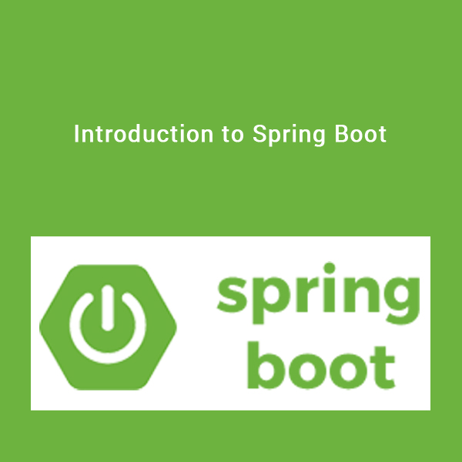

Slide 2

Before we start
A task for you – time 15 minutes
Develop a web application which reads Employee information from MySQL DB and print on the screen. You need to use Spring and Hibenate(JPA). It should run in any web container.

Slide 3
Before we start
List out the challenges you have faced while setting up the env.
Download and set up a server (e.g. Tomcat)
Download and install a DB
Download required Spring jars
Download Hibernate jar compatible with the Spring version
Download jar for MySQL driver
Setting up web.xml to use spring MVC
Anything I left ???

Slide 4
Why Spring Boot
Provides a radically faster and widely accessible ‘getting started’ experience for all Spring development
No clumsy XML Configuration by developers
Provide opinionated ‘starter’ POMs to simplify your Maven configuration
Uses project management tool such as MAVEN or GRADLE
Helps fast development and production ready code
Embed Tomcat, Jetty or Undertow directly (no need to deploy WAR files)
In memory DB

Slide 5
Documentation
http://docs.spring.io/spring-boot/docs/current/reference/html/index.html

Slide 6

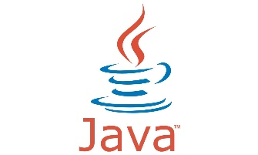
System Requirement Spring Boot 1.4.2.RELEASE
Apache Maven
Java 7 +

Slide 7
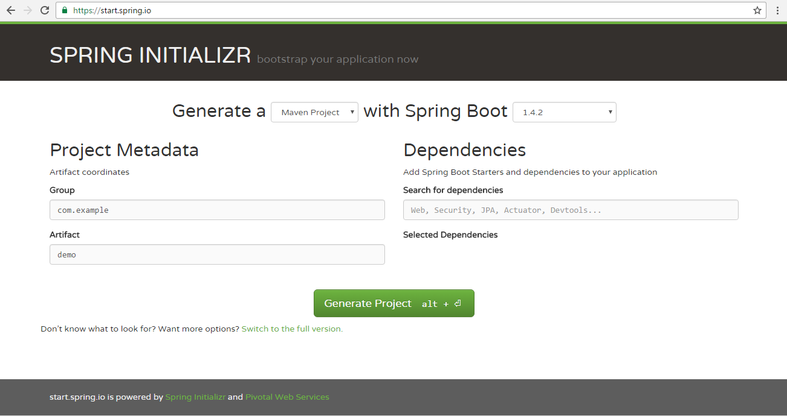
http://start.spring.io – a good starting point

Slide 8
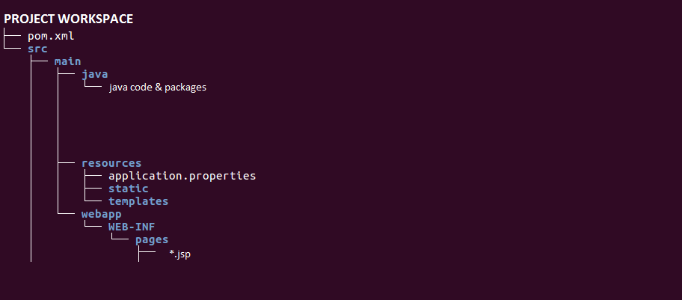
Folder Structure to be followed

Slide 9
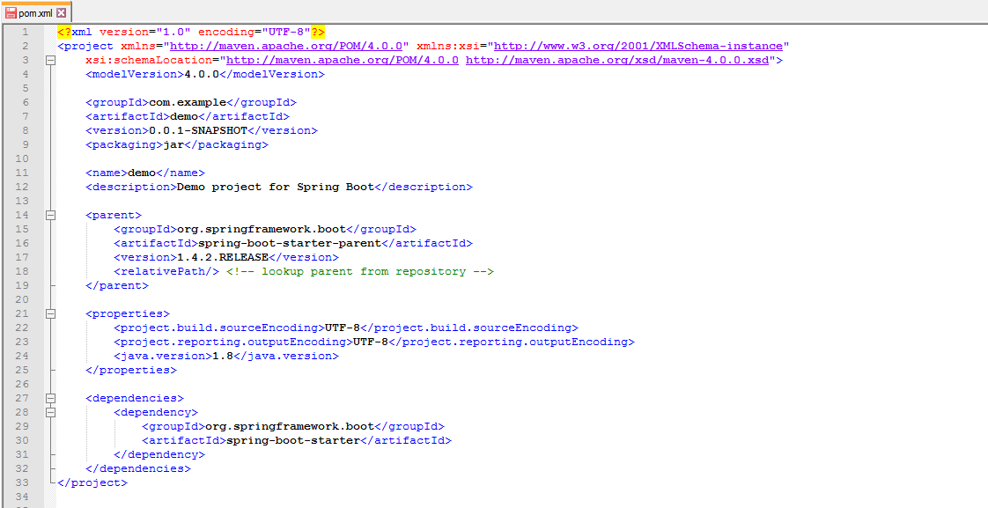
Understanding pom.xml

Slide 10
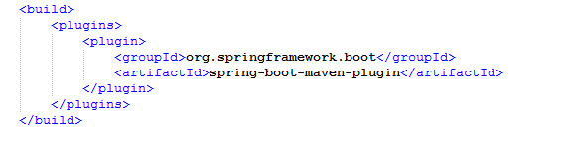
Build runnable jar

Slide 11
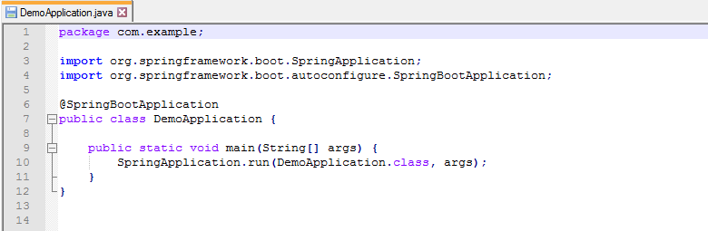
First Java Program for spring boot

Slide 12
Running the application
> mvn spring-boot:run

Slide 13
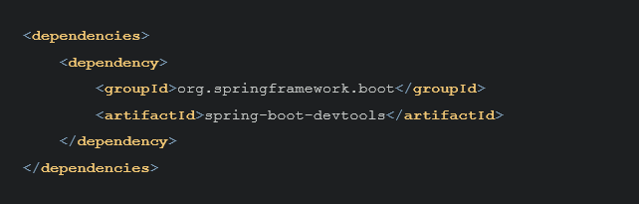
Devtools
Automatic Restart
LiveReload
Remote Debug Tunneling
Remote Update and Restart
Details at:
http://docs.spring.io/spring-boot/docs/current/reference/html/using-boot-devtools.html

Slide 14

Spring Tool Suite (sts)
Download https://spring.io/tools/sts/all

Slide 15
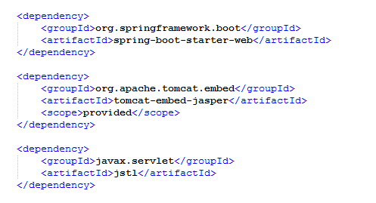
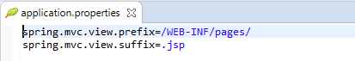
Spring Web & MVC
pom.xml
application.properties

Slide 16
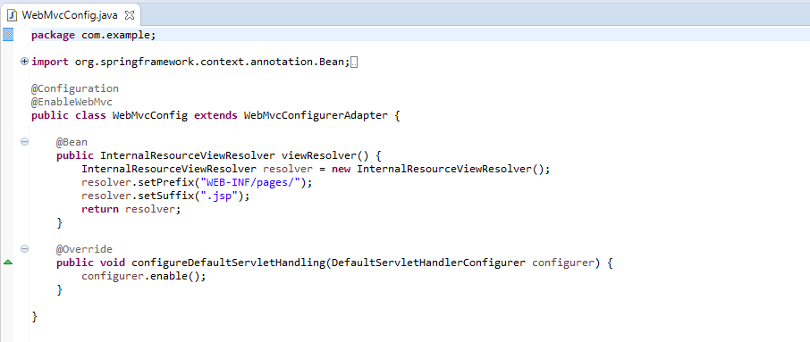
Without application.properties

Slide 17
Runnable war
1) In Main java file:
1.1 extend : org.springframework.boot.web.support.SpringBootServletInitializer
1.2 override the method:
@Override
protected SpringApplicationBuilder configure(SpringApplicationBuilder application) {
return application.sources(MyApplication.class);
}
1.3 No need of main() method.
2) In pom.xml
1.1 Change the packing to war as:
<packaging>war</packaging>
3) Use command: mvn clean package
4) In target, rename the war<context root> as you want, deploy in tomcat and access with <context root>/<request mapping>

Slide 18
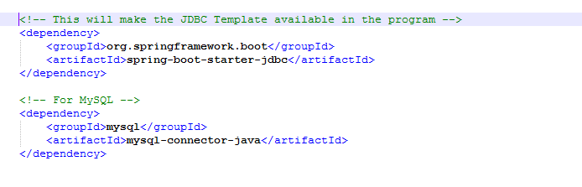
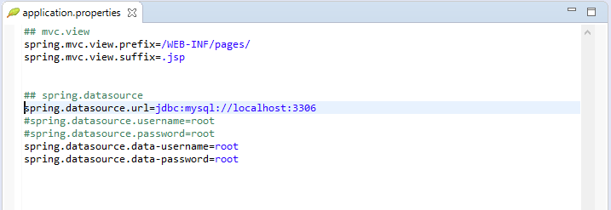
MySQL & jdbc
pom.xml
- For JNDI Datasource
spring.datasource.jndi-name=java:jboss/datasources/customers

Slide 19
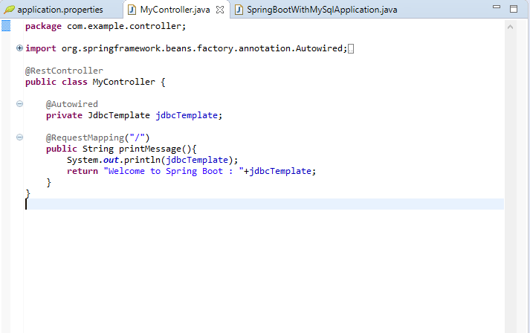
MySQL & jdbc

Slide 20
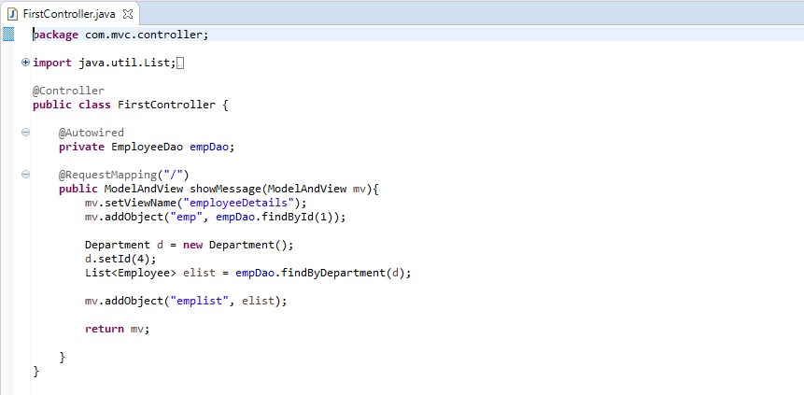
JPA in Spring Boot

Slide 21
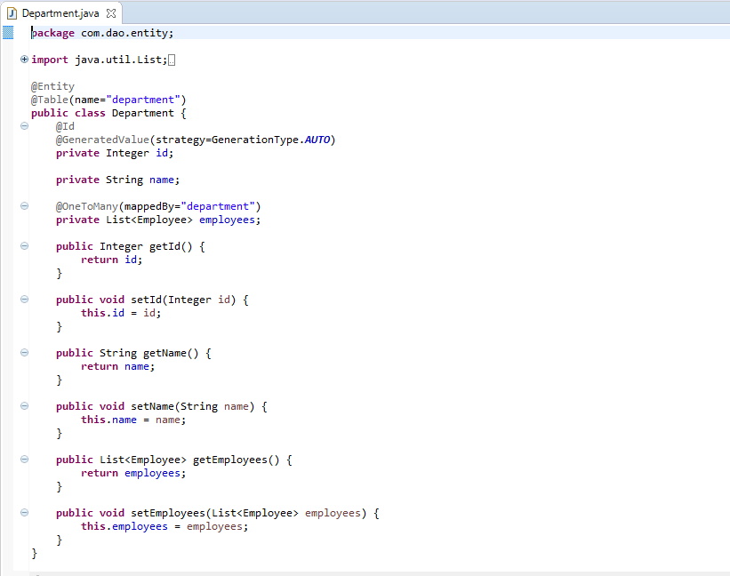
JPA in Spring Boot

Slide 22
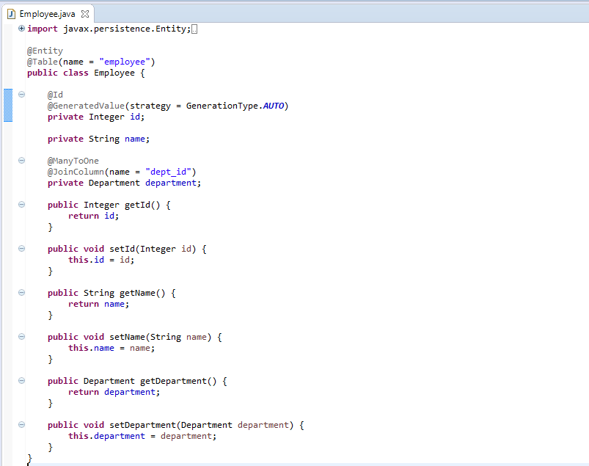
JPA in Spring Boot

Slide 23
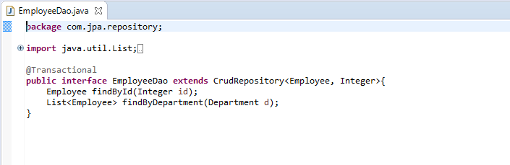
JPA in Spring Boot
Things to learn:
Only interface is enough which inherits to CrudRepository. The implementation will be provided by spring.
To know the other inherited methods, please go through the CrudRepository API.

Slide 24
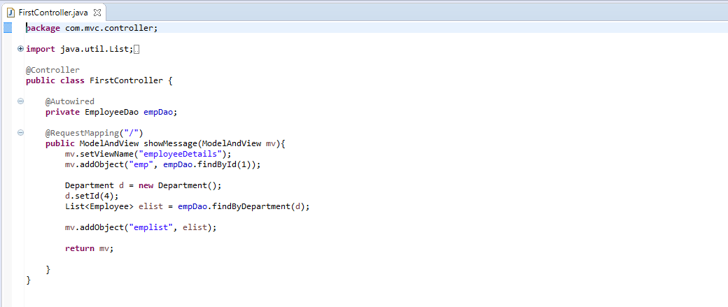
JPA in Spring Boot

Slide 25
Code
The code can be downloaded from:
https://github.com/santoshkar/SpringBoot.git

