Slide 1
UMOJA HARDWARE SYSTEM
A role-by-role guide, with a real end-to-end sale walkthrough
umoja.ehub.co.tz · Umoja Pro mobile app

Slide 2
How to read this guide
This guide has three parts:
1. Each role gets its own chapter — find your role and read it end to end.
2. The 'End-to-end sale' chapter shows one real sale going through every role on the live system.
3. The 'Mobile companion app' chapter shows Umoja Pro on Android.
Roles covered
• System Administrator — The owner or IT lead who sets the system up and keeps it healthy.
• Store Manager — The supervisor on the floor who approves orders and runs dispatch.
• Sales Representative — The cashier or salesperson at the counter or on the phone.
• Procurement Officer (Afisa Ugavi) — The person responsible for ordering goods from suppliers.
• Stock Controller — The receiving clerk who books incoming goods into the system.
• Store Keeper — The warehouse staff who picks goods for dispatch.
• Accountant — The bookkeeper who tracks money in and money out.

Slide 3
END-TO-END WALKTHROUGH
End-to-end sale: from POS to delivery
Who does this
A real sale captured live on the system, showing each role's view at every transition.
Your day, in one paragraph
Follow one Walk-in Customer's order from the moment the Sales Rep punches it in until the truck rolls out. The screenshots below are real captures from each user's logged-in session on the live site.
10 steps follow. Tips at the end of the chapter.

Slide 4
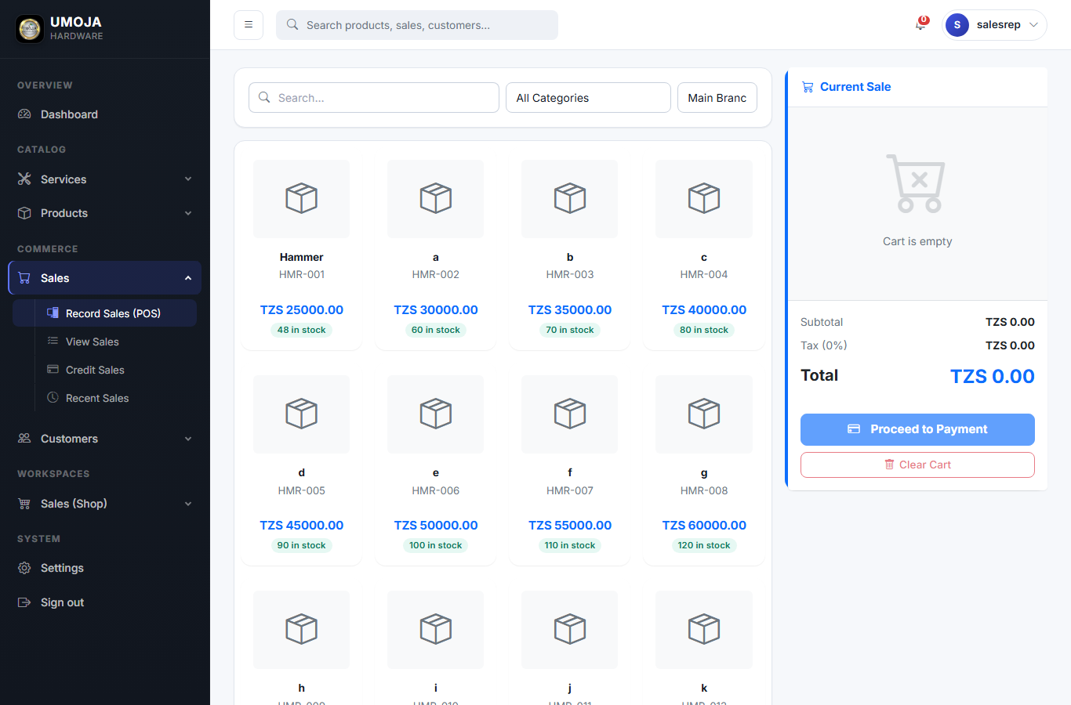
END-TO-END SALE: FROM POS TO DELIVERY · STEP 1 OF 10
1. Sales Rep — open POS
The Sales Rep logs in and opens Sales > POS. They search products, set quantity and price, pick the customer, take payment. When they Submit, the sale lands in 'Pending approval' state.
Umoja Hardware · User Guide

Slide 5

END-TO-END SALE: FROM POS TO DELIVERY · STEP 2 OF 10
2. Sales Rep — sale is pending
The new sale shows up in the rep's Sales list with status PENDING. Stock has NOT moved yet. The rep can take the next customer right away — approval is the manager's job.
Umoja Hardware · User Guide

Slide 6
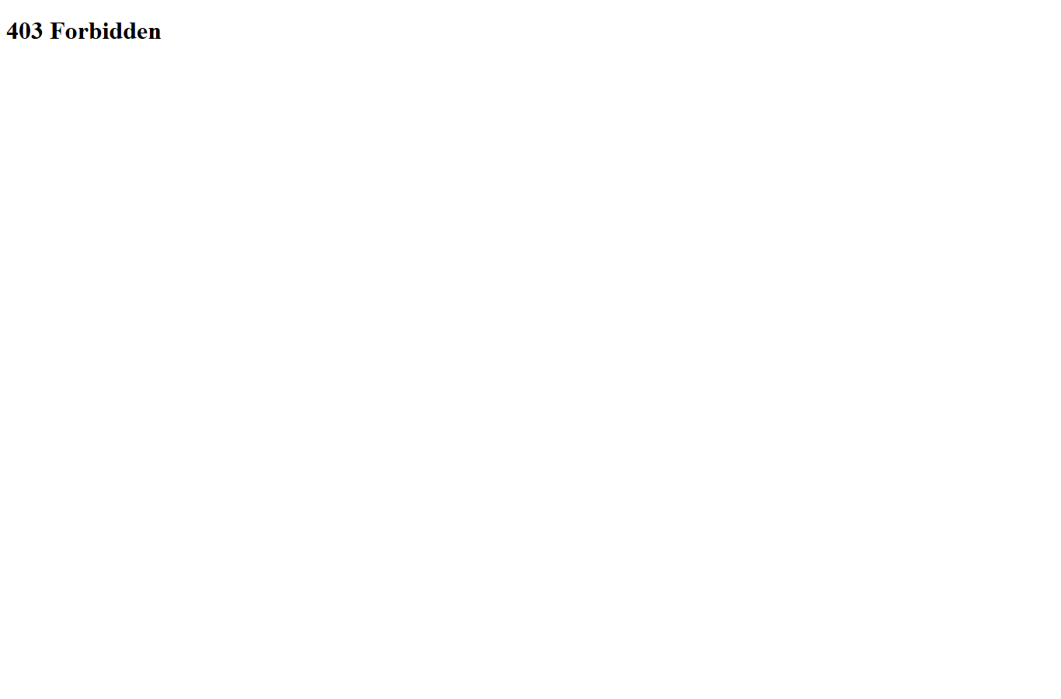
END-TO-END SALE: FROM POS TO DELIVERY · STEP 3 OF 10
3. Store Manager — sees pending order
The Store Manager opens Sales > Order management. The new order is listed with Approve / Decline buttons. They check it's a real customer and the price is right.
Umoja Hardware · User Guide

Slide 7
END-TO-END SALE: FROM POS TO DELIVERY · STEP 4 OF 10
4. Store Manager — approves
After clicking Approve, the order disappears from the Pending list. Stock is still untouched at this point — Approve only means the order is cleared for dispatch.
Umoja Hardware · User Guide

Slide 8
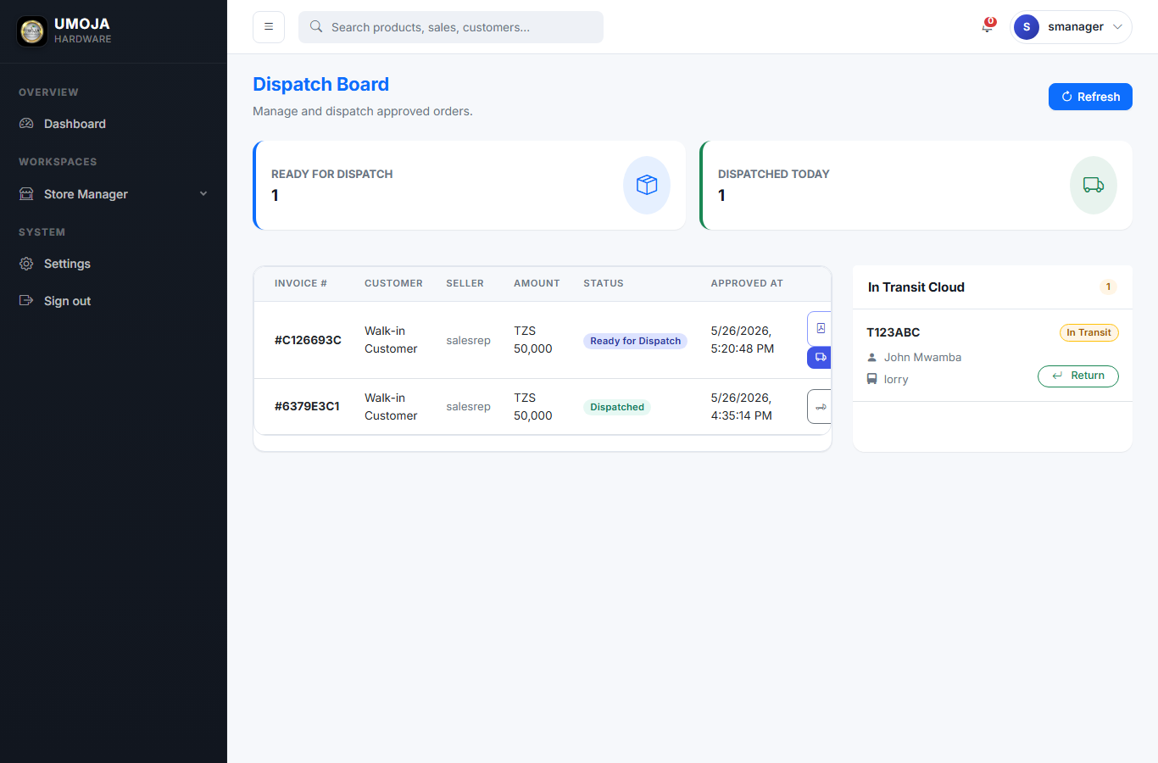
END-TO-END SALE: FROM POS TO DELIVERY · STEP 5 OF 10
5. Store Manager — opens Dispatch Board
The approved order is now on Sales > Dispatch. The manager picks the Store Keeper who will pull the goods, picks a Vehicle (or types hired lorry info), and clicks Dispatch.
Umoja Hardware · User Guide

Slide 9
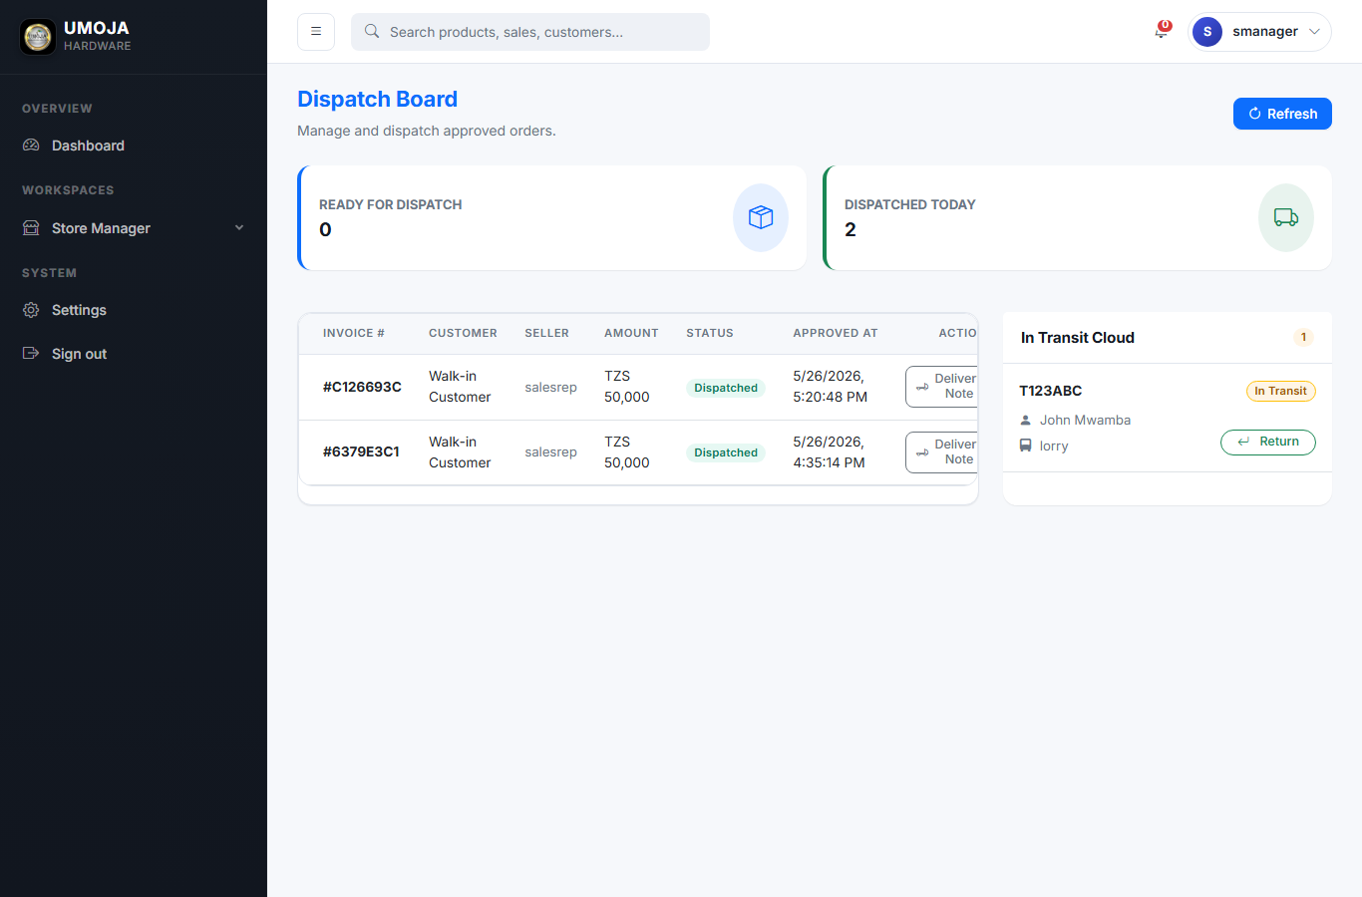
END-TO-END SALE: FROM POS TO DELIVERY · STEP 6 OF 10
6. Store Manager — order dispatched
Now stock IS deducted. The order moves to DISPATCHED status, the vehicle is marked In Transit, and PDF invoice + delivery note are generated. The driver leaves with the goods.
Umoja Hardware · User Guide

Slide 10
END-TO-END SALE: FROM POS TO DELIVERY · STEP 7 OF 10
7. Store Manager — sales list
Cross-checking the sale list now shows the order with Dispatched status, the picker assigned, and the lorry info.
Umoja Hardware · User Guide

Slide 11
END-TO-END SALE: FROM POS TO DELIVERY · STEP 8 OF 10
8. Store Keeper — picks and confirms
The Store Keeper sees the dispatched sale in their feed — they pull the goods physically and load them on the truck shown.
Umoja Hardware · User Guide

Slide 12
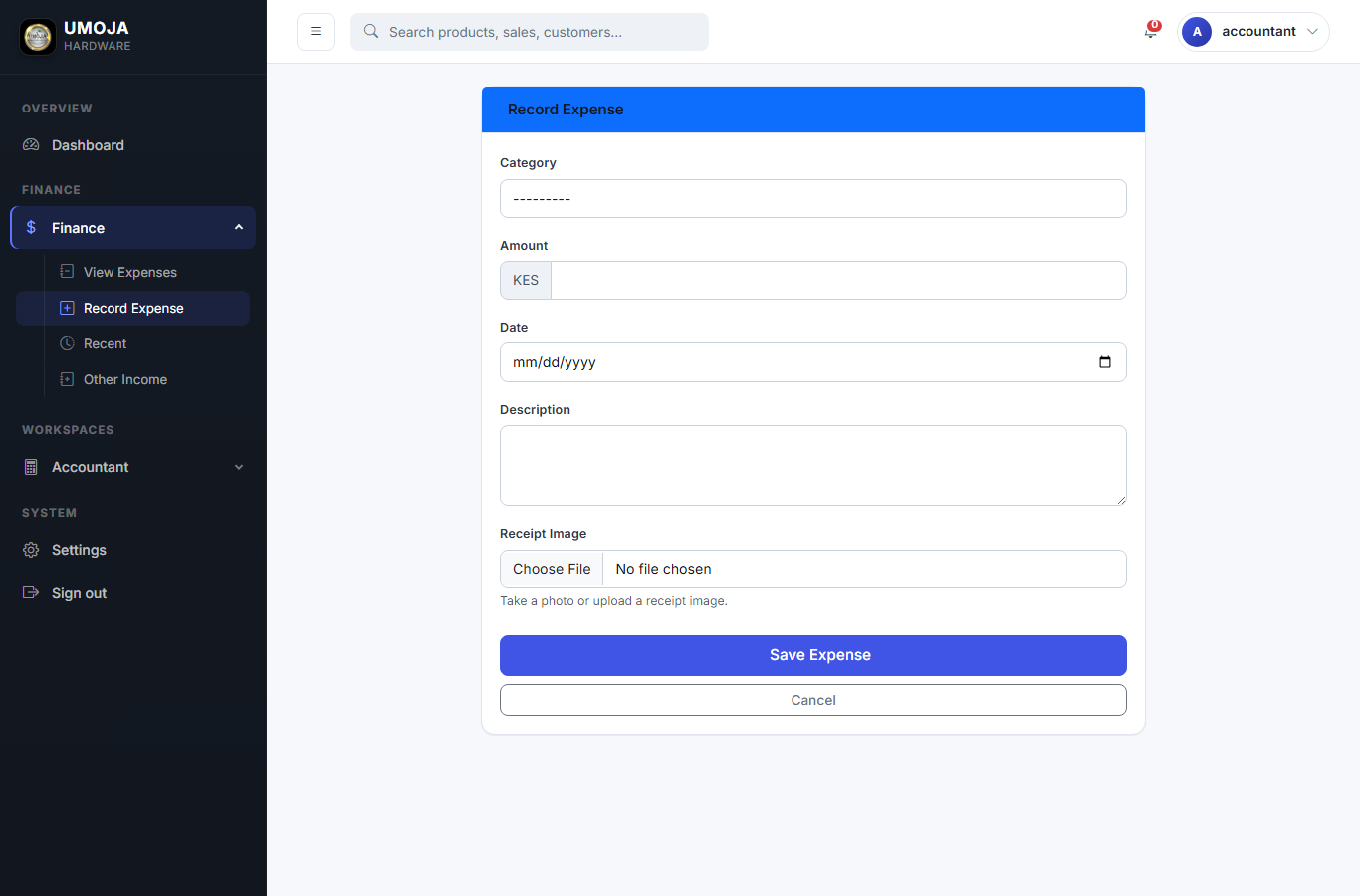
END-TO-END SALE: FROM POS TO DELIVERY · STEP 9 OF 10
9. Accountant — record the expense behind the sale
Once the truck has rolled, the Accountant logs the fuel / freight expense via Finance > Expenses > Add expense. Receipt photo attached.
Umoja Hardware · User Guide

Slide 13
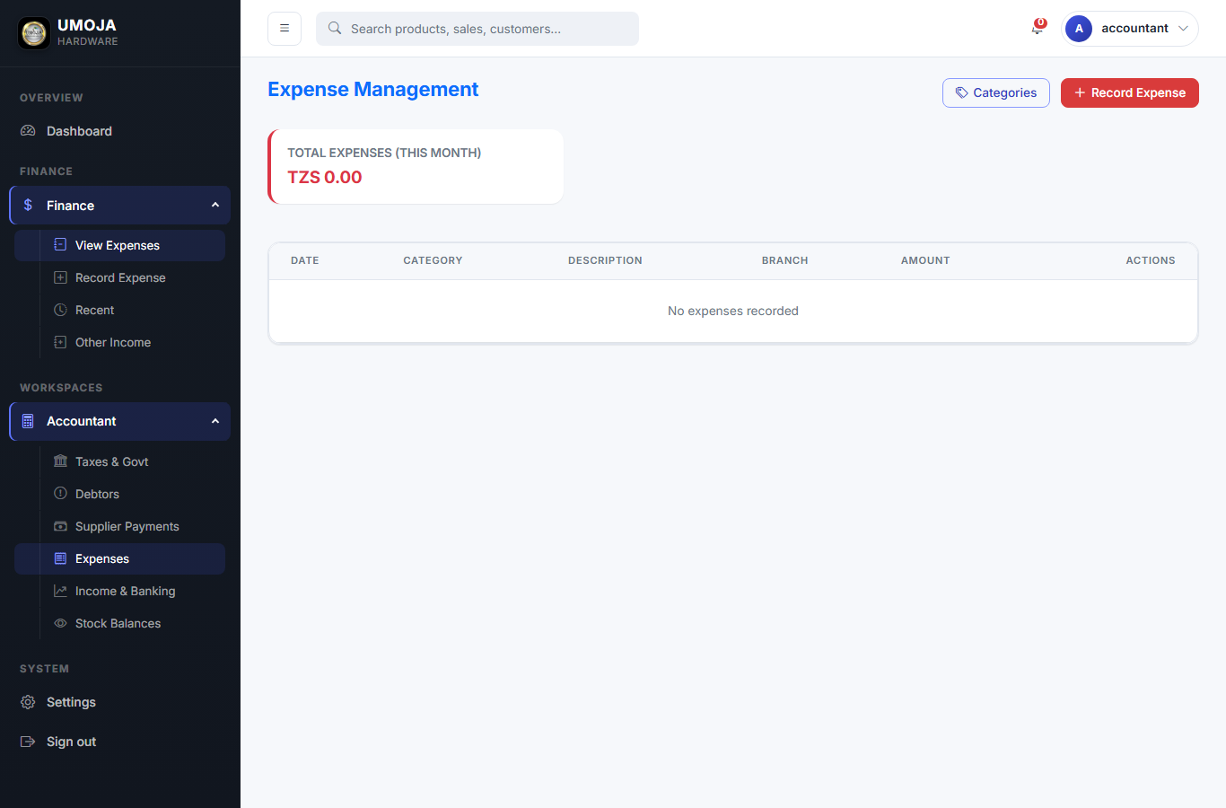
END-TO-END SALE: FROM POS TO DELIVERY · STEP 10 OF 10
10. Accountant — expenses list
The new expense shows up in the running list, categorized, with the receipt image one click away.
Umoja Hardware · User Guide

Slide 14
END-TO-END SALE: FROM POS TO DELIVERY · TIPS & GOTCHAS
Things that are easy to miss
⚑ Stock moves at step 6 (Dispatch), not at step 4 (Approve).
⚑ Commission is frozen at step 1 (sale creation) based on the product's category — changing the category rate later doesn't affect historical sales.
⚑ If the sale is later deleted, stock is restored automatically.

Slide 15
ROLE
System Administrator
Who does this
The owner or IT lead who sets the system up and keeps it healthy.
Your day, in one paragraph
You configure the business once (branches, categories, users, roles) and then mostly use the dashboard to spot problems. You can do everything any other role can do.
6 steps follow. Tips at the end of the chapter.

Slide 16
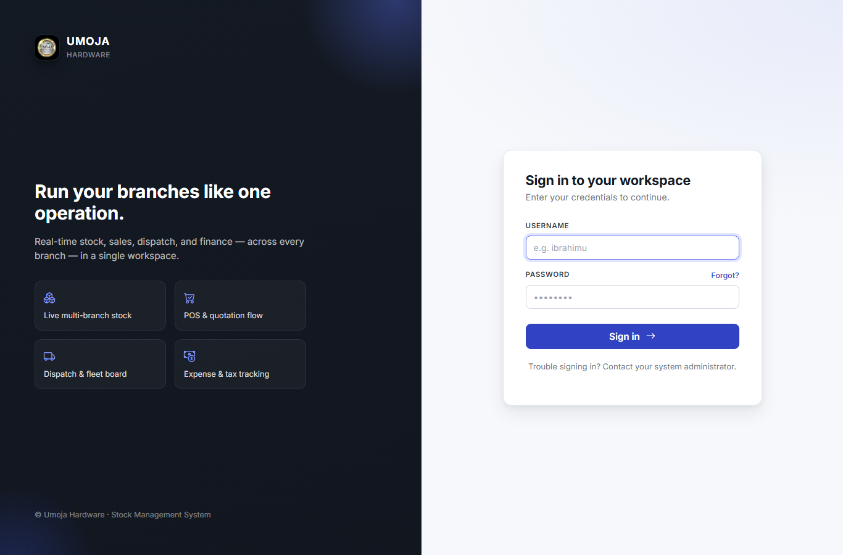
SYSTEM ADMINISTRATOR · STEP 1 OF 6
Sign in
Open https://umoja.ehub.co.tz, type your username and password, click Sign in.
Umoja Hardware · User Guide

Slide 17
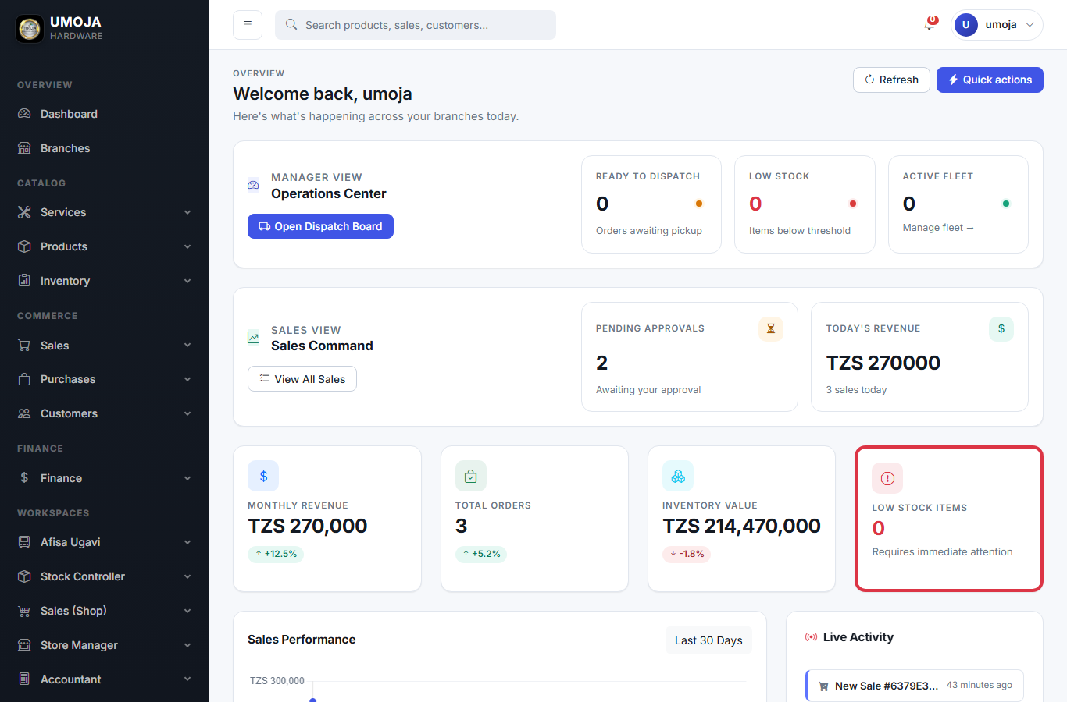
SYSTEM ADMINISTRATOR · STEP 2 OF 6
Admin dashboard
After login you land on the Dashboard. The cards at top tell you what needs attention right now: orders ready to dispatch, low-stock items, pending approvals, today's revenue.
Umoja Hardware · User Guide

Slide 18
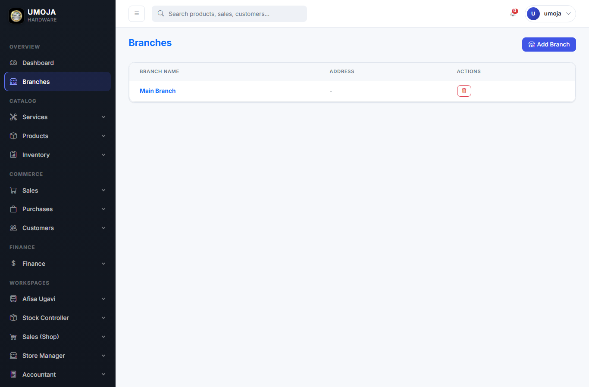
SYSTEM ADMINISTRATOR · STEP 3 OF 6
Create branches
Inventory > Branches > Add branch. Every product stock and every sale is tied to a branch — set yours up before adding any other data.
Umoja Hardware · User Guide

Slide 19
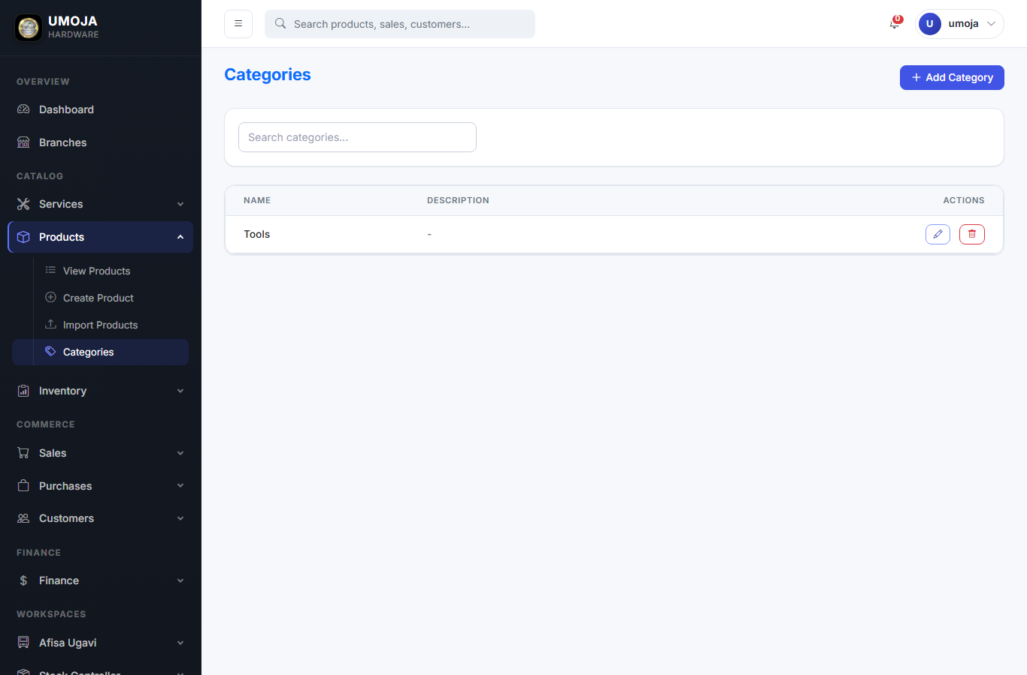
SYSTEM ADMINISTRATOR · STEP 4 OF 6
Create categories
Inventory > Categories. Each category has a commission % that is applied to every sale of products in that category. Historical sales keep their old rate even if you change it later.
Umoja Hardware · User Guide

Slide 20
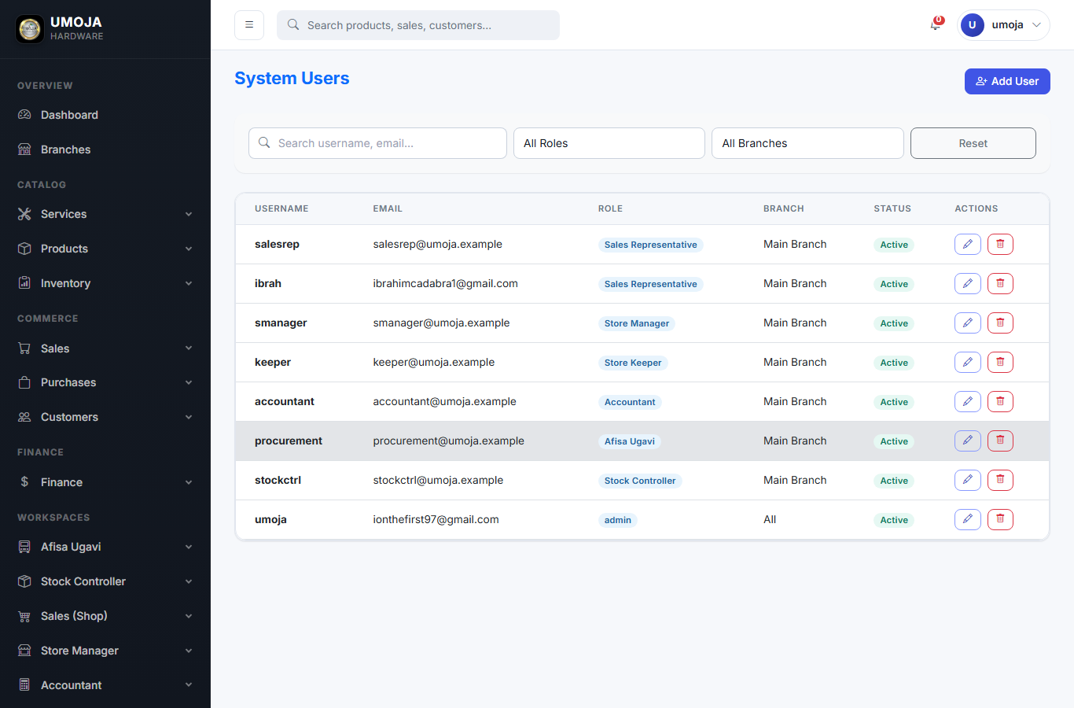
SYSTEM ADMINISTRATOR · STEP 5 OF 6
Manage users
Users. Each user has a role that decides which menu items they see and which actions they can take.
Umoja Hardware · User Guide

Slide 21
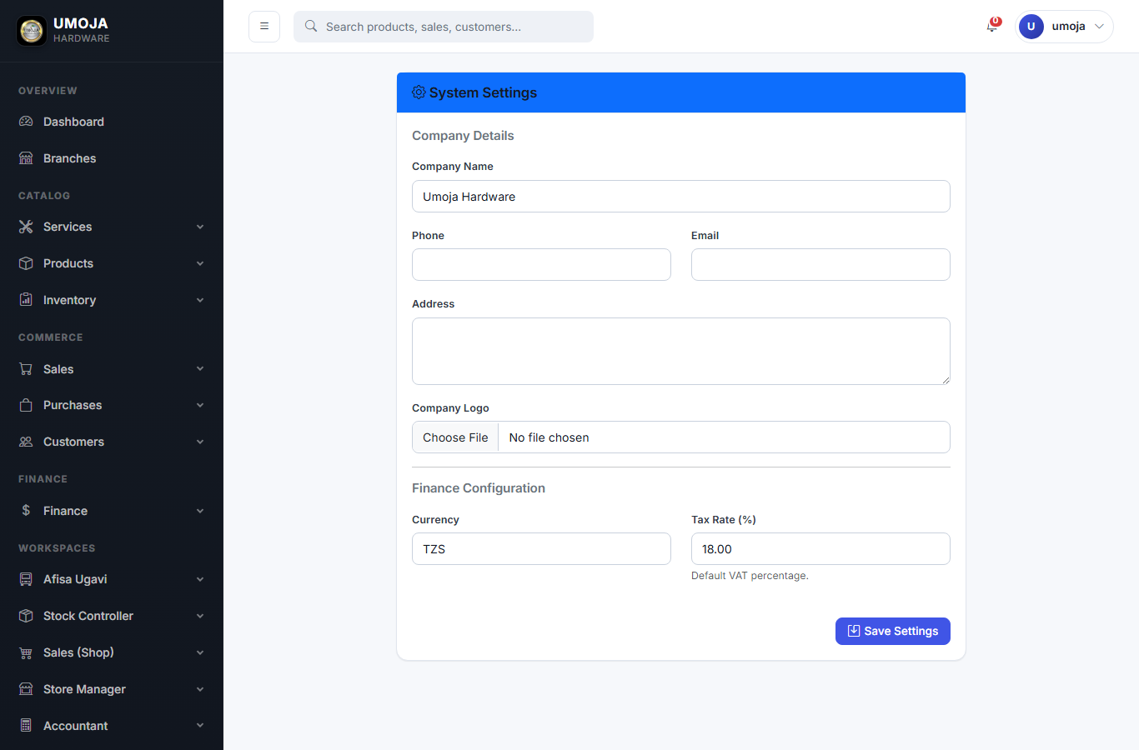
SYSTEM ADMINISTRATOR · STEP 6 OF 6
Company settings
Settings. Company name, default currency (TZS), and default tax rate. These show up on receipts and invoices.
Umoja Hardware · User Guide

Slide 22
SYSTEM ADMINISTRATOR · TIPS & GOTCHAS
Things that are easy to miss
⚑ Run `python manage.py create_roles` once after install to seed all role groups.
⚑ Keep the SECRET_KEY out of git — set it in /var/www/app/.env on the server.
⚑ Reports menu shows aging, profitability by category, and commissions per sales rep.

Slide 23
ROLE
Store Manager
Who does this
The supervisor on the floor who approves orders and runs dispatch.
Your day, in one paragraph
Sales reps create orders all day. Your job is to approve or decline them, then dispatch the approved ones — assigning a store keeper to pick the goods and a vehicle to deliver them.
5 steps follow. Tips at the end of the chapter.

Slide 24
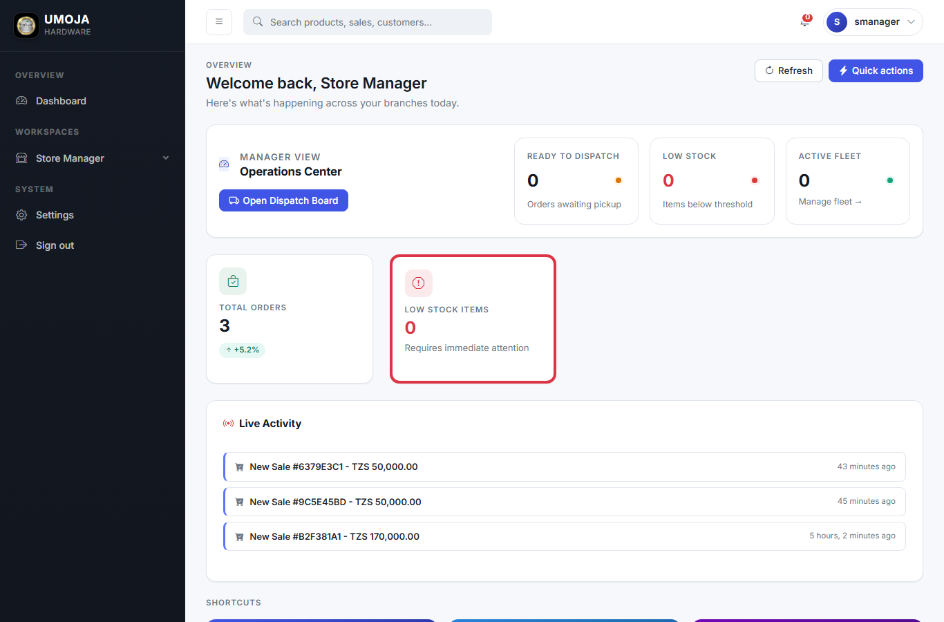
STORE MANAGER · STEP 1 OF 5
Your dashboard
The Store Manager dashboard surfaces a Manager View — ready-to-dispatch count, low-stock count, active fleet.
Umoja Hardware · User Guide

Slide 25
STORE MANAGER · STEP 2 OF 5
Order Management — approve or decline
Sales > Order management. Each pending row has Approve and Decline. Approve only when you've checked the customer is real and the price is right.
Umoja Hardware · User Guide

Slide 26
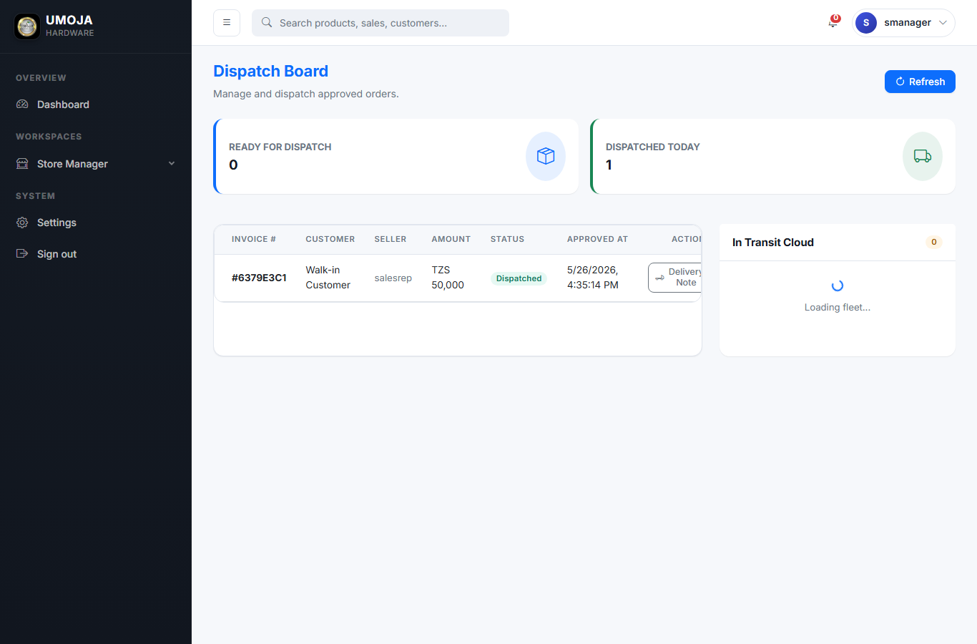
STORE MANAGER · STEP 3 OF 5
Dispatch Board — assign & ship
Sales > Dispatch board. Pick an approved order, choose a Store Keeper to pick the goods, pick a Vehicle (or type hired transport in Lorry info), click Dispatch.
Umoja Hardware · User Guide

Slide 27
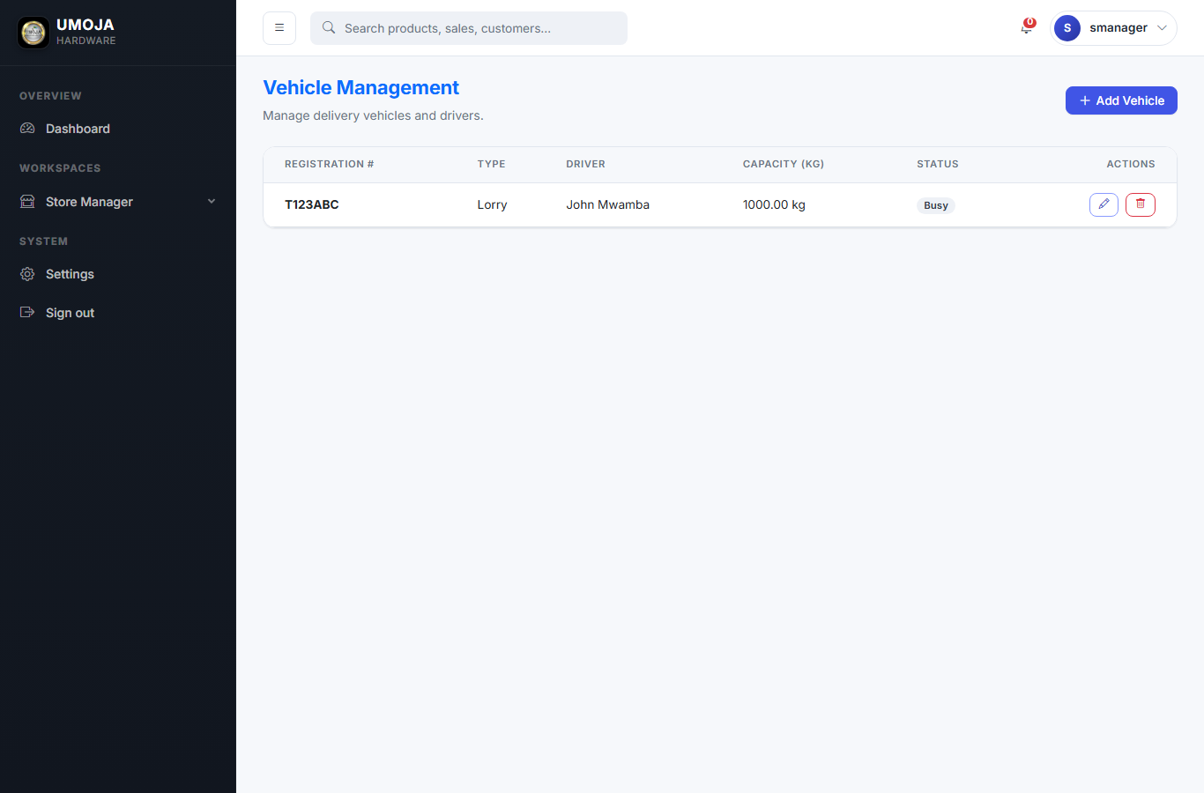
STORE MANAGER · STEP 4 OF 5
Track delivery vehicles
Sales > Vehicles. See which vehicles are Active vs busy In transit. Mark a returned vehicle Active again so it can be assigned to the next dispatch.
Umoja Hardware · User Guide

Slide 28
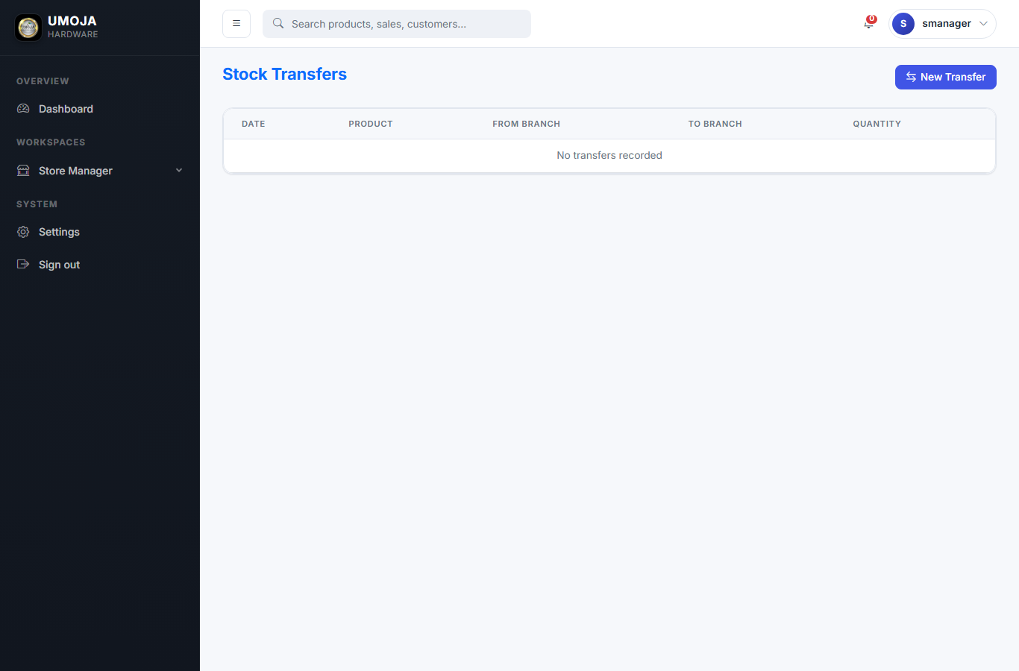
STORE MANAGER · STEP 5 OF 5
Move stock between branches
Inventory > Transfer. Use when one branch is low and another is overstocked. Stock moves out of source, into destination.
Umoja Hardware · User Guide

Slide 29
STORE MANAGER · TIPS & GOTCHAS
Things that are easy to miss
⚑ Stock only moves at Dispatch — Approve does not yet deduct stock.
⚑ If a vehicle stays 'busy' after the driver came back, click Return to free it up.
⚑ Decline within minutes — the customer is usually still on the line.

Slide 30
ROLE
Sales Representative
Who does this
The cashier or salesperson at the counter or on the phone.
Your day, in one paragraph
You take orders all day. You enter products and customer, record payment (cash, mobile money, bank transfer, or credit), and submit. The order then waits for your manager to approve and dispatch it.
5 steps follow. Tips at the end of the chapter.

Slide 31
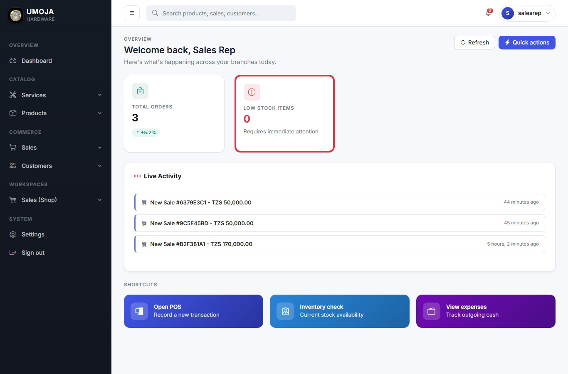
SALES REPRESENTATIVE · STEP 1 OF 5
Your dashboard
Sales Rep dashboards focus on Commerce — your total orders, low stock items, and a Sales (Shop) workspace.
Umoja Hardware · User Guide

Slide 32
SALES REPRESENTATIVE · STEP 2 OF 5
Open the POS
Sales > POS. Search products, add to cart, pick a customer, record payment.
Umoja Hardware · User Guide

Slide 33
SALES REPRESENTATIVE · STEP 3 OF 5
Sales list
Sales > Sales. Your past sales with status (Pending, Approved, Dispatched, Cancelled) and the amount, paid vs balance.
Umoja Hardware · User Guide

Slide 34
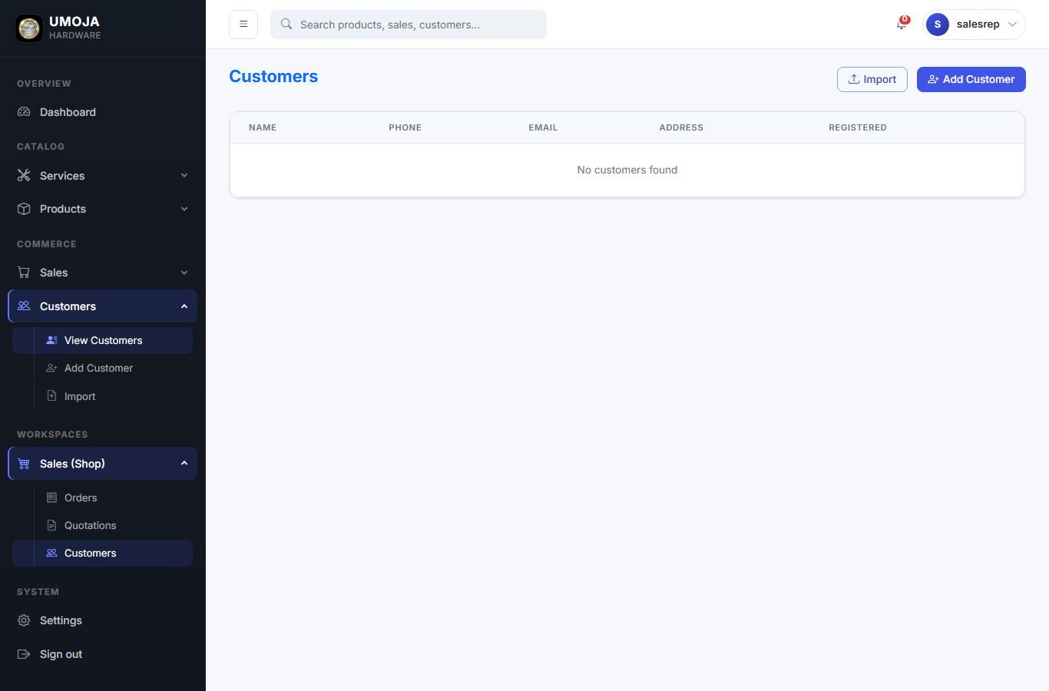
SALES REPRESENTATIVE · STEP 4 OF 5
Customers
Customers. Track existing customers and add new ones. Each customer's sales history is one click away.
Umoja Hardware · User Guide

Slide 35
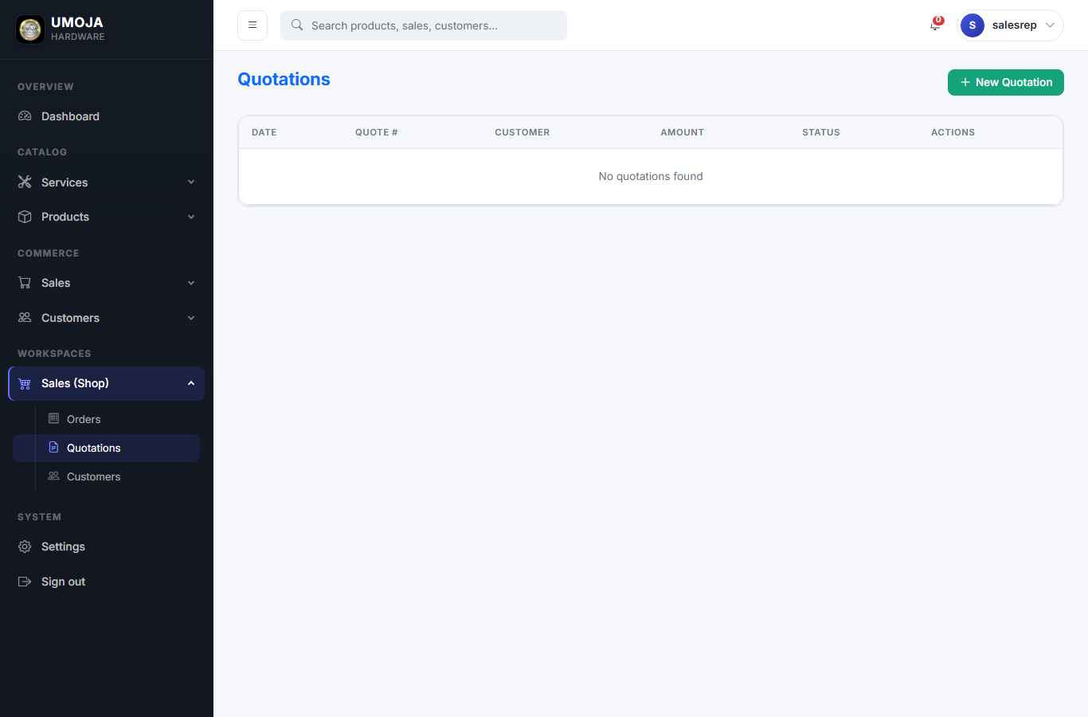
SALES REPRESENTATIVE · STEP 5 OF 5
Quotations
Quotations. Use for written price estimates — does NOT touch stock. Convert into a Sale with one click when the customer commits.
Umoja Hardware · User Guide

Slide 36
SALES REPRESENTATIVE · TIPS & GOTCHAS
Things that are easy to miss
⚑ Commission is calculated automatically based on the product's category.
⚑ If a product isn't appearing in search, it might be out of stock at your branch.
⚑ Use Quotations for big-ticket items the customer wants to think about.

Slide 37
ROLE
Procurement Officer (Afisa Ugavi)
Who does this
The person responsible for ordering goods from suppliers.
Your day, in one paragraph
You manage suppliers and raise Purchase Orders. Once goods arrive, the Stock Controller receives them against your PO.
5 steps follow. Tips at the end of the chapter.

Slide 38
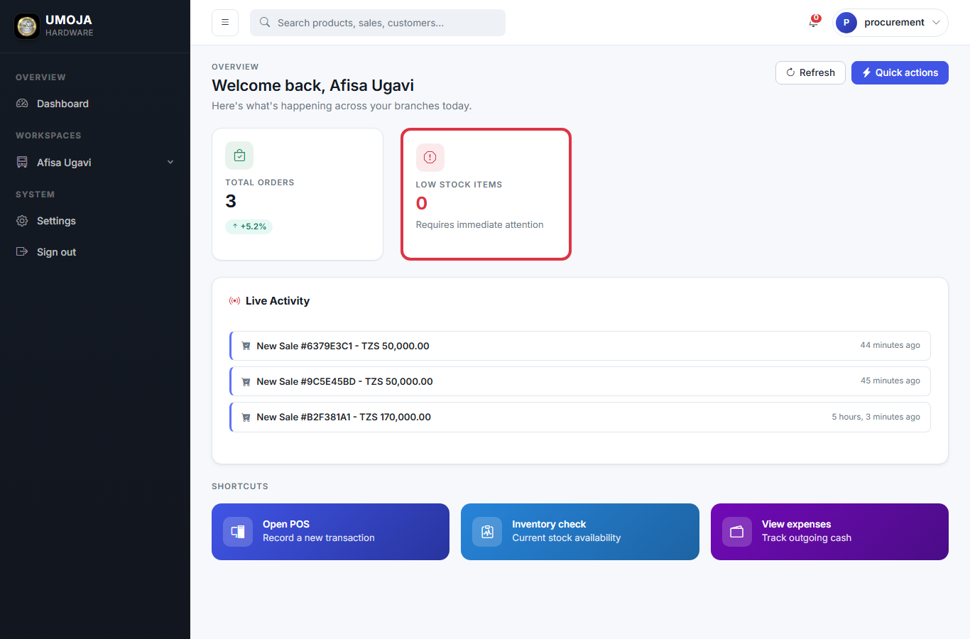
PROCUREMENT OFFICER (AFISA UGAVI) · STEP 1 OF 5
Your dashboard
Procurement dashboards are scoped to Afisa Ugavi tasks.
Umoja Hardware · User Guide

Slide 39
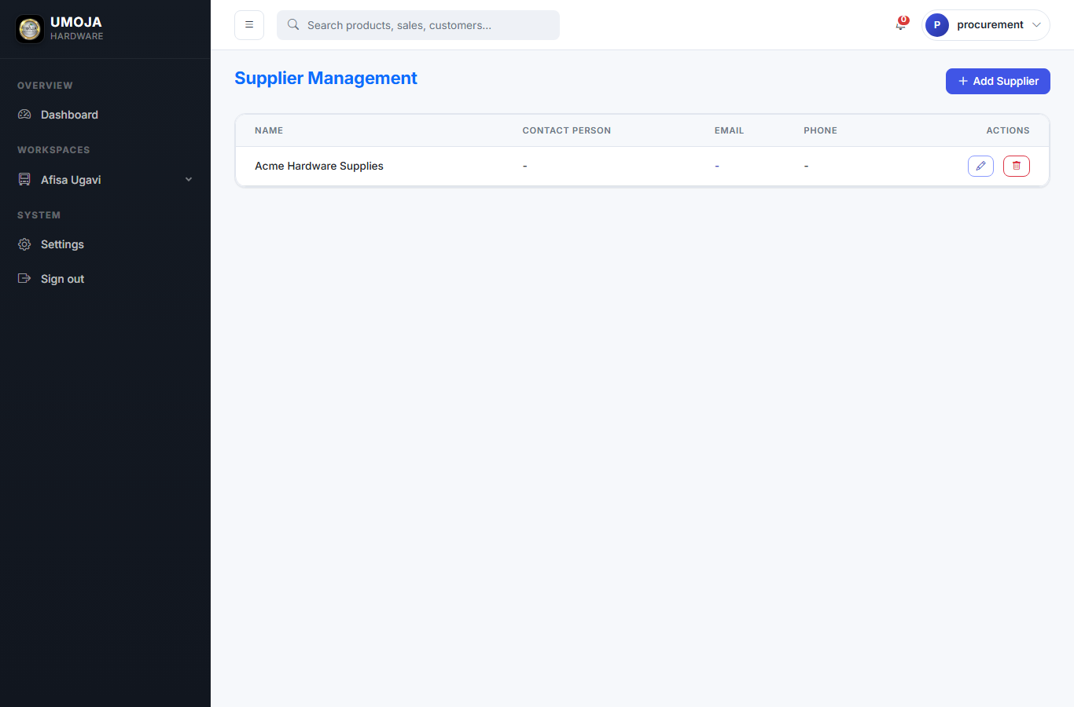
PROCUREMENT OFFICER (AFISA UGAVI) · STEP 2 OF 5
Manage suppliers
Inventory > Suppliers. Add new suppliers with their contact info. Each Purchase Order is tied to one supplier.
Umoja Hardware · User Guide

Slide 40
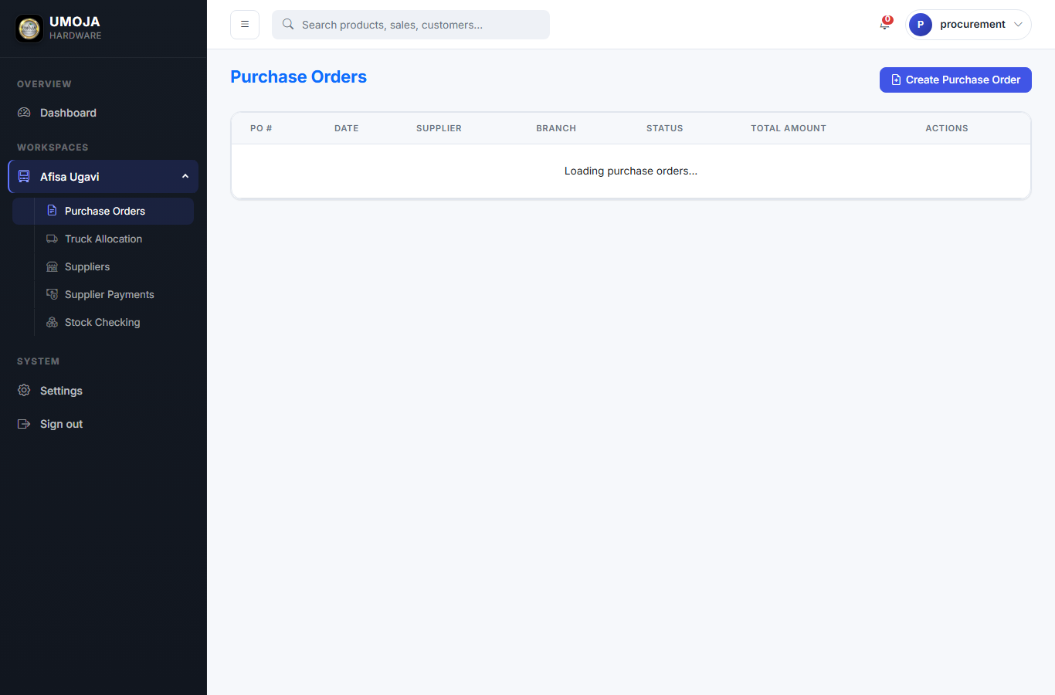
PROCUREMENT OFFICER (AFISA UGAVI) · STEP 3 OF 5
Purchase Orders
Inventory > Purchase orders. The PO list shows open, received, and closed POs.
Umoja Hardware · User Guide

Slide 41
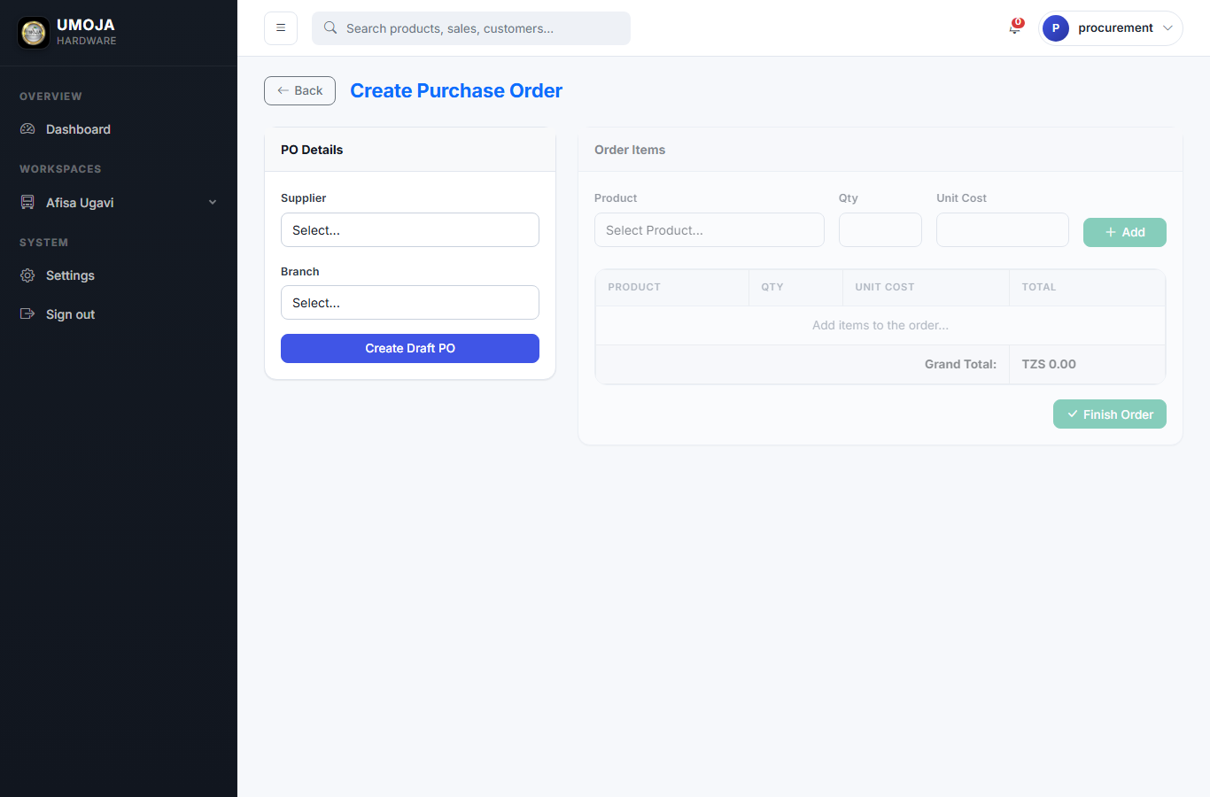
PROCUREMENT OFFICER (AFISA UGAVI) · STEP 4 OF 5
Raise a new PO
Pick the supplier, add the line items (product + quantity + agreed price). The PO is tracked in the system until goods arrive.
Umoja Hardware · User Guide

Slide 42
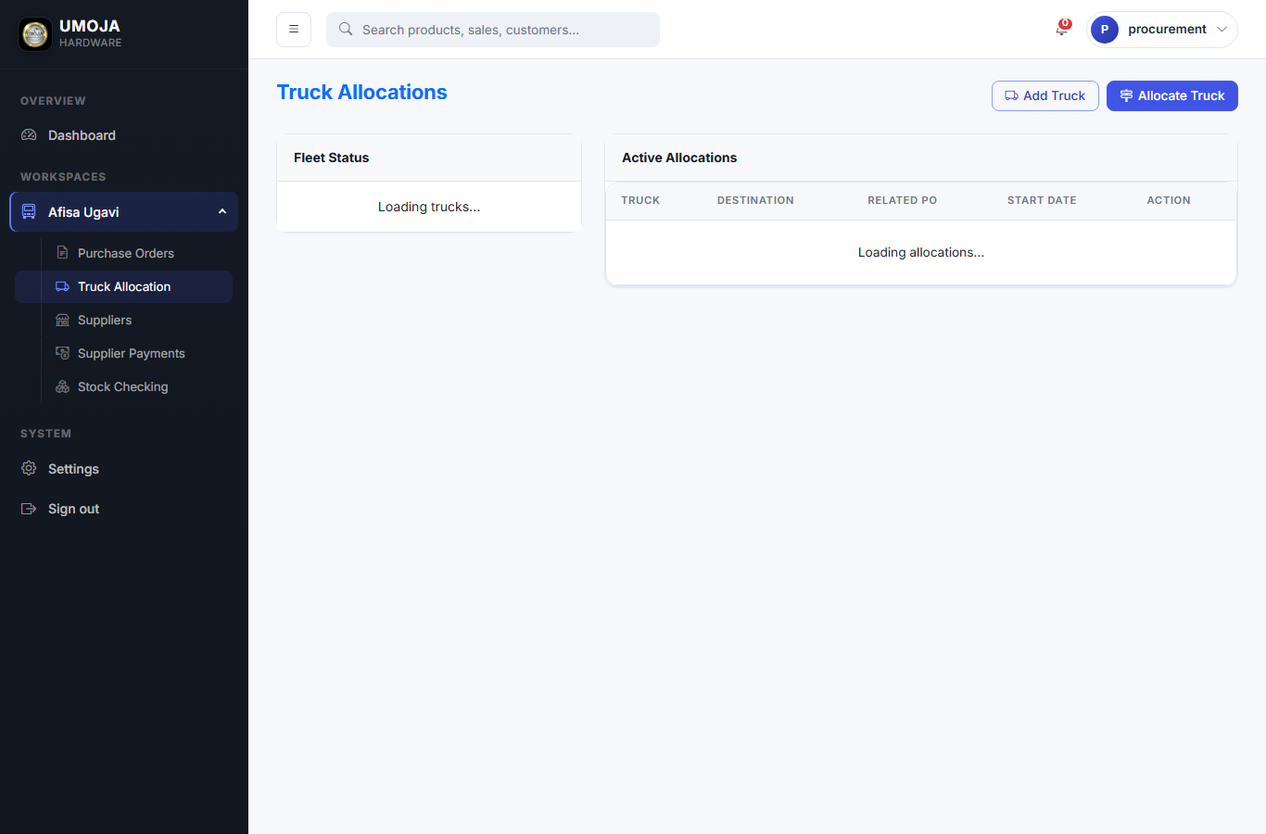
PROCUREMENT OFFICER (AFISA UGAVI) · STEP 5 OF 5
Inbound fleet
Inventory > Trucks (for inbound deliveries from suppliers). These are SEPARATE from the outbound Vehicles used by Sales.
Umoja Hardware · User Guide

Slide 43
PROCUREMENT OFFICER (AFISA UGAVI) · TIPS & GOTCHAS
Things that are easy to miss
⚑ Trucks (this section) are for INBOUND from suppliers. Vehicles (Sales section) are for OUTBOUND to customers — don't mix them.
⚑ Always raise the PO before the supplier ships — the Stock Controller's GRN matches against it line by line.

Slide 44
ROLE
Stock Controller
Who does this
The receiving clerk who books incoming goods into the system.
Your day, in one paragraph
When a delivery arrives from a supplier, you receive it against the PO with a Goods Received Note. That's what actually increases stock levels in the system.
4 steps follow. Tips at the end of the chapter.

Slide 45

STOCK CONTROLLER · STEP 1 OF 4
Your dashboard
Stock Controller dashboards focus on receiving and stock health.
Umoja Hardware · User Guide

Slide 46
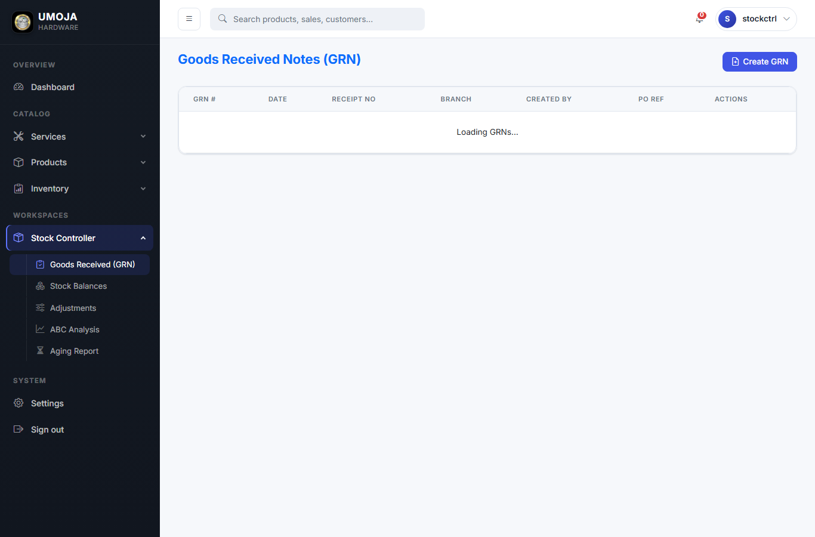
STOCK CONTROLLER · STEP 2 OF 4
GRN list
Inventory > GRNs. See past Goods Received Notes — one per delivery received.
Umoja Hardware · User Guide

Slide 47
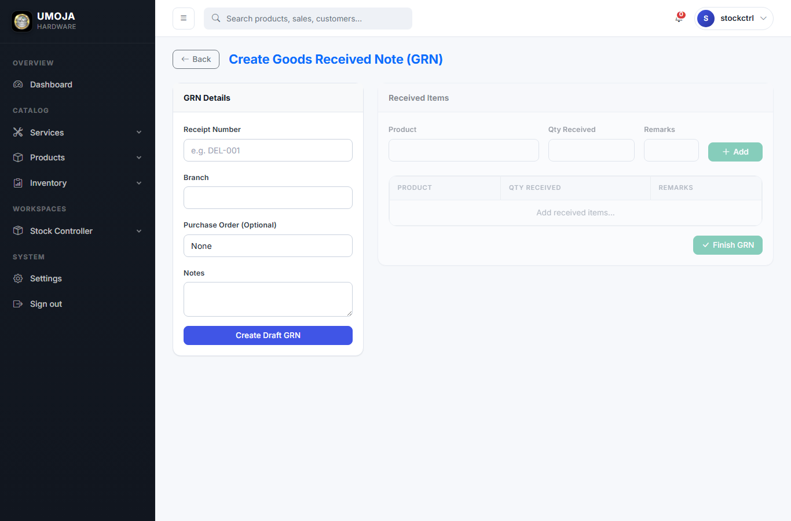
STOCK CONTROLLER · STEP 3 OF 4
Receive goods (new GRN)
Inventory > GRNs > Create. Pick the matching PO, then enter the quantities ACTUALLY received per product. Stock is added to your branch the moment you save.
Umoja Hardware · User Guide

Slide 48
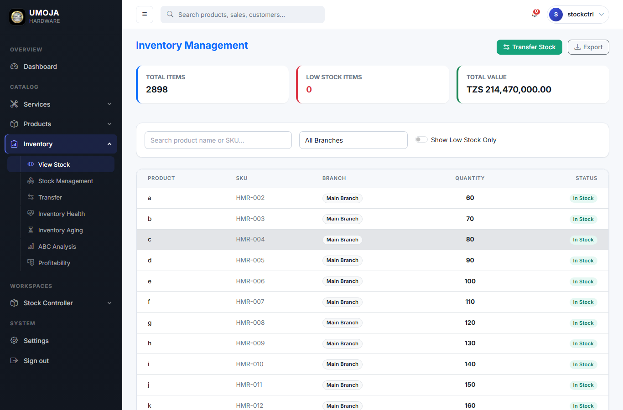
STOCK CONTROLLER · STEP 4 OF 4
Live stock per branch
Inventory > Inventory. See current quantities per product per branch. A red badge means the item is at or below the low-stock threshold.
Umoja Hardware · User Guide

Slide 49
STOCK CONTROLLER · TIPS & GOTCHAS
Things that are easy to miss
⚑ If the GRN quantity is less than the PO quantity, that's normal — the PO stays open for the rest.
⚑ Set sensible low-stock thresholds on each Stock row so the dashboard alerts trigger before you actually run out.

Slide 50
ROLE
Store Keeper
Who does this
The warehouse staff who picks goods for dispatch.
Your day, in one paragraph
When the Store Manager assigns you a sale on the dispatch board, you go pull the goods, hand them to the driver, and the system records that the order has left.
3 steps follow. Tips at the end of the chapter.

Slide 51

STORE KEEPER · STEP 1 OF 3
Your dashboard
Store Keeper sees a minimal dashboard — just the stock and sales information needed to pick orders.
Umoja Hardware · User Guide

Slide 52
STORE KEEPER · STEP 2 OF 3
See assignments
Sales > Dispatch. Filter to orders assigned to you. Each row shows the customer, the products to pick, and the delivery vehicle.
Umoja Hardware · User Guide

Slide 53
STORE KEEPER · STEP 3 OF 3
Sales list
Sales > Sales. Cross-check the sale before picking — confirm the customer, the products, and the quantities.
Umoja Hardware · User Guide

Slide 54
STORE KEEPER · TIPS & GOTCHAS
Things that are easy to miss
⚑ If something on the order is short, raise it with the Store Manager BEFORE dispatch — once dispatched the stock is decremented.
⚑ Print the delivery note from the sale's actions menu — it has the customer's address.

Slide 55
ROLE
Accountant
Who does this
The bookkeeper who tracks money in and money out.
Your day, in one paragraph
You log expenses, supplier payments, tax payments, and other income. The system already tracks sales transactions automatically — you mostly handle the non-sale side.
6 steps follow. Tips at the end of the chapter.

Slide 56

ACCOUNTANT · STEP 1 OF 6
Your dashboard
Accountant dashboards focus on cash flow — expenses, income, taxes.
Umoja Hardware · User Guide

Slide 57
ACCOUNTANT · STEP 2 OF 6
Expenses list
Finance > Expenses. See the running list of recorded expenses, filter by category or date.
Umoja Hardware · User Guide

Slide 58
ACCOUNTANT · STEP 3 OF 6
Record an expense
Finance > Expenses > Add expense. Pick a category, type the amount, attach the receipt photo. The expense lands in the current month's report straight away.
Umoja Hardware · User Guide

Slide 59
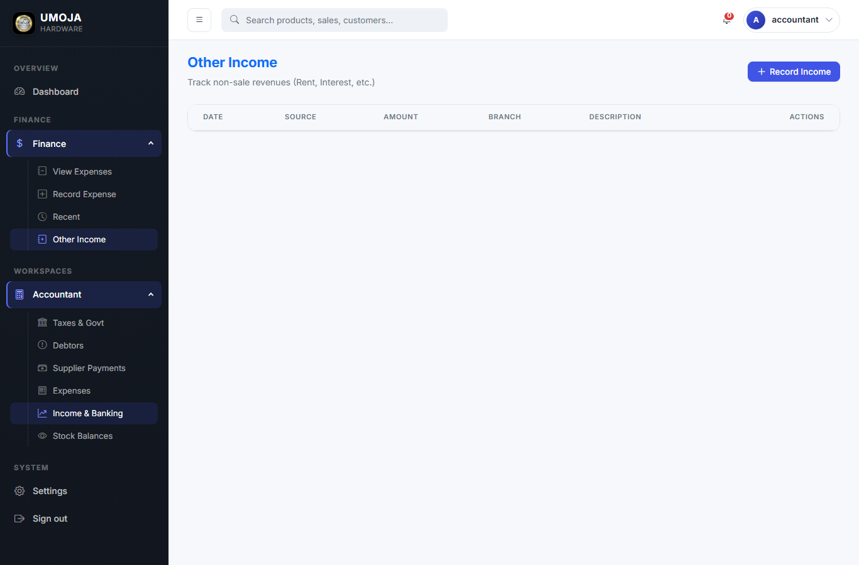
ACCOUNTANT · STEP 4 OF 6
Other income
Finance > Income. Use for income that ISN'T a product sale (rent received, service income, etc.).
Umoja Hardware · User Guide

Slide 60
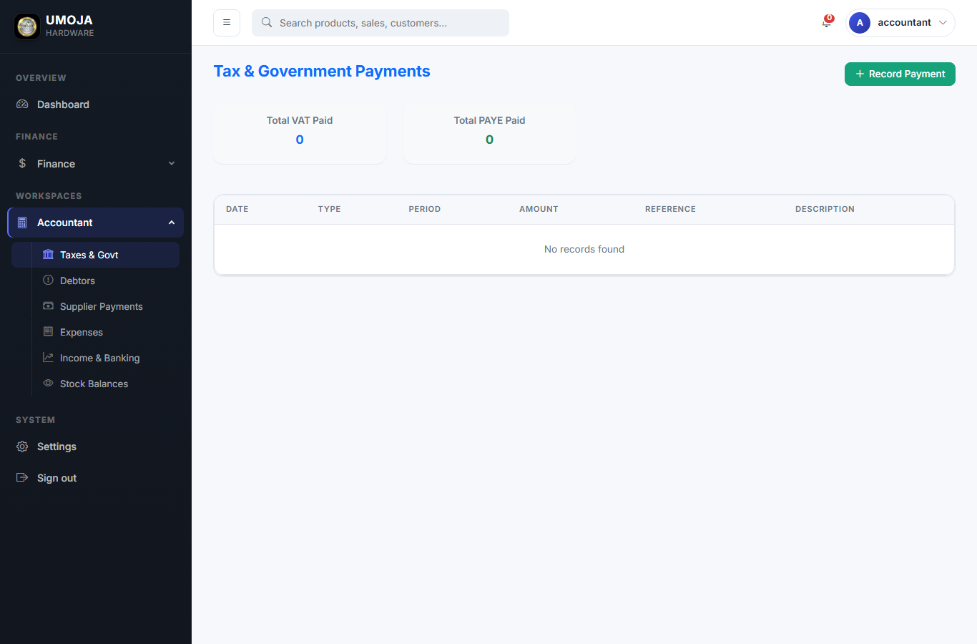
ACCOUNTANT · STEP 5 OF 6
Tax payments
Finance > Taxes. Pick the tax type (VAT, PAYE, SDL, …), the period, and the amount paid. Keep the TRA receipt number in the reference field.
Umoja Hardware · User Guide

Slide 61

ACCOUNTANT · STEP 6 OF 6
Reports
Reports. Aging, Profitability by category, Commissions per sales rep, Debtors.
Umoja Hardware · User Guide

Slide 62
ACCOUNTANT · TIPS & GOTCHAS
Things that are easy to miss
⚑ Always attach a receipt image to expenses — Tanzanian audits are picky and the system stores them with the row.
⚑ The Debtors report uses Sale.total_amount minus sum of Transactions — make sure cash payments are entered, otherwise the customer looks like a debtor.

Slide 63
MOBILE APP
Mobile companion app (Umoja Pro)
Who does this
Sales reps and field staff who work away from a desktop.
Your day, in one paragraph
Umoja Pro is the Flutter mobile app for Android phones. It signs in with the same username/password as the web site and uses the same data — the four tabs cover the daily field-sales tasks.
3 steps follow. Tips at the end of the chapter.

Slide 64
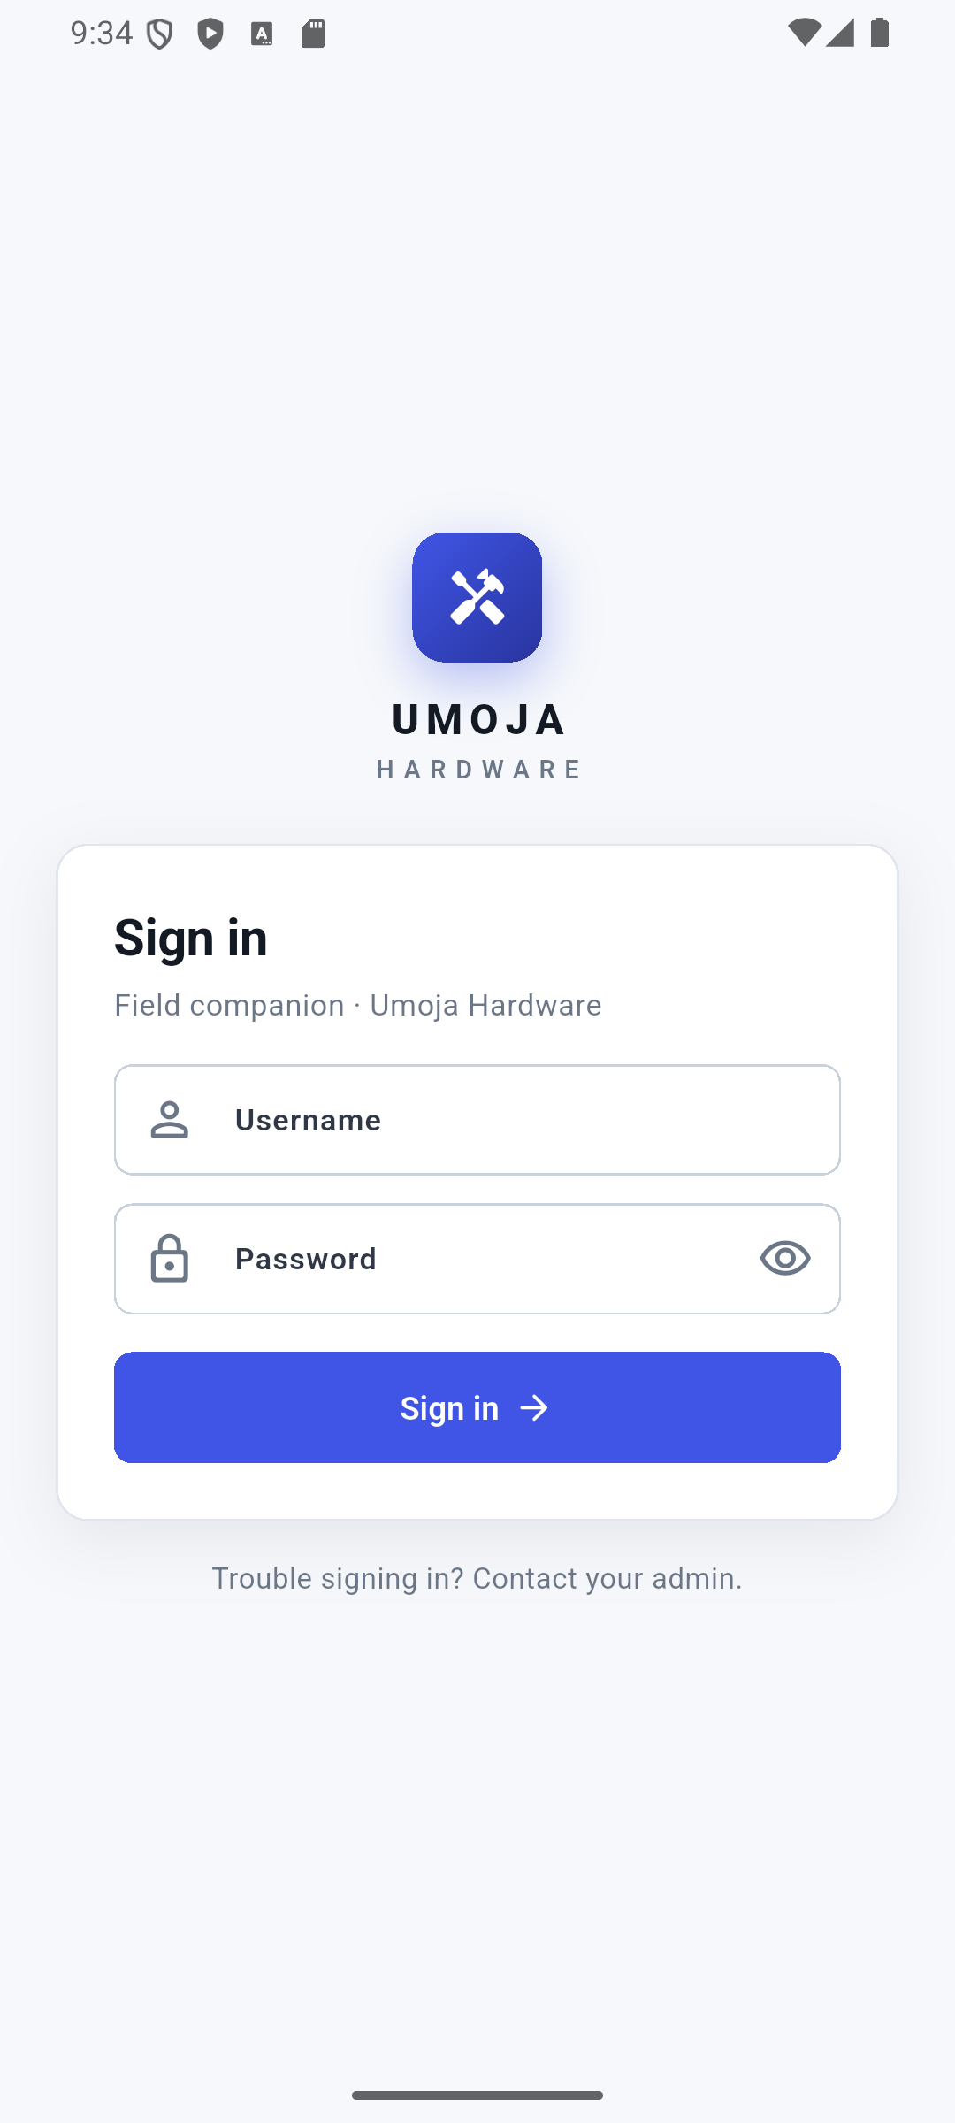
MOBILE COMPANION APP (UMOJA PRO) · STEP 1 OF 3
Sign in
Open Umoja Pro from the app drawer. The icon is the Umoja Hardware logo. Type your username and password and tap Sign in. The app remembers your token so you stay signed in across launches — sign out from the profile menu in the app bar.
Umoja Hardware · User Guide

Slide 65
MOBILE COMPANION APP (UMOJA PRO) · STEP 2 OF 3
Four tabs at the bottom
After login the app shows a four-tab bottom bar:
• POS — open a new sale, search products, take payment.
• Stock — see current stock per branch, with low-stock alerts.
• Quotes — list of quotations; tap to convert to a sale.
• Customers — directory; add new customers; see a customer's sales history.
Each tab pulls the same data as the website over HTTPS to umoja.ehub.co.tz.
Umoja Hardware · User Guide

Slide 66
MOBILE COMPANION APP (UMOJA PRO) · STEP 3 OF 3
Talks to the same backend
The app calls /api-token-auth/ once for the token, then uses every other /api/ endpoint with that token in the Authorization header. Sales created on the phone show up in the Manager's Order Management screen on the website in real time, and stock deductions broadcast over WebSocket so other devices update without a refresh.
Umoja Hardware · User Guide

Slide 67
MOBILE COMPANION APP (UMOJA PRO) · TIPS & GOTCHAS
Things that are easy to miss
⚑ If the Sign-in button does nothing, you're probably on the office Wi-Fi but the API URL is the local default. Reinstall a build made with --dart-define=API_BASE_URL=https://umoja.ehub.co.tz.
⚑ Pull-to-refresh on each tab to force a re-fetch.
⚑ Sign out from the profile menu in the app bar; this clears the token from secure storage.

Slide 68
Stuck?
• Try the menu path written in each step.
• Refresh the page (Ctrl+R) — the live activity feed reconnects automatically.
• If a button is missing, your role probably doesn't have permission — ask the System Administrator.
• Production URL: https://umoja.ehub.co.tz
• Mobile app: install Umoja Pro from your IT team.

