Slide 1





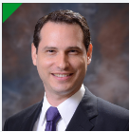


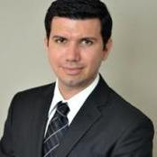




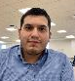

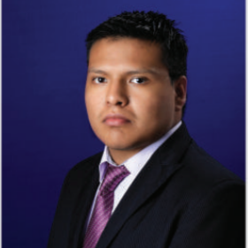
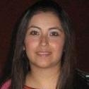
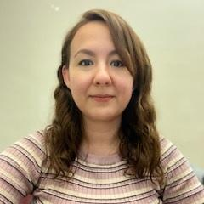


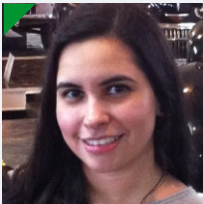



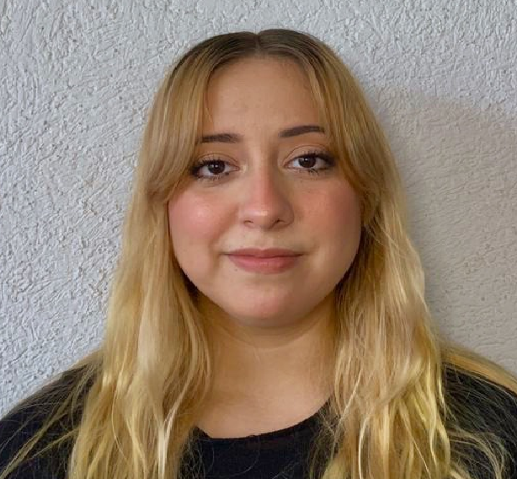




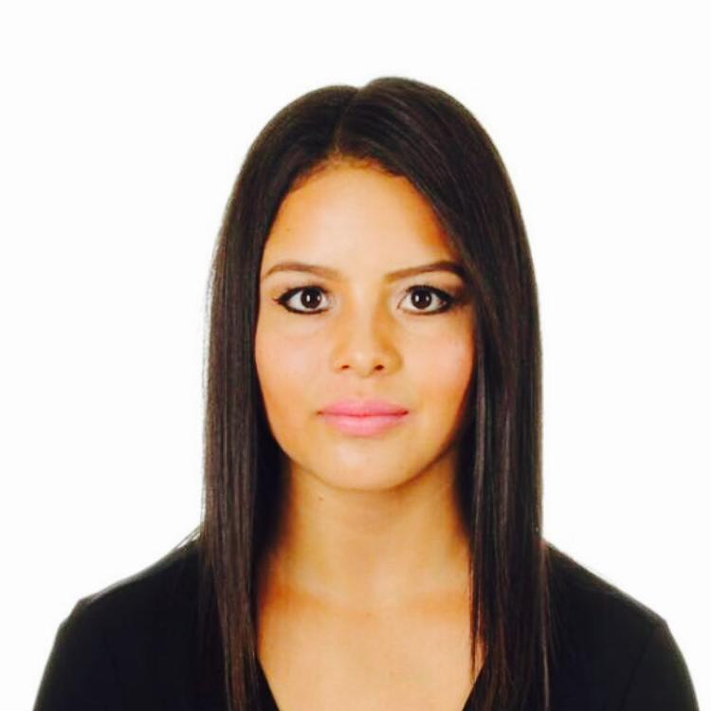


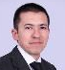



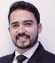

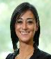














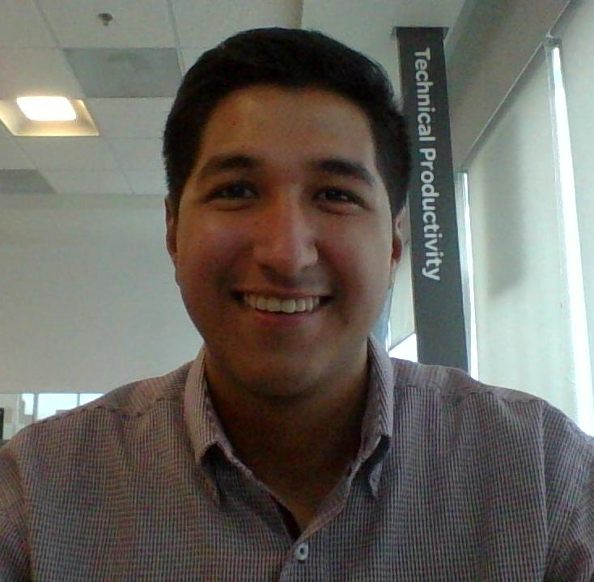










GSC NA Procurement – Transformation Organization
Horacio Galicia
Director Transformation,
MTY, MEX
Brenda Olmos
PM, MTY, MEX
Procurement Project Manager
Silvia Marisol
Procurement Project } Manager MTY MX
Nubia Nevarez
Plant Procurement Buyer
MTY MX
Business Unit Partners
Strategic Projects & Program Management
Strategic Projects & Program Management
Juan Martin Rosas
Sr. Prj Mgr, MTY, MEX
Jan Ude
Home & Distribution
MTY MX
Alejandra Romero
Sr. Manager, MTY MEX
Leader PM
Open Position
Sr. Manager, MTY MEX
Leader PM
Filiberto Escamilla
Power Products, Power S Systems, MTY MX
Fernando Rodriguez
Project Manager, MTY MEX
CoS (SBO-REB), QVE
Jaime Rodriguez
Project Manager, MTY MEX
CoS (SBO-REB), QVE
Carlos Galvan
Project Manager, MTY MEX
CoS (SBO-REB), QVE
Selene Galvan
Project Manager, MTY MEX
CoS (SBO-REB), QVE
Tools & Processes Mgt. Resources Coordination
Idea Generation
Idea Evolution
Nilda Ramos
Project Manager, MTY MEX
CoS (SBO-REB), QVE
Priscila Navarrete
Project Manager, MTY MEX
CoS (SBO-REB), QVE
Luis Perez
IT Analyst, MTY, MEX
Web Apps Development
Ibrahim Hernandez
IT Business Partner, MTY,
IT Coordination / Web Apps
Paola Gomez
NAM Idea Program Manager,Tlax,Mex
Productivity ideas program
Tadeo Garcia
PS, MTY, MEX
Purchasing Project
Teresa Cortes
PS,MTY,MEX
Purchasing Project Specialist
Madeleine Gutierrez
Industry, Digital Energy & Secure
Power, MTY, MEX
Armando Romero
Project Manager, MTY MEX
CoS (SBO-REB), QVE
Open Position
Project Manager, MTY MEX
CoS (SBO-REB), QVE
Vanessa Lucio
Project Manager, MTY MEX
CoS (SBO-REB), QVE
Carlos Garza
Sr. Project Manager, MTY MEX
CoS (SBO-REB) , QVE
Ana Paula Aguilar
Software Developer Intern,
MTY, MEX
Web Apps Development
Open
Position
Open Position
Project Manager
Productivity Workshop
Veronica Vielma
PS, MTY, MEX
Purchasing Project Specialist
Diana de la Cruz
PS MTY, MEX
Purchasing Project Specialist
Nohemi Pereira
Project Manager, MTY MEX
CoS (SBO-REB), QVE
Valdemar Berlanga
Project Manager, MTY MEX
CoS (SBO-REB), QVE
Salma Elisa Arteaga
PM, MTY, MEX
Productivity Workshop Leader
Sofia Garza
PS, MTY, MEX
Purchasing Project Specialist
Open Position
MTY, MEX
Project Specialist Intern
Armando Palomino
Project Manager, MTY MEX
CoS (SBO-REB), QVE
Fernando Taddei
Project Manager, MTY MEX
CoS (SBO-REB),
Priscilla Rodriguez
Project Manager, MTY MEX
CoS (SBO-REB), QVE
Open position
Purchasing Projects-Intern
MTY,MEX
Matias Lindow
Procurement Project
Specialist, MTY, MEX
Devorah Catellanos
MTY,MEX
Project Specialist Intern
Open Position
Mauro Reyes
Project Manager, MTY MEX
CoS (SBO-REB), QVE
Open Position
Purchasing Prj – Intern
MTY,MEX
Manuel Solis
PIIT CoS Engr Mgr, MTY, MEX
Prj Mgr, CoS & SBO
Lucy Casas
Supplier Quality Manager
NAM Strategic Projects
Liza Martinez
Elec-Mech Sr Eng. , PIIT MTY MEX
QVE-COS
Marco Rodriguez
Elec-Mech Engr, PIIT MTY, MEX
CoS & SBO
Lesli Rodriguez
Elec-Mech Prj Engr MTY MEX
Elena Manriquez
Elec-Mech Eng. PIITMTY, MEX
QVE & Reverse Engineering
Open
Position
Raul de la Rosa
Supplier Quality Engr MTY MEX
NAM Strategic Projects
Jose Luis Luna
Supplier Quality Engr TLX MEX
NAM Strategic Projects
Manuel Peinado
Elec-Mech Sr Eng.PIIT MTY, MEX CoS & SBO K5/K6
Barbara Martinez
Elec-Mech Engr, PIIT MTY, MEX
CoS & SBO
Karen Valeria Vidales
Elec.Mech Engr, PIIT MTY MEX
Hector Corpus
Mechanical Drafter, PIIT MTY MEX Design 2D 3D / Geomagic ctrl
Fatima Guzman
Supplier Quality Engr MTY MEX
NAM Strategic Projects
Nayeli Diaz
Supplier Quality Engr MTY MEX
NAM Strategic Projects
Selene Sosa Madrigal
Supply & Supplier Quality - Intern
Abraham de Leon
Mechanical Eng. PIIT MTY,MEX
CoS-Lessons Learned, SBO K1/K2
Sergio Castillo
Electronics, Prj Engr,PIIT,
MTY,MEX
Jorge Chacon
Sr Prj Elec-Mech,Rev,Eng
MTY, MEX
Jose Lopez
Mechanical Drafter, PIIT MTY MEX Design 2D 3D / Geomagic Dx
Karla Colin Renteria Supplier Quality Engr, MTY,MEX
NAM Strategic Projects
Karla Juarez
Supplier Quality Engr MTY MEX
NAM Strategic Projects
Open Position
Edgar Arredondo
Elec-Mech Sr Eng. PIIT MTY, MEX
CoS & Core Team Member
Alan Salas
Electronics, Sr Prj Engr, PIIT
MTY MEX
Mariel Puente
Sr Designer, Elec-Mech, Rev,
Eng. Geomagic, MTY, MEX
Raul Raygoza
Elec-Mech Engr, PIIT MTY, MEX
Adrian Reyes
Supplier Quality Engr MTY MEX
NAM Strategic Projects
Aldo Cardenas
Supplier Quality Engr MTY MEX
NAM Strategic Projects
Open Position
Edgar Arredondo
Elec-Mech Sr Eng. PIIT MTY, MEX
CoS & Core Team Member

Slide 2
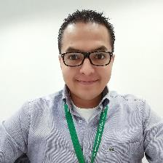
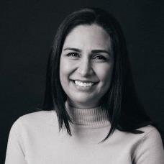
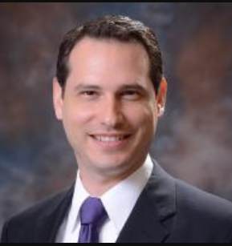
Business Unit Partners
Horacio Galicia
Director Transformation, MTY ,MEX
Filiberto Escamilla
Power Products, Power Systems BUP
Madeleine Gutierrez
Industry, Digital Energy & Secure Power
MTY MX
Jan Ude
Home & Distribution BUP,
MTY MX
Notes:
This is an example of a Text Slide. Reference the different layout options in the Slide Master (under the View tab) for different variations. Remember, our new Brand Guidelines call for clean and simple messages and design. Reference the PowerPoint Guidelines on the Brand Book for tips and useful information on creating effective presentations.

Slide 3
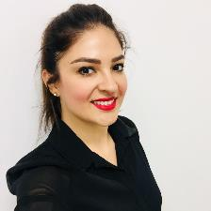
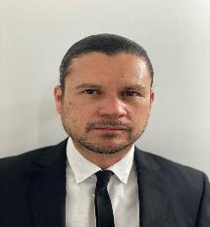

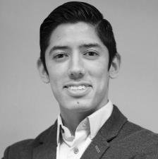

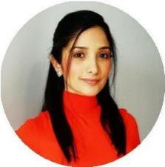
Strategic Projects & Program Management
Alejandra Romero
Sr. Manager, MTY MEX Leader PM
Fernando Rodriguez
Project Manager, TLX MEX
CoS (SBO-REB), QVE
Armando Palomino
Project Manager, MTY MEX
CoS (SBO-REB), QVE
Valdemar Berlanga
Project Manager, MTY MEX
CoS (SBO-REB), QVE
Armando Romero
Project Manager, MTY MEX
CoS (SBO-REB), QVE
Jaime Rodriguez
Project Manager, MTY MEX
CoS (SBO-REB), QVE
Fernando Taddei
Project Manager, MTY MEX
Nohemi Pereira
Project Manager, MTY MEX
CoS (SBO-REB), QVE
Open Position
Project Manager, MTY MEX
CoS (SBO-REB), QVE
Open Position
Procurement- Direct Purchasing
Intern, MTY,MEX
Notes:
This is an example of a Text Slide. Reference the different layout options in the Slide Master (under the View tab) for different variations. Remember, our new Brand Guidelines call for clean and simple messages and design. Reference the PowerPoint Guidelines on the Brand Book for tips and useful information on creating effective presentations.

Slide 4
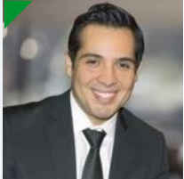
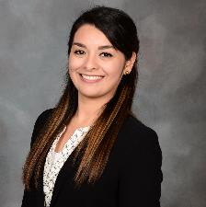
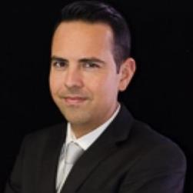
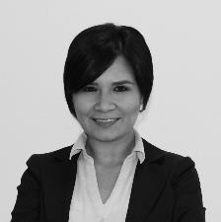
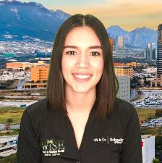

Strategic Projects & Program Management
Open Position
Sr. Manager, MTY MEX Leader PM
Carlos Galvan
Project Manager, MTY MEX
CoS (SBO-REB), QVE
Priscilla Rodriguez
Project Manager, MTY MEX
CoS (SBO-REB), QVE
Open Position
Purchasing Projects – Intern
MTY MEX
Nilda Ramos
Project Manager, MTY MEX
CoS (SBO-REB), QVE
Carlos Garza
Project Manager, MTY MEX
QVE
Open Position
Purchasing Projects-Intern
MTY MEX
Vanessa Lucio
Project Manager, MTY MEX
CoS (SBO-REB), QVE
Selene Galvan
Project Manager, MTY MEX
CoS (SBO-REB), QVE
Open Position
Priscila Navarrete
MEX Project Manager, MTY MEX
CoS(SBO-REB), QVE
Mauro Reyes
Project Manager, MTY MEX
CoS (SBO-REB), QVE
Notes:
This is an example of a Text Slide. Reference the different layout options in the Slide Master (under the View tab) for different variations. Remember, our new Brand Guidelines call for clean and simple messages and design. Reference the PowerPoint Guidelines on the Brand Book for tips and useful information on creating effective presentations.

Slide 5
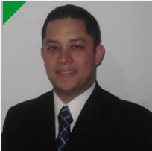
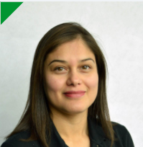
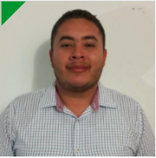
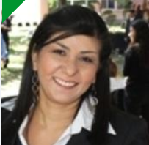

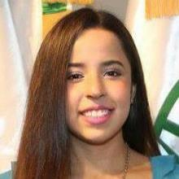
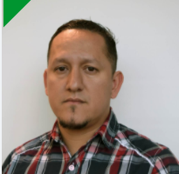
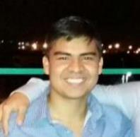


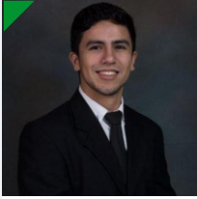
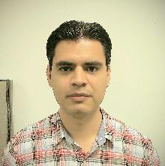
Project Engineers
Manuel Solis
PIIT CoS Engr Mgr, MTY, MEX
Prj Mgr, CoS & SBO
Liza Martinez
Elec-Mech Sr Eng. PIIT MTY, MEX
QVE-COS
Marco Rodriguez
Elec-Mech Engr, PIIT MTY, MEX
CoS & SBO
Lesli Rodriguez
Elec-Mech Prj Engr MTY MEX
Elena Manriquez
Elec-Mech Eng. PIIT MTY, MEX
QVE & Reverse Engineering
Manuel Peinado
Elec-Mech Sr Eng.PIIT MTY, MEX CoS & SBO K5/K6
Barbara Martinez
Elec-Mech Engr, PIIT MTY, MEX
CoS & SBO
Karen Valeria Vidales
Elec.Mech Engr, PIIT MTY MEX
Hector Corpus
Mechanical Drafter, PIIT MTY MEX
Design 2D 3D / Geomagic ctrl
Abraham de Leon
Mechanical Eng. PIIT MTY,MEX CoS-Lessons Learned, SBO K1/K2
Sergio Castillo
Electronics, Prj Engr, PIIT MTY MEX MEX
Jorge Chacon
Sr Prj Elec-Mech,Rev,Eng MEX MTY, MEX
Jose Lopez
Mechanical Drafter, PIIT MTY MEX Design 2D 3D / Geomagic Dx
Edgar Arredondo
Elec-Mech Sr Eng. PIIT MTY, MEX
CoS & Core Team Member
Alan Salas
Electronics, Sr Prj Engr, PIIT
MTY MEX
Mariel Puente
Sr Designer, Elec-Mech, Rev,
Eng. Geomagic, MTY, MEX
Raul Raygoza
Elec-Mech Sr Eng.PIIT MTY, MEX CoS & SBO K5/K6

Slide 6


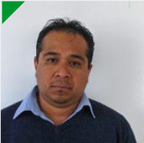

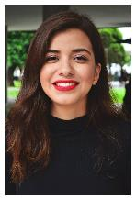
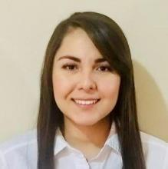
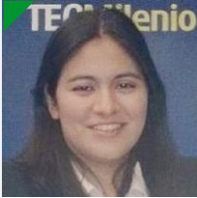

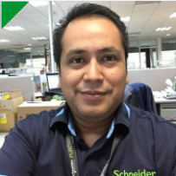
Supplier Quality & Logistics – Strategic Projects SQLD Team
Lucy Casas
Supplier Quality Manager
NAM Strategic Projects
Open Position
Raul de la ROSA
Supplier Quality Engr MTY MEX NAM Strategic Projects
Jose Luis Luna
Supplier Quality Engr TLX MEX NAM Strategic Projects
Fatima Guzman
Supplier Quality Engr MTY MEX NAM Strategic Projects
Nayeli Diaz
Supplier Quality Engr MTY MEX NAM Strategic Projects
Selene Sosa Madrigal Supply & Supplier Quality - Intern, MTY, MEX
Karla Colin Renteria
Supplier Quality Engr, MTY,MEX
NAM Strategic Projects
Karla Juarez
Supplier Quality Engr MTY MEX NAM Strategic Projects
Open Position
Adrian Reyes Supplier Quality Engr MTY MEX NAM Strategic Projects
Aldo Cardenas
Supplier Quality Engr MTY MEX NAM Strategic Projects
Open Position
Notes:
This is an example of a Text Slide. Reference the different layout options in the Slide Master (under the View tab) for different variations. Remember, our new Brand Guidelines call for clean and simple messages and design. Reference the PowerPoint Guidelines on the Brand Book for tips and useful information on creating effective presentations.

Slide 7

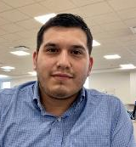
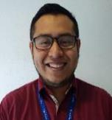

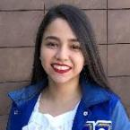

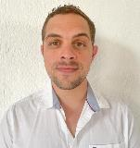

Tools Process Mgt, Resource Coordination & Idea Generation & Evolution
Juan Martin Rosas
Procurement Sr Program Mgr, MTY, MEX
Tools & Processes Mgt. Resources Coordination
Idea Generation
Idea Evolution
Paola Gomez
NAM Idea Program Manager,Tlax, Mex
Productivity ideas program
Tadeo Garcia
Procurement Project Specialist
MTY.MX
Teresa Cortes
Prj Specialist MTY, MEX Purchasing Project Specialist
Luis Perez
IT Analyst, MTY, MEX
Web Apps Development
Ibrahim Hernandez
IT Business Partner, MTY, MEX
IT Coordination / Web Apps Dev
Open Position
Project Manager, MTY,MEX
Productivity Workshop
Veronica Vielma
Prj Specialist MTY, MEX
Purchasing Project Specialist
Diana de la Cruz
Prj Specialist MTY, MEX
Purchasing Project Specialist
Ana Paula Aguilar
Software Developer Intern
MTY, MEX
Web Apps Development
Open position
Procurement Intern,
MTY, MEX
Web Apps Development
Salma Elisa Arteaga
Productivity Workshop MTY, MEX
Idea Evolution (Home & Distribution, PP)
Sofia Garza
Prj Specialist MTY, MEX
Purchasing Project Specialist
Open Position
MTY, MEX
Project Specialist Intern
Matias Lindow
Procurement Project Specialist
MTY, MEX
Devorah Castellanos
Project Specialist Intern,
MTY,MEX

Slide 8








Project Mgr.'s By Category (SBO-REB)
Carlos Galvan
Project Manager, MTY MEX
CoS (SBO-REB), QVE
Priscilla Rdz.
Project Manager, MTY MEX
CoS (SBO-REB), QVE
G3
K2
Nohemi Pereira
Project Manager, MTY MEX
CoS (SBO-REB), QVE
K3
Selene Galvan
Project Manager, MTY MEX
CoS (SBO-REB), QVE
K1
D2
M2
H1
Nilda Ramos
Project Manager, MTY MEX
CoS (SBO-REB), QVE
Armando Romero
Project Manager, MTY MEX
CoS (SBO-REB), QVE
K2
P1
Priscila Navarrete
Project Manager, MTY ME
CoS (SBO-REB), QVE
K4
K5
K6
Jaime Rodriguez
Project Manager, MTY MEX
CoS (SBO-REB), QVE
Raw Materials
Fernando Rdz.
Project Manager, TLX MEX
CoS (SBO-REB), QVE
K7
Mauro Reyes
Project Manager, MTY MEX
CoS (SBO-REB), QVE
Raw Materials
Armando Palomino
Project Manager, MTY MEX
CoS (SBO-REB), QVE
Carlos Garza
Project Manager, MTY MEX
CoS (SBO-REB), QVE
K3
K7
Fernando Taddei.
Project Manager, MTY MEX
CoS (SBO-REB), QVE
H3

