Slide 1
Coplanar waveguide resonators
Mahmoud Almansouri

Slide 2
Outline and outcomes
Superconducting Quantum circuits
Resonator’s noise sources
Design parameters to consider
Input-output coupling
Worked examples
Full design workflow
Use cases

Slide 3
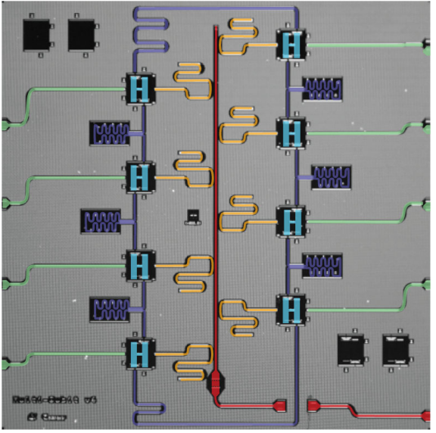
Superconducting quantum circuit
Main components:
1.Resonator CPWr.
2. Qubit (nonlinear inductor).
Complementary:
3. Coupler for entanglement CPWr.
4. Drive line CPWr.
5. Readout line CPWr.
Resonators are used in quantum circuits for:
Entanglement (qbit-qbit coupling).
Readout filtering and readout channel.
Control and drive of qubit states.
Therefore, better resonators means less noise in the circuit.

Slide 4

What is resonator’s loss or noise?
$$Q= \frac{Energy stored}{Energy lost per cycle}$$
Internal losses (Qi):
Physical loss sources causes the stored energy in the resonator to dissipate. This is measured assuming the resonator is in complete isolation from all other circuit components.
Fabrication defects
Metal contamination
Substrate loss tangent
External losses (Qe):
Simulated loss is determined by capacitive or inductive coupling between the circuit components using a simulation software.
Crosstalk between circuit elements.
Strong coupling between drive lines or readout line.

Slide 5
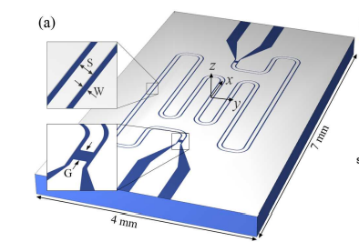
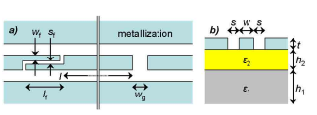
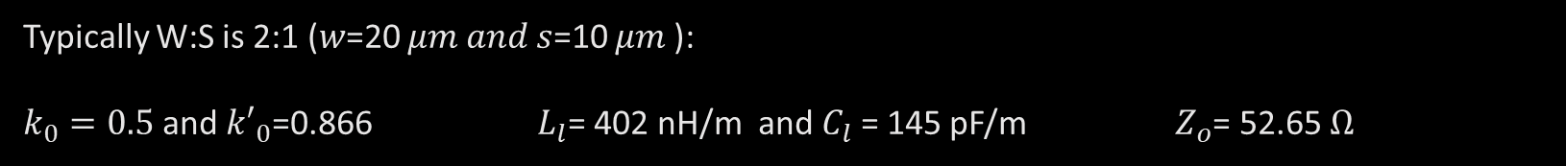
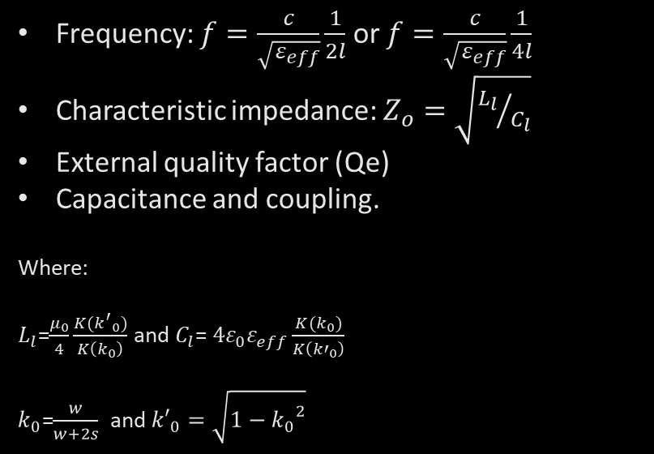
Design parameters in resonators
Frequency: $f=\frac{c}{\sqrt{ε_{eff}}}\frac{1}{2l}$ or $f=\frac{c}{\sqrt{ε_{eff}}}\frac{1}{4l}$
Characteristic impedance: $Z_{o}=\sqrt{{L_{l}}/{C_{l}}}$
External quality factor (Qe)
Capacitance and coupling.
Where:
$L_{l}$=$\frac{μ_{0}}{4}\frac{K({k^{′}}_{0})}{K\left(k_{0}\right)}$ and $C_{l}$= $4ε_{0}ε_{eff}\frac{K(k_{0})}{K\left({k′}_{0}\right)}$
$k_{0}$=$\frac{w}{w+2s}$ and ${k′}_{0}=\sqrt{1−{k_{0}}^{2}}$
HFSS
CST
COMSOL
Typically W:S is 2:1 (𝑤=20 𝜇𝑚 𝑎𝑛𝑑 𝑠=10 𝜇𝑚 ):
$k_{0}=0.5$ and ${k′}_{0}$=0.866 $L_{l}$= 402 nH/m and $C_{l}$ = 145 pF/m $Z_{o}$= 52.65 $Ω$

Slide 6
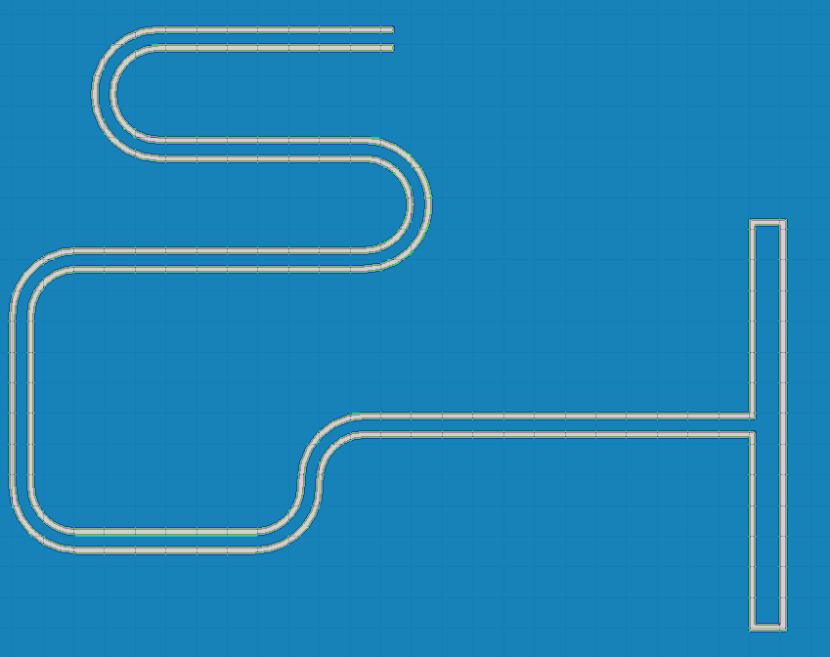
Example of a resonator design
Middle conductor to gap is 2:1
Total length corresponds to 6 GHz
Blue is the metal (Perfect E) and white is silicon.

Slide 7
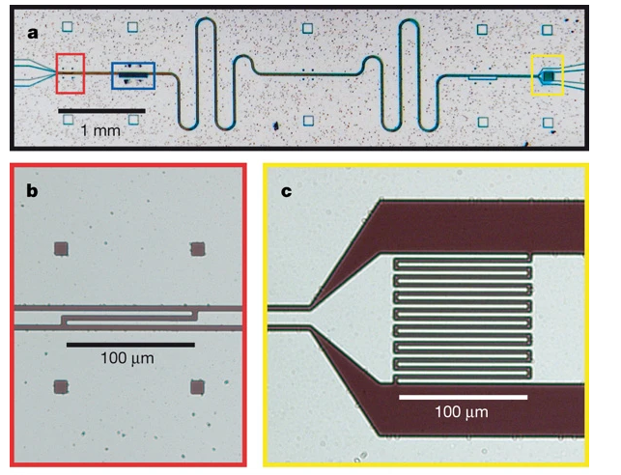
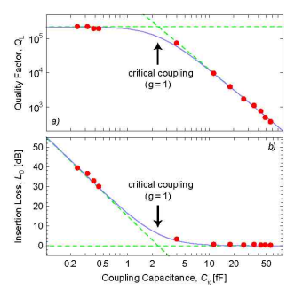
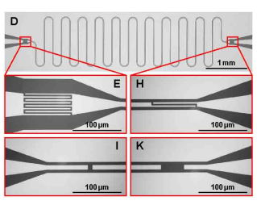
Input-output coupling

Slide 8
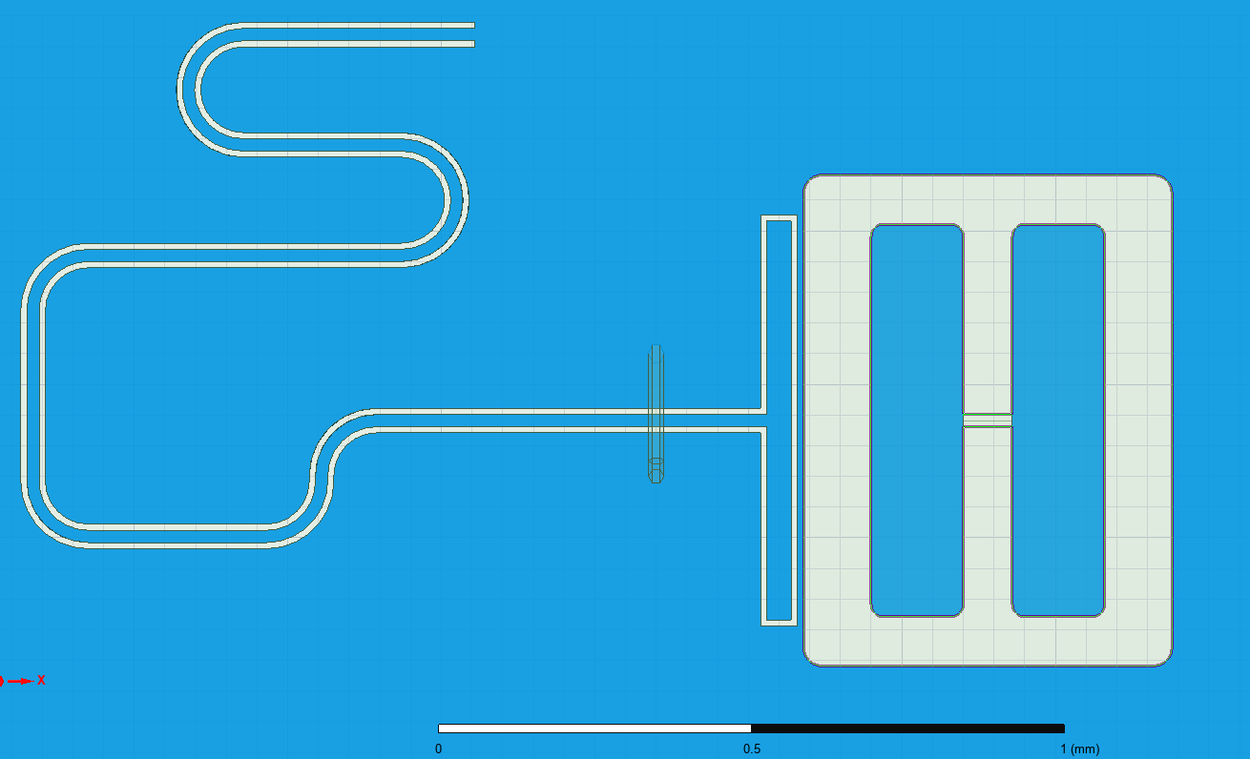

More on capacitive coupling
Capacitive coupling is also important in terms of connecting different circuit elements.
Lumped RLC: $ω= \frac{1}{\sqrt{LC}}$
All capacitances are computed with Maxwell 3D including:
Capacitor pads
Qubit-resonator coupling
Resonator-readout coupling
Qubit-qubit coupling
Additionally:
The coupling strength can be estimated from the external quality factor of each component on HFSS.
Capacitive coupling
Capacitor pads

Slide 9
Complete design workflow
Full design steps:
Draw coplanar structures for all resonators and readout lines:
Adjust the frequencies based on length
Adjust the impedance matching (2:1)
Adjust the external Q
Qubit pads:
Optimize the capacitance with Maxwell 3D to get the qubit frequency
Reach the desired coupling by optimizing Qe and capacitance.
Apply lumped RLC ~12 nH box to simulate the frequency classically.
For accurate frequency and anharmonicity use PyEPR instead.

Slide 10
Discussion:use cases
Algorithm specific design
High kinetic inductance
Compact fields and resonators
Remote entanglement
All of the above are based on the design principles we discussed.

Slide 11
Thanks
Questions?

Slide 12
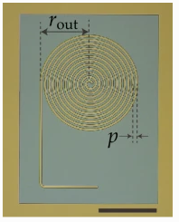
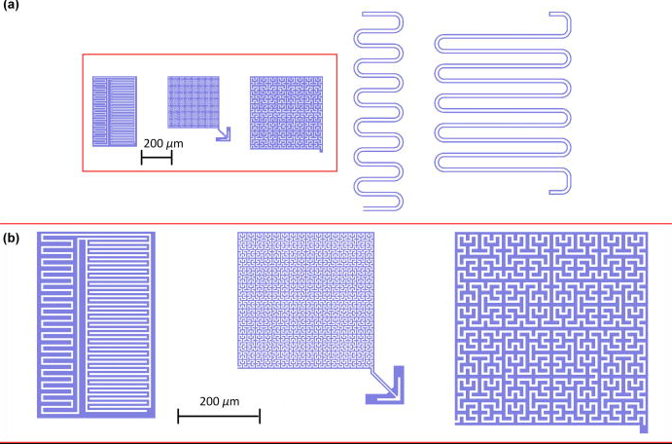
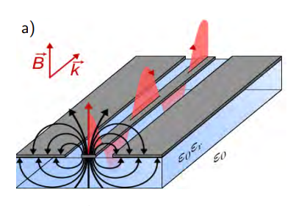
Design geometry and field intensity can also change Qi
Spiral geometry (10M Qi)
Spiral geometry (100K Qi)
CPW geometry (2-6M Qi)

Slide 13
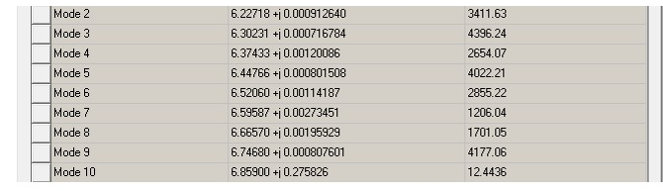

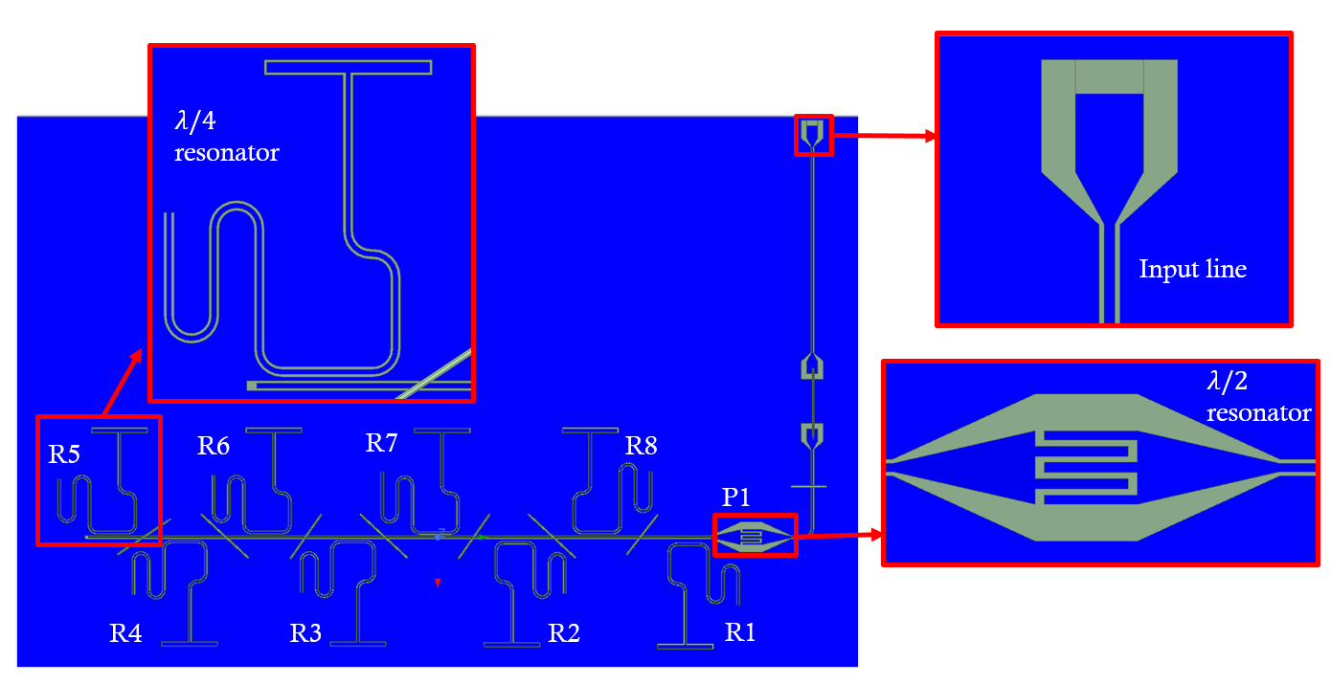
Example on how to design resonators on HFSS
Blue is the metal of the CPW.
Green is the substrate.
The finger capacitors determines the coupling to the measurement instruments.

