Slide 1
PHYS 512
Week 07
Saleem Rao

Slide 2
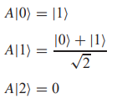




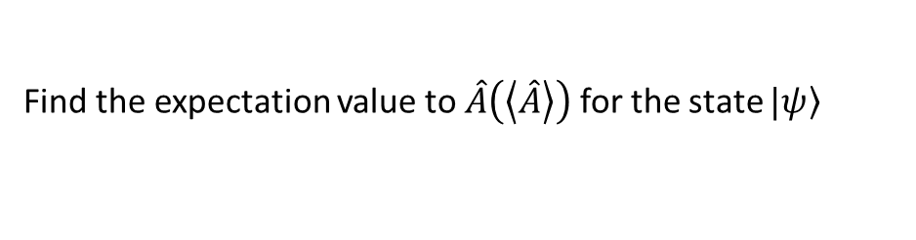
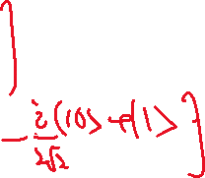







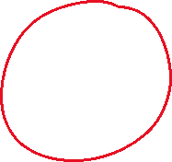







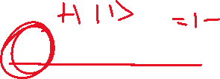



From previous lecture
Problem 01
An operator $\hat{A}$ is defined as
Find the expectation value to $\hat{A}\left(\left\langle \hat{A}\right\rangle \right)$ for the state $|\left.ψ\right\rangle$
$$\left\langle \hat{A}\right\rangle =\left\langle ψ | \hat{A} | ψ\right\rangle$$

Slide 3
Density Operator
Bloch Sphere
Two /more Qubit gate Operation

Slide 4







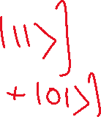








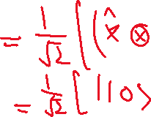






Slide 5




















Slide 6





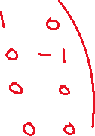


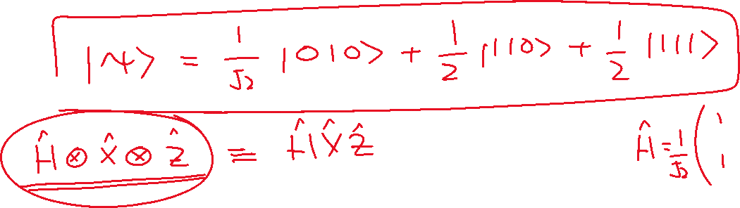




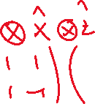



Slide 7






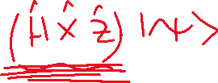













Slide 8




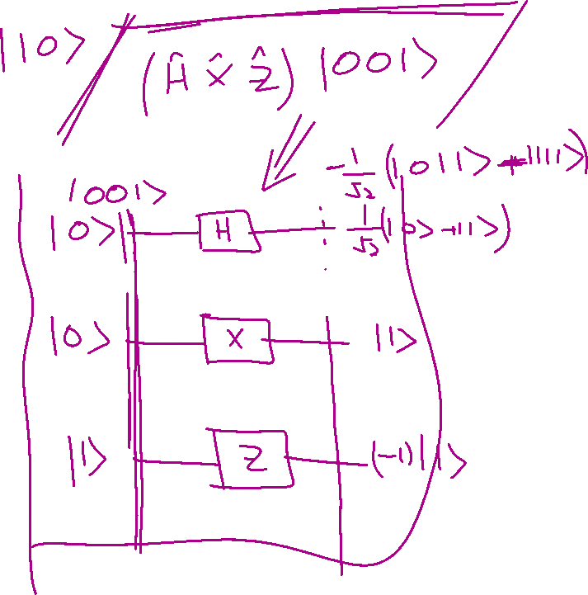

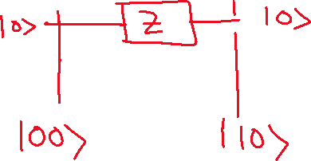



Slide 9
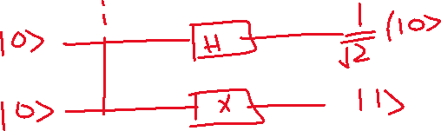


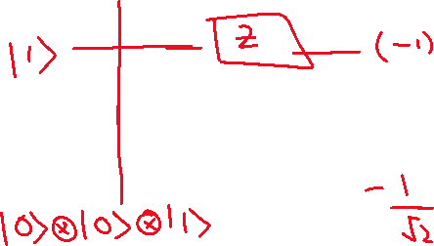






Slide 10












Slide 12




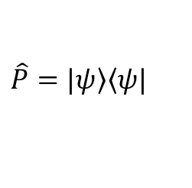
Projection operator
$$\hat{P}=|\left.ψ\right\rangle \left\langle ψ\right.|$$

Slide 13
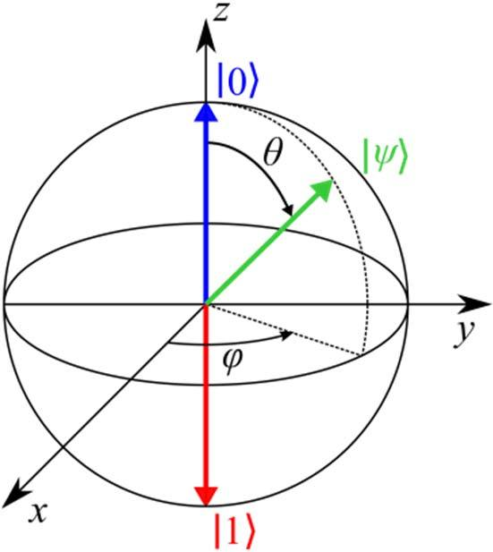







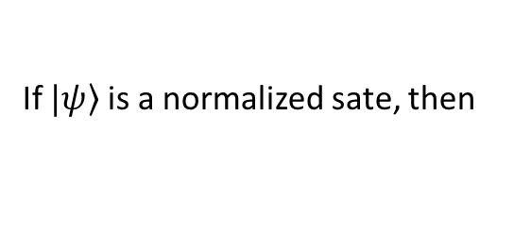
The Bloch Sphere
A vector representing the state of a quantum system could look something like arrow, enclosed inside the Bloch sphere, which is the so-called "state space" of all possible points to which our state vectors can "point"
Our state vectors are allowed to rotate anywhere on the surface of the sphere, and each of these points represents a different quantum state.
$$\left|\left.\right\rangle =α\right|\left.0\right\rangle +β|\left.1\right\rangle =\left(\begin{matrix}α \\ β\end{matrix}\right)$$
$α$ and $β$ are complex numbers
$$\left\langle  | \right\rangle =\left(\begin{matrix}α^{∗} & β^{∗}\end{matrix}\right)\left(\begin{matrix}α \\ β\end{matrix}\right)=α^{2}+β^{2}$$
$\left\langle  | \right\rangle =α^{2}+β^{2}=1$ when state is normalized
$$α \text{and} β \text{are} \text{complex} \text{numbers}\text{, }\text{therefore}$$
$α=x_{0}+ix_{1}$ and $β=x_{2}+ix_{3}$
Where all x’s are real numbers
If $\left.|ψ\right\rangle$ is a normalized sate, then
$$x_{0}^{2}+x_{1}^{2}+x_{2}^{2}+x_{3}^{2}=1$$
x, y, z are just for reference, actually Qubit lives in Hilbert space NOT in 2D or 3D Euclidean space
This equation describe a 3-sphere embedded in a 4-D space

Slide 14
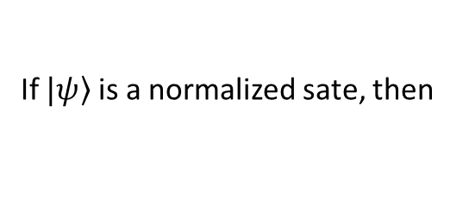

The Bloch Sphere
A vector representing the state of a quantum system could look something like arrow, enclosed inside the Bloch sphere, which is the so-called "state space" of all possible points to which our state vectors can "point"
If $\left.|ψ\right\rangle$ is a normalized sate, then
$$x_{0}^{2}+x_{1}^{2}+x_{2}^{2}+x_{3}^{2}=1$$
This equation describe a 3-sphere embedded in a 4-D space with center at origin
Standard parameterization of a unit 2-sphere in spherical coordinate system. Here θ and φ are polar and azimuthal angles, respectively

Slide 15
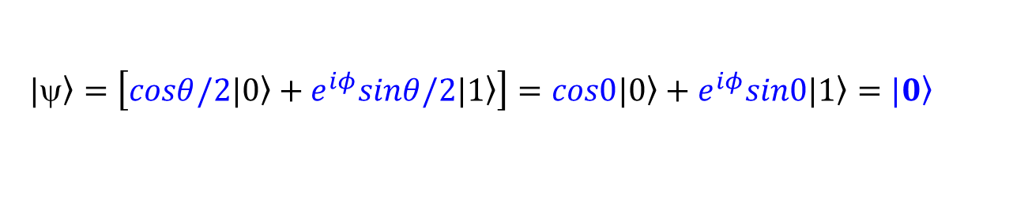


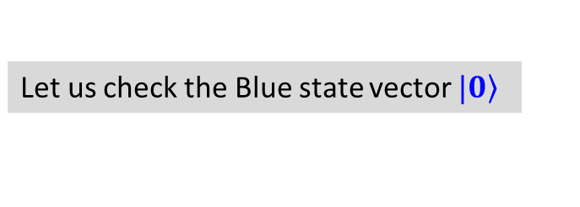
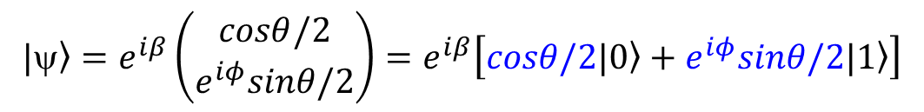
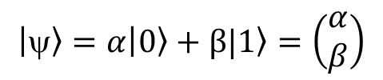

The Bloch Sphere
A vector representing the state of a quantum system could look something like arrow, enclosed inside the Bloch sphere, which is the so-called "state space" of all possible points to which our state vectors can "point"
Normalized state $\left.|ψ\right\rangle$ on Bloch sphere can be written as
$$\left.|\right\rangle =e^{iβ}\left(\begin{matrix}cosθ/2 \\ e^{iφ}sinθ/2\end{matrix}\right)=e^{iβ}\left[\left.cosθ/2|0\right\rangle +e^{iφ}sinθ/2|\left.1\right\rangle \right]$$
Remember in ket-bra notation it was
$$\left|\left.\right\rangle =α\right|\left.0\right\rangle +β|\left.1\right\rangle =\left(\begin{matrix}α \\ β\end{matrix}\right)$$
Let us check the Blue state vector $\left.|0\right\rangle$
$θ=0$, what about $φ$=?
$$\left.|\right\rangle =\left[\left.cosθ/2|0\right\rangle +e^{iφ}sinθ/2|\left.1\right\rangle \right]=\left.cos0|0\right\rangle +e^{iφ}sin0|\left.1\right\rangle =\left.|0\right\rangle$$
P
Let us find the state vector of location ‘P’
$θ=$π/2, what about $φ$=0
$$\left.|\right\rangle =\left[\left.cosθ/2|0\right\rangle +e^{iφ}sinθ/2|\left.1\right\rangle \right]=\left.cosπ/4|0\right\rangle +e^{i0}sinπ/4|\left.1\right\rangle =\frac{1}{\sqrt{2}}\left.|0\right\rangle +\frac{1}{\sqrt{2}}\left.|1\right\rangle$$

Slide 16

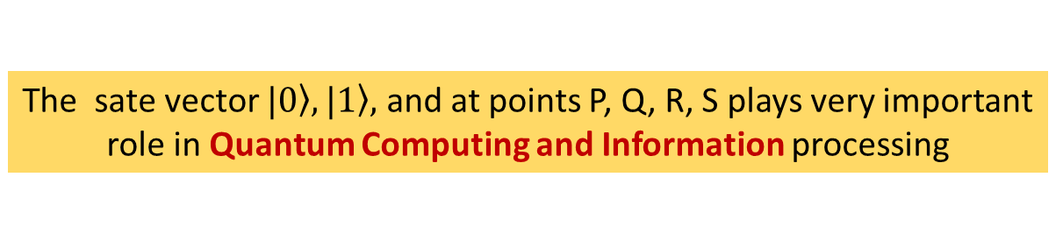
The Bloch Sphere
A vector representing the state of a quantum system could look something like arrow, enclosed inside the Bloch sphere, which is the so-called "state space" of all possible points to which our state vectors can "point"
$$\left.|\right\rangle =e^{iβ}\left(\begin{matrix}cosθ/2 \\ e^{iφ}sinθ/2\end{matrix}\right)=e^{iβ}\left[\left.cosθ/2|0\right\rangle +e^{iφ}sinθ/2|\left.1\right\rangle \right]$$
$e^{iβ}$ is called overall phase factor and can not be measured. State of a Qubit can be specified by ‘a point’ on the block sphere, ignoring the ‘overall’ phase factor
R
Find the state vector of location ‘Q’, ‘R’, ‘S’
S
Q
(‘R’ is a point where –ve x-axis cuts the Bloch sphere)
P
The sate vector $|\left.0\right\rangle ,|\left.1\right\rangle ,$ and at points P, Q, R, S plays very important role in Quantum Computing and Information processing

Slide 18


Slide 20
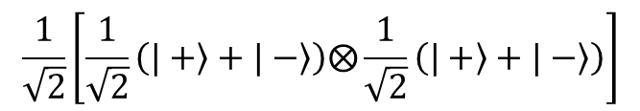
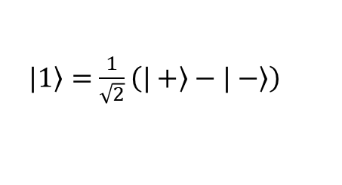

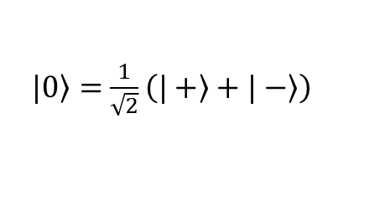
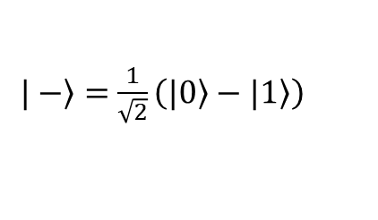
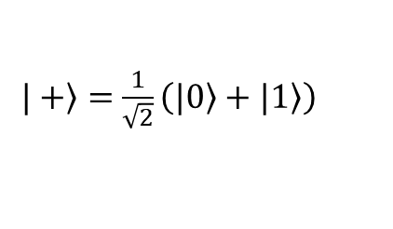
$$\frac{1}{\sqrt{2}}\left.|00\right\rangle$$
$$\frac{1}{\sqrt{2}}\left[\frac{1}{\sqrt{2}}\left(\left.|+\right\rangle +\left.|−\right\rangle \right)⨂\frac{1}{\sqrt{2}}\left(\left.|+\right\rangle +\left.|−\right\rangle \right)\right]$$
$\left.|+\right\rangle =$ $\frac{1}{\sqrt{2}}\left(\left.|0\right\rangle +\left.|1\right\rangle \right)$
$\left.|1\right\rangle =$ $\frac{1}{\sqrt{2}}\left(\left.|+\right\rangle −\left.|−\right\rangle \right)$
$\left.|−\right\rangle =$ $\frac{1}{\sqrt{2}}\left(\left.|0\right\rangle −\left.|1\right\rangle \right)$
$\left.|0\right\rangle =$ $\frac{1}{\sqrt{2}}\left(\left.|+\right\rangle +\left.|−\right\rangle \right)$

