Slide 1
PHYS 512
Introduction to Quantum Information and Computing
Saleem Rao
Week -01

Slide 2
To understand/use a Quantum Computer we need to know
What is a superposition/entangled state (conceptually, physically and mathematically – PHYS 510, PHYS 512, PHYS 514)
How to create a superposition/entangled state (PHYS 512, PHYS 514)
Quantum Algorithms (MATH 570, ICS 561)
Quantum Computer Architecture (COE 530)
Applications – Quantum Cryptography, Quantum Communication (ICS 562, COE 531)

Slide 3
Course Objectives
Give students basic knowledge of quantum mechanics required for quantum computing and quantum information
Explain the difference between conventional (classical) and quantum computing and quantum information processing
Prepare students for upper level courses in the field of quantum computing and quantum information and future careers using quantum-based information technologies

Slide 4
Course Outline
Review of relevant Quantum Mechanics concepts including linear vector spaces.
Superposition, Entanglement, the EPR paradox, and Bell's inequality.
Quantum Computation including the qubit, quantum gates and search algorithms.
Quantum error correction including Communication and teleportation.
Overview of some experimental implementations.

Slide 5
Course Learning Outcomes (CLO)
CLO-1 Describe basic postulate of quantum mechanics (Knowledge)
CLO-2 Use Linear Algebra necessary for understanding the axioms of Quantum Mechanics (Skill)
CLO-3 Describe Quantum Computing via quantum circuit model: Description of qubit and universal set of gates (Knowledge)
CLO-4 Relate quantum complexity classes to the classical ones (Skill)
CLO-5 Explain and analyze quantum algorithms described in quantum circuit or measurement-based quantum computing models (Competence)

Slide 6
Topics Covered
Introduction to Quantum Mechanics; history and basic concepts, Concept of quantization and quantized states. (1 Week)
Superposition, The Stern-Gerlach experiment and Young's double-slit experiment. (1 Week)
Qubits and Quantum States (1 Week)
Linear Vector Space; Matrices and Operators, Tensor Products (2 Weeks)
Density Operators (1 Week)
The Qubit, the Bloch Sphere, Quantum Measurement Theory (1 Week)
The postulates of quantum mechanics and The EPR paradox and Bell's inequalities (1 Week)
Controlled gates and entanglement generation, Universal quantum gates (1 Week)
Universal quantum gates and quantum Algorithms (1 Week)
No-Cloning Theorem, Teleportation and Spooky Correlations (2 Week)
Quantum Communication, the no-cloning theorem, classical and quantum cryptography (2 Weeks)

Slide 7
Grading Policy
Quizzes 12%
Homework 18%
Midterm Exam 30%
Final Exam 40%

Slide 8
Dr. Saleem Rao - Fall 2024 – T 251
Office: 6-147, email: saleemg@kfupm.edu.sa

Slide 9
Quantum Physics
Ever since its invention in the 1920s, quantum physics has given rise to countless discussions about its meaning and about how to interpret the theory correctly.
These discussions focus on issues like the Einstein-Podolsky-Rosen (EPR) paradox, quantum non-locality and the role of measurement in quantum physics.
In recent years, however, research into the very foundations of quantum mechanics has also led to a new field – quantum information technology.
The use of quantum physics could revolutionize the way we communicate and process information.

Slide 10
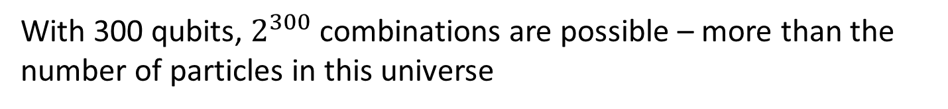
Quantum Computing
Quantum System are exponentially Powerful !
With 300 qubits, $2^{300}$combinations are possible – more than the number of particles in this universe
All types of problems can NOT be solved by Quantum Computing
Pick right computational problem; like, Factoring, simulation of real quantum system, optimization etc.
Design Quantum Algorithm
Quantum Fourier Transform
Limit of Quantum Computer – Problems that can not be solved by Quant Comp
????
Building a Quantum Computer

Slide 11
Quantum Computing – a misconception
a buzz word
More appropriate term is ‘Quantum Information Processing’
Quantum computers is not ONLY outcome of this technology
This technology can be used in many other fields like, Communication, sensing, simulation of real quantum system
10 QUANTUM COMPUTING APPLICATIONS TO KNOW
Cybersecurity, Drug Development, Financial Modeling
Better Batteries, Cleaner Fertilization
Traffic Optimization, Weather Forecasting and Climate Change
Artificial Intelligence
Solar Capture, Electronic Materials Discovery

Slide 12
Quantum Computer We Need for………
In principal impossible with current technology (even with super computer scientist can think about)
Device with extraordinary computational power
Quantum networks and communications
which may lead to revolutionary ways to share information.
Quantum sensing and metrology
which leverage the extreme sensitivity of qubits to the environment to realize sensing beyond the classical shot noise limit,
Simulation
of Materials and Chemical
Chemical Reactions are evolution of a quantum system- naturally QC can solve such issues
Medicine
Diagnosis, Pharmacy

Slide 13
Quantum Computing Technology – what is special
You will learn and use new aspect of Quantum Mechanics
Most of the existing devices (basically, Diode/transistor and laser) belongs to first generation of Quantum Mechanics
Quantum Computing is ‘Second Generation’ of Quantum Mechanics where we use superposition and entanglement concepts of Q.M
The important new observation is that information is not independent of the physical laws used to store and processes it (see Landauer in further reading).
Although modern computers rely on quantum mechanics to operate, the information itself is still encoded classically.
A new approach is to treat information as a quantum concept and to ask what new insights can be gained by encoding this information in individual quantum systems. In other words, what happens when both the transmission and processing of information are governed by quantum laws?

Slide 14
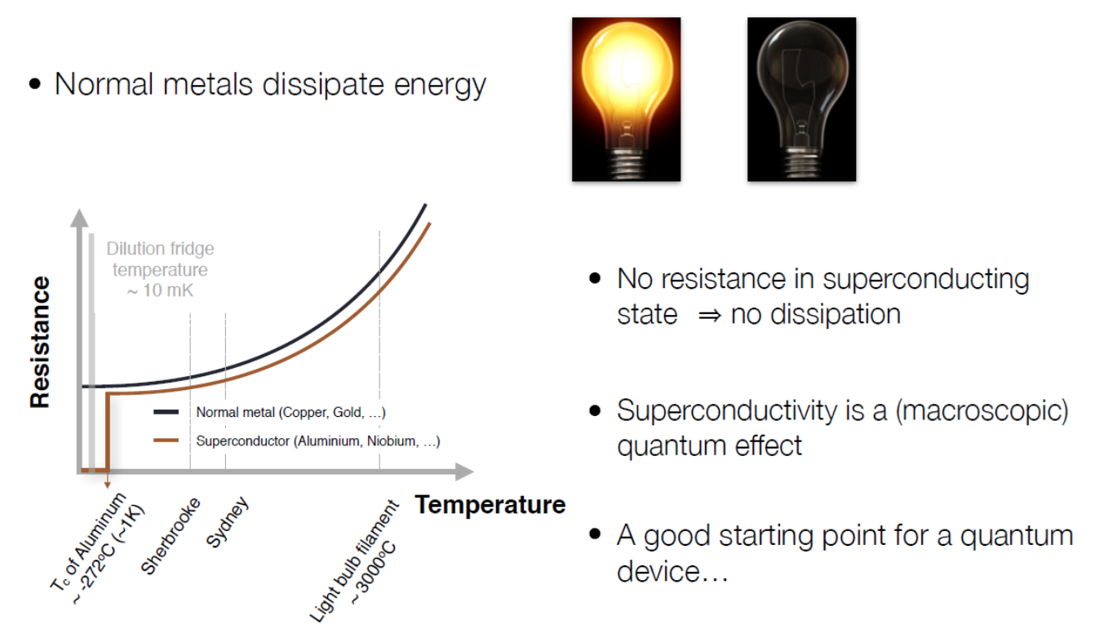



What is Quantum Computer
Classical Computer (Binary)
A computer that uses voltages flowing through circuits and gates, which can be calculated entirely by classical mechanics.
Not interested only increased power
Looking for new Technology
Quantum Computer
A computer that uses quantum mechanical phenomena to perform operations on data through devices such as superposition and entanglement.
Quantum computer will NOT only faster than classical ones; the science/physics behind the operation of quantum computing is entirely different from classical (excising) computer
$$2^{10}=1028 combination$$
For n-bits possible combinations are 2^{n}
$$250=??$$
1,125,899,906,842,624 = 1.13 x 10¹⁵ combinations
With 300 qubit you can have a ‘quantum system’ with states same as number of particles in universe!
Quantum Computer are NOT fast super computer; IT IS NEW SCIENCE –SUPERPOSITION AND ENTANGLEMENT

Slide 15
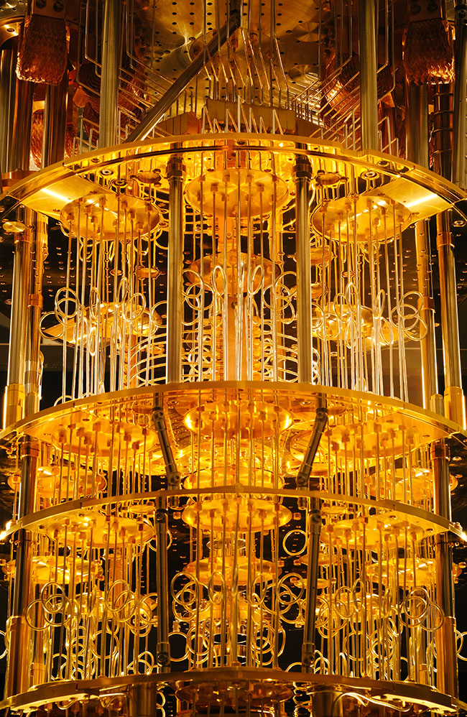
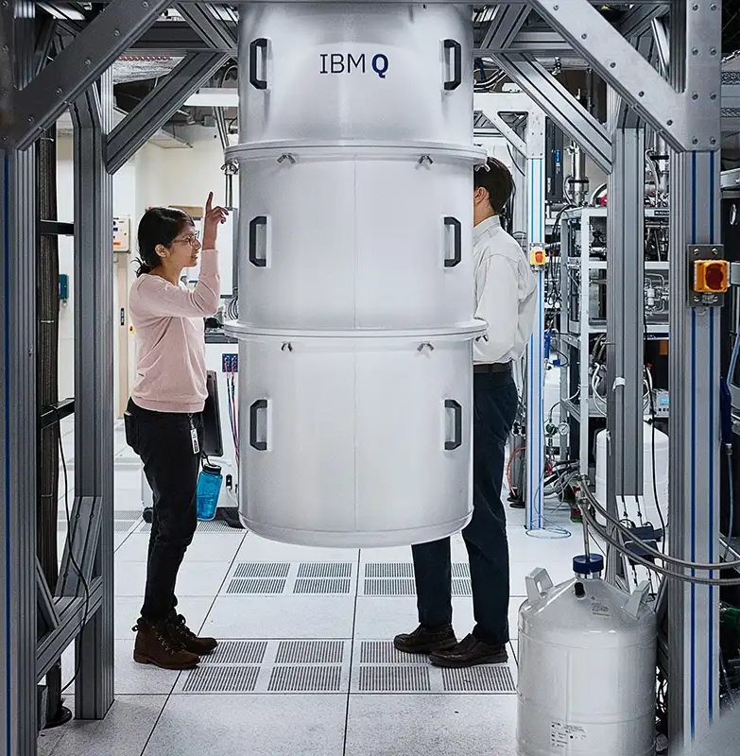
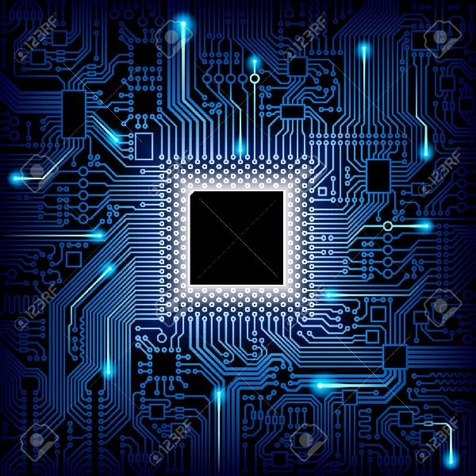

How Different is Quantum Computing from Classical Computing
Almost the same
Completely new Sci. and Tech.
Same with additional features
Quant Comp will be ‘just’ much faster than classical computing

Slide 16

Classical and Quantum Computing
Completely new mean?
At user interface there is a classical computers: we will communicate with Quant Comp through classical computer
Quantum Data
Classical data
Classical data
Input data
Output data
Quantum Processor
Data to be processed by QC
Processed data from QC
Quantum Computer receive/deliver
information from/to classical computers
Mostly Quant Comp receive data from classical computer in the form of combinations of bit (0,1)
Data processing in Quant Comp will be in ‘quantum state’ (NOT in conventional/classical combinations of 0’s and 1’s)
Data in ‘quantum processor’ can not be observed/measured

Slide 17


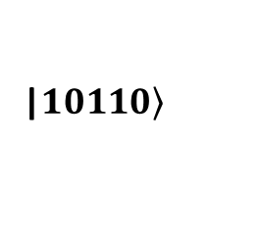
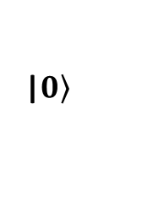
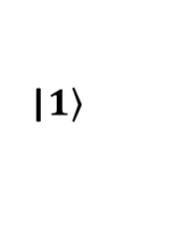
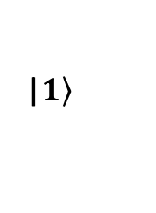
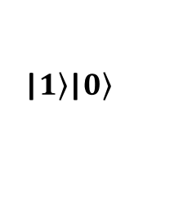
Exponentially Large Computing Power of Quantum Computer
Can you predict ON/OFF arrangement for these five lamps
No, until you observe/measure it, quite obvious!
ON/ OFF/ ON/ ON/ OFF
Five Hidden Lamps
|$\left.1\right\rangle$|$\left.0\right\rangle$
|$\left.1\right\rangle$
|$\left.1\right\rangle$
|$\left.0\right\rangle$
|$\left.10110\right\rangle$
Classically you “measure or don’t” same ON/OFF arrangement exist prior to observation
Quantum mechanically before you do measurement ‘no one knows about the ON/OFF arrangement’ – Measurements collapse the array into specific order of ON and OFF (like one we observed; ON/ OFF/ ON/ ON/ OFF
According to Quantum theory before measurement the array of lamp can be in ‘all 32 (2⁵) possible states (superposition state)’ – Upon measurements/Observation system will collapse into one of the measureable state!!!!
In Quantum Computing we use these exponentially large possible ‘superposition states’ to do computing

Slide 18
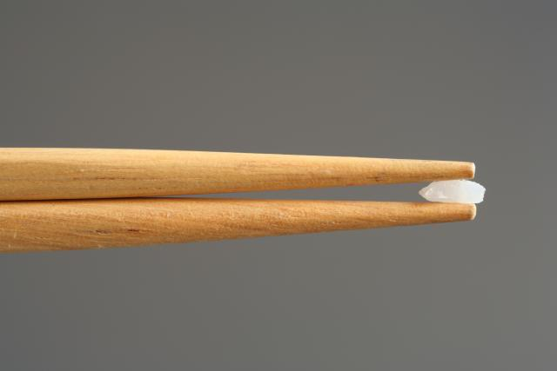
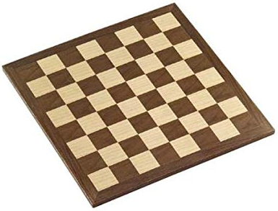
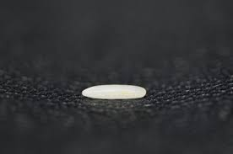

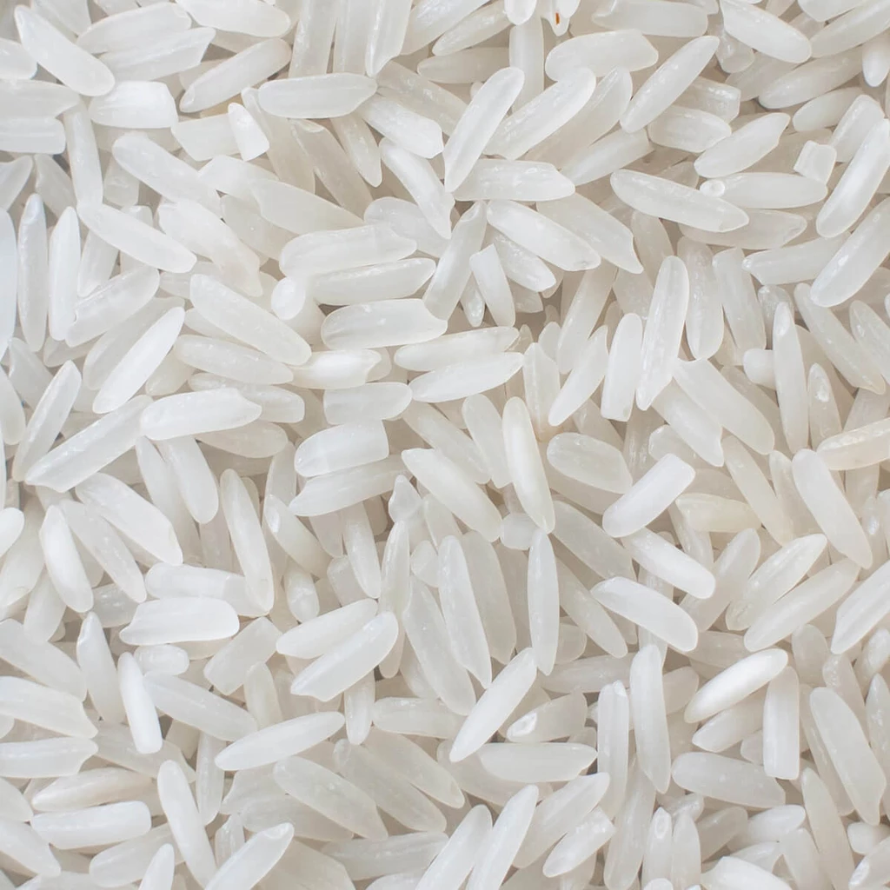


Exponential Scaling /Increase (Most of the real system grows exponentially and to solve them you QC)
Probably King thought in total it will be a small amount, like
Current annual world production of rice is approx. 500 million metric tons
and he is kidding
But if you do calculation,
his total demand
On 28th day $268×{10}^{6 }$grains
He asked for 1000 year production
In Total of $4.61×{10}^{14}kg$– 461 Billions of metric tons

Slide 19

Nature is Classical or Quantum Mechanical?
Nature is Quantum Mechanical
But we can not
the nature
We CAN NOT observe/measure useful/interesting quantum states
Quantum Mechanical processes happening around us “CAN NOT’ be observed/measured/seen
Postulate of Quant. Mech. as well
Quantum ‘state of the system’ collapse upon measurements !

Slide 20


Quantum State and Measurements
Quantum mechanically, he can pass through both the doors at the same
However, this step we can not observe/measure !
1
You have to believe in QM
2
If you try to measure/observe, he will pass through 1 or 2, NOT through both, same as classical system

Slide 21
Classical and Quantum States
Possible states of a single bit
Classical bit
0, 1
Two bit’s possible states are 00, 01, 10, 11
Three bit’s possible states are 000, 001, 010, 011, ……111 (total of eight)
Four bit’s possible states are 0000, 0001, 0010, 0011, …….1111 (total of 16)
You can send/processes/(system can be) in any ONE of these states at a time
Quantum bit
0, 1
But Quant Mechanically the system can be in both 0 and 1 states at the same time !
Qubit
Superposition state
Two qubits system can be in all possible states “00, 01, 10, 11” at the same time!!!
You can process many ‘states’ in a single step!!!
Three qubits system can be in all possible states 000, 001, 010, 011, ……111 (total of eight)
at the same time!!!
Four qubits system can be in all possible states 0000, 0001, 0010, 0011, …….1111 (total of 16)
at the same time!!!

Slide 22
Superposition of States
It is NOT unusual or a special phenomena
Nature follow it almost every where at atomic and molecular level
Nature follow ‘this rule’ we (physicist) learned/discovered it almost 100 years ago
But now due to technological development in last 20 years we can measure/ feel it quite often (in many different systems)
Richard Feynman proposed in Conference that if you would like to simulate nature build a Quantum Computer
(Physics of Computation Conference, Edicott House, MIT, May 6-8, 1981)
“Nature is not classical, dammit, and if you want to make a simulation of nature, you’d better make it quantum mechanical, and by golly, it’s a wonderful problem, because it doesn't look so easy “

Slide 23
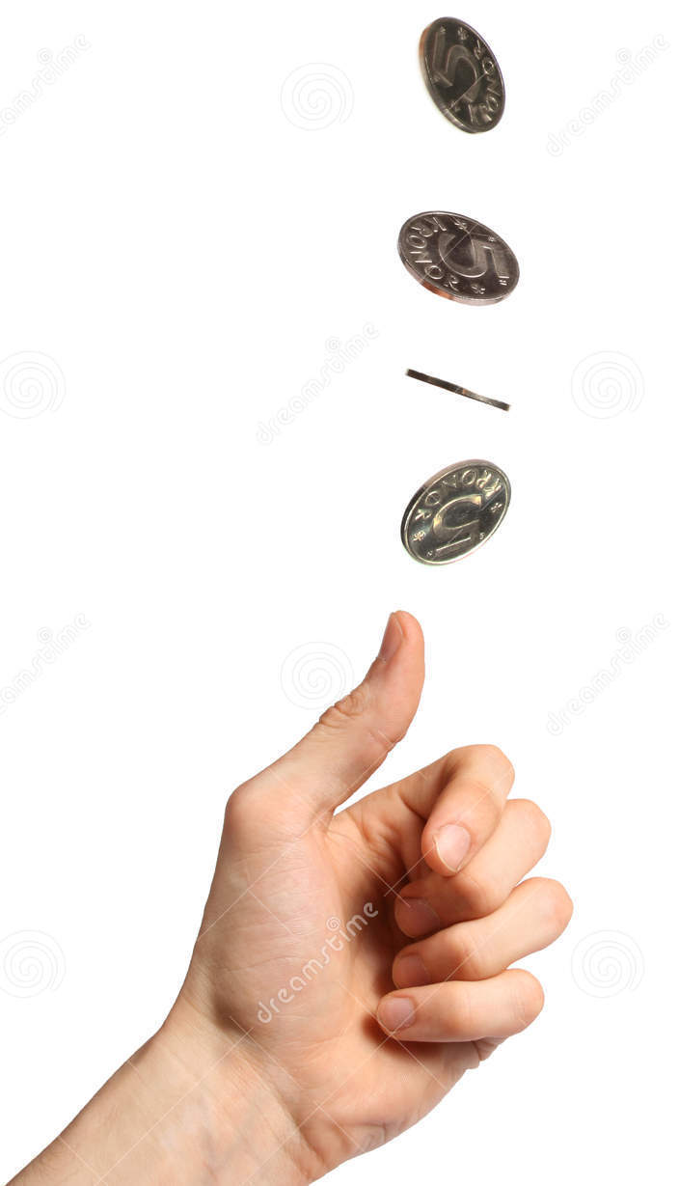
Superposition Concept by Flipping a Coin
What is the ‘sate’ of coin (still in air)?
Classically – we don’t know the state
H or T or both – we don’t know
Quantum mechanics says it is both the states
(superposition of H and T) at the same time
Quantum mechanically state is well defined – 50% H and 50% T
Imagine a switch in both ON and OFF state at the same time
Before measurements coin is in superposition state (of H and T), However upon measurements coin collapses to either H or T state
single bit can be in 0 and 1 state at the same time
Quant mechanically flipped coin is in both states, ‘H and T’ at the same time
Looks nothing new !
Quantum ‘state of the system’ collapse upon measurements !

Slide 24


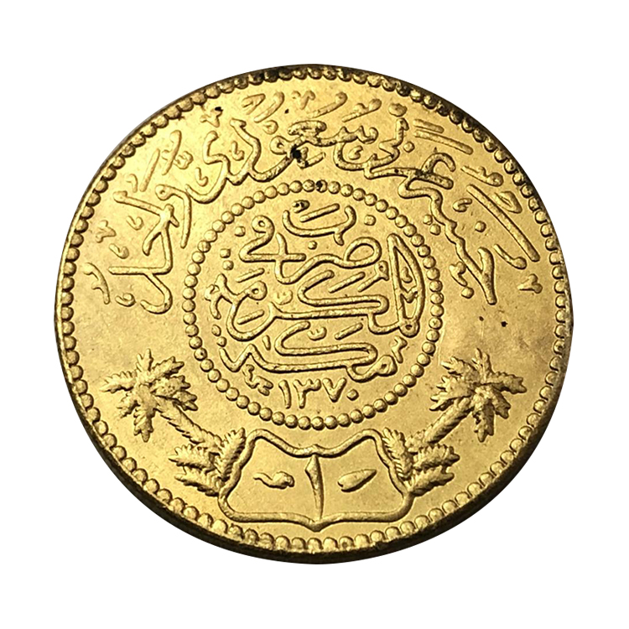

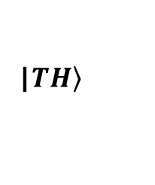
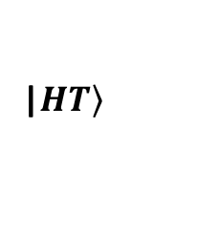
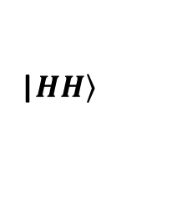
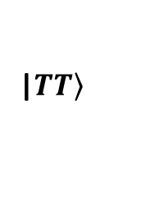
Flip two Coins
What is the state now ?
Classically possible states can be
HH
HT
TH
TT
we don’t know
Quantum mechanically
|$\left.HH\right\rangle$
|$\left.HT\right\rangle$
|$\left.TH\right\rangle$
|$\left.TT\right\rangle$
System is in all states “HH, HT, TH, TT”
However, when you try to measure the states of two coin you will end up (or measure) any of the these “HH, HT, TH, TT” states
Nothing new !
Classically, when ever you measure, you will measure the same thing (with certain probability)
Before any measurement, coins remains in ‘all four states’ (superposition state)
and these states can be used to process the information quant mechanically
Think about if you flip three, four or more coins, how many ‘states’ will be available in ‘superposition state’?

Slide 25
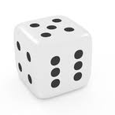
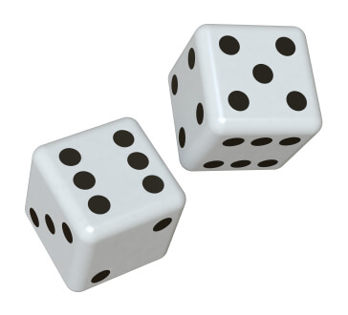
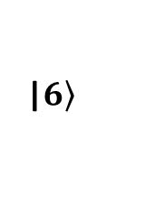
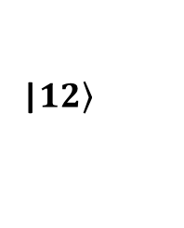
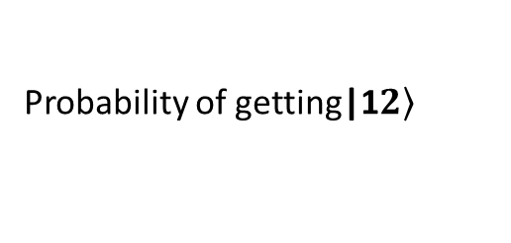
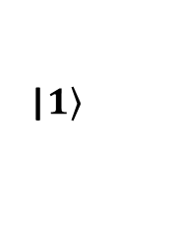
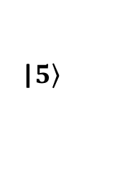
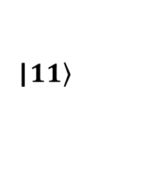
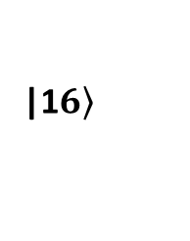
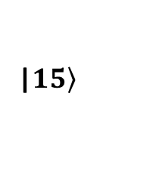
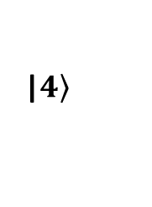
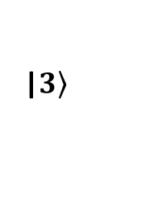
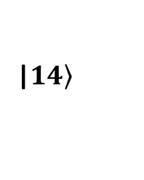
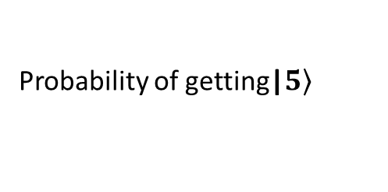
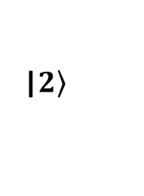
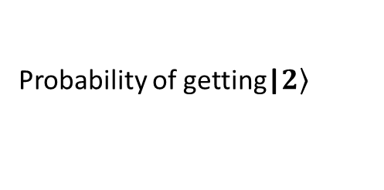
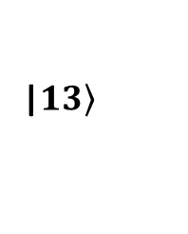
Now Consider a Die
When you through a dice, how many outcomes/states are possible
|$\left.1\right\rangle$
|$\left.2\right\rangle$
|$\left.3\right\rangle$
|$\left.4\right\rangle$
|$\left.5\right\rangle$
|$\left.6\right\rangle$
If the die is fair all six possible outcomes are equally probable
Probability of getting|$\left.2\right\rangle$
1/6
Same for all possible outcomes
Probability of getting|$\left.5\right\rangle$
1/6
Remember Quant Mech. before measurements the die will remain in all ‘possible six states’
If you through ‘two dies’ together, how many possible outcomes
|$\left.11\right\rangle$
|$\left.12\right\rangle$
|$\left.13\right\rangle$
|$\left.14\right\rangle$
|$\left.15\right\rangle$
|1$\left.6\right\rangle$
………………Count total yourself
Probability of getting|1$\left.2\right\rangle$
??
Remember Quant Mech. before measurements two dies will remain in all ‘possible …. states’

Slide 26
Quantum Computing is Probabilistic NOT Deterministic
We know quantum system before measurements remain in all possible states (remember coin/die are NOT real quantum system)
Output of coin/die is probabilistic – if I am interested in specific out put i.e. HH /HT/11/35 etc. (like in computing) how I will select?
For fair systems probabilities are equal – such probabilistic systems system are not good for computing
Output of quantum system is always probabilistic, and probabilities of all outcomes are not equal, further probabilities of certain outcome can be increased/decreased
If we plot probability histogram, we can select an out put ‘max height in histogram’

Slide 27
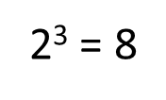
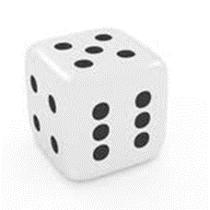
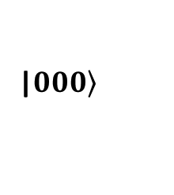
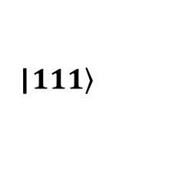
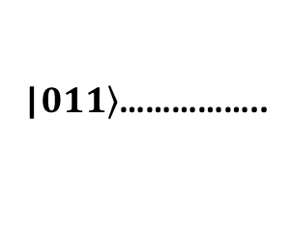
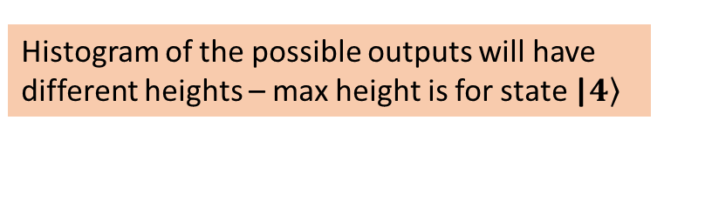
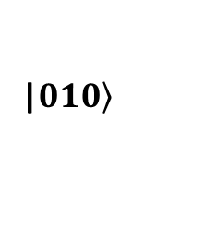
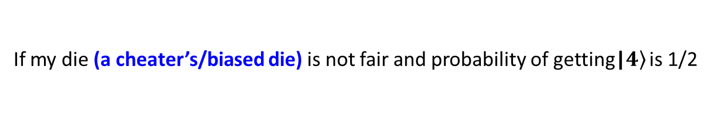
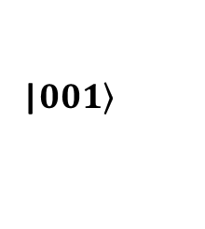
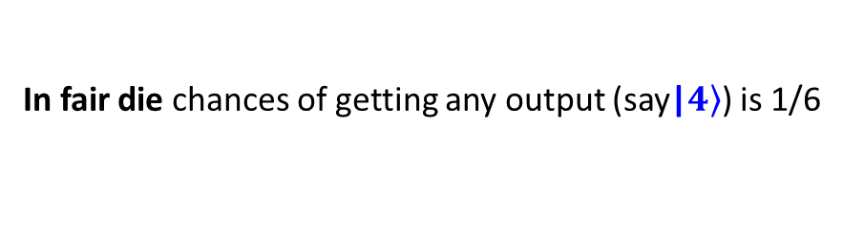
Consider three Qubits
Classically possible outcomes are
2³ = 8
|$\left.000\right\rangle$
|$\left.001\right\rangle$
|$\left.010\right\rangle$
|$\left.011\right\rangle$……………..
|$\left.111\right\rangle$
one classical combination of input
one classical combination of output
All possible outcomes (after H gates) are equally probable?
Quant
Process.
In Quant Processor before measurements three coins will remain in superposition of eight states
If all outcomes are equally probable
Quantum Computer is useless
But in any computing process we are interested in ONLY ONE outcome!
How Quant computer can provide the required output ?
Using Algorithms
Algorithms increases the probability of required outcome
In fair die chances of getting any output (say|$\left.4\right\rangle$) is 1/6
1/6 -
Histogram of the possible outputs will have same height
1 2 3 4 5 6
If my die (a cheater’s/biased die) is not fair and probability of getting|$\left.4\right\rangle$ is 1/2
1/2 -
Histogram of the possible outputs will have different heights – max height is for state |$\left.4\right\rangle$
1/6 -
1 2 3 4 5 6

Slide 28
Superposition and Measurements
Before measurements, in ‘superposition’, quantum system remain in many states at the same time
All these states can be used to processes the information (many information can be processed at the same time in a single step (how? we will see)
Upon measurement system will collapse to any of these possible states (can 2 or millions or billions!)
Every ‘measurement outcome’ have certain probability – we can never be sure about the outcome If every outcome have same probability, we can not compute anything
To compute something we have to increase the probability of certain out come (like cheater’s die)

Slide 29
Measurement outcomes of a Superposition State (of a quantum system/state)
Measurements outcome of a quantum system (superposition state) is probabilistic NOT deterministic
If all possible outcomes, of a superposition state are equally probable, such quantum system are not useful in quantum computing
In quantum computing we increase the probability of ‘required outcome’
How ??
using concept of cheater's die – call algorithms (where we will ‘add’ or ‘sub’ Prob amplitudes)
Algorithms increases/decreases the probability of some possible outcomes
How algorithms can do this – using concept of interference (that can be constructive or destructive)
How we execute these algorithms? – Using quantum gates (like classical gates AND, OR, NOT, NAND etc.)

Slide 30
Measurement outcomes of a Superposition State (of a quantum system/state)
Measurements outcome of a quantum system (superposition state) is probabilistic NOT deterministic
If all possible outcomes, of a superposition state are equally probable, such quantum system are less useful in quantum computing
In quantum computing we increase the probability of ‘required outcome’
How ??
using concept of cheater's die – call algorithms
Algorithms increases/decreases the probability of some possible outcomes
How algorithms can do this – using concept of interference (that can be constructive or destructive)
How we execute these algorithms? – Using quantum gates (classical gates AND, OR, NOT, NAND etc.)

Slide 31
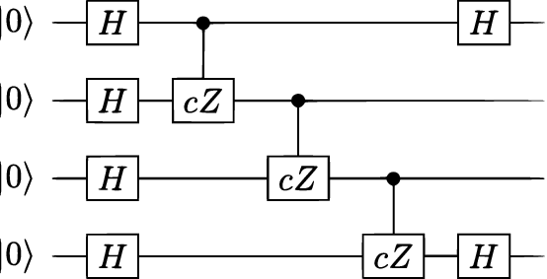
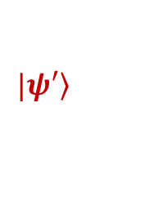
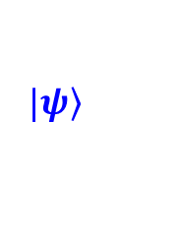

Creation of Superposition States: Quantum Gates
Quantum Data
Classical data
Classical data
Input data
Output data
Quantum Processor
Data to be processed by QC
Processed data from QC
Data converted into quant data, qubits, no more classical bits 0, 1
$$|\left.ψ\right\rangle$$
$$|\left.ψ′\right\rangle$$
$$|\left.ψ\right\rangle =|\left.0000\right\rangle$$
16 states with same probability amplitude
$$|\left.ψ^{′}\right\rangle =\frac{1}{\sqrt{16}}\left.|0000\right\rangle +\frac{1}{\sqrt{16}}\left.|0001\right\rangle +\frac{1}{\sqrt{16}}\left.|0010\right\rangle +\frac{1}{\sqrt{16}}\left.|0011\right\rangle +\frac{1}{\sqrt{16}}\left.|0100\right\rangle +\frac{1}{\sqrt{16}}\left.|0110\right\rangle +…\frac{1}{\sqrt{16}}\left.|1111\right\rangle$$

Slide 32
Intro to Quantum Information and Computing
Superposition state of some naturally excising quantum system
Collapse of quantum state upon measurements (direct or indirect)
Mathematical representation of quantum state – different notations
Rest is mathematical formalism development for quantum computing

Slide 33

What is Qubit Simply a two level system
Basic unit of information is called a bit
It represents a binary-valued quantity such as a yes/no, on/off, stop/go 1/0 etc.
‘0’ and ‘1’ quantum state is different from ‘0’ and ‘1’ bit concept in classical computers
That is why called quantum bit or in short ‘qubit’
These two states of a natural or artificial atom (system) can be calculated/ measured or explained only using rules of Quantum Mechanics

Slide 34









Summary of Lecture 01
State of single flipped coin
For one fair die
$$\frac{1}{2}|\left.H\right\rangle +\frac{1}{2}|\left.T\right\rangle$$
$$\frac{1}{6}\left.|1\right\rangle +\frac{1}{6}\left.|2\right\rangle +\frac{1}{6}\left.|3\right\rangle +\frac{1}{6}\left.|4\right\rangle +\frac{1}{6}\left.|5\right\rangle +\frac{1}{6}\left.|6\right\rangle$$
All these states are NOT ‘true’ quantum states! coin and die are not quantum system quantum systems are more complicated
For two fair dies
$$\frac{1}{30}\left.|11\right\rangle +\frac{1}{30}\left.|12\right\rangle +\frac{1}{30}\left.|13\right\rangle +……….+\frac{1}{30}\left.|66\right\rangle$$
State of two flipped coin
For one unfair dies
$\frac{1}{4}|\left.HH\right\rangle +\frac{1}{4}|\left.HT\right\rangle$+$\frac{1}{4}|\left.TH\right\rangle +\frac{1}{4}|\left.TT\right\rangle$
Where prob. Of getting $\left.|4\right\rangle$ is ½ and rest of all options have equal prob.
$$\frac{1}{10}\left.|1\right\rangle +\frac{1}{10}\left.|2\right\rangle +\frac{1}{10}\left.|3\right\rangle +\frac{1}{2}\left.|4\right\rangle +\frac{1}{10}\left.|5\right\rangle +\frac{1}{10}\left.|6\right\rangle$$
Sum of probabilities in every case is one – it should be

Slide 35







Probabilities concept Classically and Quant Mech.
State of single flipped coin
For one fair die
$$\frac{1}{2}|\left.H\right\rangle +\frac{1}{2}|\left.T\right\rangle$$
$$\frac{1}{6}\left.|1\right\rangle +\frac{1}{6}\left.|2\right\rangle +\frac{1}{6}\left.|3\right\rangle +\frac{1}{6}\left.|4\right\rangle +\frac{1}{6}\left.|5\right\rangle +\frac{1}{6}\left.|6\right\rangle$$
These states are NOT of a quantum mechanical system even if coin/die is two/six state QM system
Classically we know the probabilities of possible outcomes
Quantum mechanically we can also know the probabilities of possible outcomes
Quant Mech.
But this not an acceptable state in Quant Mech.
$$\frac{1}{2}|\left.H\right\rangle +\frac{1}{2}|\left.T\right\rangle$$
$$α|\left.H\right\rangle +β\left.|T\right\rangle$$
Where $α$ and $β$ are unknown and
$${ \left|α\right|}^{2}+{\left|β\right|}^{2}=1$$
${ \left|α\right|}^{2}$ is probability of getting the$|\left.H\right\rangle$
$α and β$are probability amplitudes
${ \left|β\right|}^{2}$ is probability of getting the$|\left.T\right\rangle$

Slide 36




Schrodinger’s cat Dead or alive or both
A cat inside a box with a bowl/bottle of poison
Without opening the box, what you can say
about the cat; dead or alive?
Classically – we don’t know (until we open the box)
Quantum mechanically; both (dead and alive)
Quantum State of the cat inside the box
Before opening the box
After opening the box the state will be same (classically and quantum mechanically) i.e. what we observe/measure
Why $\frac{1}{\sqrt{2}}$
Different from previous slides notation!
$\frac{1}{\sqrt{2}}$ is NOT the probability of one possible outcome!

Slide 37
What is Quantization
In Quantum Mechanics every physics quantity is quantized?
Momentum, position, distance, velocity, electric/magnetic field etc.

Slide 38


Quantization of Physical Quantities?
Ramp
You can at any height from the floor
Stairs
Height from the floor = n x height of each step
In case of stairs ‘height is quantized’
Charge on an object is always quantized: 1e, 5e, 16e,………ne
Stairs
Ramp
Radius of electron around nucleus is quantized
Structure of an atom
Energy of electron around nucleus is quantized
At atomic/molecular level many physical quantities are quantized like momentum, magnetic filed, energy, electric filed etc.

Slide 39

Quantization of Physical Quantities?
Quantization is one of the basic law of nature, without basic knowledge quantum mechanics you can accept this well accepted ‘law of nature’, like solar system
Scientist and scholars took 100’s of years to complete this solar system model, however, our generation accepts it in minutes!

Slide 40





Quantization of Physical Quantities?
One more example of quantized system (very important for qubit)
Mass attached to a spring
Amplitude = $x$
Energy = $\frac{1}{2}kx^{2}$
Energy Vs displacement for SHO
Clearly Energy and displacements are NOT Quantized’
Now if you solve the same problem (mass attached to a spring – at atomic/molecular level) using quant mech.
Energy states become quantized and lowest energy state is not zero

Slide 41



Quantization of Physical Quantities?
Spin of an electron is also quantized (one of the first qubit)
Two possible spin states we can measure

Slide 42





What is Qubit Simply a two level system
A two level system where with good control, state of a system can changed
Like spin of an electron, polarization of light, electron in atomic orbitals, etc.
Spin of an electron
Electron orbits in a hydrogen Atom
Diamond with NV center
Quantum mechanical two state systems, NOT ‘0’ and ‘1’ bit in classical computing

Slide 43


What is Qubit a two level ^ Quantum system
Few more ‘Two Level Quantum System’
Light polarization
Where ‘vertical’ and ‘horizontal’ polarization can act as state of qubit
Path of the Photon
Where two paths created by ‘beam splitter’ can act as two level system fro qubit
Any two level system that can be explained/studied using Q.M. can as qubit

Slide 44
What is Qubit a two level ^ Quantum system
All the two level system give in previous slides (and many more similar) are excellent ‘Two Level Quantum System’
where
State can be precisely controlled
Some of them have very long coherence time (like NV center in diamond - few ms at room temp)
Control by shining laser tuned at the desired transition frequency Hyperfine levels of 9Be+ have long relaxation and dephasing times T1 ⇠ a few years T2 & 10 seconds Reasonably short gate time Tnot ⇠ 5 µs Low error per gates: ~ 0.48%
Trapped Ions
But major issue with most of such qubit is how to integrate them to develop a quantum device

Slide 45
Quantization and Superposition
Entanglement

Slide 46



Entangled States
Measurement out come of one coin (qubit) guarantee the measurement outcome of the second coin (qubit)
First
Coin
Second
Coin
When Coins are ‘entangled’
such that the outcome can be ‘HH or TT’ ONLY
HH
HT
TH
TT
When Coins are ‘entangled’
such that the outcome can
be ‘HT or TH’ ONLY

Slide 47










What is Entanglement?
State of first qubit
If you have two Qubits the possible states are
|$\left.00\right\rangle$
classically
|$\left.00\right\rangle$
|$\left.01\right\rangle$
|$\left.10\right\rangle$
|$\left.11\right\rangle$
State of
second
qubit
$$α\left.|00\right\rangle +β\left.|01\right\rangle +\left.γ|10\right\rangle +\left.δ|11\right\rangle$$
Quantum mechanically
$$α\left.|00\right\rangle +\left.δ|11\right\rangle$$
Called Entangled states
(all are not possible why?)
$$β\left.|01\right\rangle +\left.γ|10\right\rangle$$
What is special about entangled state of a quantum system
$$α\left.|00\right\rangle +\left.δ|11\right\rangle$$
If you measure the first qubit in state ‘0’
what is the state of second qubit?
Prepare the Quantum system in state
$$β\left.|01\right\rangle +\left.γ|10\right\rangle$$
If you measure the second qubit in state ‘1’
what is the state of first qubit?
Entangled states ‘guarantee’ the measurement out of the other qubit if you know the state of one of them.
If you measure one for sure you can find the state other qubit without measurements (no matter how far it is!)

Slide 48
Quantum Computing
What is special about Quantum Bits – Qubits
Key
Concept
Superposition
“Anyone who is not shocked by Quantum Mechanics has NOT understood it” ….Neil Bohr
Counter intuitive concepts – at least we feel?
Entanglement
Bell’s Inequality
Teleportation
No background in Quantum Mechanics could be helpful to learn these concepts – Clean sheet, write whatever you want

Slide 49
Qubit of an ‘artificial atom’
One of the most promising qubit for Quantum Computing
In contrast to other platforms, e.g. electron spins in silicon and quantum dots, trapped ions, ultra-cold atoms, nitrogen-vacancies in diamonds , and polarized photons
Where the quantum information is encoded in natural microscopic quantum systems
Superconducting qubits are macroscopic in size and lithographically defined.
A multi-qubit quantum processor involves superconducting qubits, in which information is stored in the quantum degrees of freedom of nanofabricated, anharmonic oscillators constructed from superconducting circuit elements.

Slide 50




Quantum Information Processing: The Challenge
Qubit:
Two level systems
Two qubit
entangling gates
Qubit readout
Single qubit
control
∼
∼
∼
Qubit - artificial atom
Superconducting qubit
Important requirements; long coherence time, fast control and readout

Slide 51




Qubit of an ‘artificial atom’
With existing micro/nano fab technology it is very difficult to integrate most of the naturally existing qubit on a chip, unless there is a break through
What is circuit qubit based ‘artificial atom’
Standard tool kit
Electrical engineers have ‘only three alphabets’ whenever they talk about circuits
Resistor, capacitor, inductor
No matter how complicated the device is for physicist
– they can translate it into R, L and C combination
Based on same idea, circuit qubit is simply a RLC oscillator
RLC oscillator can be used as an ‘artificial atom’
These ‘artificial atoms’ are based upon the knowledge of
Harmonic oscillators and basic electrical circuits
Superconductivity and Josephson junctions
Harmonic Oscillator - RLC (Ideally LC) circuits is another option to develop a Qubit, where integration is an inherent property
Remember; Integration of Nanostructures on a chip is a ‘bottle-neck’ in developing many promising NS-based devices

Slide 52


Introduction to Quantum Mechanics
Nature of Light
Wave or Particle ?
Wave Particle Duality
Electromagnetic Waves
Photon
DeBroglie wave-particle duality
$λ=\frac{h}{P}$ where λ is wavelength
P is momentum
Reflection, Refraction, Interference, Polarization, diffraction
Photoelectric effect
Maxwell’s Equations
Plank’s $E=hf$
Energy of light
of frequency f
Why new theory; why classical physics is NOT adequate
Black body radiation
Specific heat capacity (at low temperature)
Quantum Mechanics
Semiconducting behavior of materials

Slide 53


Introduction to Quantum Mechanics
Energy States of electrons are quantized
Bohr’s atomic model – Classical Model
Quantum Mechanics explains all experimental observations
Bohr’s atomic model was not enough to explain many observations; need additional theory
Classical physics can not explain this experimental observations
Stern-Gerlach Experiment; 1922
Quantum Mechanics successfully explains this experimental observations
First experiment gives the idea about the ‘spin’
Q M Introduces Wave Functions
Black body radiation
Schrodinger wave Equation:1923
Quantum
Mechanics
Concept of wave function
Specific heat capacity (at low temperature)
What is wave function ???
Everything associated with the particle/ system can be determined from wave function like, position, momentum, energy etc.
Semiconducting behavior of materials

Slide 54
Number of Photons generated by a lamp
Question. Calculate the number of photons generated by 100 W lamp per second. Assume all the energy is consumed by lamp is converted into visible light of wave length 500 nm.

Slide 55


Young’s Double Slit Experiment (light)
Wave theory successfully explain the double slit experimental results
Can QM explain this experimental observation ? Yes and tell us something new about this experiment

Slide 56


Young’s Double Slit Experiment (with electrons)
Electron also behaves like a wave (wave-particle duality)
I can safely say that no one understand Quantum Mechanics ----- Richard Feynman

Slide 57
Strange Experimental Observations
(during Young’s double Slit experiment)

Slide 58



Young’s Double Slit Experiment
Where we are now (in ref. to previous slides)?
Light is a wave and wave theory can successfully explain the interference pattern of all types of waves
(weather they are classical wave or a particle that can be treated as wave as per DeBroglie wave-particle duality)
If you fire photons/electrons/atoms etc. one by one
Source of particles
Still can we see the interference pattern on the screen?
YES
How come? interference pattern (in wave theory) is collective behavior of xple wave!
Wave theory CAN NOT explain this experimental observation
How to explain this single photon/electron interference pattern?
Quantum Theory explain this experimental observation successfully
How?
Using concept of superposition

Slide 59

Young’s Double Slit Experiment
Interference patterns of particles fired one by one
Source of particles
S₁
If you fire photons/electrons/atoms etc. one by one
Still we can see the interference pattern on the screen
S₂
We are firing electron/photon one by one, therefore, at an instant electron/Photon will pass through either of the slits S₁ or S₂, but NOT through both at the same time (electron/photon are indivisible particles)
Now let us try to measure, at specific instant, electron/photon passes through which slit S₁ or S₂
As soon as you measure/detect the path of electron/photon, Interference will pattern disappear
Strange!! Why
Quantum Theory also explain this experimental observation successfully
How?
Using concept of superposition
How single electron/photon can produce interference pattern and why on detecting the path (of electron/Photon) interference pattern disappears ?
The Quantum theory that explain this experimental observation and we use it in Quantum Computing/information

Slide 60

Summary: Under what conditions Young’s Double Slit Experiment will give inference/ fringe patterns
Quantum interference can be explained by saying that the particle is in a superposition of the two experimental paths: |passage through the upper slit〉 and |passage through the lower slit〉. Similarly a quantum bit can be in a superposition of |0〉 and |1〉.
Experiments in quantum information processing tend to use interferometers rather than double slits but the principle is the same.
Always constructive
interference
So far single-particle quantum interference has been observed with photons, electrons, neutrons and atoms.
Something interesting, counter intuitive, CAN NOT be understood/ explained by classical mechanics
Observations used to develop Quantum Communication Technology

Slide 61

Single Photon Quantum Interference
Single-particle quantum interference fringes can be observed in a two-path interferometer if there is no way of knowing, not even in principle, which path the particle takes.
In a Mach-Zehnder interferometer a quantum particle strikes a beam splitter and has a 50/50 chance of being transmitted or reflected.
Mirrors reflect both paths so that they meet at a second 50/50 beam splitter, and the numbers of particles transmitted/reflected by this beam splitter are counted.
If no information about the path is available, the particle is in a superposition of the upper and lower paths. To observe interference it is necessary to vary the length of one of the paths (e.g. with a variable wave plate) and count coincidences between the detectors as a function of this phase.

Slide 62












Single Photon Quantum Interference
BS-Beam Splitter
D₂
$$\left.|1\right\rangle$$
Orthogonal
possibilities
BS creates superposition state$\left. |ψ\right\rangle$
$$\left.|ψ\right\rangle =\frac{1}{\sqrt{2}}|\left.0\right\rangle +\frac{1}{\sqrt{2}}|\left.1\right\rangle$$
$$\left.|0\right\rangle$$
$$\left.|0\right\rangle$$
50% prob. that D₁ ‘clicks’ and 50% prob. D₂ ‘clicks’
Single photon input
D₁
State$\left. |ψ\right\rangle$ CAN NOT be measured
50-50 BS
Before measurement it is qubit, however after measurements it becomes a ‘classical bit’ – bit in a definite state
BS-Beam Splitter
D₂
$$\left.|1\right\rangle$$
BS creates superposition state$\left. |ψ\right\rangle$
$$\left.|ψ\right\rangle =\frac{1}{\sqrt{3}}|\left.0\right\rangle +\sqrt{\frac{2}{3}}|\left.1\right\rangle$$
$$\left.|0\right\rangle$$
Single photon input
$$\left.|0\right\rangle$$
D₁
?? prob. that D₁ ‘clicks’ and ?? prob. D₂ ‘clicks’
State$\left. |ψ\right\rangle$ CAN NOT be measured
NOT a 50-50 BS

Slide 63





BS-Beam Splitter
D₂
$$\left.|1\right\rangle$$
If input of 50-50 beam splitter is $\left.|0\right\rangle$, then the out put is
$$\left.|0\right\rangle$$
$$\frac{1}{\sqrt{2}}\left.|0\right\rangle +\frac{1}{\sqrt{2}}\left.|1\right\rangle$$
Single photon input
$$\left.|0\right\rangle$$
D₁
50-50 BS
BS-Beam Splitter
D₂
$$\left.|1\right\rangle$$
If input of 50-50 beam splitter is $\left.|1\right\rangle$, then the out put is
$$\left.|0\right\rangle$$
$$\frac{1}{\sqrt{2}}\left.|0\right\rangle −\frac{1}{\sqrt{2}}\left.|1\right\rangle$$
Single photon input
$$\left.|1\right\rangle$$
D₁
50-50 BS

Slide 64












On previous slide I defined the output of a 50-50 BS for both inputs ($\left.|0\right\rangle$ and $\left.|1\right\rangle$)
Out put of first beam splitter (BS-1) for and input $\left.|1\right\rangle$
D₂
$$\left.|0\right\rangle$$
$$\frac{1}{\sqrt{2}}\left.|0\right\rangle −\frac{1}{\sqrt{2}}\left.|1\right\rangle$$
BS-2
$$\left.|1\right\rangle$$
D₁
Out put of second beam splitter (BS-2) for and input for above input
$$\left.|1\right\rangle$$
BS-1
$$\frac{1}{\sqrt{2}}\left(\frac{1}{\sqrt{2}}\left.|0\right\rangle +\frac{1}{\sqrt{2}}\left.|1\right\rangle \right)−\frac{1}{\sqrt{2}}\left(\frac{1}{\sqrt{2}}\left.|0\right\rangle −\frac{1}{\sqrt{2}}\left.|1\right\rangle \right)$$
$$\left.|1\right\rangle$$
$$\left.|0\right\rangle$$
$$=\left[\frac{1}{2}\left.|0\right\rangle +\frac{1}{2}\left.|1\right\rangle \right]−\left[\frac{1}{2}\left.|0\right\rangle −\frac{1}{2}\left.|1\right\rangle \right]$$
$$=\frac{1}{2}\left.|0\right\rangle +\frac{1}{2}\left.|1\right\rangle −\frac{1}{2}\left.|0\right\rangle +\frac{1}{2}\left.|1\right\rangle$$
$$\left.=|1\right\rangle$$
Only D₁ will click!

Slide 65








Single Photon Quantum Interference
BS-Beam Splitter
D₂
$$\left.|1\right\rangle$$
BS creates superposition state$\left. |ψ\right\rangle$
$$\left.|ψ\right\rangle =\frac{1}{\sqrt{2}}|\left.0\right\rangle +\frac{1}{\sqrt{2}}|\left.1\right\rangle$$
$$\left.|0\right\rangle$$
$$\left.|0\right\rangle$$
50% prob. that D₁ ‘clicks’ and 50% prob. D₂ ‘clicks’
Single photon input
D₁
State$\left. |ψ\right\rangle$ CAN NOT be measured
50-50 BS
D₂
$$\left.|0\right\rangle$$
Which of the detector will ‘click’
D₁
OR
D₂
OR
Both
BS-2
$$\left.|1\right\rangle$$
$$\left.|0\right\rangle ⇒\frac{1}{\sqrt{2}}|\left.0\right\rangle +\frac{1}{\sqrt{2}}|\left.1\right\rangle$$
$$\left.|1\right\rangle ⇒\frac{1}{\sqrt{2}}|\left.0\right\rangle −\frac{1}{\sqrt{2}}|\left.1\right\rangle$$
D₁
$$\left.|1\right\rangle$$
$$\frac{1}{\sqrt{2}}\left[\left.|0\right\rangle +\left.|1\right\rangle \right]=\frac{1}{\sqrt{2}}\left[\frac{1}{\sqrt{2}}|\left.0\right\rangle +\frac{1}{\sqrt{2}}|\left.1\right\rangle \right]+\frac{1}{\sqrt{2}}\left[\frac{1}{\sqrt{2}}|\left.0\right\rangle −\frac{1}{\sqrt{2}}|\left.1\right\rangle \right]$$
BS-1
$$\left.|0\right\rangle$$
$$or \left.|1\right\rangle$$
$$\left.|0\right\rangle$$
Final out come $≡\frac{1}{\sqrt{2}}\left[\left.|0\right\rangle +\left.|1\right\rangle \right]=\left.|0\right\rangle$

Slide 66






Concept of Superposition in Light
$\left.|0\right\rangle ≡$ $\left.|V\right\rangle$
S is the source of light that can produce photons one-by-one
$\left.|1\right\rangle ≡$ $\left.|H\right\rangle$
100 photons are produced one-by-one from source S. A vertical polarizer is placed first, followed by a horizontal polarizer in front of the source.
S
D
~50 photons detected
~20 photons detected
0
$$\left.{|ψ}_{s}\right\rangle =\frac{1}{\sqrt{5}}\left.|0\right\rangle +\frac{2}{\sqrt{5}}\left.|1\right\rangle$$
$$\left.{|ψ}_{s}\right\rangle =\frac{1}{\sqrt{2}}\left.|0\right\rangle +\frac{1}{\sqrt{2}}\left.|1\right\rangle$$
S
~80 photons detected
D
~50 photons detected
0
Will detector detect any thing?
What % of incoming photon will reach the D
$$\frac{1}{\sqrt{3}}|\left.V\right\rangle +\frac{\sqrt{2}}{\sqrt{3}}|\left.H\right\rangle$$
D
Yes/ No
100% or 50% or 67%
0

Slide 67









Concept of Superposition in Light
$\left.|0\right\rangle ≡$ $\left.|V\right\rangle$
$\left.|1\right\rangle ≡$ $\left.|H\right\rangle$
Will detector detect any thing?
S
D
Yes/ No
$$\left.{|ψ}_{s}\right\rangle =\frac{1}{\sqrt{2}}\left.|0\right\rangle +\frac{1}{\sqrt{2}}\left.|1\right\rangle$$
0
$$\left.{|ψ′}_{s}\right\rangle$$
$\left.{|ψ′}_{s}\right\rangle =$ $\left.|0\right\rangle$
45º
Will detector detect any thing?
S
D
Yes/ No
$$\left.{|ψ}_{s}\right\rangle =\frac{1}{\sqrt{2}}\left.|0\right\rangle +\frac{1}{\sqrt{2}}\left.|1\right\rangle$$
Polarizer 3
$\left.{|ψ′}_{s}\right\rangle =$ $\left.|0\right\rangle$
$$\left.{|ψ′′}_{s}\right\rangle =\frac{1}{\sqrt{2}}\left.|0\right\rangle +\frac{1}{\sqrt{2}}\left.|1\right\rangle$$
0
100
50
25
0

Slide 68


















Geomaterial Visualization of “Quantum Measurement”
Measurement axis are $\left.|0\right\rangle$ and $\left.|1\right\rangle$
After one specific measurement
$$\left.|1\right\rangle$$
$$\left.|1\right\rangle$$
$$\left.|1\right\rangle$$
$$\left.|ψ\right\rangle$$
50%
45º
$$\left.|0\right\rangle$$
$$\left.|0\right\rangle$$
50%
$$\left.|0\right\rangle$$
Measure $\left.|ψ\right\rangle$ in $\left.|0\right\rangle$, $\left.|1\right\rangle$ basis
$$\left.|ψ_{1}\right\rangle =\left.|0\right\rangle$$
$$\left.|ψ\right\rangle =\frac{1}{\sqrt{2}}\left.|0\right\rangle +\frac{1}{\sqrt{2}}\left.|1\right\rangle$$
Now if you measure above state in $\left.|+\right\rangle$, $\left.|−\right\rangle$
$$\left.|−\right\rangle$$
Measure $\left.|ψ\right\rangle$ in $\left.|+\right\rangle$and $\left.|−\right\rangle$ basis
$$\left.|1\right\rangle$$
$$\left.|ψ_{2}\right\rangle =\frac{1}{\sqrt{2}}\left.|+\right\rangle −\frac{1}{\sqrt{2}}\left.|−\right\rangle$$
Measurement out come will be 100 % $\left.|+\right\rangle$
45º
$$\left.|+\right\rangle$$
Superposition sate in $\left.|+\right\rangle$, $\left.|−\right\rangle$
$$\left.|0\right\rangle$$
Whether a state is considered a pure state or a superposition state depends on the measurement basis (or frame) used to observe it.

Slide 69





Light-Polarization based Qubit
0
Horizontal polarizer
$$|\left.V\right\rangle$$
Vertical polarizer
$$|\left.V\right\rangle$$
D
Yes/ No
No light wave behind Horizontal polarizer
Probability ?
0
Vertically polarized light wave
$$\frac{1}{\sqrt{2}}|\left.V\right\rangle +\frac{1}{\sqrt{2}}|\left.H\right\rangle$$
Light passes through crossed polarizer
D
Yes/ No
Probability ?
$$|\left.V\right\rangle$$
D
Yes/ No
$$\frac{1}{\sqrt{3}}|\left.V\right\rangle +\frac{\sqrt{2}}{\sqrt{3}}|\left.H\right\rangle$$
Probability ?
D
Yes/ No
Probability ?
q5
0

Slide 70
Light-Polarization based Qubit
Horizontal polarizer
Vertical polarizer
$$|\left.V\right\rangle$$
No light wave behind Horizontal polarizer
Vertically polarized light wave
Light passes through crossed polarizer
Polarizer 3
Light /
No light ???
0
q5

Slide 71





Polarization-light based Qubit
Polarizer 3
$$|\left.V\right\rangle$$
Horizontally polarized Light
$$\frac{1}{\sqrt{2}}|\left.V\right\rangle +\frac{1}{\sqrt{2}}|\left.H\right\rangle$$
$$|\left.V\right\rangle$$
$$|\left.H\right\rangle$$
probability ?
0
q5
$$\frac{1}{\sqrt{2}}|\left.H\right\rangle +\frac{1}{\sqrt{2}}|\left.V\right\rangle$$
Incoming light can be a single photon
Superposition state of polarized light, φ=45

Slide 72













Light-Polarization based Qubit (beam splitter that polarizes the light)
We can use either $|\left.0\right\rangle ,|\left.1\right\rangle$, or $\left|\left.V\right\rangle ,\right|\left.H\right\rangle$ notation
Polarized Beam Splitter
$$|\left.0\right\rangle$$
$$|\left.0\right\rangle$$
D₁
100%
Which detector will click: D₁ or D₂ or both
$$|\left.0\right\rangle$$
$$|\left.1\right\rangle$$
$$|\left.1\right\rangle$$
0%
D₂
HV - BS
$$\frac{1}{\sqrt{2}}|\left.0\right\rangle +\frac{1}{\sqrt{2}}|\left.1\right\rangle$$
$$|\left.0\right\rangle$$
$$|\left.0\right\rangle$$
D₁
50%
$$|\left.0\right\rangle$$
$$or |\left.1\right\rangle$$
$$|\left.0\right\rangle$$
D₁
0%
$$|\left.1\right\rangle$$
$$|\left.1\right\rangle$$
$$|\left.1\right\rangle$$
D₂
50%
D₂
100%
Which detector will click: D₁ or D₂ or both
Which detector will click: D₁ or D₂ or both

Slide 73










Light-Polarization based Qubit (beam splitter that polarizes the light)
Polarized Beam Splitter
Polarized Beam Splitter
$$|\left.0\right\rangle$$
$$\frac{1}{\sqrt{2}}|\left.0\right\rangle +\frac{1}{\sqrt{2}}|\left.1\right\rangle$$
$$|\left.1\right\rangle$$
$$\frac{1}{\sqrt{2}}|\left.0\right\rangle −\frac{1}{\sqrt{2}}|\left.1\right\rangle$$
HV - BS
45º - BS
$$|\left.0\right\rangle$$
$$|\left.0\right\rangle$$
$$|\left.1\right\rangle$$
$|\left.0\right\rangle$ or
$$|\left.1\right\rangle$$
$$|\left.0\right\rangle$$
$$|\left.1\right\rangle$$
$$|\left.0\right\rangle$$
D₁
25%
D₁
$$|\left.1\right\rangle$$
$$|\left.1\right\rangle$$
0%
100%
$$|\left.1\right\rangle$$
D₂
D₂
25%
$|\left.1\right\rangle$ is superposition of two out states
Which detector will click: D₁ or D₂ or both
Which detector will click: D₁ or D₂ or both

Slide 74










Vector Algebra
The state of a quantum system in 2-dimensional Hilbert space
$$|\left.ψ\right\rangle =α|\left.0\right\rangle +β|\left.1\right\rangle$$
OR $|\left.ψ\right\rangle =α|\left.H\right\rangle +β|\left.V\right\rangle$
OR $|\left.ψ\right\rangle =α|\left.1\right\rangle +β|\left.2\right\rangle$
Where ${\left|α\right|}^{2}+{\left|β\right|}^{2}=1$
Hilbert space vectors$\left\{|\left.0\right\rangle , |\left.1\right\rangle \right\}$ or $\left\{|\left.H\right\rangle , |\left.V\right\rangle \right\}, or \left\{|\left.1\right\rangle , |\left.2\right\rangle \right\}$, $\left.|0\right\rangle , |\left.1\right\rangle$ etc. called Basis
$\left\langle 1\right.|\left.1\right\rangle =\left\langle 0\right.|\left.0\right\rangle$=1
Orthonormality condition in general
$$\left\langle i\right.|\left.j\right\rangle =δ_{ij}$$
If basis are orthonormal
Orthonormality condition
$\left\langle 1\right.|\left.0\right\rangle =\left\langle 0\right.|\left.1\right\rangle$=0
kronecker delta
The state of a quantum system in n-dimensional Hilbert space
$\left|\left.ψ\right\rangle =c_{1}\right|\left.1\right\rangle +c_{2}\left|\left.2\right\rangle +c_{1}\right|\left.3\right\rangle +…c_{n}|\left.n\right\rangle$
These state vectors are ‘linearly independent’ if non of them can be written as linear combination of others
Hilbert space vectors$\left\{|\left.1\right\rangle , |\left.2\right\rangle ,|\left.3\right\rangle , …..|\left.n\right\rangle \right\}$
This set of linearly independent state vector form basis of Hilbert space. Any state vector in this Hilbert state can be written as linear combination of these vectors

Slide 75













Vector Algebra
General state of a quantum system
why
$\left|\left.ψ\right\rangle =c_{1}\right|\left.1\right\rangle +c_{2}\left|\left.2\right\rangle +c_{1}\right|\left.3\right\rangle +…c_{n}|\left.n\right\rangle$
Where ${\left|c_{1}\right|}^{2}+{\left|c_{2}\right|}^{2}+…{\left|c_{n}\right|}^{2}=1$
State is normalized
$$|\left.ψ\right\rangle =\sum_{i=1}^{n}{c_{i}\left.|i\right\rangle }$$
Inner Product
$$\left\langle φ\right.|\left.ψ\right\rangle$$
Is a scaler quantity
$$|\left.ψ\right\rangle =a|\left.0\right\rangle +b|\left.1\right\rangle$$
$$|\left.φ\right\rangle =c|\left.0\right\rangle +d|\left.1\right\rangle$$
$$\left\langle φ\right.|\left.ψ\right\rangle =?$$
$${\left[|\left.φ\right\rangle \right]}^{∗}={\left[c|\left.0\right\rangle +d|\left.1\right\rangle \right]}^{∗}$$
$$\left\langle φ\right.|=\left\langle 0\right.|c^{∗}+\left\langle 1\right.|d^{∗}$$
$$\left\langle φ\right.|\left.ψ\right\rangle =\left[\left\langle 0\right.|c^{∗}+\left\langle 1\right.|d^{∗} \right]\left[a|\left.0\right\rangle +b|\left.1\right\rangle \right]$$
$\left\langle 1\right.|\left.1\right\rangle =\left\langle 0\right.|\left.0\right\rangle$=1
using
$$\left\langle φ\right.|\left.ψ\right\rangle =ac^{∗}+bd^{∗}$$
$\left\langle 1\right.|\left.0\right\rangle =\left\langle 0\right.|\left.1\right\rangle$=0

Slide 76







Stern-Gerlach Experiment
Stern-Gerlach Experiment; 1922
Classical physics can not explain this experimental observations
First experiment gives the idea about the ‘spin’
Quantum Mechanics successfully explains this experimental observations
Oven creates ions and they comes out of the oven in the form of a ‘beam of ions’
The passes through the magnetic filed
If ions have magnetic dipole moment (called $\vec{μ}$)
$\vec{μ}=NiA$ magnetic moment of a current loop – PHYS 102
The energy of magnetic dipole $U=−\vec{μ}.\vec{B}$
For an electron orbiting around nucleus
$\vec{μ}=NiA=1\frac{vq}{2πr}πr^{2}=\frac{q}{2m}\vec{L}$
where L = mvr (angular momentum)
Now force on magnetic dipole in magnetic filed
$$F_{x}=μ\frac{d}{dx}(B_{x})$$
$$F_{y}=μ\frac{d}{dy}(B_{y})$$
$$F_{z}=μ\frac{d}{dz}(B_{z})$$
Force $\vec{F}=−∇U⇒$
If magnetic field along z-axis is uniform, No force on the magnetic dipole – particles will go straight
If there is non-uniform magnetic field in z-direction, then there is a force on ions (mag dipoles) depending upon the direction of μ

Slide 77




Stern-Gerlach Experiment
Classical physics can not explain this experimental observations
Stern-Gerlach Experiment; 1922
Quantum Mechanics successfully explains this experimental observations
First experiment gives the idea about the ‘spin’
$$F_{x}=μ\frac{d}{dx}(B_{x})$$
$$F_{y}=μ\frac{d}{dy}(B_{y})$$
$$F_{z}=μ\frac{d}{dz}(B_{z})$$
Force $\vec{F}=−∇U⇒$
If uniform magnetic field is only along z-axis, No force on the magnetic dipole – particles will go straight
If there is non-uniform magnetic field, of constant gradient, z-direction, then there is a force on ions (magnetic dipoles)
Classical Physics tells us the magnetic dipole $\vec{μ}$ can be in any direction
Therefore Stern and Gerlach were expecting a line of ions on the screen
Surprisingly they observed only two spots on the screen
Why?
No answer in Classical Physics
According to QM it’s a NEW inherent property of the electrons, called spin

Slide 78







Stern-Gerlach Experiment
Classical physics can not explain this experimental observations
Stern-Gerlach Experiment; 1922
Quantum Mechanics successfully explains this experimental observations
First experiment gives the idea about the ‘spin’
$$F_{x}=μ_{x}\frac{d}{dx}(B_{x})$$
$$F_{y}=μ_{y}\frac{d}{dy}(B_{y})$$
$$F_{z}=μ_{z}\frac{d}{dz}(B_{z})$$
Force $\vec{F}=−∇U⇒$
$\vec{μ}=NiA$ magnetic moment of a current loop – PHYS 102
For an electron orbiting around nucleus
$\vec{μ}=NiA=1\frac{vq}{2πr}πr^{2}=\frac{q}{2m}\vec{L}$ where L = mvr (angular momentum)
When such experiment were repeated with H-atoms (with s – electrons), protons, nucleus, and neutrons,
similar results were observed – two spots on the screen
Total magnetic moment of electron
$$\vec{μ}=g\frac{q}{2m}\vec{S}$$
Gyromagnetic ratio,
g=2 for electron
Spin angular momentum
$$\vec{μ}=\frac{q}{2m}(\vec{L}+g\vec{S_{z})}$$
According to QM spin is inherent property of the electrons, protons, neutrons etc. known as spin particles $S_{z}=ℏ/2$

Slide 79






Stern-Gerlach Experiment
Spin state - a qubit
How to create qubit using spin state of a particle
Single Z-Stern-Gerlach setup
SG-Z
$$|\left.↑\right\rangle or |\left.0\right\rangle$$
Source of
spin ½ particles
Incoming particles will deflect ‘UP’ or ‘DOWN’ as per spin state
$$|\left.↓\right\rangle or |\left.1\right\rangle$$
Beam of spin1/2 part.
Double Z-Stern-Gerlach setup
SG-Z
SG-Z
Output ???
$$|\left.↑\right\rangle or |\left.0\right\rangle$$
$$|\left.↑\right\rangle or |\left.0\right\rangle$$
block
Source of
spin ½ particles
$$|\left.↓\right\rangle or |\left.1\right\rangle$$
$$|\left.↓\right\rangle or |\left.1\right\rangle$$
Beam of spin1/2 part.
Probability ???

Slide 80










Stern-Gerlach Experiment
Spin state - a qubit
Double Z Stern-Gerlach setup
SG-Z
SG-Z
$$|\left.↑\right\rangle or |\left.0\right\rangle$$
Output ???
$$|\left.↑\right\rangle or |\left.0\right\rangle$$
block
Source of
spin ½ particles
$$|\left.↓\right\rangle or |\left.1\right\rangle$$
$$|\left.↓\right\rangle or |\left.1\right\rangle$$
Beam of spin1/2 part.
$$\frac{|\left.0\right\rangle +|\left.1\right\rangle }{\sqrt{2}}$$
Double Z- and single X- Stern-Gerlach setup
SG-Z
SG-X
SG-Z
Output ???
$$|\left.↑\right\rangle or |\left.0\right\rangle$$
$$|\left.↑\right\rangle or |\left.0\right\rangle$$
block
block
Source of
spin ½ particles
$$|\left.↓\right\rangle or |\left.1\right\rangle$$
$$|\left.↓\right\rangle or |\left.1\right\rangle$$
Beam of spin1/2 part.
$$\frac{|\left.0\right\rangle −|\left.1\right\rangle }{\sqrt{2}}$$
Probability(ies)?

Slide 81
Back Up

Slide 82




Basic Principals of Quantum Mechanics
According to the principles of quantum mechanics, systems are set to a definite state only once they are measured.
Before a measurement, systems are in an indeterminate state ψ; after we measure them, they are in a definite state
If we have a system that can take on one of two discrete states when measured, we can represent the two states in Dirac notation as $|\left.0\right\rangle$ and$|\left.1\right\rangle$
We can then represent a superposition of states as a linear combination of these states, such as
$$|\left.ψ\right\rangle =α|\left.0\right\rangle +β|\left.1\right\rangle$$
$$|\left.ψ\right\rangle =\frac{1}{\sqrt{2}}|\left.0\right\rangle +\frac{1}{\sqrt{2}}|\left.1\right\rangle$$
OR
Where ${\left|α\right|}^{2}+{\left|β\right|}^{2}=1$

