Slide 1
Gamma Spectroscopy and Compton Edge
BY:
Ibraheem Alyousef
Moayad Ekhwan
Umar Alhuwaymel
Under the supervision of:
Prof. Khalil Al-Ziq

Slide 2
Table of Contents
Gamma Rays
Gamma Spectroscopy
Compton Scattering
Energy
Conclusion
References

Slide 3
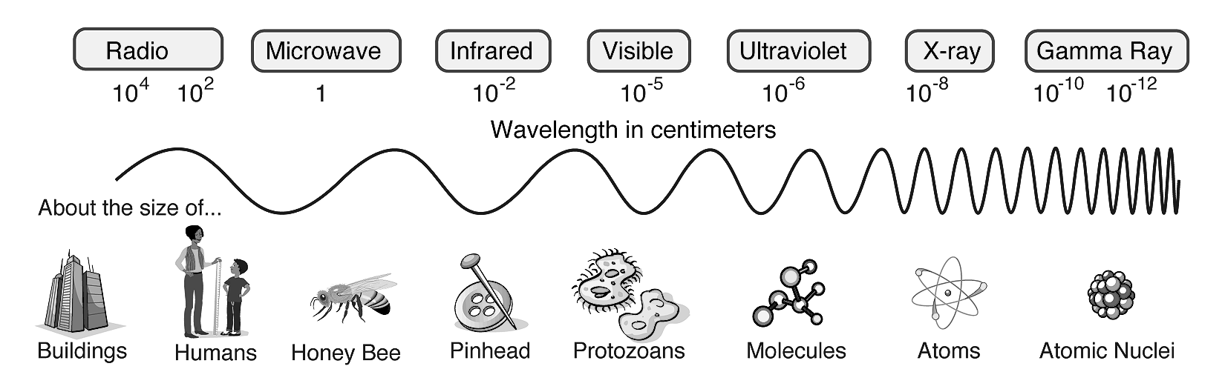
Gamma Rays
Electromagnetic wave
Decay
Shortest Wavelength

Slide 4
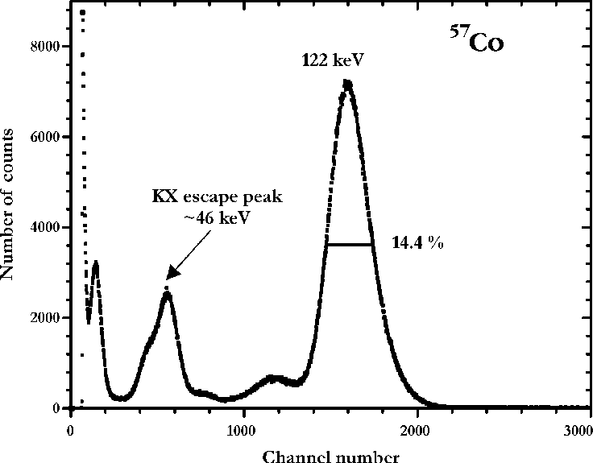
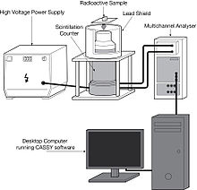
Gamma Spectroscopy
Energy Spectra
Detector
Photoelectric effect & Compton effect

Slide 5
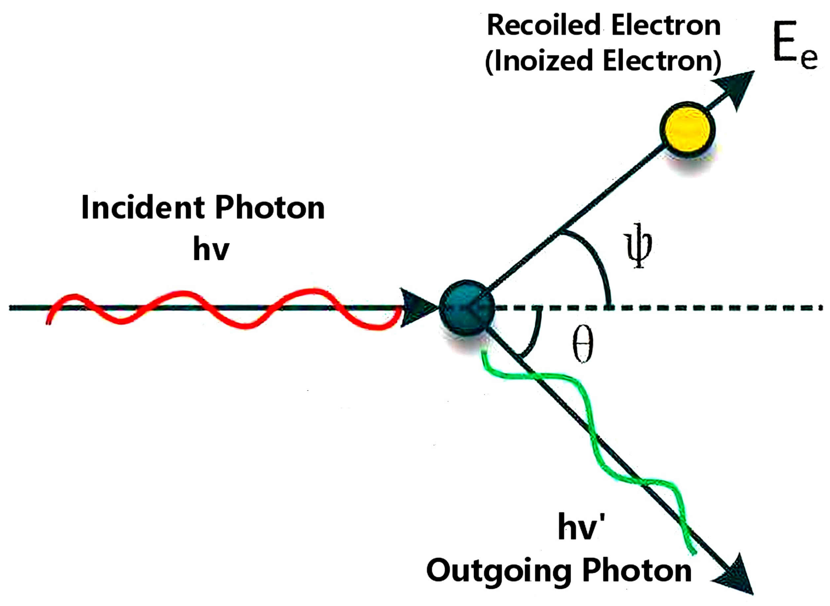
Compton Scattering
Spectrophotometry
Proton + charged particle
Energy transfer

Slide 6
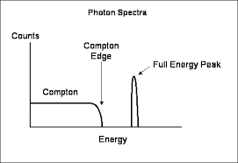
Energy
Scattering
Escape (% of energy)
Angle -> Spectrum

Slide 7
Conclusion
Determination
Energy
Interaction

Slide 8
References
https://www.sciencedirect.com/topics/medicine-and-dentistry/gamma-spectrometry
https://www.nuclear-power.com/nuclear-engineering/radiation-detection/gamma-spectroscopy/
https://en.wikipedia.org/wiki/Gamma_spectroscopy
http://atlas.physics.arizona.edu/~shupe/Physics_Courses/Phys_586_S2015_S2016_S2017/LectureSupplements/ComptonEdge.pdf
https://www.radiation-dosimetry.org/what-is-compton-edge-definition/
https://en.wikipedia.org/wiki/Compton_edge
https://www.britannica.com/science/Compton-effect

