Slide 1
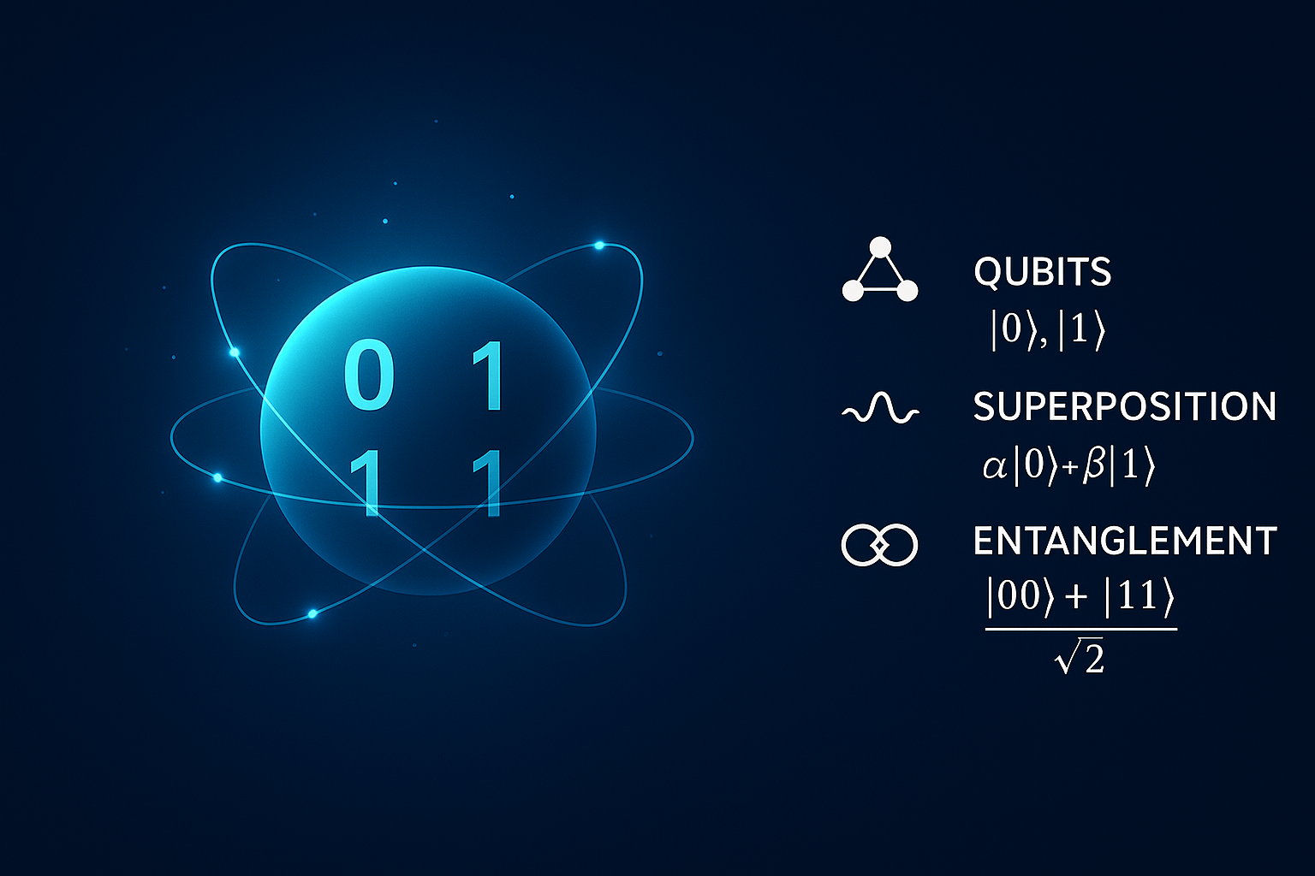
Foundations of Quantum Computing ICS 560
Dr Alawi A. Al-Saggaf
Information and Computer Science Dept.
alawi@kfupm.edu.sa
Building/Office: 22-306

Slide 2
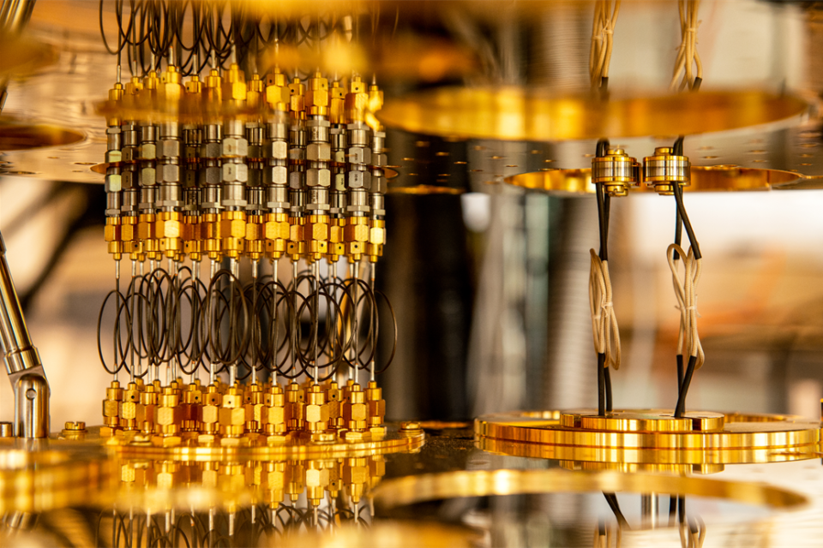
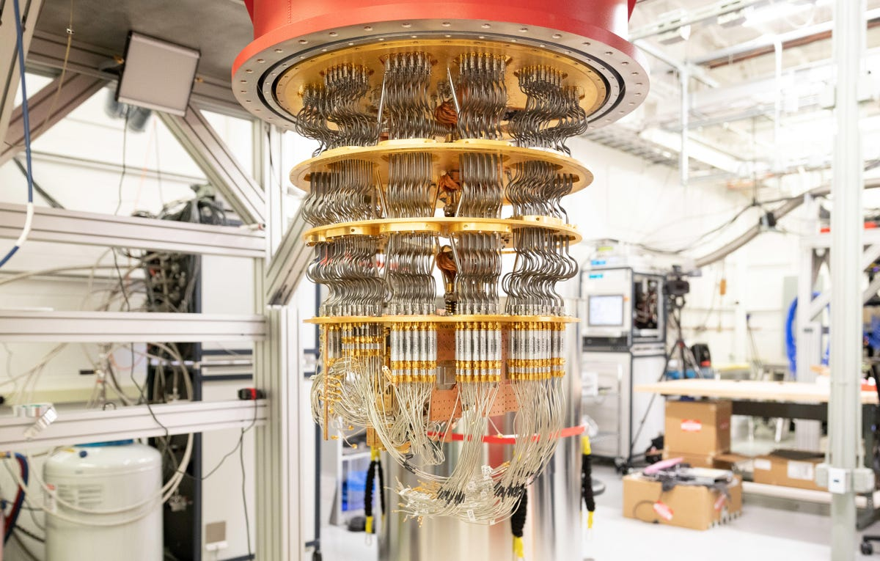
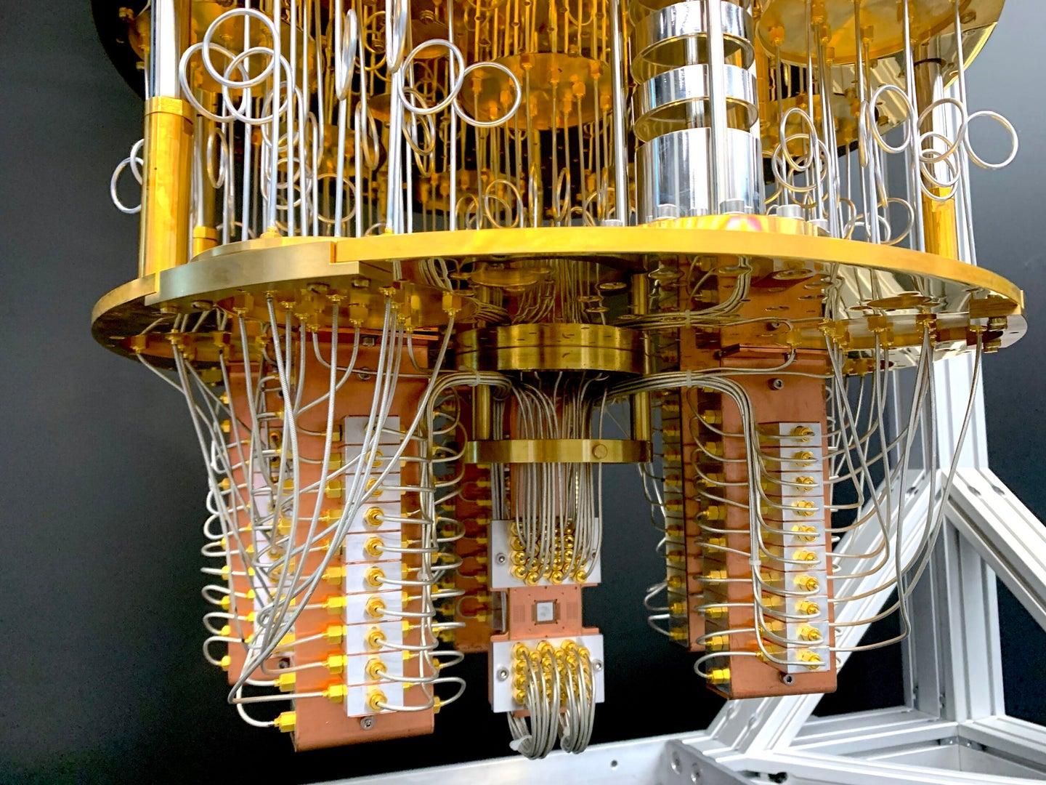
What is quantum computing?
Quantum computing is an emerging technology that uses the laws of quantum mechanics to solve problems too complex for classical computers.
Quantum Computing is the design of hardware and software that replaces Boolean logic by quantum gates at the algorithmic level.
Microsoft quantum computer
Google quantum computer
IBM quantum computer

Slide 3

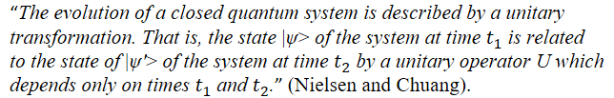
Postulates of Quantum Mechanics
Quantum physics uses quantum mechanics to explain nature.
Quantum mechanics is a mathematical language.
Quantum computers are understood through the principles of quantum mechanics.
Griffiths, David J. Introduction to Quantum Mechanics, 2nd Edition. Pearson Prentice Hall, 2005.
P1: Definition of a quantum bit, or qubit.
P2: How qubit(s) transform (Quantum Gates).

Slide 4
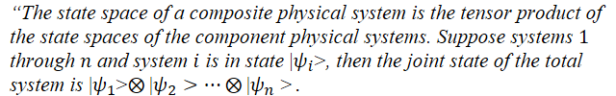
Postulates of Quantum Mechanics
P3: The effect of measurement.
P4: How qubits combine together into systems of qubits.

Slide 5
Accomplishments, future directions, and challenges
Theoretical Foundation
From Theory to Practical
Business Development
2022
433- qubit
By IBM
2025
Est. 4153 qubits predicted by IBM
2030
Est. 1000,000 qubit predicted by several companies
1982
Richard Feynman
Quantum simulator proposed
1996 Grover
Search algorithm
2001
IBM and Sandford Uni.
Implement Factoring on 7-qubit processor.
2004
First photon entanglement
2016
5-qubit quantum Comp. by IBM
2017
IBM make 50-qubit quantum available in cloud
2019
53-qubit by Google
(Google supremacy)
2021
127-qubit by IBM
1985
David Deutsch
Idea of universal quantum computer
1994
Peter Shor
Factoring algorithm

Slide 6

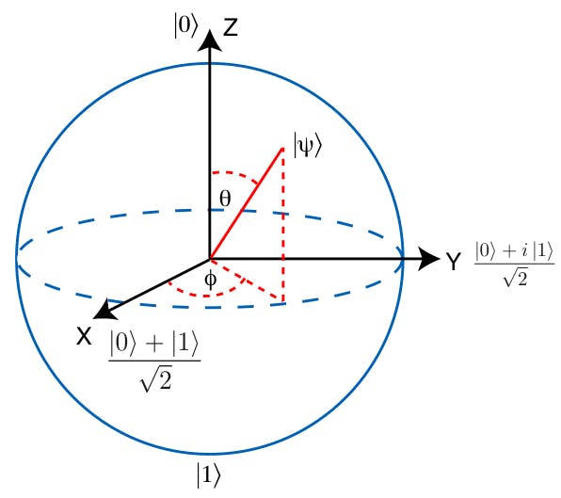
kick off a new computing era
Conventional Computer
Quantum Computer
0
1
Bit: unit of classical state 0 or 1
Basic Unit
Qubit: unit of quantum state $\left\langle 0|\right.$ and $\left\langle 1|\right.$
Qubit: unit of quantum state ⟨0|┤ and ⟨1|┤
Processing
Operations performed in parallel to superposition and entanglement
Operations
Quantum grates
Operations performed one at a time in sequence
Boolean logic gates
Binary information encoded in 0s and 1s
Representation
Superposition: qubits represent between $\left\langle 0|\right.$ and $\left\langle 1|\right.$
Superposition: qubits represent between ⟨0|┤ and ⟨1|┤
Algorithm Complexity
Exponential speedup: solves problems exponential faster
Error handling
Probabilistic: require error correction code
Polynomial time: time complexity scales polynomial with input
Deterministic: outcomes are predictable with given input

Slide 7
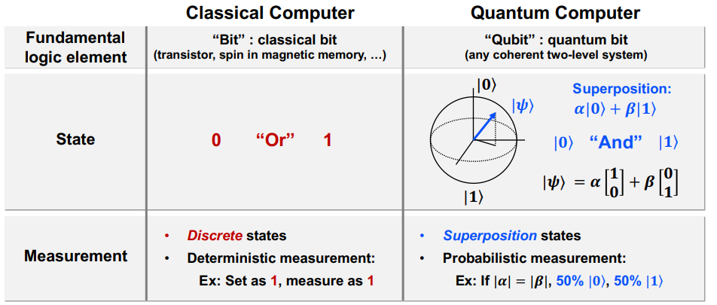
How classical and quantum computers are different?

Slide 8
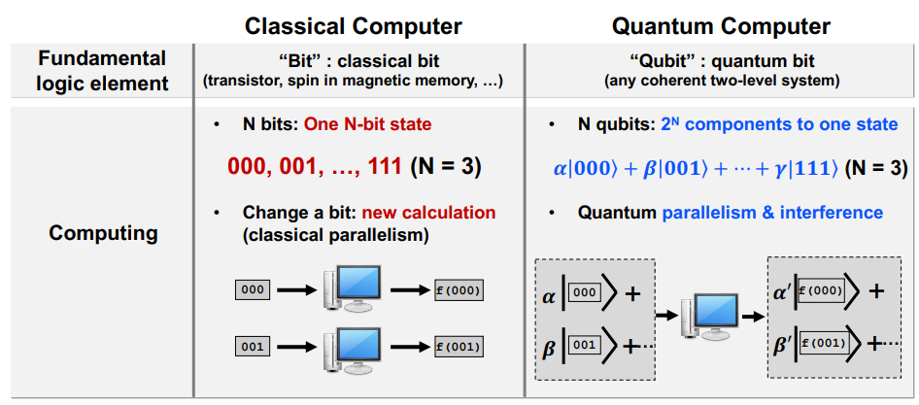
How classical and quantum computers are different?

Slide 9
ICS560 Plan
Course Description
Complex numbers and complex vector space, Hilbert Space, Number theory, Integer representation, Modular arithmetic, Primes, Deterministic and probabilistic Systems, Quantum Systems. Quantum States. Reversible and Quantum Gates. Super dense coding, Deutsch Algorithm, Deutsch-Josza Algorithm, Quantum Programing Languages, Quantum Functions Implementation.
Textbook
Yanofsky, N., & Mannucci, M. (2008). Quantum Computing for Computer Scientists. Cambridge: Cambridge University Press. doi:10.1017/CBO9780511813887
References
Thomas Wong, "Introduction to Classical and Quantum Computing“
Hiu Yung Wong, Introduction to Quantum Computing: From a Layperson to a Programmer in 30 Steps, Springer Cham, Sep. 2023.

Slide 10
Content Outlines
Week # | Date |  | Topic
1 | 25 Aug – 29 Aug |  | Review of complex numbers.
2-3 | 1 Sep – 12 Sep |  | Complex vector space and Hilbert space.
4-5 | 15 Sep – 26 Sep |  | Number theory, Integer representation, Modular arithmetic, Primes, Fermat theorem
5-6 | 29 Sep – 10 Oct |  | Deterministic and probabilistic systems, Probabilistic primality test.
7-8 | 13 Oct – 24 Oct |  | Quantum systems, Quantum states, Reversible and quantum gates.
Midterm Exam Friday – 1 November 2024
9-10 | 27 Oct- 7 Nov. |  | Quantum Circuits Simulators and Quantum programming languages (Quirk, Qiskit),
11 | 10 Nov.- 14 Nov |  | Classical and quantum oracles, Quantum speedup
12-13 | 17 Nov – 28 Nov |  | Deutsch algorithm, Deutsch-Josza algorithm, Quantum function implementation.
14-15 | 1 Dec.- 12 Dec |  | Information Entropy, Super Dense Coding.
16 |  |  | Revision
Final Exam Date will be announced by the registrar’s office

Slide 11
ICS560 Plan
Evaluation (Tentative)
Homework 15%
Quizzes 15%
Term project 20%
Midterm Exam 20% (Week 8)
Final Exam 30%

Slide 12
About Instructor
PhD in Cryptography, MSc. Mathematics.
King Fahd University of Petroleum and Minerals.
IRC- Intelligent Secure Systems Center/KFUPM.
Received Distinction Award in Instructional Technology, 2019, KFUPM
Received Best Teaching Award 2020, 2025 KFUPM
Granted a US patent “Post-Quantum Fuzzy Commitment Scheme for Biometric Template Protection”.
Filled a US patent “Quantum-Safe Passwordless Authentication: System and Method”
Research Interest: Quantum Security systems, Post-Quantum Cryptography
https://scholar.google.com/citations?user=X8gsJkEAAAAJ&hl=en

Slide 13
Lectures: Sunday and Tuesday, 17:20 -18:35
Location: Building #22-Room 120
Email: alawi@kfupm.edu.sa
Course site: Blackboard
Office hour: Monday and Wednesday, 11:00 - 12:00, (or send me on Teams and I will try to accommodate your Qs online).

Slide 14
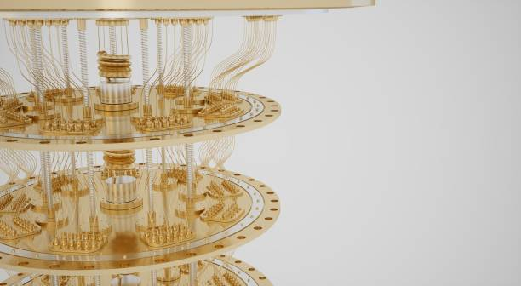
Thank you

