Slide 1



Build an AI App with Azure SQL Hyperscale, Fabric & Foundry
LAB513 · Retrieval-Augmented Generation over enterprise FAQ data
Microsoft Build 2026 · Hands-on Lab

Slide 2

Microsoft
Agenda
1
Overview & learning outcomes
2
Solution architecture & technology stack
3
End-to-end RAG workflow
4
Security & governance model
5
Deploy, cost & next steps

Slide 3
Microsoft
Lab at a glance
What you provision and build
6
2
F2
0
Guided exercises
vCore Hyperscale serverless
Fabric capacity + OneLake
Secrets — token-only auth

Slide 4
Microsoft
Three pillars
How the solution comes together
Data
AI
Analytics
Azure SQL Hyperscale — serverless vector search over FAQ embeddings.
Azure OpenAI in Foundry — gpt-5 grounded RAG and text-embedding-3-small.
Microsoft Fabric — OneLake mirroring and Power BI reporting.

Slide 5
Microsoft
End-to-end RAG workflow
1
2
3
4
5
Ingest
Embed
Retrieve
Generate
Analyze
Seed FAQ content into Azure SQL (dbo.FAQ_Content).
Generate vectors with AI_GENERATE_EMBEDDINGS (Managed Identity).
Rank nearest vectors with dbo.SearchFAQ.
Call gpt-5 with a grounded prompt for the answer.
Mirror to OneLake and report in Power BI.

Slide 6
Technology capability areas
DATA
AI
GOVERN
ANALYZE
ORCHESTRATE
Store
Ground
Protect
Report
Automate
Serverless vector search over FAQ embeddings.
gpt-5 grounded RAG with text-embedding-3-small.
Purview catalog, lineage, and Managed Identity.
Fabric OneLake mirroring and Power BI Direct Lake.
Foundry Agent calls an MCP tool over a dev tunnel.

Slide 7
Keyless security model
Authentication · This lab vs traditional
This lab — Managed Identity
Traditional — API key
What It Is
What It Is
SQL connects to Azure OpenAI using a system-assigned Managed Identity token.
SQL connects using an api-key passed in request headers.
Focus Areas
Focus Areas
disableLocalAuth=true; no keys in code, config, or secrets.
Keys must be stored, rotated, and protected from leakage.
Goals
Goals
Zero stored secrets and auditable, least-privilege access.
Works, but adds secret-management burden and risk.

Slide 8
Microsoft
Authentication comparison
Official api-key flow vs this lab’s Managed Identity
Capability | API key (official) | Managed Identity (this lab)
Embeddings (AI_GENERATE_EMBEDDINGS) | Y | Y
No secrets stored | — | Y
Chat completion (gpt-5) | Y | Y
Auditable least-privilege access | — | Y

Slide 9
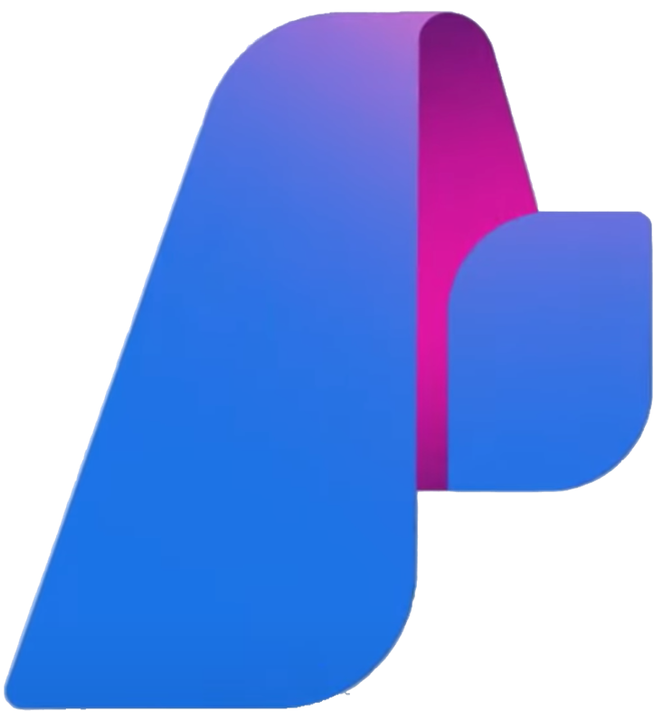
Microsoft Foundry (Azure AI Foundry)
Orchestrate with Microsoft Foundry Agents
A Foundry Agent calls an MCP tool over a dev tunnel to query Azure SQL
Exercise 04 · Agent + MCP

Slide 10
Thank you
Keep learning at aka.ms/build26-next-steps · Connect the Microsoft Learn MCP Server in VS Code

