Slide 1

HANDS-ON WORKSHOP · REAL RUN
Ship Contoso's
company profile
the agent-native way
One story, seven chapters: plan, build, review, secure and ship with GitHub.
Real run, real screenshots
ibranibeny.github.io/gh-agentic-engineering-workshop
Notes:
Welcome. In this workshop you join Contoso Technology Solutions, a fictional IT solution provider, as it moves to GitHub's agent-native engineering system. Every screenshot in the guide comes from a real run. The guide has a story mode for presenters and a developer mode with every command and file.

Slide 2
THE STORY
Kick-off at Contoso Tower
“Start with our public company profile: live on GitHub Pages, a Careers page for Lina, and Raka signs off security before anything ships.”
Daniel Wijaya, CTO
DW
LH
Daniel Wijaya
CTO, the sponsor
Lina Hartono
Chief People Officer
RN
YOU
Raka Nugroho
CISO, security gates
Dewi
You, the developer
Contoso Agent-Native Engineering Workshop
2 / 16
Notes:
Introduce the cast. Daniel wants proof that agents make Contoso faster without making it less safe. Lina brings the business request: a Careers page to hire 120 engineers. Raka is the voice of security in every chapter. The participant plays Dewi, a developer.

Slide 3
THE AGENTIC SDLC
Agents do the work, you decide
PLAN
BUILD
REVIEW
SECURE
UPDATE
SHIP
An agent
triages every
new issue
Chapter 2
Copilot
Fusion builds
the feature
Chapter 3
Copilot
reviews every
pull request
Chapter 4
CodeQL and
Autofix; push
protection
Chapter 5
Dependabot
patches
dependencies
Chapter 6
Actions
deploys; GHAS
governs
Chapters 1, 7
Every agent action lands as an issue comment, a pull request or a workflow run, so every step stays reviewable and auditable.
Contoso Agent-Native Engineering Workshop
3 / 16
Notes:
This is the loop the workshop runs. Each chapter is one stage. The developer stays in control: agents propose through issues, pull requests and runs, and humans merge.

Slide 4
THE AGENDA
Seven chapters, one story
SET UP
PLAN
BUILD
REVIEW
SECURE
UPDATE
GOVERN
1
2
3
4
5
6
7
Prepare
the repo
Agentic
workflows
Copilot
Fusion
Copilot
code review
Code
security
Dependabot
updates
Advanced
Security
20 min
45 min
30 min
25 min
35 min
30 min
20 min
205 min
hands-on across seven chapters. Plan breaks around them.
Contoso Agent-Native Engineering Workshop
4 / 16
Notes:
Seven chapters following the deck's steps. Hands-on time adds up to 205 minutes; plan for breaks. Chapters 1 and 2 are documented from the real run; chapters 3 to 7 are written from GitHub Docs and get real-run screenshots next.

Slide 5
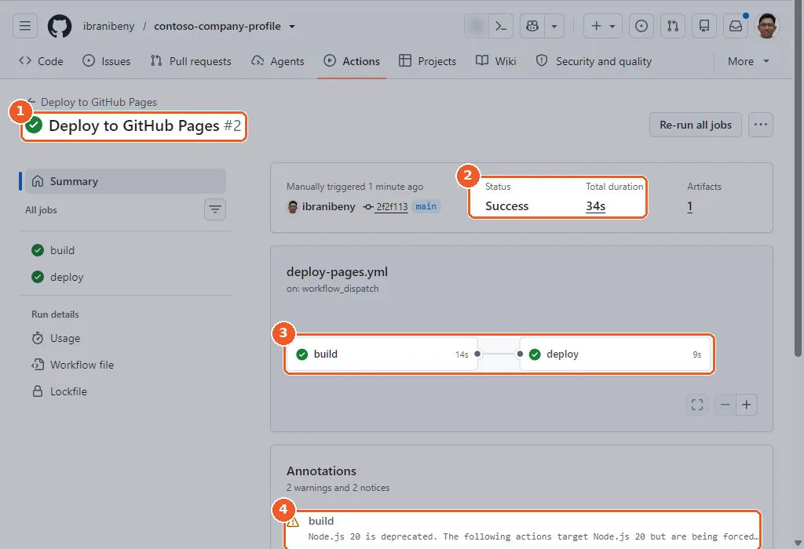
CHAPTER 1 · 20 MIN · REAL RUN
Prepare the repo and ship it
1
Use the starter template: create a new public repository
2
Settings > Pages > Source: GitHub Actions
3
Re-run Deploy to GitHub Pages: run 1 fails until Pages is on
34 s
test, build and deploy
5
pages from EJS and JSON
Contoso Agent-Native Engineering Workshop
5 / 16
Notes:
Create the repository from the template, make it public, switch Pages to GitHub Actions and re-run the deploy. The first run fails because Pages was still off when the repository was created; that is expected. The second run took 34 seconds end to end.

Slide 6
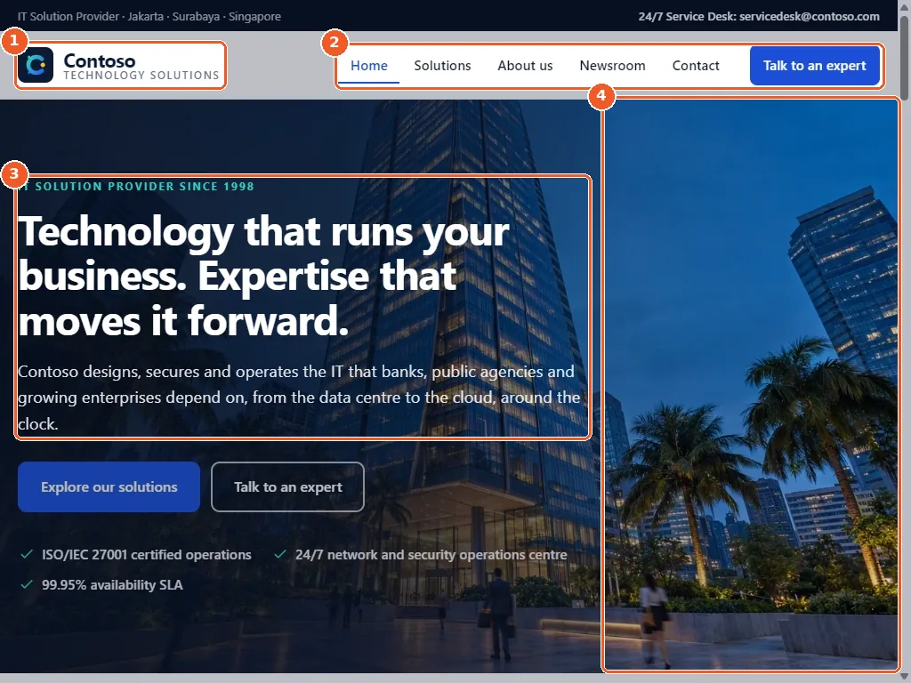
CHAPTER 1 · RESULT
Contoso is live on GitHub Pages
• An IT solution provider profile
• Home, Solutions, About, News, Contact
• All copy lives in src/data/site.json
LIVE AT
ibranibeny.github.io/contoso-company-profile
Public repository: GitHub Pages, code scanning, secret scanning and Dependabot at no cost.
Contoso Agent-Native Engineering Workshop
6 / 16
Notes:
Show the live site. Point out that content is data-driven and that a public repository unlocks GitHub's security features for free, which chapters 5 and 6 rely on.

Slide 7
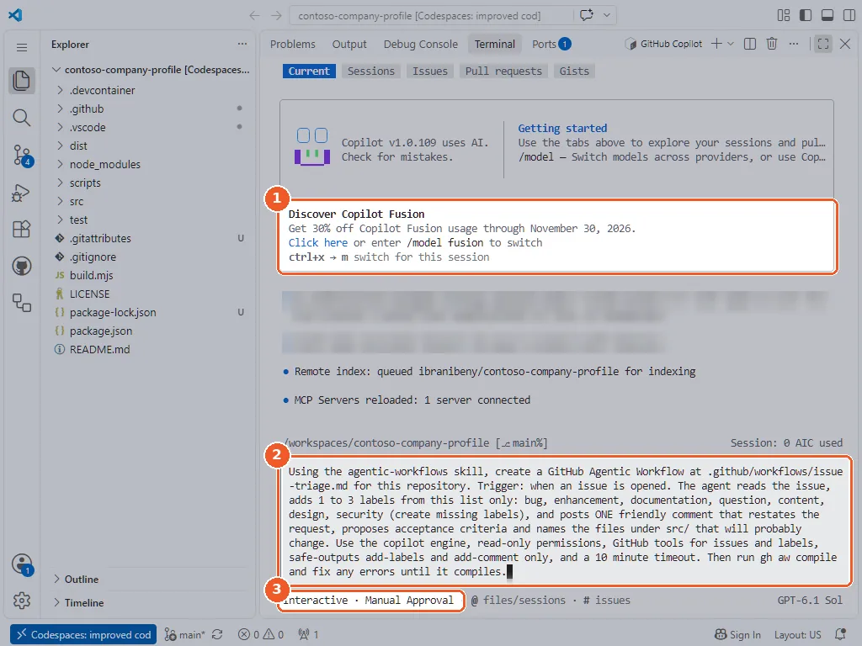
CHAPTER 2 · 45 MIN · REAL RUN
Describe the agent in plain words
1
Codespace on main; all 4 tests pass
2
Install gh-aw, run gh aw init
3
Start copilot, describe the triage agent
4
Approve each step, gh aw compile, push
80
lines of Markdown
149 KB
compiled lock file
Contoso Agent-Native Engineering Workshop
7 / 16
Notes:
The prompt reads like a ticket: trigger, allowed labels, the comment, engine, read-only permissions, safe outputs and a 10-minute timeout. Copilot loads the agentic-workflows skill, reads the official guides, writes .github/workflows/issue-triage.md and compiles it into a locked GitHub Actions workflow.

Slide 8
CHAPTER 2 · RAKA'S GUARDRAILS
Read-only agent, declared outputs
Read-only agent
Read-only permissions, tools
No direct pushes or edits
Safe outputs
Listed labels, one comment
No undeclared actions
Threat detection
A generated detection job
Injected output is stopped
Sanitised output
Safe-output processing
E-mail addresses redacted
No extra network
network.allowed: []
No calls to other endpoints
Limits
10-minute timeout, AI budget
No runaway runs or bills
Before real use: remove roles: all, so only trusted roles can start a run that spends AI credits.
Contoso Agent-Native Engineering Workshop
8 / 16
Notes:
The agent job never holds write access. Separate jobs check its output and apply only the labels and the one comment it was allowed. Copilot generated roles: all, which lets anyone who opens an issue on a public repository start a run that spends AI credits; remove it before real use.

Slide 9
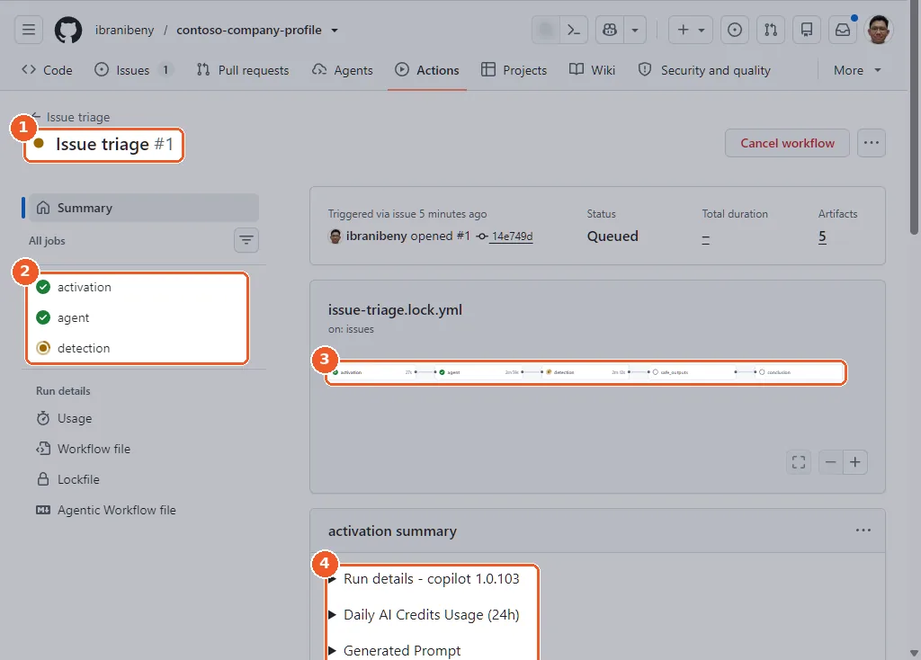
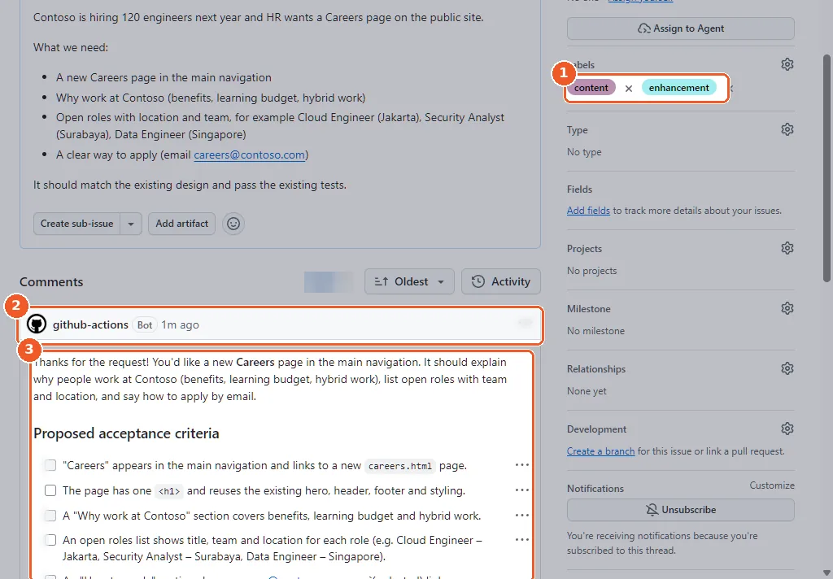
CHAPTER 2 · RESULT
HR's request, triaged in minutes
Five jobs: activation, agent, detection, safe outputs, conclusion
Two allowed labels and one scoped comment
~3 min
agent job
~13
AI credits for the run
The e-mail address in the agent's comment was redacted automatically by the safe-output sanitiser.
Contoso Agent-Native Engineering Workshop
9 / 16
Notes:
Lina files the Careers request as issue 1. The workflow runs on the issues opened event. The agent labels it and posts acceptance criteria and likely files. The e-mail address in its comment was redacted automatically. The run used about 13 AI credits.

Slide 10
CHAPTER 3 · 30 MIN · FROM GITHUB DOCS
Build the Careers page with Fusion
> /model fusion
1
Switch the Copilot CLI to Copilot Fusion
2
Hand over issue 1: its triage is the spec
EFFORT TIERS
3
Approve each diff; npm test stays green
Standard
High
Max
4
Push feature/careers-page; the PR closes issue 1
Generally available 28 Oct 2026. Billed in AI credits at the rates of the models it calls.
Contoso Agent-Native Engineering Workshop
10 / 16
Notes:
Copilot Fusion routes and combines models for the task instead of you picking one. Standard effort is enough for this feature. Your organisation's model policies decide which models it may use.

Slide 11
CHAPTER 4 · 25 MIN · FROM GITHUB DOCS
Copilot reviews every pull request
Request
Reviewers menu,
select Copilot
Read
Summary and
inline comments
Fix
Commit the
suggestions
Automate
A ruleset asks
on every PR
Balanced
default review effort
Opt-in
Copilot can approve PRs
Preview
Max effort level
Contoso Agent-Native Engineering Workshop
11 / 16
Notes:
Copilot code review reads the diff with the repository context and .github/copilot-instructions.md. By default it comments and never blocks a merge. A branch ruleset makes the review automatic for every pull request to main.

Slide 12
CHAPTER 5 · 35 MIN · FROM GITHUB DOCS
Find and fix a real XSS
// legacy widget: src/assets/js/news-search.js
const query = params.get('q');
// ...
document.getElementById('search-summary').innerHTML =
matches + ' result(s) for <strong>'
+ query + '</strong>';
CodeQL default setup
XSS alert: source to sink
Copilot Autofix PR
Merge; alert closes
Push protection even blocked our own upload of this guide while it quoted the docs' dummy token.
Contoso Agent-Native Engineering Workshop
12 / 16
Notes:
The legacy newsroom search writes the q URL parameter into innerHTML. CodeQL default setup finds it, Copilot Autofix proposes the patch, and merging closes the alert. Then show push protection: when we published this guide through the API, GitHub blocked it because the page contained the dummy token from the docs tutorial.

Slide 13
CHAPTER 6 · 30 MIN · FROM GITHUB DOCS
Patch dependencies automatically
# .github/dependabot.yml
version: 2
updates:
- package-ecosystem: "npm"
directory: "/"
schedule:
interval: "weekly"
groups:
npm-dependencies:
patterns: ["*"]
- package-ecosystem: "github-actions"
directory: "/"
schedule:
interval: "weekly"
groups:
github-actions:
patterns: ["*"]
ejs 3.1.6
ejs ≥ 3.1.10
pinned in the starter
fixes both advisories
CVE-2022-29078: template injection, fixed in 3.1.7
CVE-2024-33883: prototype pollution, fixed in 3.1.10
The grouped GitHub Actions update also retires the Node.js 20 warnings from Chapter 1.
Contoso Agent-Native Engineering Workshop
13 / 16
Notes:
Turn on Dependabot alerts and security updates. Dependabot raises an alert for ejs 3.1.6 and opens a pull request to a patched version. Add dependabot.yml so npm packages and workflow actions stay current every week.

Slide 14
CHAPTER 7 · 20 MIN
Free on public, licensed on private
USD 19
per active committer / month
GitHub Secret Protection
Secret scanning, push
protection, custom patterns,
delegated bypass
USD 30
per active committer / month
GitHub Code Security
CodeQL, Copilot Autofix,
AI scan (preview), security
campaigns
Included
on every plan
Dependabot
Alerts, security updates
and version updates for
npm and Actions
Public repositories get secret scanning, push protection, code scanning and Autofix at no cost. Both products need GitHub Team or GitHub Enterprise.
Prices: USD list price per active committer per month (GitHub Changelog, 4 March 2025)
14 / 16
Notes:
Map what participants used to what Contoso would license for private repositories. Prices are list prices per active committer per month; confirm current pricing with the GitHub account team.

Slide 15
SECURITY COMPARISON
Who finds what, and when
Copilot
code review
FINDS
Bugs and rule
breaks in a PR
RUNS WHEN
On request or
by ruleset
COST
Copilot plan,
AI credits
CodeQL
code scanning
FINDS
Vulnerabilities
by data flow
RUNS WHEN
Push, PR and
weekly
COST
Free on public;
Code Security
Copilot
Autofix
FINDS
A patch for
each alert
RUNS WHEN
PR alerts;
Generate fix
COST
Free on public;
Code Security
Secret
scanning
FINDS
Leaked
credentials
RUNS WHEN
Every push,
edit, upload
COST
Free on public;
Secret Protection
Dependabot
alerts, PRs
FINDS
Vulnerable
dependencies
RUNS WHEN
New advisories;
on a schedule
COST
Included on
every plan
Copilot code review is a reviewer. The scanners are gates you can enforce.
Contoso Agent-Native Engineering Workshop
15 / 16
Notes:
Copilot code review is broad and conversational but never a gate on its own. CodeQL, secret scanning and Dependabot are detectors with stable rules that rulesets can enforce. Autofix and Dependabot updates turn detections into ready-to-merge fixes.

Slide 16

SIGN-OFF
One playbook
for every team
WORKSHOP GUIDE
ibranibeny.github.io/gh-agentic-engineering-workshop
STARTER TEMPLATE
github.com/ibranibeny/contoso-company-profile-starter
LIVE CONTOSO SITE
ibranibeny.github.io/contoso-company-profile
Notes:
Wrap up: in seven chapters Contoso went from a template to a deployed, reviewed and secured site, with an audit trail in GitHub for every step. Share the guide and the starter template.

