Slide 1

Riding the Demand: Insights for a Bike-Share PM
09/28/2025
A Data Analysis to give Insights PM, Operations, and Marketing Teams
BY Ibrahima Diallo

Slide 2
Key Takeaway: Commuter demand drives bike-share usage, especially during weekday peaks and good weather. Strategic scheduling, marketing, and feature rollouts should target these high-value windows while ensuring equity across rider types.

Slide 3
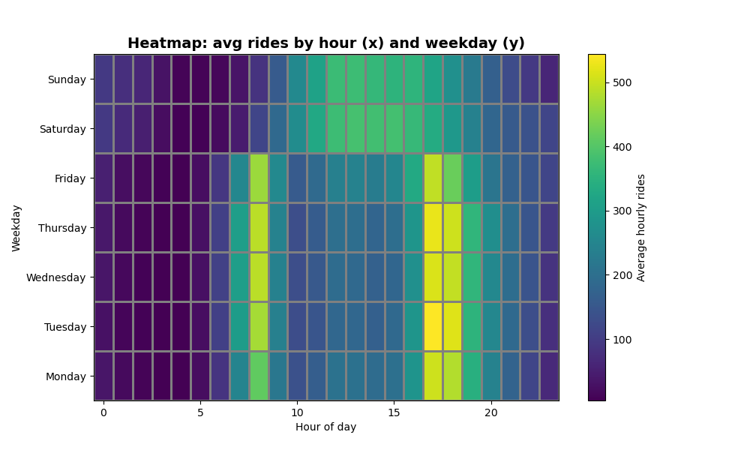
Data Overview & EDA Highlights
Dataset: Hourly bike-share data
Key EDA Findings:
Strong commuter peaks at 8–9 AM and 5–7 PM.
Weather matters: clear/misty days see much higher demand.
Stakeholder Relevance:
PM: user patterns
Ops: staffing windows
Marketing: promo timing

Slide 4
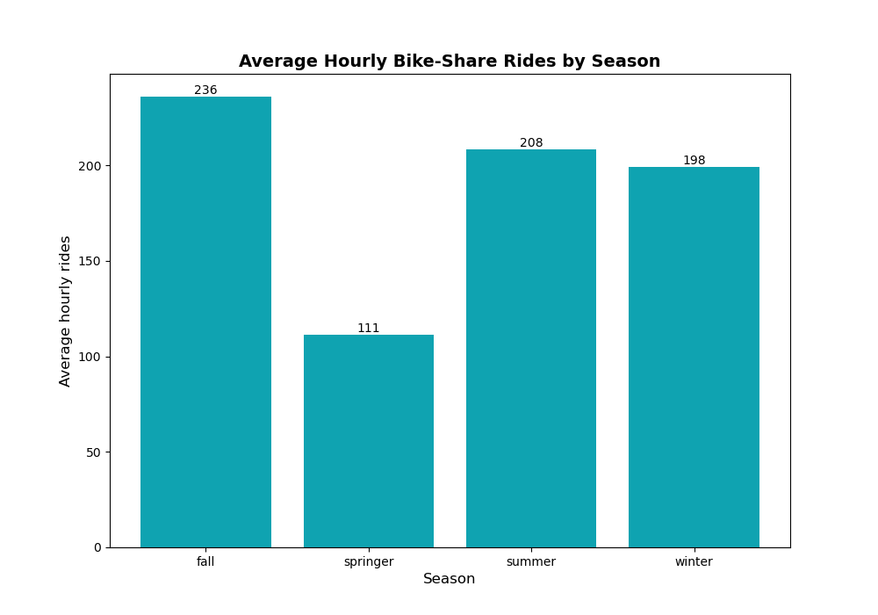
Seasonality
Demand is highest in summer/fall, but lowest in spring.
Marketing team to should target peak season to do marketing campaign and promotion to get more riders.

Slide 5
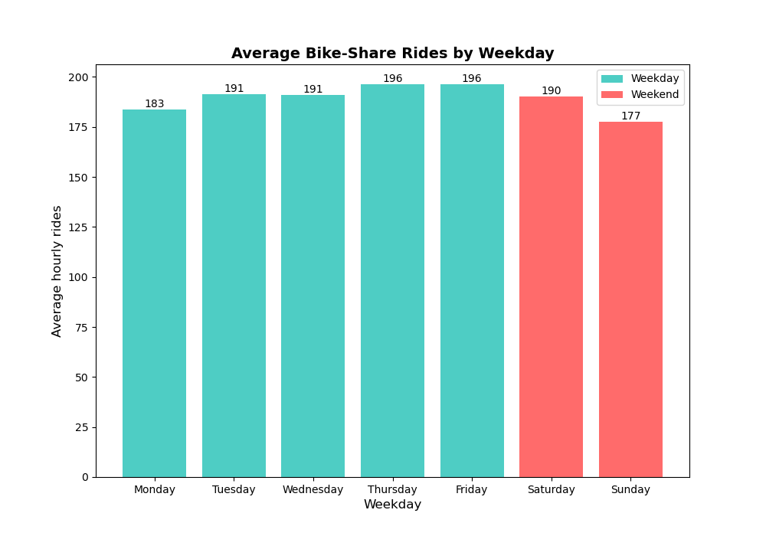
Hypothesis Testing Results
Q1 (Working vs. Non-working Days):
Welch’s t-test, α = 0.05 to prevent getting false positive
Result: p < 0.001, CI ≈ [+20, +40] rides/hour → significant
Q2 (Seasonal Differences):
ANOVA (F ≈ 50, p < 0.001)
Tukey HSD → winter significantly lower than summer/fall
Conclusion:
Clear demand gaps across weekdays and seasons → informs staffing & pricing.

Slide 6
A/B Test Result (Commuter-hour Focus)
Objective: Test feature’s impact on commuter-hour rides (17–19h).
Result:
t ≈ -1.56, p = 0.12 → not statistically significant at α = 0.05
Mean difference ≈ +6 rides/hour
CI: [−0.2, +12.4]
Decision: Statistically inconclusive, but practically meaningful.
Recommendation: Further testing with a larger sample size to over a longer period may be needed to detect smaller but practically meaningful effects.

Slide 7
Top 3 Trends/Insights
Seasonality: Summer/fall peaks, winter lows. plan staffing on peak period & maintenance in low traffic.
Commuter Peaks: Morning & evening. align marketing & feature rollouts during that window frame
Weather Sensitivity: Clear/mild weather drives demand, marketing team should target promo.
Ethical Considerations
Equity Risks: Over-focusing on commuters risks neglecting casual/weekend riders.
Observational Data: May include confounding factors (events, holidays).
Assumptions: Normality/variance may not fully hold, even we used a robust test
Recommendations
Product Manager: Prioritize feature experiments for 17:00–19:00 on working days, highest absolute demand, and most predictable commuting window. Consider micro-experiments to do some promotion to reward registered riders and prevent hurting customer retention.
Operation: Rebalance before 17:00 and schedule peak staffing around 16:30–18:30.
Marketing: Time promotions on weekdays in late afternoon/early evening for registered riders; use messaging that favors registered users if retention is a goal.

