Slide 1
BPE & WordPiece
Building two engines of modern language models, from scratch.
Ibrar · Dayo · Lama
Supervisor: Marie Candito — M1, Université Paris Cité
1
Notes:
IBRAR opens. Good morning. We were asked to build two of the engines inside modern language models — the tokenizers BPE and WordPiece — from scratch, and to compare them scientifically. I'll cover the algorithms, Dayo will cover the experiments, and Lama will cover what we learned. Pause on the title.

Slide 2
IBRAR
THE TASK
A computer only
understands numbers.
Before a model can read “the cats are running,” that sentence must become a list of numbers. The question that defines everything: what should one token be?
2
Notes:
IBRAR. The starting problem: a neural network only understands numbers. So the very first job is to cut text into units and number them. The whole field comes down to one question — what should a token be? Don't rush this slide; it frames everything.

Slide 3
IBRAR
THE IDEA
Three ways to cut text
Characters
Words
Subwords
T · h · e
running
un · break · ability
Never fails, but far too granular. Meaning is buried in detail.
Intuitive, but language is infinite. Unknown words break it.
The Goldilocks zone. Reusable pieces that never run out.
3
Notes:
IBRAR. Three ways to choose a token. Characters: never fails, but too granular — the model drowns in detail. Words: intuitive, but language is infinite, so unknown words break it (the OOV problem). Subwords: the Goldilocks zone — reusable pieces. 'unbreakability' becomes un + break + ability. This is what BPE and WordPiece do.

Slide 4
IBRAR
HOW IT WORKS
Two phases
01
Training
Read a large corpus once and learn the vocabulary of pieces. Slow, done a single time.
02
Tokenizing
Apply that vocabulary to new text, cutting each word into known pieces. Fast, runs constantly.
4
Notes:
IBRAR. One distinction before the algorithms: training (done once, learns the vocabulary) versus tokenizing (runs on every sentence, applies it). Keep them separate in your mind.

Slide 5
IBRAR
ALGORITHM ONE
BPE
Byte Pair Encoding — used by GPT, RoBERTa
The rule: merge the most frequent adjacent pair.
e · s → es es · t → est
Step by step, common pairs grow into longer, reusable pieces. The order of merges is saved.
5
Notes:
IBRAR. BPE's rule is beautifully simple: merge the most frequent adjacent pair, over and over. Start from characters, glue the commonest pair, repeat. It records the order of merges, which makes tokenizing perfectly reproducible. Walk through the es → est example.

Slide 6
IBRAR
ALGORITHM TWO
WordPiece
Used by BERT, DistilBERT
score = freq(AB) / ( freq(A) × freq(B) )
It rewards pairs that appear together more than expected — informative pairs, not just frequent ones. This one idea is why the two algorithms diverge.
6
Notes:
IBRAR. WordPiece looks similar but chooses differently. Instead of frequency it uses a score: frequency of the pair divided by the frequency of each piece. The denominator punishes pairs whose halves are each already common. So WordPiece prefers INFORMATIVE pairs, not merely frequent ones. This single difference explains everything Dayo will show. Give the 'de' vs 'qu' intuition.

Slide 7
IBRAR
HANDLING AMBIGUITY
“there” = ?
BPE
Replays its merge rules in the exact order learned. One possible outcome, always.
WordPiece
Greedy longest-match: take the longest piece that fits, then continue.
Ties broken alphabetically — so naive and fast make identical choices.
7
Notes:
IBRAR. Tokenizing isn't always unambiguous. 'there' could split several ways. BPE resolves it by replaying merges in their learned order. WordPiece resolves it by greedy longest-match. And in training, ties are broken alphabetically so our naive and fast versions always agree. Then hand to Dayo.

Slide 8
Experiments
Five questions, one corpus: German Wikipedia.
8
Notes:
DAYO takes over here. I ran the experiments. We trained both algorithms, in naive and fast forms, on German Wikipedia — chosen because German morphology is rich. Five experiments follow.

Slide 9
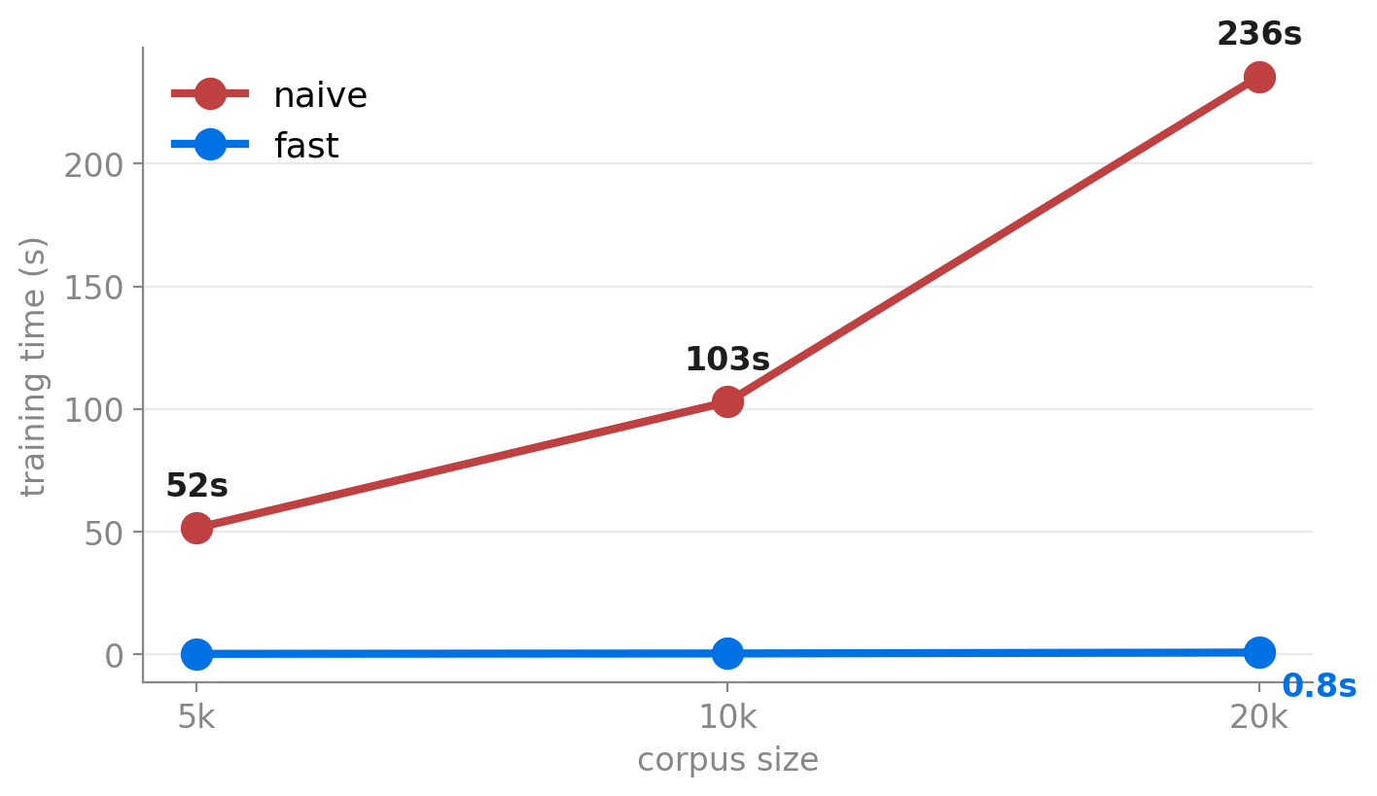
DAYO
EXPERIMENT 1 · SPEED
Fast stays flat.
235s
naive WordPiece at 20k words
0.8s
fast WordPiece, same task
9
Notes:
DAYO. Experiment one: does the fast version matter? Yes, dramatically. As the corpus grows, naive WordPiece climbs to almost four minutes; fast stays under a second. The point isn't a single speed-up number — it's the SHAPE: naive grows with the data, fast stays flat.

Slide 10
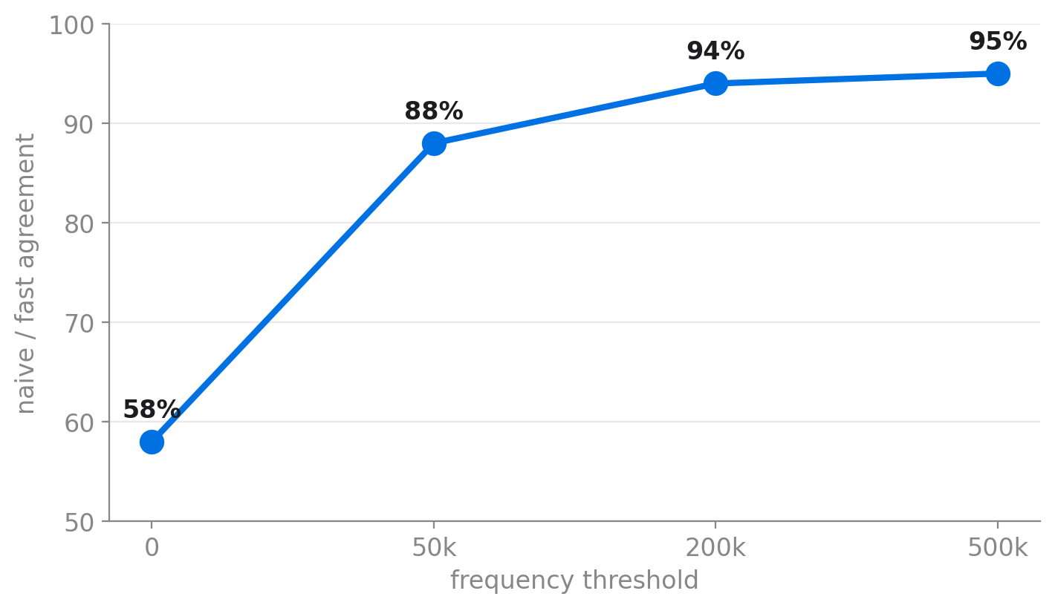
DAYO
EXPERIMENT 2 · THRESHOLD
A quality–quantity trade-off.
A frequency threshold cleans up junk merges and lifts naive/fast agreement to 95%.
But set it too high and the vocabulary saturates — it stops growing before the target size.
10
Notes:
DAYO. WordPiece's score over-rewards very rare pairs, making junk merges. A frequency threshold fixes that and raises naive/fast agreement from 58 to 95 percent. But it's a trade-off: too high a threshold starves the vocabulary, which saturates below the size we asked for. Quality versus quantity.

Slide 11
DAYO
EXPERIMENT 3–4 · LENGTH & COST
Fewer tokens, cheaper model.
Attention cost grows with the square of the token count (n × n).
7
25
~10×
BPE tokens / sentence
WordPiece tokens / sentence
larger attention matrix
11
Notes:
DAYO. Why does token count matter? Attention builds an n-by-n matrix, so cost grows with the square of the number of tokens. Because un-tuned WordPiece produces about three times more tokens than BPE, it implies an attention matrix up to ten times larger. Tokenizer choice is an efficiency lever, not just preprocessing.

Slide 12
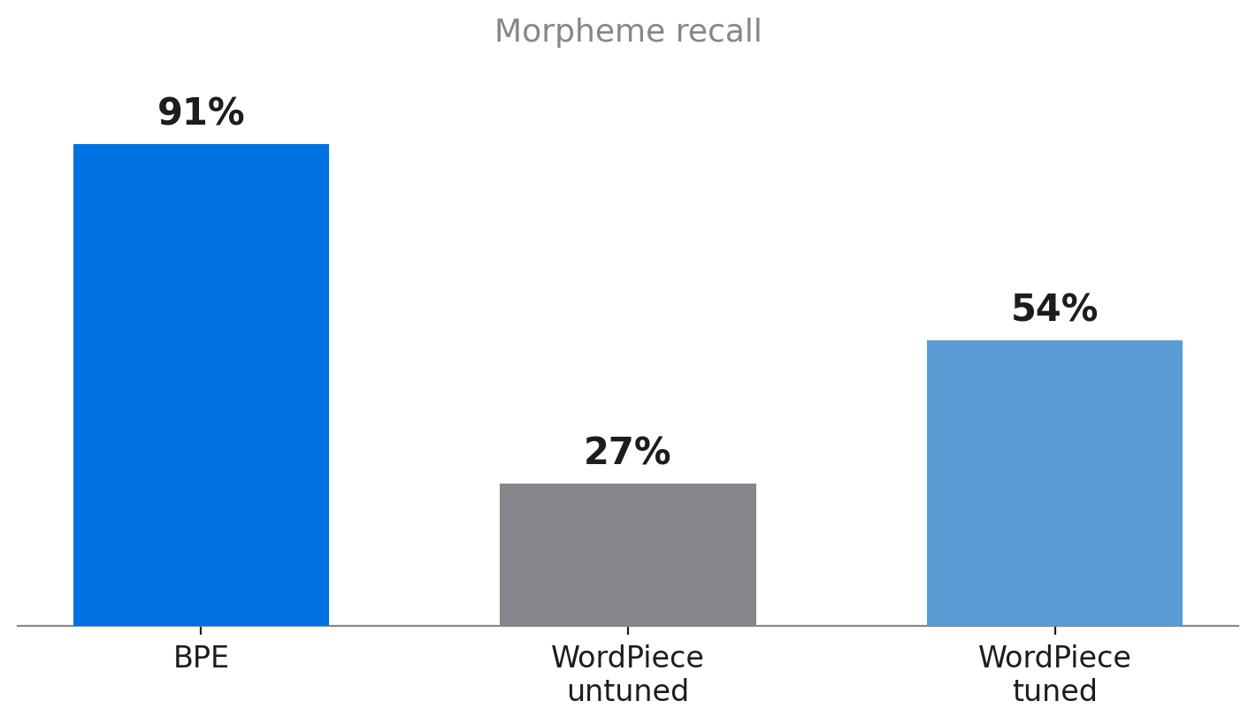
DAYO
EXPERIMENT 5 · MORPHOLOGY
BPE aligns with morphology — for free.
BPE’s frequency merging happens to land on morpheme boundaries.
WordPiece needs the threshold to approach it — and only by accepting a smaller, saturated vocabulary.
An independent tool, spaCy, confirms the same gap.
12
Notes:
DAYO. The core finding. We compared each algorithm's splits to a German morphological gold standard. BPE recalls 91% of morphemes with NO tuning — its frequency merging happens to align with morphology. Un-tuned WordPiece only 27%. The threshold doubles it to ~52%, but only by saturating the vocabulary. And crucially — if asked — we cross-checked this against spaCy, an automatic tool the brief suggested: it agreed completely (BPE 0.62 vs WordPiece 0.14, and 2/3 vs 0/3 on root consistency). Two independent methods agreeing means the finding is real. BPE gets good morphology for free; WordPiece has to be tuned for it.

Slide 13
DAYO
SCIENTIFIC HONESTY
We found our own bugs.
The stale-heap bug
Fast WordPiece discarded valid pairs from its queue instead of re-checking them. We had mistaken it for a finding. Fixed.
The threshold saturation
A fixed frequency threshold starves the vocabulary. Documented as a real trade-off, not hidden.
Diagnosed with Claude, cross-checked against HuggingFace documentation.
13
Notes:
DAYO. We're transparent about the road. We found a real bug — our fast WordPiece discarded valid candidate pairs from its queue, which we'd wrongly called a 'finding.' We fixed it. We also found the threshold saturation. We documented both, with provenance: diagnosed with help from Claude, cross-checked against HuggingFace docs. Then hand to Lama.

Slide 14
LAMA
SYNTHESIS
What we learned
1
Speed is structural
Fast implementations turn training time that grows with the data into time that stays nearly constant.
2
They optimise different things
BPE maximises frequency; WordPiece maximises informativeness. That single difference explains every result.
3
BPE wins morphology for free
On German, frequency merging lands on morpheme boundaries; WordPiece must be tuned to approach it.
14
Notes:
LAMA takes over for the synthesis. Three things we learned. One: the fast versions turn linear training time into near-constant time. Two: the two algorithms differ because they optimise different things — frequency versus informativeness. Three: on German, BPE aligns with morphology for free; WordPiece must be tuned for it.

Slide 15
LAMA
HONEST LIMITS
Where it breaks
Small gold standard — though cross-checked against spaCy, which agreed.
Modest vocabulary sizes next to BERT’s 30,000.
The inflection test (trink-) defeats both algorithms.
These methods are statistical, not linguistic — they learn patterns that sometimes coincide with morphemes.
15
Notes:
LAMA. Honest limits. Our gold standard is small and hand-built. Our vocabularies are small next to production tokenizers like BERT's 30k. And the inflection test — trinke, trinkst, getrunken — defeats BOTH algorithms: neither isolates the shared root. That's the real boundary of statistical tokenization: it learns patterns, not linguistics.

Slide 16
We built the engines,
and learned from the friction.
Thank you.
Questions · live demo on request
16
Notes:
LAMA closes. We built both engines from scratch, made them fast, and compared them honestly. We learned the most from the difficulties — a bug that taught us why WordPiece is hard to optimise, a fix that revealed a trade-off, and a test that showed the limits of both. Thank you — we're happy to take questions, and to demo the code.

