Slide 1
Survey Best Practices for Social Science Researchers
Lauren M. Conoscenti, Ph.D.
June 5, 2015

Slide 2
Introductions
Name
Institution
Have you administered/designed surveys before?
Do you use an online survey tool? Which one?

Slide 3
Agenda
Preparing your survey
Guiding questions
IRB
Sampling
Survey delivery methods
Writing good questions
Survey design and aesthetics
Evaluating your survey
Implementation
Managing your survey
Response rates
Incentives
Reminders
After your survey
Taking down your survey
Reporting
If time permits:
Qualtrics Demo

Slide 4
Preparing your survey: Guiding Questions
Guiding Questions

Slide 5
Preparing your survey: Guiding Questions
Before worrying about design:
What exactly do I want to know?
What do I want to learn from the survey?
Why do I want to know this information?
How will I use the information?

Slide 6
Preparing your survey: Guiding Questions
Clear research question and purpose
Survey should collect good data
Good data = truthful, reflective of reality (or as close to this as possible)
Survey should not burden participants
Burden = unnecessary effort = bad data!
Do not collect data “because it’s interesting.”

Slide 7
Preparing your survey: Guiding Questions
Clear research questions also make it easier for you to collect and analyze data. Consider:
I want to know something about whether or not students are happy with campus life at Tufts.
versus
I want to know if students are satisfied with the extracurricular opportunities at Tufts.

Slide 8
Preparing your survey: Guiding Questions
Not all research questions demand surveys
Is the data already available?
Common Data Set
IPEDS
Data warehouse/Student information system
Past surveys
Talk to your Office of Institutional Research!

Slide 9
Preparing your survey: Guiding Questions
Not all research questions demand surveys
What about focus groups or interviews?
Can allow a more nuanced insight into a research question
Can build rapport with participants, more personal
More effective for people for whom surveys may pose a challenge (e.g. non-native English speakers, individuals with dyslexia)

Slide 10
Preparing your survey: Institutional Review Board
IRB

Slide 11
Preparing your survey: Institutional Review Board
Institutional Review Board (IRB) developed in response to research abuse
Federally mandated and regulated
Different kinds of reviews
Exempt – your project is not technically research, does not need a review.
Expedited – your project poses minimal risk, can be reviewed by a subset of the IRB committee
Full – your project poses more than minimal risk, must be reviewed by entire IRB committee

Slide 12

Preparing your survey: Institutional Review Board
Will guide you to ensure your research is ethical
Contact your IRB before you plan to launch your survey – do not wait until the last minute!
Although some research is exempt from review, a full or even expedited review can take months.
Only when you have received approval can you conduct your research.

Slide 13
Preparing your survey: Who to survey?
Sampling

Slide 14
Preparing your survey: Who to survey?
Population: people in the world who match a certain description (e.g. women, ages 18-25)
Sample: a subset of the population, assumed to be a proxy for the entire population, invited to do the survey (e.g., 200 women, ages 18-25, from Tufts University)
Participants: the people who actually do the survey (e.g., 126 women, ages 18.4-23.8, from Tufts University)

Slide 15
Preparing your survey: Who to survey?
population
sample
participants

Slide 16
Preparing your survey: Who to survey?
Ideally, a survey’s participants represent the sample and the population
If your population is 50% female, your sample should be 50% and your participants should be 50% female.
If it is not, your results may be biased.
Bias: a pattern of response that differs from the “norm” in a specific way
Multiple kinds of bias, not always a death sentence
If we know about it in advance, may be able to correct for it
(We don’t always know if our findings are biased)

Slide 17
Preparing your survey: Who to survey?
What is your population?
Students?
Undergraduate and/or graduate? FT only? Specific majors?
Faculty?
Tenure Track? Teaching faculty only? Grant-funded?
Staff?
Only those who have email addresses? Temps?
Alumni?
Young alumni?
Be as specific as you can be!

Slide 18
Preparing your survey: Who to survey?
Who is in your sample?
Sometimes the sample is the population – you send the survey to all people in the population.
Not always cost-effective, can lead to other problems
Selecting a subset of the population:
Probability samples
Non-probability samples

Slide 19

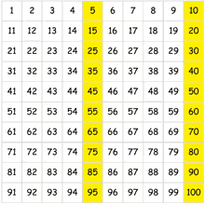
Preparing your survey: Who to survey?
Probability sampling: When everyone in the population has the same chance of being selected
Simple random sample: “picking from a hat”
Systematic Selection: apply a systematic method, e.g., going down a list and selecting every 5th person.

Slide 20
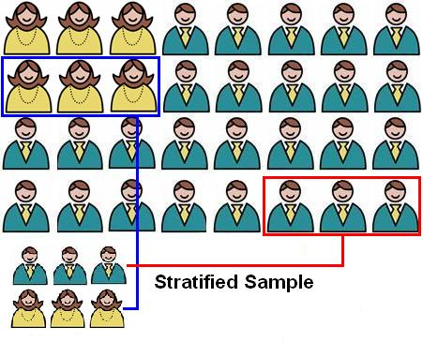
Preparing your survey: Who to survey?
Non-probability sampling: When not everyone has the same chance at being selected.
May introduce sampling bias…but sometimes it is necessary
Stratified sample: Sampling from different subpopulations at different rates (e.g. population is 20% female, you want sample to be 50% female)

Slide 21
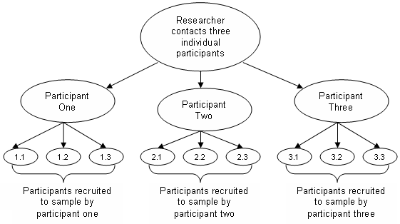
Preparing your survey: Who to survey?
Snowball sampling: existing participants recruit other participants, “refer a friend!”

Slide 22
Preparing your survey: Who to survey?
Who are your respondents?
We can’t control who does the survey and who does not.
Response rate: The number of people who do the survey, compared to the number of people invited to do the survey
The higher the better… but high response rates are rare
Lots of things you can do to improve the response rate (we’ll cover them today ☺)

Slide 23

Preparing your survey: Who to survey?
Nonresponse bias: When survey responders differ from nonresponders in key ways, leading us to draw erroneous conclusions.
Course evaluations = only those who attend last class, usually the most motivated students
= most and least satisfied customers
Online surveys = only those who check their email regularly

Slide 24
Preparing your survey: Who to survey?
1936 Literary Digest case: who will you vote for in the upcoming presidential election?
Sent 10 million surveys
Literary Digest predicted Alf Landon would win, with 57% of the vote.

Slide 25
Preparing your survey: Who to survey?
1936 Literary Digest case: who will you vote for in the upcoming presidential election?
Sent 10 million surveys
Literary Digest predicted Alf Landon would win, with 57% of the vote.
Actual results: FDR won, with 63% of the vote.

Slide 26

Preparing your survey: Who to survey?
WHAT WENT WRONG???

Slide 27

Preparing your survey: Who to survey?
Sample drawn from telephone directories, club memberships, magazine subscription lists…

Slide 28
Preparing your survey: Who to survey?
Sample drawn from telephone directories, club memberships, magazine subscription lists…
…all of which were luxuries during the Great Depression. Only wealthier citizens could afford to get the survey!

Slide 29
Preparing your survey: Who to survey?
Sample = 10 million
Respondents = 2.4 million
Seems like a lot of people, but…

Slide 30
Preparing your survey: Who to survey?
Sample = 10 million
Respondents = 2.4 million
Seems like a lot of people, but…
Response rate = 24% (low)
Maybe the people who did not take the survey thought it was junk mail, had no time, were undecided, did not want to share their opinion…

Slide 31
Preparing your survey: Who to survey?
Sample was not representative of the population!
Respondents were not representative of the sample or the population!
Survey failed to accurately predict election outcome.
Classic example of bias impacting research

Slide 32
Preparing your survey: Survey delivery methods
Survey Delivery Methods

Slide 33
Preparing your survey: Survey delivery methods
What is the most appropriate method to choose for a particular research question?
What is the impact of a particular method of data collection on survey bias and costs?

Slide 34

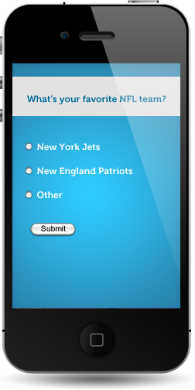
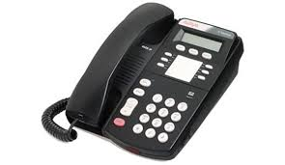


Preparing your survey: Survey delivery methods
In-person
Phone
Mail
Online
Survey apps

Slide 35
Preparing your survey: In-person surveys
Researcher interacts directly with participant
Goes to a place where qualified participants are likely to be found, solicits participation, and administers survey on the spot.
Schedules interviews
Questions can be asked orally, or can present respondent with paper survey.
Can also make observations about respondents.

Slide 36
Preparing your survey: In-person surveys
Pros:
Higher response rates; decreases the number of “Don’t knows” and “No answers”
Can access hard-to-reach populations (e.g. senior citizens)
Can be done in a variety of settings
Can involve all 5 senses (e.g. taste test)
Cons:
More expensive and time consuming
Interviewer error
Can be complex

Slide 37
Preparing your survey: Telephone surveys
Interviewers ask the questions orally over the phone, respondents’ answers are recorded
Pros:
Higher response rates; decreases the number of “Don’t knows” and “No answers”
Lower cost and less time than in-person interviews
Can be computer-assisted
Cons:
Unlisted numbers
Cell phones
Telemarketing ruined it for everyone

Slide 38
Preparing your survey: Mail surveys
Questionnaire is accompanied by a letter of explanation and a self-addressed, stamped envelope for returning the questionnaire
Follow-up mailing
Three mailings (1 original, 2 follow-ups) are the norm
Follow-up can be a postcard
2-3 weeks in between mailings

Slide 39
Preparing your survey: Mail surveys
Pros:
Large samples
Cheaper than interviews
Respondent does survey on own time
Cons
More expensive than online
Low response rates
Illegible answers!

Slide 40
Preparing your survey: Online surveys
Potential respondents will receive an email asking them to go to a web link where the survey resides
Options for design and administration vary according to platform

Slide 41
Preparing your survey: Online surveys
Pros:
Inexpensive, least time-consuming
Automatic data entry
Can easily merge with additional data
Cons:
Lower response rates than in-person
Respondents must have access to computer, use an email address
Technical errors

Slide 42
Preparing your survey: Survey apps
Survey apps
Newest survey research format
Respondent downloads an app to their mobile device
App prompts them to provide data – ask a single question or directs to an entire survey
Can do surveys without an internet connection
…but unclear how these fundamentally differ from online surveys
Data security concerns

Slide 43
Preparing your survey: Writing good questions
Writing Good Survey Questions

Slide 44
Preparing your survey: Writing good questions
Good questions → good data
Bad questions → bad data
When respondents do not understand the question or its purpose, they:
Drop out of the survey
Try to guess what the question is asking, and respond to that
Select random answers
(All bad data!)

Slide 45
Preparing your survey: Writing good questions
Good questions start with proper English!
Spelling, grammar, punctuation
Rate your favorite ice cream, brands.
…what???

Slide 46

Preparing your survey: Writing good questions

Slide 47
Preparing your survey: Writing good questions
Good questions start with proper English!
Spelling, grammar, punctuation
Rate your favorite ice cream, brands.
Clear, short prompts
Tell us about the preferred flavor of ice cream you desire.
…huh?

Slide 48
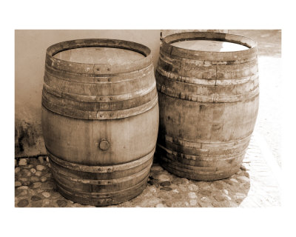
Preparing your survey: Writing good questions
Double-barreled questions: ask about multiple things in a single question
How satisfied are you with the ice cream flavors and toppings at JP Licks?
…What if I am satisfied with flavors but not toppings?

Slide 49

Preparing your survey: Writing good questions
Extra, unnecessary cognitive effort → bad data!
Your participants should not need a doctorate to decipher your survey.

Slide 50
Preparing your survey: Writing good questions
Make the questions as specific as possible
Vague questions = bad data (or at the very least, data that is difficult to analyze)
Use words that virtually all respondents will understand
Limit jargon or definitions
If your respondents may speak another language, have options available for translation

Slide 51
Preparing your survey: Fixed-choice vs. Open-ended questions
Fixed-choice vs. open-ended questions
Fixed-choice:
Which flavor of ice cream is your favorite?
Chocolate
Vanilla
Strawberry
Open-ended:
Which flavor of ice cream is your favorite?

Slide 52
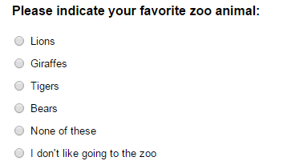
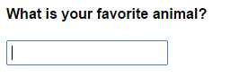
Preparing your survey: Fixed-choice vs. Open-ended questions
Fixed-choice:
Open-ended:

Slide 53
Preparing your survey: Fixed-choice vs. Open-ended questions
Fixed-Choice Questions
Pros:
Easier data collection
Easier data analysis
Best approach for large populations
A variety of ways to ask questions
Cons:
Must include all reasonable possibilities or you may not get at participant’s true feelings/thoughts

Slide 54
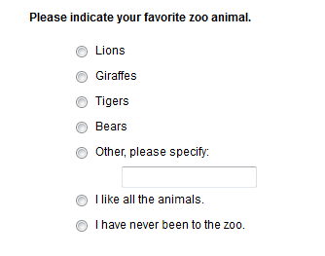
Preparing your survey: Fixed-choice vs. Open-ended questions
Fixed-Choice Questions: Tips
Randomizing the order of choices can reduce bias – most online programs have a randomizer.
A write-in box allows you to collect data about things you didn’t think to include in your list.
Have an option so people who are unable to answer the question because it does not apply to them can still provide a response.

Slide 55
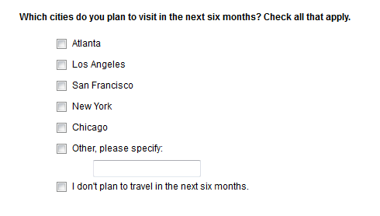
Preparing your survey: Fixed-choice vs. Open-ended questions
Fixed-Choice Questions: Tips
“Check all that apply” allows greater flexibility for the respondent.
Most online programs allow you to “make answer exclusive” – if you check this, you can’t check the other boxes.

Slide 56
Preparing your survey: Fixed-choice vs. Open-ended questions
Open-Ended Questions
Pros:
Offers flexibility and freedom in responding
Rich, interesting data
Cons:
Time-consuming
Coding a challenge
Vague or irrelevant responses

Slide 57
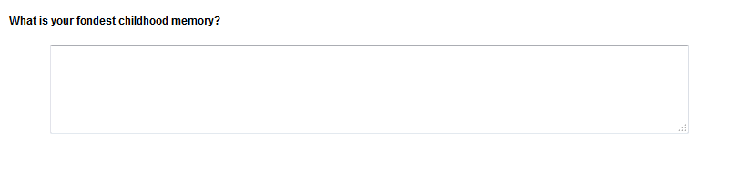
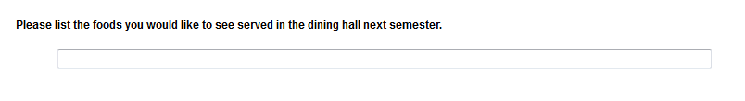
Preparing your survey: Fixed-choice vs. Open-ended questions
Open-ended Questions: Tips
Size open-ended text boxes appropriately. They cue the respondent as to how much you expect them to write.

Slide 58
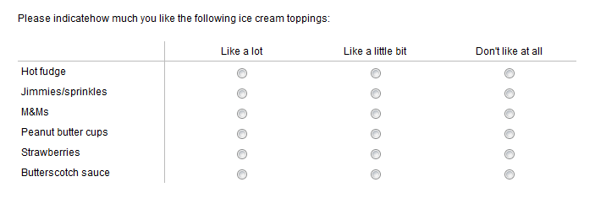
Preparing your survey: Matrix questions
Matrix Questions:

Slide 59
Preparing your survey: Matrix questions
Pros:
Items use the same scale
A time-saver for the researcher and respondent
Can save space
Cons:
Can become visually overwhelming with too many prompts
Scale points must be identical

Slide 60
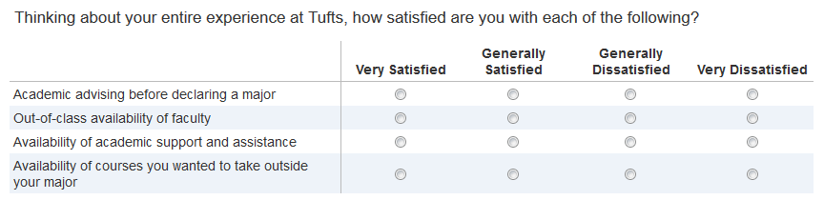
Preparing your survey: Matrix questions
Matrix Questions: Tips
It doesn’t really matter what points you put at which ends of the scale – as long as you are consistent for every question.
Either end of the scale can go here. We could put “Very Dissatisfied” at this end, but we put “Very Satisfied” there instead. Now, all questions in this survey must have “Very Satisfied” at the left end.

Slide 61
Preparing your survey: Matrix questions
Matrix Questions: Tips
Label every scale point!

Slide 62
Preparing your survey: Matrix questions
How many scale points?
It depends on what you’re measuring and who you’re sampling.
Generally, 5-7 is recommended…
I find 4-5 to be adequate and 7 to be overwhelming.
Be sure the scale matches the question
If you ask, “Are you satisfied…” the scale points should reflect satisfaction.

Slide 63
Preparing your survey: Matrix questions
Neutral options can be a “cop out” choice
If you want the respondent to state their opinion, do not give a neutral option!
Neutral options may be interpreted as “does not apply to me”
Give the respondent a “does not apply” option or program your survey so it only shows question to relevant participants

Slide 64
Preparing your survey: Other questions
Lots of other question formats…
…but fixed-choice, open-ended questions, and matrix questions used most often
Don’t use too many question types in a single survey
Keep in mind survey aesthetics…

Slide 65
Preparing your survey: Survey aesthetics
Survey Design and Aesthetics

Slide 66
Preparing your survey: Survey aesthetics
Simplest way to encourage participation in a survey is to make it look simple!
Survey length is important
Focus group: undergrads don’t want to spend more than 10-15 minutes doing a survey
Can’t always control how long the survey is (topic-dependent)
But you can make sure each question MUST be on the survey
Delete duplicates or vague questions
Employ skip logic or display logic so respondents see only relevant items

Slide 67

Preparing your survey: Survey aesthetics
Skip logic: instructions (either on paper or programmed) that direct a respondent to a particular question based on their answer to a previous item.
1. Are you wearing pants?
Yes
No → skip to Question 4 (“Are you wearing a skirt?”)

Slide 68
Preparing your survey: Survey aesthetics
Display logic: Programming your survey so that questions are displayed to respondents only if they meet a set of predetermined criteria.
Predetermined criteria may be:
Responses to one or more earlier items e.g., “If yes to Q1 and no to Q2 and yes to Q3: show Q4” (Can’t do this with skip logic!)
Data associated with your panel e.g. All freshmen see Q1, all sophomores see Q2, all juniors see Q3.

Slide 69
Preparing your survey: Survey aesthetics
Display logic: 1. Are you wearing a shirt? Yes No 2. Are you wearing shoes? Yes No 3. Are you attempting to get service? Yes No 4. Are you able to get service? Yes No
Question 4 ONLY appears if respondent answers “No” to Q1, “No” to Q2, and “Yes” to Q3.

Slide 70
Preparing your survey: Survey aesthetics
Display logic: Database:
 | Shirt? | Shoes? | Attempting to get service?
Person 1 | Yes | Yes | No
Person 2 | No | Yes | Yes
Person 3 | No | No | Yes
Person 4 | Yes | No | No
Person 5 | Yes | No | Yes
Person 6 | Yes | Yes | Yes
Person 7 | No | No | No
If “Shoes?” = No and If “Shirt?” = No and If “Attempting to get service?” = Yes” THEN
Display Question: “Are you able to get service?”

Slide 71
Preparing your survey: Survey aesthetics
Display logic: Database:
 | Shirt? | Shoes? | Attempting to get service?
Person 1 | Yes | Yes | No
Person 2 | No | Yes | Yes
Person 3 | No | No | Yes
Person 4 | Yes | No | No
Person 5 | Yes | No | Yes
Person 6 | Yes | Yes | Yes
Person 7 | No | No | No
If “Shoes?” = No and If “Shirt?” = No and If “Attempting to get service?” = Yes” THEN
Display Question: “Are you able to get service?”
Only Person 3 sees the Question.

Slide 72
Preparing your survey: Survey aesthetics
Skip logic and display logic improve survey aesthetics…
…but they help minimize data errors as well. Tufts Senior Survey: Do you use these services (library, dining, maintenance, etc.)? How satisfied are you with the services you use?
Using display logic: fewer data errors if people are only permitted rate the services they indicate they use

Slide 73
Preparing your survey: Survey aesthetics
Look at the survey! Preview it on multiple devices.
A cluttered, busy survey = cognitive load = nonresponse “Ugh, there’s so much here… It’ll take me forever to do this survey… it’s not worth my time.”
Things to consider:
Do you have to scroll down or across on the average laptop screen?
Break up long pages into bite sized chunks.
More pages is ok – just use a “survey progress” bar.

Slide 74
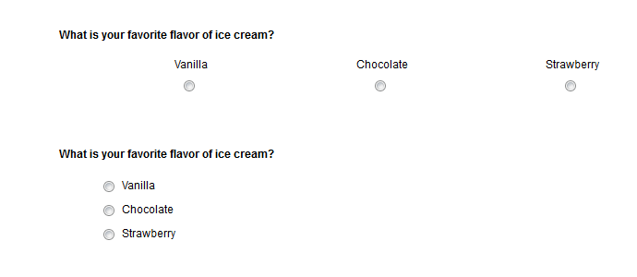
Preparing your survey: Survey aesthetics
Does the eye have to track horizontally across the entire screen to read an item?
List down, not across

Slide 75
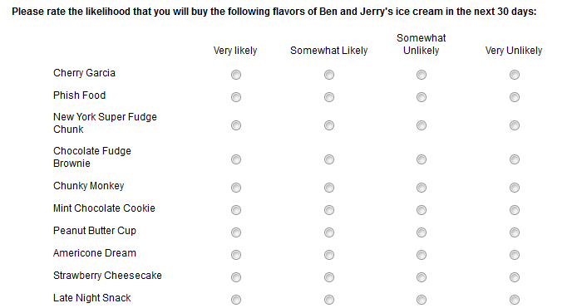
Preparing your survey: Survey aesthetics
Are your matrix questions walls of text?

Slide 76
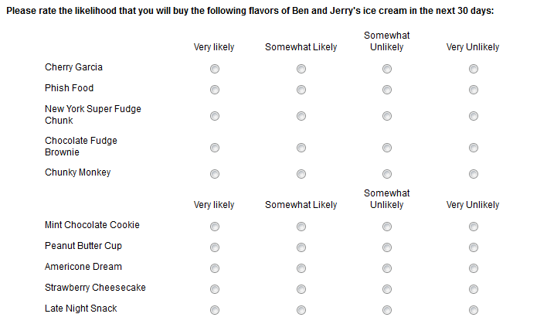
Preparing your survey: Survey aesthetics
Repeat your headers to visually break things up

Slide 77
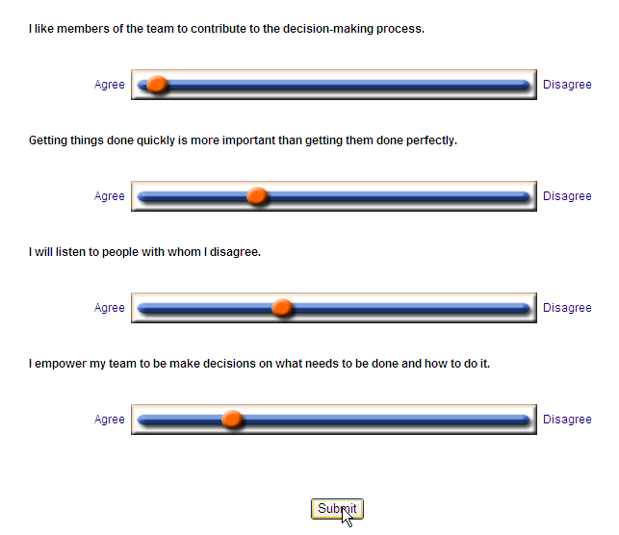
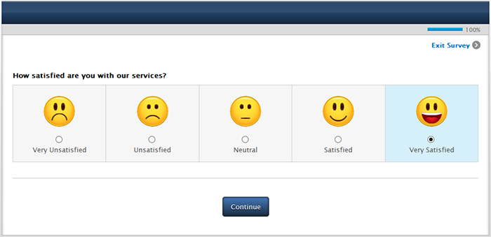
Preparing your survey: Survey aesthetics
Do you have bells and whistles in your survey? (e.g. sliders, heat maps, animations)
Format your survey to avoid them (if at all possible)
Distracting! Annoying!
May not work on all devices

Slide 78
Preparing your survey: Evaluating your survey
Evaluating Your Survey

Slide 79
Preparing your survey: Evaluating your survey
Always test your survey! (and test, and test again, and test some more)
Circulate it to friends/colleagues
If possible, pilot it with people from the population you plan to research
Does the survey make sense?
Can people understand what you’re asking?
Do the response options make sense?
Is the survey sufficiently transparent, or is the purpose unclear?

Slide 80
Preparing your survey: Evaluating your survey
Are you measuring what you think you are measuring?
Validity in testing is too big to cover here… but here’s an idea of what you should consider:
Face validity: what does the survey look like it’s measuring?
Construct validity: what is it actually measuring?
Content validity: does it represent all facets of the thing you are trying to measure?

Slide 81
Preparing your survey: Evaluating your survey
Does the survey look ok?
Are all the scales similar (highest rating is on the same side for all items)?
Is it overwhelming or cluttered anywhere?
For online surveys:
Does the skip logic and display logic work?
What does the data look like when it is downloaded? Is it easy to interpret and manipulate?

Slide 82
Survey Implementation
Implementing Your Survey

Slide 83
Survey Implementation: Invitations
Invitations to do the survey are a “first impression”
Saying the wrong thing can drive people away!
People like a personal touch – use this to your advantage
Paper or online surveys: Address each respondent by his/her name, if possible
In-person or phone surveys: Err on the side of being overly formal. “Sir”, “Ms.”, “Dr.”, etc.

Slide 84
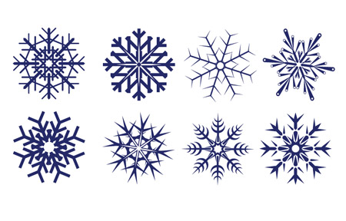
Survey Implementation: Invitations
People also like to feel special – use this to your advantage
“You have been selected…”
“We chose you for this project…”
“We hope you can share your opinion, we want to know what you think…”

Slide 85
Survey Implementation: Invitations
People also like to feel special – use this to your advantage
“You have been selected…”
“We chose you for this project…”
“We hope you can share your opinion, we want to know what you think…”
Yes, it sounds cheesy, but consider the alternative.
“We sent this to everyone, and we are only really interested in averages.”

Slide 86
Survey Implementation: Invitations
Include key information:
Survey aim
Time it takes to complete the survey (under 15 minutes is key!)
Deadline, if any
Incentive (more on this soon)
If using an online survey, don’t forget the link!
Keep it short! 1-2 paragraphs, tops.

Slide 87
Survey Implementation: Invitations
Dear Lauren,
You have been selected to participate in the Tufts Ice Cream Survey! The purpose of this survey is to learn more about ice cream preferences so we can stock the Jumbo Scoop Shop with your favorites.
This survey should take just 5 minutes of your time. At the end of the survey you can enter to win unlimited ice cream for a year! Please complete the survey by December 1.
http://www.scoopshopsurvey.com
If you have questions, contact Katia Miller (katia.miller@tufts.edu). Thank you for your time!
--Jumbo Scoop Shop

Slide 88
Implementation: Distribution
Be thoughtful about when and how you distribute your survey
Consider the calendar: holidays, alumni giving cycles, exam periods, vacations
Survey fatigue – are other surveys circulating?
Sensitivity matters – consider the context.
A light-hearted survey about ice cream flavors should probably not be circulated the same day as a memorial service.

Slide 89
Implementation: Online survey distribution
Anonymous Link
Pros:
Good for sensitive topics
Can be distributed widely and publicly
Cons:
Potential for duplicated data
Includes both accidental and deliberate duplication
Survey panel
Pros
Tracks responses, can target reminders more effectively
Cons
Data security

Slide 90
Survey Management
Managing Your Survey

Slide 91
Managing your survey: Response Rates
A high response rate…
Improve representativeness of sample
Provides more diverse opinions, better data
Protects against nonresponse error
A low response rate…
May or may not be bad
If the respondents are similar to the sample and population, maybe it’s ok

Slide 92
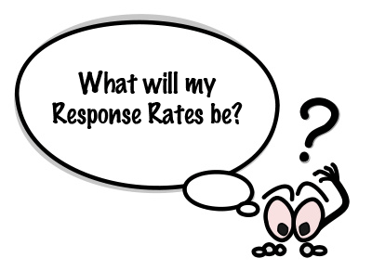
Managing your survey: Response Rates

Slide 93
Managing your survey: Response Rates
What is a good response rate?
What is your expected response rate?
Depends on the survey, the population, and the incentive
In-person = highest response rate
20%-35% for a 10-minute online survey
Be realistic, don’t over-promise

Slide 94

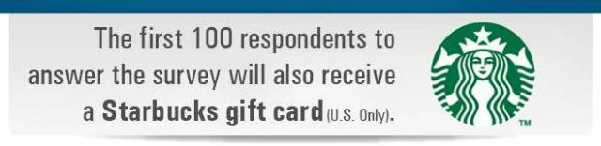

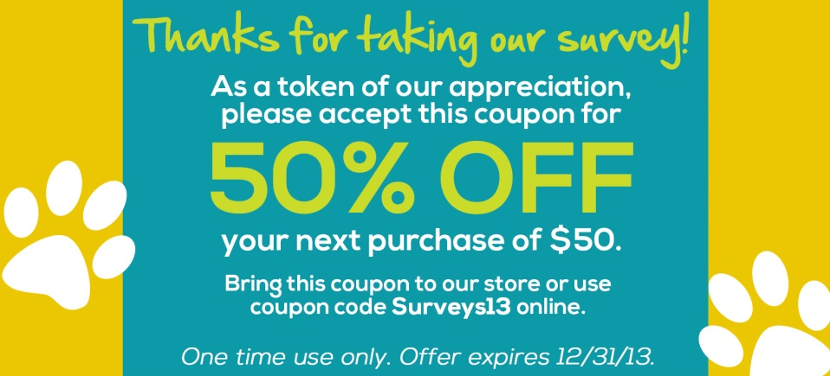

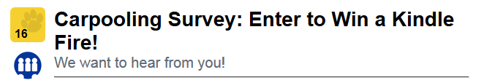
Managing your survey: Incentives

Slide 95
Managing your survey: Incentives
Incentives increase response rates
Which incentives work best?
It depends on…
Your population
Your budget
Your survey methods
Guaranteed small incentives > Raffles
Be creative
Does not have to be expensive or flashy

Slide 96
Managing your survey: Incentives
$5 JumboCash
Coupon for coffee at campus coffee shop
Dinner with the President at dining hall
$3 toward printing at library
Free tickets to campus concert
VIP seating for a high-profile campus speaker
Tufts sweatshirt
Gift cards for local eateries (burritos, ice cream)

Slide 97
Managing your survey: Reminders
Reminders
Participation drops steeply after a few days for online surveys
Usually after just 48 hours!

Slide 98
Managing your survey: Reminders

Slide 99
Managing your survey: Reminders
Reminders
Participation drops steeply after a few days for online surveys
Usually after just 48 hours!
Mail surveys will show a similar pattern, just delayed
Reminders are highly recommended
Generally, 2 reminders is appropriate
Timing will depend on the survey

Slide 100
Managing your survey: Reminders
Online surveys:
Can email reminders…but be careful about duplicates
Reminders are easier when using survey panels
Mail surveys
Send postcards or new copies of survey
Keep track of returned mail
Depending on population, may wish to phone potential respondents to see if they need help

Slide 101
Data Analysis and More
After Your Survey…

Slide 102
Data Analysis and More: Taking down data
Create a data dictionary
What are the variable names? What are the values?
Online surveys:
Deactivate!!
Download data into Excel, SPSS, SAS, etc.
Paper-and-pencil surveys:
Enter data in Excel, SPSS, SAS, etc. by hand
Double-entering data will help you catch errors with data entry, even if more time consuming

Slide 103
Data Analysis and More: Data Cleaning
Clean your data…
Run descriptive statistics to…
Identify impossible values
How many hours of community service? 10,000,000 hours…
Look for outliers in the data
How much student debt? Most respondents report $50,000, but a few report $200,000… not impossible.
Look for patterns that may indicate errors
Maybe skip logic was faulty or coding was not correct?

Slide 104
Data Analysis and More: Data Cleaning
Clean your data…
Identify duplicated data (e.g. two entries from same person)
Remove people who clicked through the survey, provided no usable data
Transform your data for statistical analysis
Recoding variables
Reducing data from multiple items into composite scores
Other statistical transformations, depending on analyses you intend to conduct

Slide 105
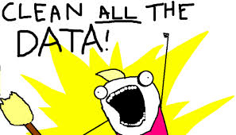
Data Analysis and More: Data Cleaning
Clean your data…
…but ALWAYS keep your original data saved!
(You never know what you’ll need later!)

Slide 106
Data Analysis and More: Missing data
Most surveys will have missing data somewhere
Respondents do not answer question
Question voluntarily or accidentally skipped
Question not shown to/asked of respondent
Respondents provide data, but it is bad data
How many hours of community service? 10,000,000…
Respondents discontinue survey
Survey attrition: can look at patterns to figure out if there is a “trigger” – perhaps a confusing question or overwhelming page…

Slide 107

Data Analysis and More: Missing data
Missing data can be very harmful
Can contribute to nonresponse error
Those who answer questions are different than those who do not…
…and ultimately poor decision-making.

Slide 108
After your survey: Missing data
First, examine patterns of missing data
Is the missing data random? Or is there a pattern of any kind?
Are some questions routinely skipped? (e.g., question asking students to evaluate a service that is rarely used)
Do many respondents drop out of the survey after or before the same item?
Do some kinds of respondents routinely skip some questions? (e.g., men don’t answer questions about the women’s center)
Sort your data to explore patterns of missing data more carefully

Slide 109
After your survey: Missing data
There may be reasons why…
Two-sided paper survey
Very sensitive question, people don’t want to answer
Question is not relevant to respondent in ways you hadn’t previously considered
Question or survey instructions are unclear
Online survey not programmed correctly
…and sometimes, it’s just random.

Slide 110
Data Analysis and More: Missing data
Decide what you want to do about missing data
This will largely depend on the data and how you plan to analyze it
Common approaches
Listwise deletion – delete the entire row of data
Decreases statistical power in reporting
Leave blank – but report your n for the item
Enter the survey average for the item
Enter a random value

Slide 111
Data Analysis and More: Data analysis
Analytic strategy (statistics) will depend on…
…your research question
…your data
…the recipient of analysis
…your statistical expertise
…your expertise with relevant statistical software (SPSS is Tufts’ tool of choice)
Don’t be afraid to ask for help – the wrong statistical approach can lead to the wrong conclusions.

Slide 112
Data Analysis and More: Data analysis
Descriptive statistics: analyses that describe the data as it is (e.g., mean, median, standard deviation)
What is the temperature? What flavors of ice cream do we have? How much ice cream do we have at different points in time?
Inferential statistics: analyses that make statements about relationships between variables
Do variables change relative to other variables?
As the temperature increases, the ice cream melts.
Are there differences between variables?
Does chocolate ice cream melt faster than vanilla ice cream?
Can some variables predict the outcome of another variable?
Can we predict the rate of melting based on the temperature and flavor of ice cream?

Slide 113
Data Analysis and More: Data analysis
Sometimes, your analytical approach matches the research question you set out to answer…
…and sometimes, you come up with new questions.
…or the data indicate new questions should be considered
Use visual tools to explore your data. Bar graphs, scatter plots, pie charts, etc.
Be creative in how you explore your data. Insights may not be readily apparent.

Slide 114
Data Analysis and More: Reporting
The final step!
Revisit your research question
Did the data answer your question?
Did the data support a hypothesis?
Reflect on the survey process
Did the survey satisfy your data needs?
Did you learn anything for future survey research?

Slide 115
Data Analysis and More: Reporting
Reports can take many forms depending on research question, data, and recipient
Choose the method that will communicate findings in the clearest and simplest way possible
Don’t assume your readers will know anything about your data!
Include definitions, labels, references

Slide 116
Data Analysis and More: Reporting
Some reporting tips from Tufts OIR&E…
Include a data summary on front page
If you only had one page, what should that page say?
Show how your respondents differed from your non-respondents, if possible
Be sure to clearly indicate where skip or display logic occurred

Slide 117
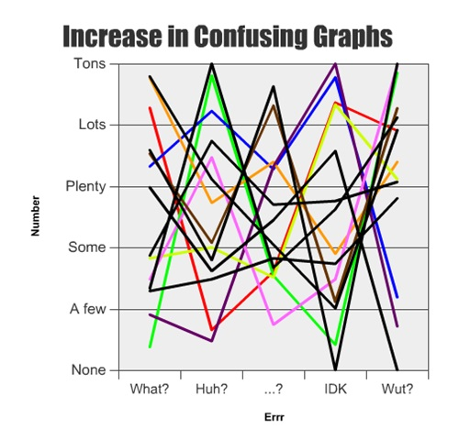
Data Analysis and More: Reporting
Use data visualizations – bar charts, scatterplots, etc. in your reporting
But use them wisely!
Too much can be confusing.
Be sure to label everything in a data visualization
Use color appropriately
Consider infographics or interactive displays

Slide 118
Data Analysis and More: Reporting
Make it interesting! What’s the real story here? Tell it!
May not be what you expected…
Check and double-check your data
A typo can be very problematic. Was that 5% or 50%?
Have others critique and proofread your reports before distribution

Slide 119
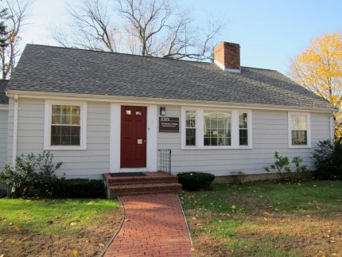
Contact information
Questions?
Lauren.Conoscenti@tufts.edu
http://go.tufts.edu/OIRE

