Slide 1

Deep Dive Into PostgreSQL Indexes
Ibrar Ahmed
Senior Database Architect - Percona LLC
May 2019

Slide 2
Tables (Heap)
“Tuple” and “Rows” are synonym
Rows / Tuples stored in a table
Every table in PostgreSQL has physical disk file(s)
postgres=# CREATE TABLE foo(id int, name text);
postgres=# SELECT relfilenode FROM pg_class WHERE relname LIKE 'foo’;
relfilenode
-------------
16384
“Relfilenode” is table file name of that table
“pg_class” is system table to contain table information
“16384” is table filename
$PGDATA is Data Directory
The physical files on disk can be seen in the PostgreSQL $PGDATA directory.
$ ls -lrt $PGDATA/base/13680/16384
-rw------- 1 vagrant vagrant 0 Apr 29 11:48 $PGDATA/base/13680/16384
Tuple stored in a table does not have any order

Slide 3
Tables (Heap)
Select whole table, must be a sequential scan.
Select table’s rows where id is 5432, it should not be a sequential scan.
EXPLAIN SELECT name FROM bar;
QUERY PLAN
----------------------------------------------------------------------------
Seq Scan on bar (cost=0.00..163693.05 rows=9999905 width=11
Make sense
EXPLAIN SELECT name FROM bar WHERE id = 5432;
QUERY PLAN
----------------------------------------------------------------------------
Gather (cost=1000.00..116776.94 rows=1 width=11)
Workers Planned: 2
-> Parallel Seq Scan on bar (cost=0.00..115776.84 rows=1 width=11)
Filter: (id = 5432)
Why?

Slide 4
Selecting Data 2/2
CREATE TABLE foo(id INTEGER, name TEXT);
INSERT INTO foo VALUES(1, 'Alex');
INSERT INTO foo VALUES(2, 'Bob');
Page 0/N
Tuple - 1
H EAP
Tuple - 2
Tuple - 3
Tuple - n
Page 1/N
Tuple - 1
Tuple - 2
SELECT ctid, * FROM foo;
ctid | id | name
-------+----+------
(0,1) | 1 | Alex
(0,2) | 2 | Bob
(2 rows)
Tuple - 3
Tuple - n
Page 2/N
Tuple - 1
Tuple - 2
Tuple - 3
Tuple - n
How to select the data from the HEAP?
Need to scan each and every page and look for the tuple in the page
Page N/N
Tuple - 1
Tuple - 2
Tuple - 3
Cost?
Tuple - n

Slide 5
PostgreSQL Indexes
https://www.postgresql.org/docs/current/indexes.html

Slide 6
Why Index?
Indexes are entry points for tables
Index used to locate the tuples in the table
The sole reason to have an index is performance
Index is stored separately from the table’s main storage (PostgreSQL Heap)
More storage required to store the index along with original table
postgres=# EXPLAIN SELECT name FROM bar WHERE id = 5432;
QUERY PLAN
----------------------------------------------------------------------------
Seq Scan on bar (cost=0.00..159235.00 rows=38216 width=32)
Filter: (id = 5432)
Cost of the query
postgres=# CREATE INDEX bar_idx ON bar(id);
postgres=# EXPLAIN SELECT name FROM bar WHERE id = 5432;
QUERY PLAN
----------------------------------------------------------------------------
Bitmap Heap Scan on bar (cost=939.93..64313.02 rows=50000 width=32)
Recheck Cond: (id = 5432)
-> Bitmap Index Scan on bar_idx (cost=0.00..927.43 rows=50000 width=0)
Index Cond: (id = 5432)
64313/159235 * 100 = 40%

Slide 7
Index
PostgreSQL standard way to create a index
(https://www.postgresql.org/docs/current/sql-createindex.html)
postgres=# CREATE INDEX idx_btree ON bar(id);
PostgreSQL’s Catalog for relations/index
postgres=# SELECT relfilenode FROM pg_class WHERE relname LIKE ‘idx_btree’;
relfilenode
-------------
16425
Physical file name of the index
PostgreSQL index has its own file on disk.
The physical file on disk can be seen in the PostgreSQL $PGDATA directory.
$ ls -lrt $PGDATA/13680/16425
-rw-------1 vagrant vagrant 1073741824 Apr 29 13:05 $PGDATA/base/13680/16425

Slide 8
Creating Index 1/2
Index based on single column of the table
”bar” is a table and ”id” is column
postgres=# CREATE INDEX bar_idx ON bar(id);
postgres=# EXPLAIN SELECT name FROM bar WHERE id = 5432;
QUERY PLAN
----------------------------------------------------------------------
Bitmap Heap Scan on bar (cost=939.93..64313.02 rows=50000 width=32)
Recheck Cond: (id = 5432)
-> Bitmap Index Scan on bar_idx (cost=0.00..927.43 rows=50000 width=0)
Index Cond: (id = 5432)

Slide 9
Creating Index 2/2
PostgreSQL locks the table when creating index
CREATE INDEX idx_btree ON bar USING BTREE(id);
CREATE INDEX
Time: 12303.172 ms (00:12.303)
CONCURRENTLY option creates the index without locking the table
CREATE INDEX CONCURRENTLY idx_btree ON bar USING BTREE(id);
CREATE INDEX
Time: 23025.372 ms (00:23.025)

Slide 10
Expression Index 1/2
EXPLAIN SELECT * FROM bar WHERE lower(name) LIKE 'Text1';
QUERY PLAN
-------------------------------------------------------------
Seq Scan on bar (cost=0.00..213694.00 rows=50000 width=40)
Filter: (lower((name)::text) ~~ 'Text1'::text)
CREATE INDEX idx_exp ON bar (lower(name));
EXPLAIN SELECT * FROM bar WHERE lower(name) LIKE 'Text1';
QUERY PLAN
-----------------------------------------------------------------------------
Bitmap Heap Scan on bar (cost=1159.93..64658.02 rows=50000 width=40)
Filter: (lower((name)::text) ~~ 'Text1'::text)
-> Bitmap Index Scan on idx_exp (cost=0.00..1147.43 rows=50000 width=0)
Index Cond: (lower((name)::text) = 'Text1'::text)

Slide 11
Expression Index 2/2
postgres=# EXPLAIN SELECT * FROM bar WHERE (dt + (INTERVAL '2 days')) < now();
QUERY PLAN
---------------------------------------------------------------
Seq Scan on bar (cost=0.00..238694.00 rows=3333333 width=40)
Filter: ((dt + '2 days'::interval) < now())
postgres=# CREATE INDEX idx_math_exp ON bar((dt + (INTERVAL '2 days')));
postgres=# EXPLAIN SELECT * FROM bar WHERE (dt + (INTERVAL '2 days')) < now();
QUERY PLAN
-------------------------------------------------------------------------------------
Bitmap Heap Scan on bar (cost=62449.77..184477.10 rows=3333333 width=40)
Recheck Cond: ((dt + '2 days'::interval) < now())
-> Bitmap Index Scan on idx_math_exp (cost=0.00..61616.43 rows=3333333 width=0)
Index Cond: ((dt + '2 days'::interval) < now())

Slide 12
Partial Index
Index
Partial Index
CREATE INDEX idx_full ON bar(id);
EXPLAIN SELECT * FROM bar
WHERE id < 1000
AND name LIKE 'text1000’;
QUERY PLAN
--------------------------------------------------------------------------
Bitmap Heap Scan on bar (cost=61568.60..175262.59 rows=16667 width=40)
Recheck Cond: (id < 1000)
Filter: ((name)::text ~~ 'text1000'::text)
-> Bitmap Index Scan on idx_full (cost=0.00..61564.43 rows=3333333 width=0)
Index Cond: (id < 1000)
SELECT pg_size_pretty(pg_total_relation_size('idx_full'));
pg_size_pretty
----------------
214 MB
(1 row)
CREATE INDEX idx_part ON bar(id) where id < 10000;
EXPLAIN SELECT * FROM bar
WHERE id < 1000
AND name LIKE 'text1000’;
QUERY PLAN
-----------------------------------------------------------------------
Bitmap Heap Scan on bar (cost=199.44..113893.44 rows=16667 width=40)
Recheck Cond: (id < 1000)
Filter: ((name)::text ~~ 'text1000'::text)
-> Bitmap Index Scan on idx_part (cost=0.00..195.28 rows=3333333 width=0)
Index Cond: (id < 1000)
SELECT pg_size_pretty(pg_total_relation_size('idx_part'));
pg_size_pretty
----------------
240 kB
(1 row)
Index where id < 1000 only
Q: What will happen when we query where id >1000?
A: Answer is simple, this index won’t selected.
Why create full index if we don’t need that.
Look at the size of the index

Slide 13
Index Types
https://www.postgresql.org/docs/current/indexes-types.html

Slide 14
B-Tree Index 1/2
Wikipedia: (https://en.wikipedia.org/wiki/Self-balancing_binary_search_tree)
In computer science, a self-balancing (or height-balanced) binary search tree is any node-based binary search tree that automatically keeps its height small in the face of arbitrary item insertions and deletions.
What is a B-Tree index?
Supported Operators
Less than <
Less than equal to <=
Equal =
Greater than equal to >=
Greater than >
CREATE INDEX idx_btree ON foo USING BTREE (name);
postgres=# EXPLAIN ANALYZE SELECT * FROM foo WHERE name = 'text%';
QUERY PLAN
----------------------------------------------------------------------------------------------------------------
Index Scan using idx_btree on foo (cost=0.43..8.45 rows=1 width=19) (actual time=0.015..0.015 rows=0 loops=1)
Index Cond: ((name)::text = 'text%'::text)
Planning Time: 0.105 ms
Execution Time: 0.031 ms
(4 rows)

Slide 15
B-Tree Index 2/2
CREATE TABLE foo(id INTEGER, name TEXT);
INSERT INTO foo VALUES(1, 'Alex');
INSERT INTO foo VALUES(2, 'Bob');
Page 0/N
Tuple - 1
H EAP
Tuple - 2
Tuple - 3
SELECT ctid, * FROM foo;
ctid | id | name
-------+----+------
(0,1) | 1 | Alex
(0,2) | 2 | Bob
Tuple - n
Page 1/N
Tuple - 1
Tuple - 2
Tuple - 3
Tuple - n
Page 2/N
Tuple - 1
Tuple - 2
Tuple - 3
Index have the key and the location of the tuple.
ctid | name
-------+------
(0,1) | Alex
(0,2) | Bob
Tuple - n
Page N/N
Tuple - 1
Tuple - 2
Tuple - 3
Tuple - n

Slide 16
HASH Index
What is a Hash index?
Hash indexes only handles equality operators
Hash function is used to locate the tuples
postgres=# \d bar
Table "public.bar"
Column | Type | Collation | Nullable | Default
--------+-------------------+-----------+----------+---------
id | integer | | |
name | character varying | | |
dt | date | | |
Indexes:
"idx_btree" btree (name)
"idx_hash" btree (name)
CREATE INDEX idx_hash ON bar USING HASH (name);
EXPLAIN ANALYZE SELECT * FROM bar WHERE name = 'text%';
QUERY PLAN
Index Scan using idx_hash on bar (cost=0.43..8.45 rows=1 width=19) (actual time=0.023..0.023 rows=0 loops=1)
Index Cond: ((name)::text = 'text%'::text)
Planning Time: 0.080 ms
Execution Time: 0.041 ms
(4 rows)

Slide 17
BRIN Index 1/2
BRIN is a “Block Range Index”
Used when columns have some correlation with their physical location in the table
Space optimized because BRIN index contains only three items
Page number
Min value of column
Max value of column
Like date, date of city have logical group
Size of Index = 21 MB
CREATE INDEX idx_btree ON bar USING BTREE (date);
Size of Index = 47 MB
CREATE INDEX idx_hash ON bar USING HASH (date);
Size of Index = 48KB
CREATE INDEX idx_brin ON bar USING BRIN (date);

Slide 18
BRIN Index 2/2
Sequential Scan
BRIN Index
postgres=# EXPLAIN ANALYZE SELECT *
FROM bar
WHERE dt > '2022-09-28’
AND dt < '2022-10-28';
QUERY PLAN
-----------------------------------------------------
Seq Scan on bar (cost=0.00..2235285.00 rows=1
width=27)
(actual time=0.139..7397.090 rows=29
loops=1)
Filter: ((dt > '2022-09-28 00:00:00)
AND (dt < '2022-10-28 00:00:00))
Rows Removed by Filter: 99999971
Planning Time: 0.114 ms
Execution Time: 7397.107 ms
(5 rows)
postgres=# EXPLAIN ANALYZE SELECT *
FROM bar
WHERE dt > '2022-09-28’
AND dt < '2022-10-28';
QUERY PLAN
------------------------------------------------------Bitmap Heap Scan on bar (cost=92.03..61271.08 rows=1
width=27) (actual time=1.720..4.186 rows=29 loops=1)
Recheck Cond: ((dt > '2022-09-28 00:00:00’)
AND (dt < '2022-10-28 00:00:00'))
Rows Removed by Index Recheck: 18716
Heap Blocks: lossy=128
-> Bitmap Index Scan on idx_brin
(cost=0.00..92.03 rows=17406 width=0)
(actual time=1.456..1.456 rows=1280 loops=1)
Index Cond: ((dt > '2022-09-28 00:00:00’)
AND (dt < '2022-10-28 00:00:00'))
Planning Time: 0.130 ms
Execution Time: 4.233 ms
(8 rows)

Slide 19
GIN Index 1/2
Generalized Inverted Index
GIN is to handle where we need to index composite values
Slow while creating the index because it needs to scan the document up front
postgres=# \d bar
Table "public.bar"
Column | Type | Collation | Nullable | Default
--------+---------+-----------+----------+---------
id | integer | | |
name | jsonb | | |
dt | date | | |
postgres=# SELECT DISTINCT name, dt FROM bar LIMIT 5;
name | dt
---------------------------------------------------------------------------+------------
{"name": "Alex", "phone": ["333-333-333", "222-222-222", "111-111-111"]} | 2019-05-13
{"name": "Bob", "phone": ["333-333-444", "222-222-444", "111-111-444"]} | 2019-05-14
{"name": "John", "phone": ["333-3333", "777-7777", "555-5555"]} | 2019-05-15
{"name": "David", "phone": ["333-333-555", "222-222-555", "111-111-555"]} | 2019-05-16
(4 rows)

Slide 20
GIN Index 2/2
Generalized Inverted Index
GIN is to handle where we need to index composite values
Slow while creating index because it needs to scan the document up front
CREATE INDEX idx_gin ON bar USING GIN (name);
postgres=# EXPLAIN ANALYZE SELECT * FROM bar
WHERE name @> '{"name": "Alex"}’;
QUERY PLAN
-----------------------------------------------------Seq Scan on bar (cost=0.00..108309.34 rows=3499 width=96) (actual time=396.019..1050.143 rows=1000000 loops=1)
Filter: (name @> '{"name": "Alex"}'::jsonb)
Rows Removed by Filter: 3000000
Planning Time: 0.107 ms
Execution Time: 1079.861 ms
postgres=# EXPLAIN ANALYZE SELECT * FROM bar
WHERE name @> '{"name": "Alex"}';
QUERY PLAN
-----------------------------------------------------Bitmap Heap Scan on bar (cost=679.00..13395.57 rows=4000 width=96) (actual time=91.110..445.112 rows=1000000 loops=1)
Recheck Cond: (name @> '{"name": "Alex"}'::jsonb)
Heap Blocks: exact=16394
-> Bitmap Index Scan on idx_gin (cost=0.00..678.00 rows=4000 width=0) (actual time=89.033..89.033 rows=1000000 loops=1)
Index Cond: (name @> '{"name": "Alex"}'::jsonb)
Planning Time: 0.168 ms
Execution Time: 475.447 ms
Even if you create a BTREE index, it won’t be considered. Because it does not know the individual element in value.

Slide 21
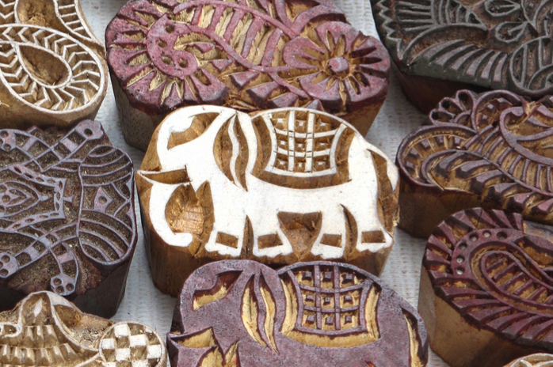
GiST Index
Generalized Search Tree
Tree-structured access method
Used to find the point within box
Used for full text search

Slide 22
Where and What?
B-Tree: Use this index for most of the queries and different data types
Hash: Used for equality operators
BRIN: For really large sequentially lineup datasets
GIN: Used for documents and arrays
GiST: Used for full text search

Slide 23
Index Only Scans
Index is stored separately from the table’s main storage (PostgreSQL Heap)
Query needs to scan both the index and the heap
Index Only Scans only used when all the columns in the query part of the index
In this case PostgreSQL fetches data from index only
In PostgreSQL term

Slide 24
Index Only Scans
CREATE INDEX idx_btree_ios ON bar (id, name);
EXPLAIN SELECT id, name, dt FROM bar WHERE id > 100000 AND id <100010;
QUERY PLAN
Index Scan using idx_btree_ios on bar (cost=0.56..99.20 rows=25 width=19)
Index Cond: ((id > 100000) AND (id < 100010))
(2 rows)
EXPLAIN SELECT id, name FROM bar WHERE id > 100000 AND id <100010;
QUERY PLAN
Index Only Scan using idx_btree_ios on bar (cost=0.56..99.20 rows=25 width=15)
Index Cond: ((id > 100000) AND (id < 100010))
(2 rows)

Slide 25
Duplicate Indexes
SELECT indrelid::regclass relname,
indexrelid::regclass indexname, indkey
FROM pg_index
GROUP BY relname,indexname,indkey;
relname | indexname | indkey
--------------------------+-----------------------------------------------+---------
pg_index | pg_index_indexrelid_index | 1
pg_toast.pg_toast_2615 | pg_toast.pg_toast_2615_index | 1 2
pg_constraint | pg_constraint_conparentid_index | 11
SELECT indrelid::regclass relname, indkey, amname
FROM pg_index i, pg_opclass o, pg_am a
WHERE o.oid = ALL (indclass)
AND a.oid = o.opcmethod
GROUP BY relname, indclass, amname, indkey
HAVING count(*) > 1;
relname | indkey | amname
---------+--------+--------
bar | 2 | btree
(1 row)

Slide 26
Unused Indexes
SELECT relname, indexrelname, idx_scan
FROM pg_catalog.pg_stat_user_indexes;
relname | indexrelname | idx_scan
---------+---------------+----------
foo | idx_foo_date | 0
bar | idx_btree | 0
bar | idx_btree_id | 0
bar | idx_btree_name| 6
bar | idx_brin_brin | 4
(7 rows)

Slide 27
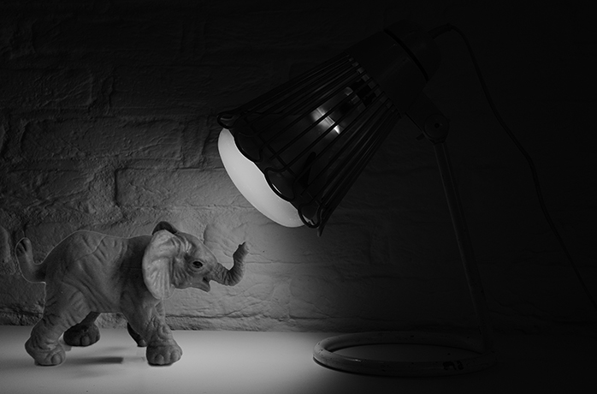
?
“Poor leaders rarely ask questions of themselves or others. Good leaders, on the other hand, ask many questions. Great leaders ask the great questions.”
Michael Marquardt author of Leading with Questions

Slide 28























Thank You to Our Sponsors

Slide 29
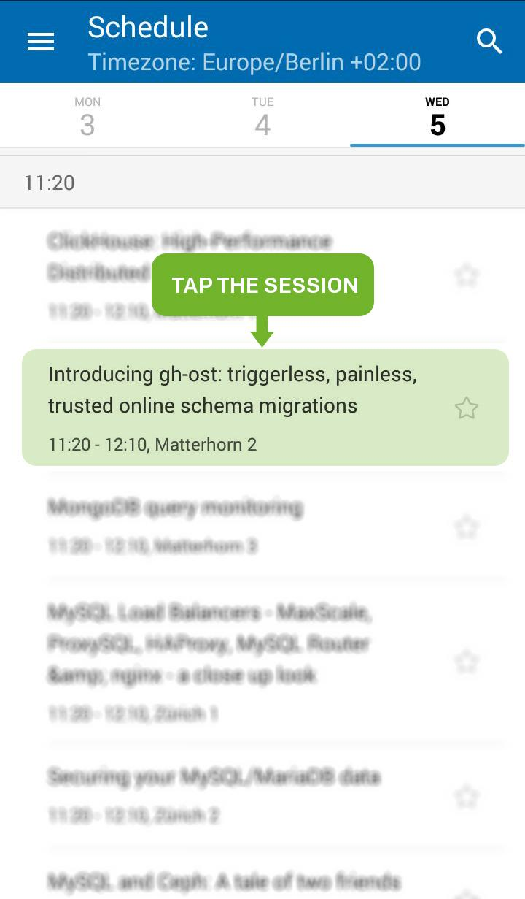
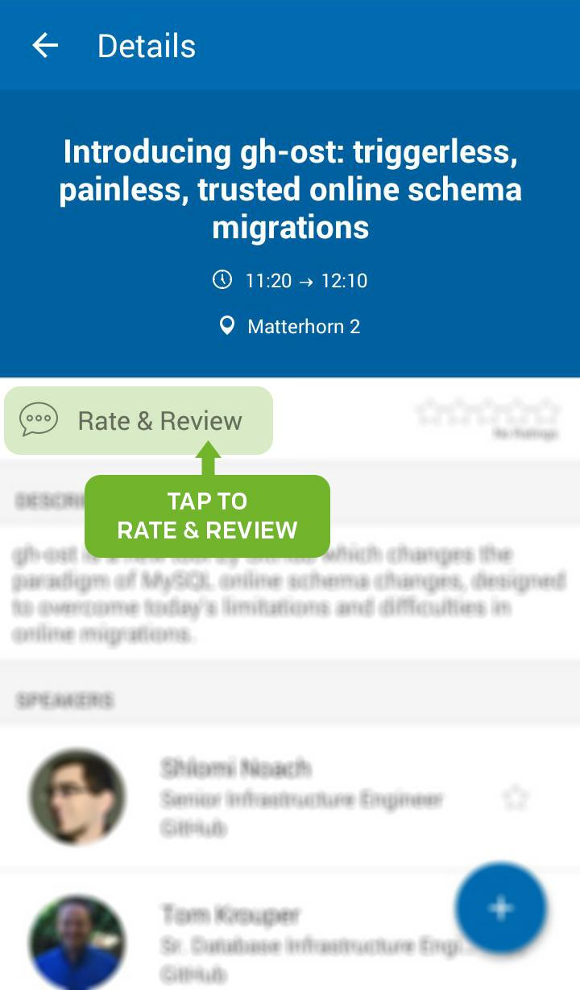
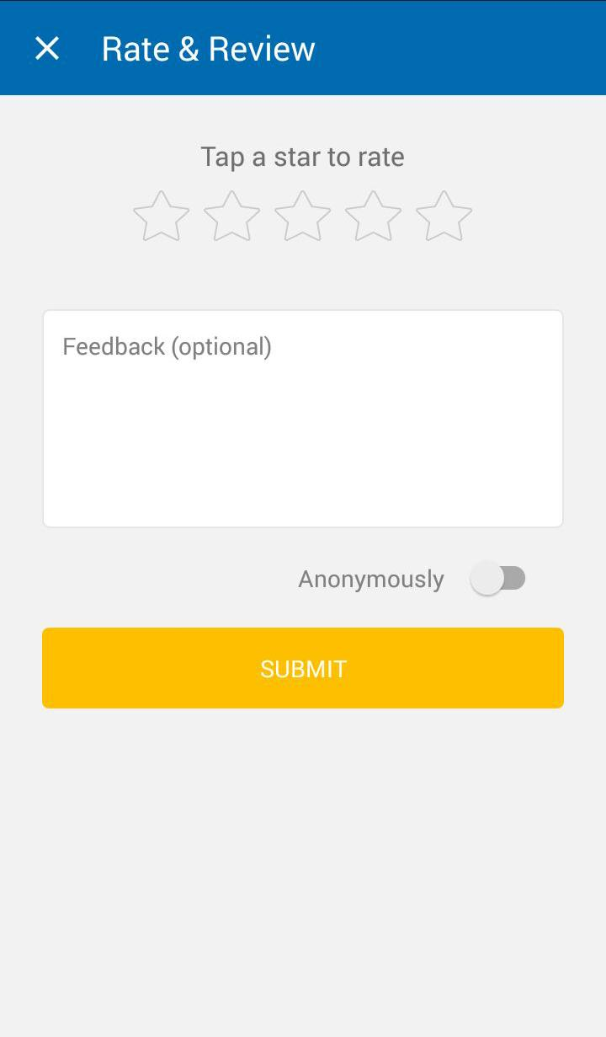
Rate My Session

